Slide 1








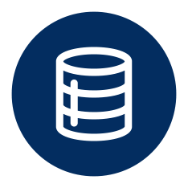
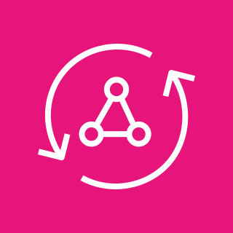

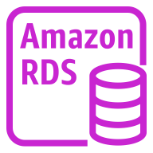

AWS Cloud
Availability Zone 1
Availability Zone 2
VPC
Public subnet
Public subnet
AWS Secrets Manager
NAT gateway
NAT gateway
Artifacts bucket
Private subnet
Private subnet
send GraphQL
operations
query
External Objects
GraphQL Adapter
RDS resolver Lambda function
Amazon Aurora instance
Amazon Aurora instance
AWS AppSync
Parameter Store

Slide 2
AWS Cloud
Availability Zone 1
Availability Zone 2
VPC
Public subnet
Public subnet
AWS Secrets Manager
NAT gateway
NAT gateway
Private subnet
Private subnet
Artifacts bucket
send GraphQL
operations
query
Amazon Aurora instance
Amazon Aurora instance
RDS resolver Lambda function
GraphQL Adapter
External Objects
AWS AppSync
Parameter Store

