Slide 1




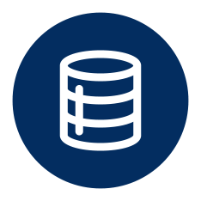
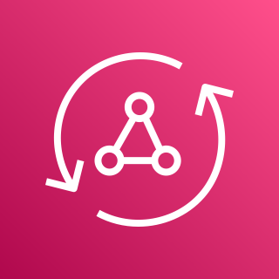



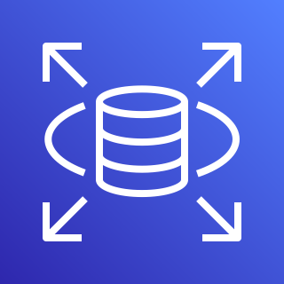
Virtual private cloud (VPC)
Amazon S3 bucket
sends GraphQL operations to
relays operations to
External Objects
GraphQL Adapter
AWS Lambda function
AWS AppSync
AWS Systems Manager Parameter Store
accessed via
AWS Secrets Manager
Amazon Relational Database Service

