Slide 1
VARIANT 4 · KHYBER PAKHTUNKHWA, RURAL
19,896
Who can read, and what does school cost?
persons in rural KP
13,200
Literacy by age and sex, and what families spend on school
literacy sample (age 10-64)
FA24-BEDS-004
04 = 0 × 8 + 4 → variant 4
prov_code = 1 · urban_rural = 1
4,912
students (spending > 0)
Abdul Muqeet · Person file joined to household file by hhid · every statistic weighted by hhweight
Notes:
Introduce yourself and the variant: reg. no. ends in 04, 4 = 0x8+4, so variant 4 = rural Khyber Pakhtunkhwa. Data: PSLM 2019-20. Person file has no weight, province or area, so I attached hhweight, prov_code and urban_rural from the household file by hhid. Three groups: 19,896 persons in rural KP; 13,200 aged 10-64 with a literacy answer; 4,912 students with spending above zero. Everything is weighted. About 45 seconds.

Slide 2
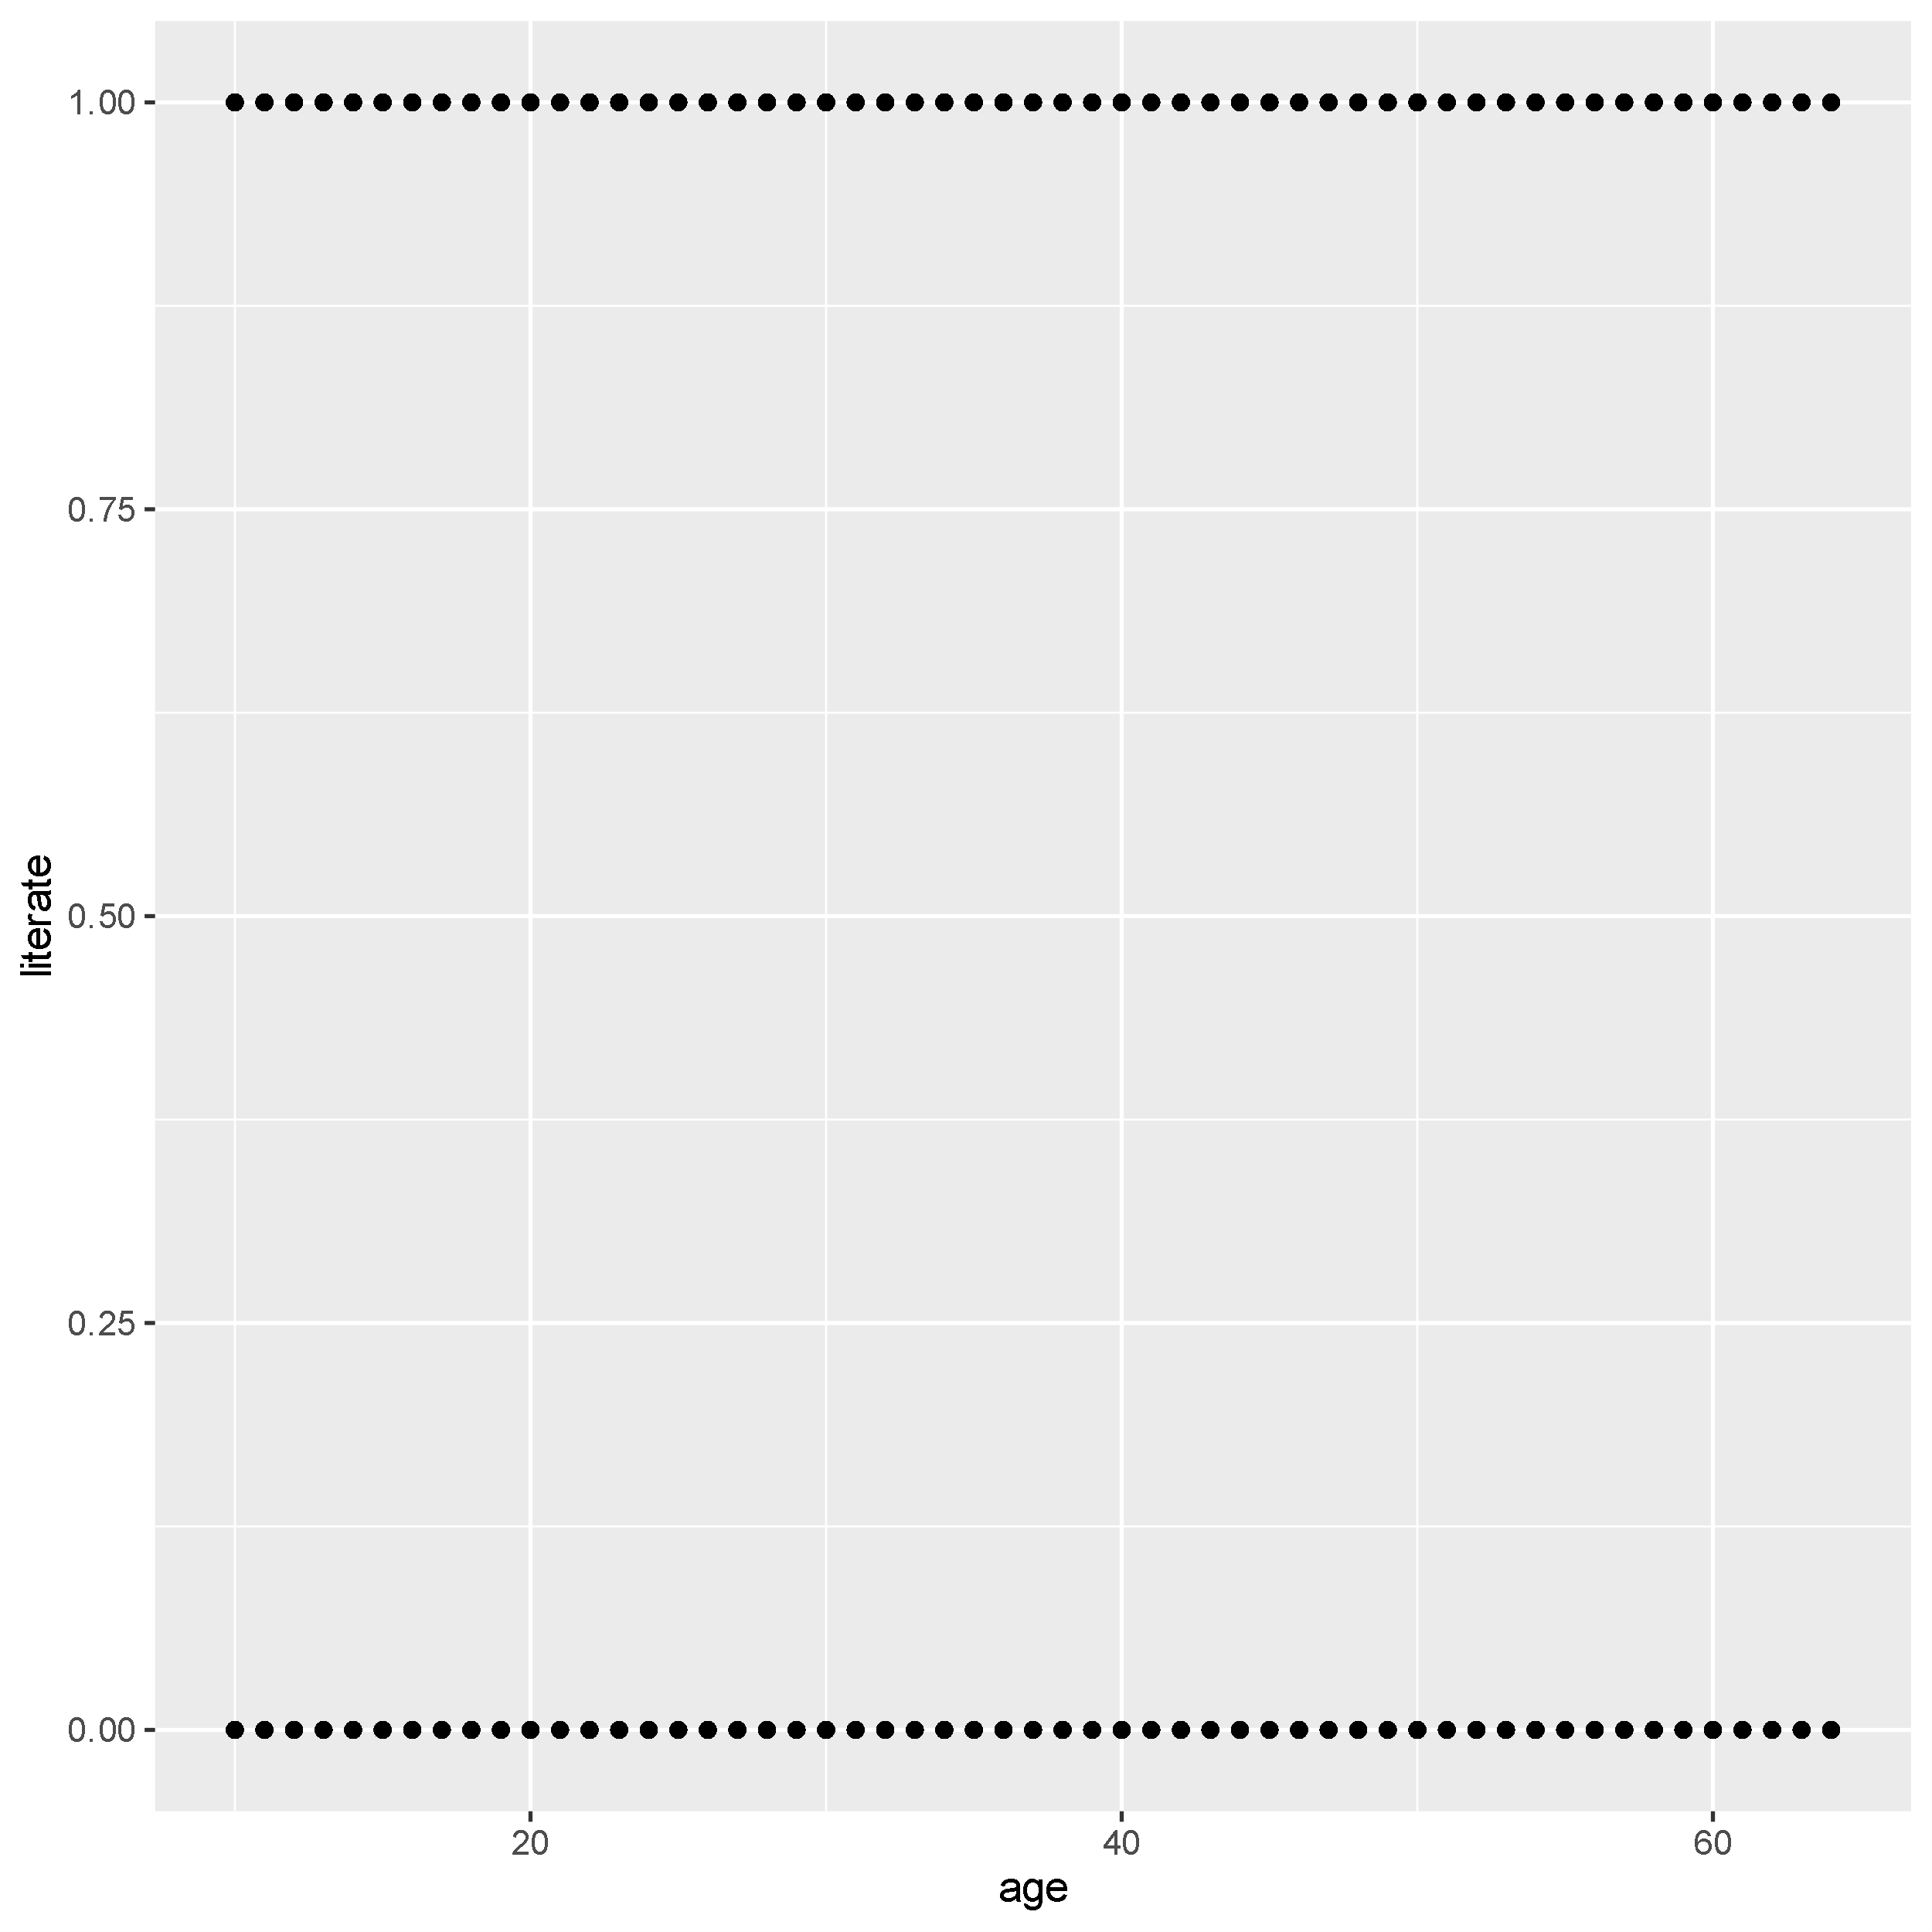
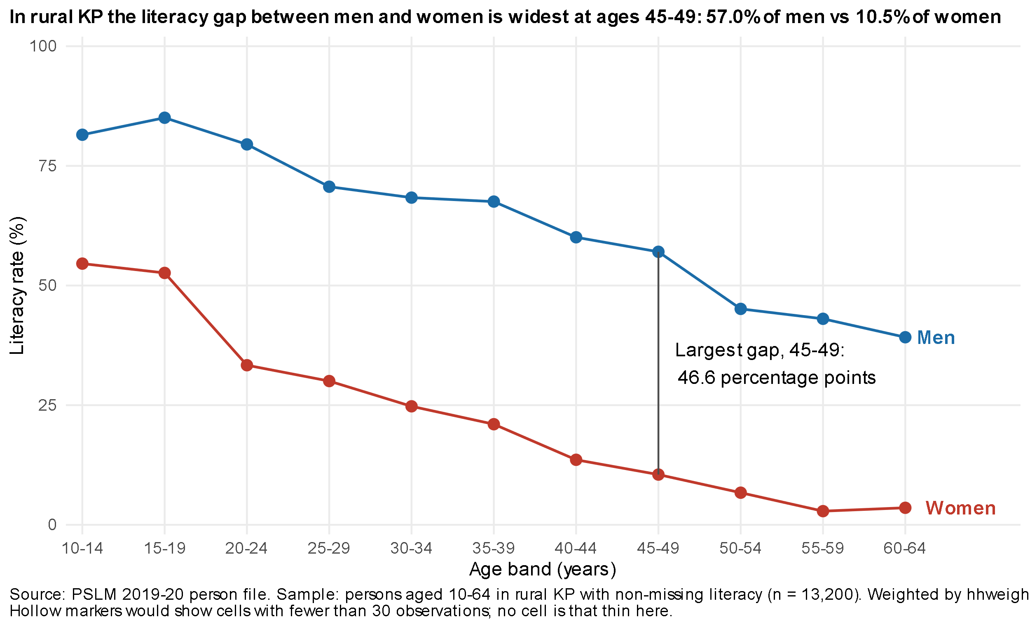
Makeover: from two rows of dots to a clear story
DEFAULT
REDESIGN
Conditional means
not 13,200 overlapping 0/1 dots
Common 0-100 scale
position is the easiest channel to read
Direct labels
no legend, less ink
Notes:
Left: the R default, ggplot(lit, aes(age, literate)) + geom_point(). A 0/1 variable stacks into two solid rows; overplotting hides the pattern. Right: my redesign. Three changes: (1) weighted conditional means by age band, (2) position on a common 0-100 scale, women and men as two lines, (3) direct labels instead of a legend, lighter grid. What the default shows that mine hides: the individual observations and single-year ages. About 1 minute 15.

Slide 3
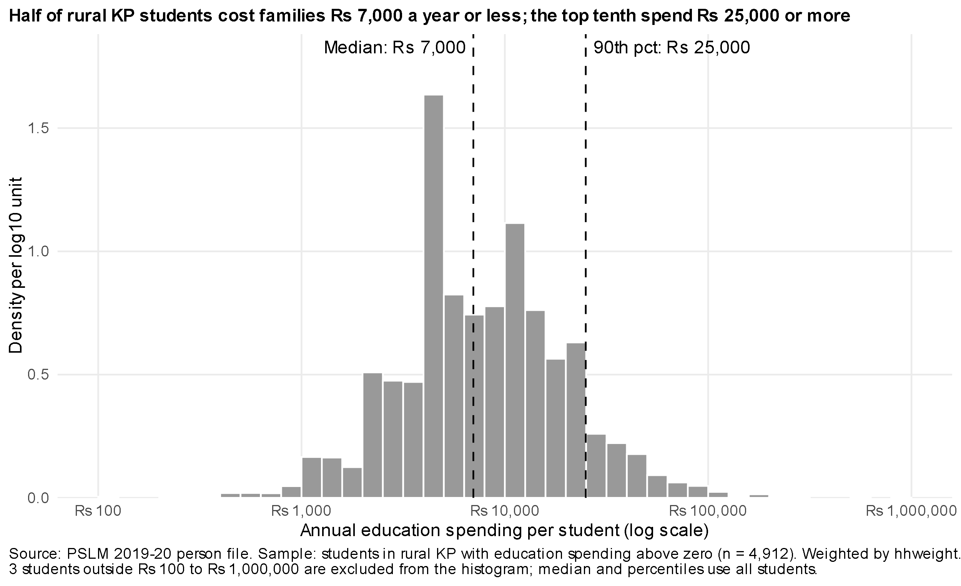
Half of rural KP students cost Rs 7,000 a year or less
Rs 7,000
weighted median (= unweighted)
Rs 2,500
weighted 10th percentile
Rs 25,000
weighted 90th percentile
10.00×
p90 / p10 ratio
Weighted histogram, log10 bins 0.1 wide. 3 students outside Rs 100-1,000,000 excluded from the histogram only.
Spending is right-skewed. Families report round amounts, so the weighted and unweighted medians coincide.
Notes:
4,912 students. Spending runs from Rs 30 to Rs 1.4 million so I use a log10 axis with bins 0.1 wide from 2.0 to 6.0 and density on the vertical axis. Weighted median Rs 7,000, p10 Rs 2,500, p90 Rs 25,000, ratio 10.00. Weighted and unweighted medians are both 7,000 because many families report the same round amount. Quantiles use my own function: the smallest value where cumulative weight share reaches p. Three students are excluded from the histogram; the statistics use all 4,912. About 1 minute 15.

Slide 4
MOST IMPORTANT FINDING
Among 55-59 year-olds, 2.9% of women can read vs 43.0% of men
46.6 points
largest gap, at ages 45-49 (57.0% vs 10.5%)
52.6% vs 85.1%
women vs men aged 15-19: narrowing, not closed
One cross-section
mixes age and cohort effects
Notes:
The finding I think matters most: literacy in rural KP is far higher among younger cohorts, but women still trail men at every age. At 55-59, 2.9% of women vs 43.0% of men. At 15-19, 52.6% vs 85.1%. The largest gap is at 45-49: 57.0% vs 10.5%, 46.6 points. An economist reads this as expanding schooling access across cohorts with girls still behind. What it cannot tell us: whether individuals lose literacy with age or older cohorts never attended school; it is one cross-section, so age and cohort effects are mixed. I reproduced the table in Python; women 15-19 is 52.6% in both. About 1 minute 15.

