Slide 1

Loan Lending Club Case Study
October 2024

Slide 2
Risk Prediction Analysis
Predicting Loan Default Risks Using Univariate, Bivariate, Segmented, and Multivariate Analysis

Slide 3
Lending Club is a peer-to-peer lending company that provides loans to borrowers. As default risks increase, it's crucial for the company to identify factors that contribute to loan defaults to minimize losses. The company thus wants to predict whether a borrower will default on their loan, based on historical data of previous loans. Our objective is to develop a model to predict the risk of default and provide actionable insights into borrower profiles that are more prone to default.
Problem Statement

Slide 4
Our first objective is to identify key factors that influence loan default and create a predictive model to assess the likelihood of loan default based on these factors. Our secondary objectives include conducting exploratory analysis (univariate, bivariate, segmented) to uncover patterns and relationships, performing multivariate analysis to create a predictive model and providing recommendations for minimizing loan default risks.
Objective

Slide 5
The Lending Club dataset contains information on loans issued, including borrower characteristics, loan amount, interest rates, loan status, and more through the time period 2007 t0 2011.
Data

Slide 6
The methodology includes data preparation, where we loaded the dataset, conducted initial exploration, addressed missing values, and made adjustments to specific columns. We converted date fields, derived new columns, and dropped unnecessary ones. After preparing the final dataset, we performed univariate analysis on variables such as loan amount, interest rate, annual income, debt-to-income ratio, home ownership, and loan status. We also derived new metrics like the credit utilization rate, installment-to-income ratio, delinquency risk index, loan payment-to-principal ratio, and loan charge-off rate. Next, we conducted segmented analysis by employment length, income level, region, and loan purpose. In bivariate analysis, we explored relationships like credit utilization vs. loan status, installment-to-income ratio, and delinquency risk index. Lastly, we performed multivariate analysis to examine interactions between variables like loan amount, interest rate, and debt-to-income ratio.
Methodology

Slide 7
The majority of loan amounts ranged between $5,000 and $15,000, with most borrowers charged an interest rate around 7.5%. The Debt-to-Income Ratio (DTI) peaked at 15, suggesting moderate borrower indebtedness, though higher DTIs could signal potential risk. California had the highest number of loan applications, reflecting its large population and economic activity. Regarding homeownership, most borrowers were renters or had mortgaged properties, with a small portion owning their homes outright. Grade B loans were the most common, indicating moderate risk, and borrowers typically had around 10 years of employment, suggesting a stable employment background. Debt consolidation was the most frequent loan purpose, and most loans had a 36-month term, which is common for consumer loans.
Univariate Analysis

Slide 8
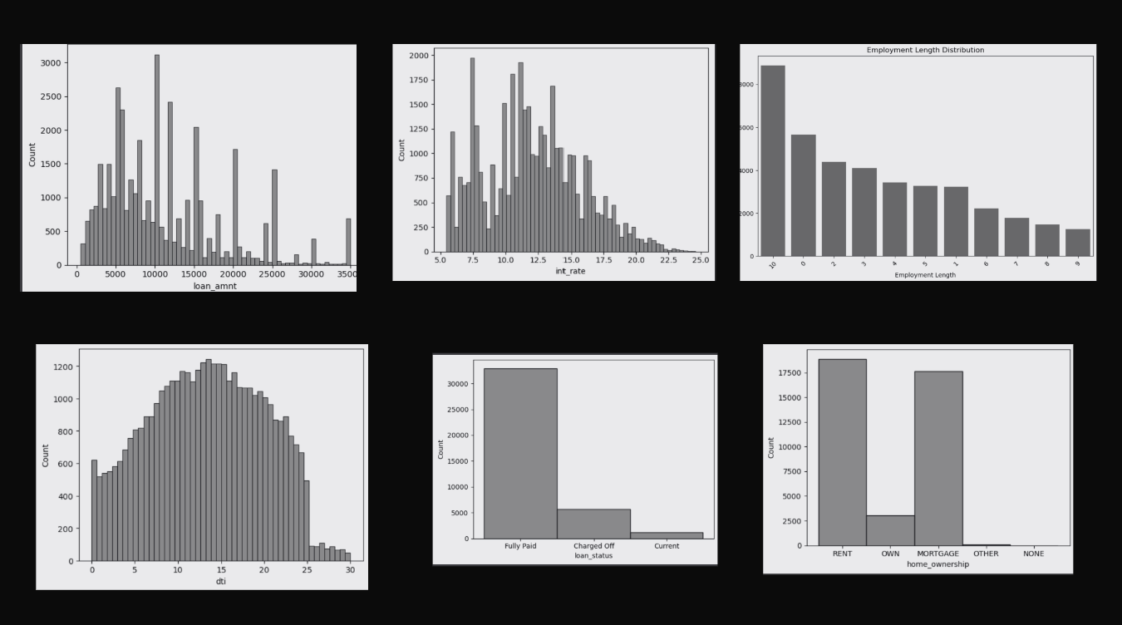

Slide 9
New metrics were derived to deepen insights into default risks. The Loan-to-Income Ratio followed a bell-shaped distribution, with most values between 0 and 0.2, indicating that borrowers generally did not overextend relative to income. A FICO Proxy Score was created using variables like delinquency and revolving credit, with the highest concentration between 5,000 and 10,000. The Missed Payments metric, based on loan status and late fees, showed that most borrowers did not miss payments, though those who did were heavily skewed toward charged-off loans. The Credit Utilization Rate was around 10,000 for fully paid loans, compared to under 2,000 for charged-off loans, suggesting higher credit usage for borrowers who fully repaid. The Installment-to-Income Ratio was 0.19 for charged-off loans, higher than the 0.16 for fully paid loans, indicating a heavier financial burden on defaulting borrowers. Additionally, the Loan Charge-Off Rate was highest for Grade F loans, establishing a clear link between low credit grades and higher likelihood of default.
Derived Metrices

Slide 10
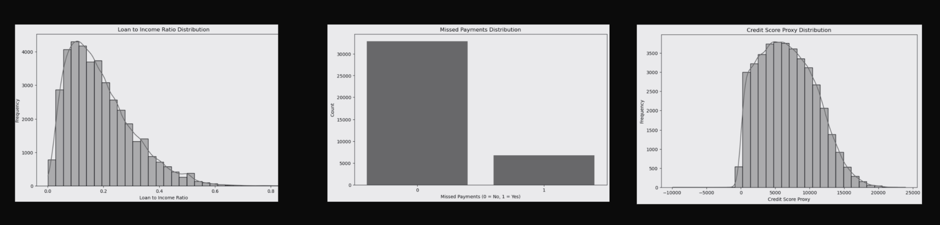

Slide 11
Segmentation of the data revealed that loan amounts were highest for current loans, followed by charged-off and then fully paid loans. Among high-income borrowers, those in the top 1% had the largest charged-off loans, around $25,000, while medium- and low-income groups had loans between $10,000 and $20,000. The interest rates for charged-off loans were notably higher, particularly for current loans (17.5%) and charged-off loans (16%). Utah, Wyoming, and Alaska had the highest loan amounts for charged-off loans, often associated with higher interest rates, emphasizing geographic risk variations. The most common loan purpose for charged-off borrowers was debt consolidation, which consistently had the highest loan amounts. Charged-off loans for home-related purposes carried the highest interest rates (17.5%).
Segmented Analysis

Slide 12
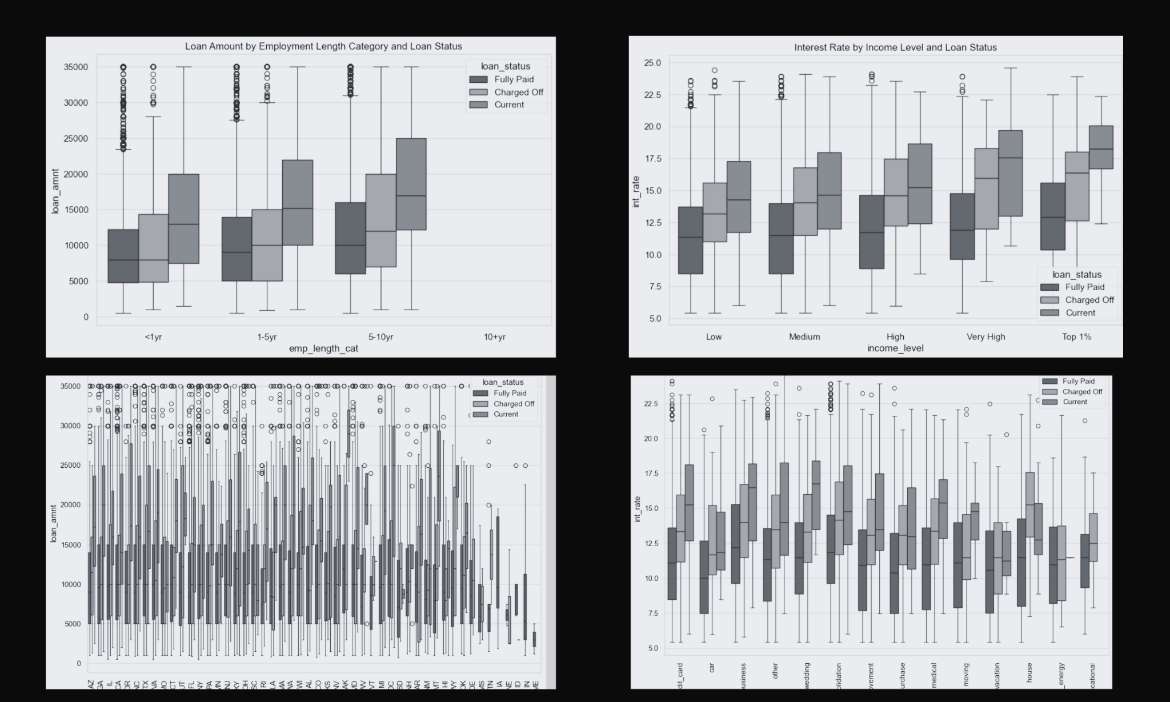

Slide 13
Bivariate analysis identified key risk factors. Interest rates were significantly higher for current borrowers and charged-off loans, signaling that borrowers who struggled with repayments were charged at risk-adjusted higher rates. Employment length was a strong indicator of default risk, with borrowers having shorter employment histories (around 1 year) more likely to default. This trend suggests that job stability plays a critical role in loan repayment success. While the DTI ratio did not show large variations across loan statuses, lower credit grades consistently had higher DTI ratios, particularly Grade F and B. Homeownership was more common among fully paid borrowers, while charged-off borrowers predominantly rented, indicating that homeownership may correlate with financial stability. Borrowers with 36-month loan terms generally fared better, with higher default rates linked to longer loan terms.
Bivariate Analysis

Slide 14
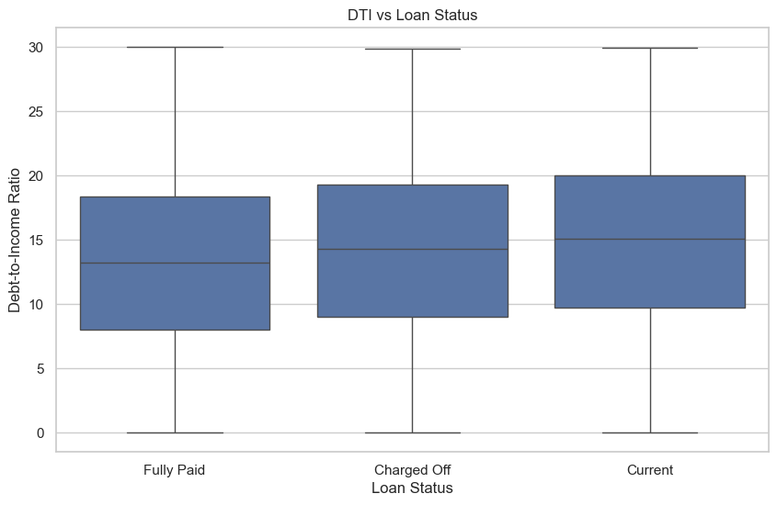
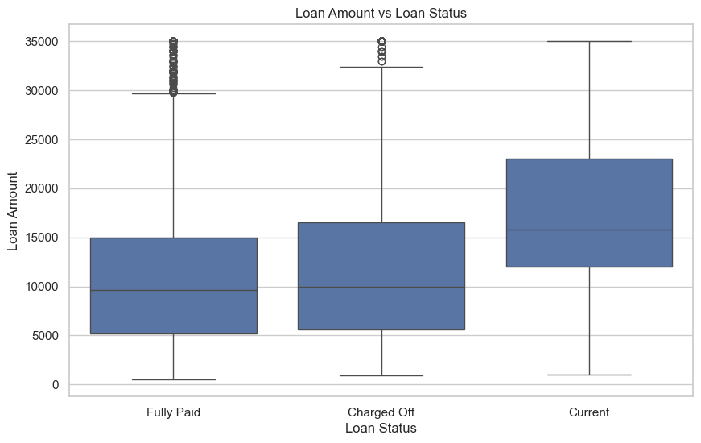
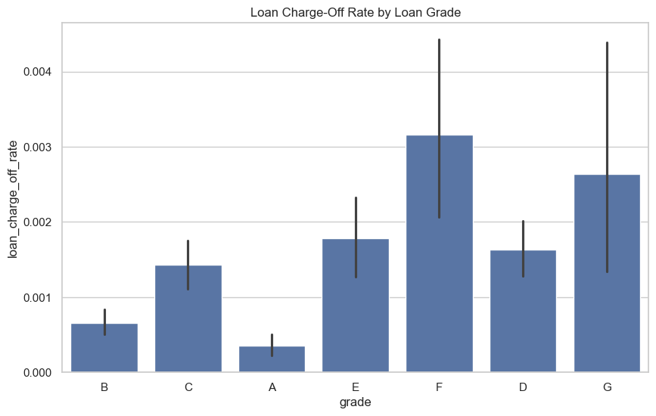
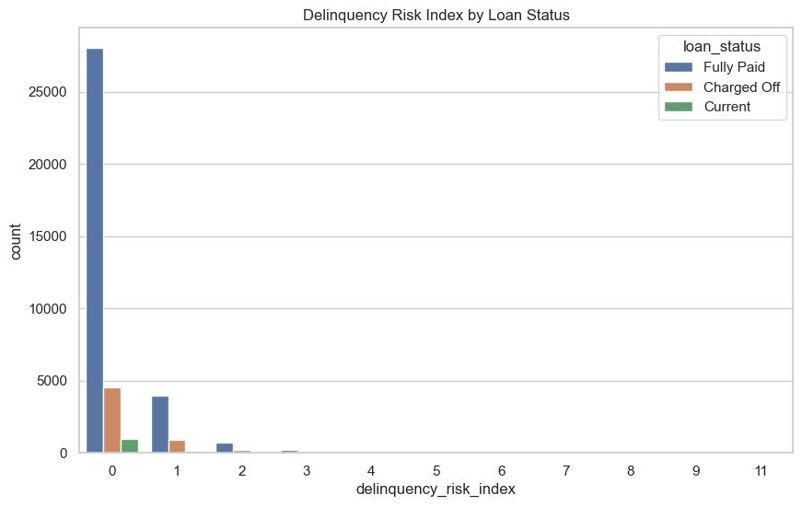
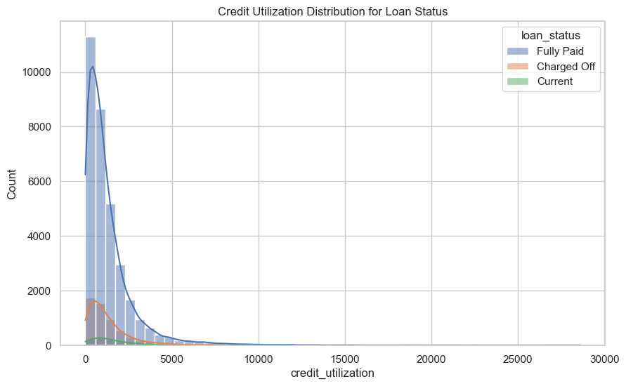
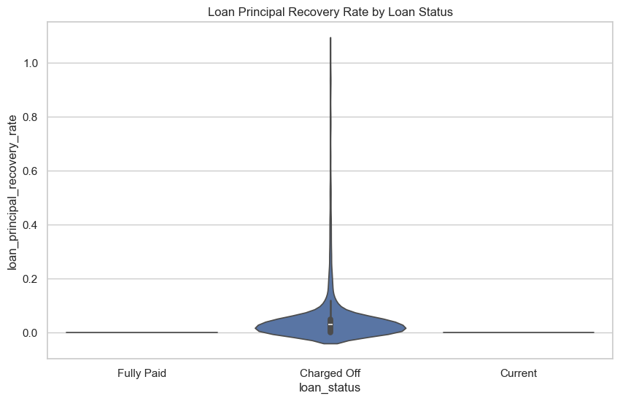

Slide 15
The multivariate analysis further revealed that loan amounts between $5,000 and $10,000, paired with an interest rate of 7.5%, were most common among borrowers. However, charged-off loans were more frequently associated with shorter employment lengths, typically around 1 year, and DTI ratios peaking at 35 for lower grades (F and B), indicating a strong likelihood of default. Fully paid loans, by contrast, had DTIs below 20, suggesting a more conservative financial profile. The Loan Payment to Principal Ratio showed that 75% of borrowers with charged-off loans had a ratio between 0.75 and 1, reinforcing that these borrowers had difficulty paying beyond the principal amount. The Delinquency Risk Index highlighted that charged-off loans had a higher risk score, helping identify borrowers with high default risk early on. Loan Charge-Off Rates for Grade F loans were the highest, underscoring the importance of credit grade as a risk factor.
Multivariate Analysis

Slide 16
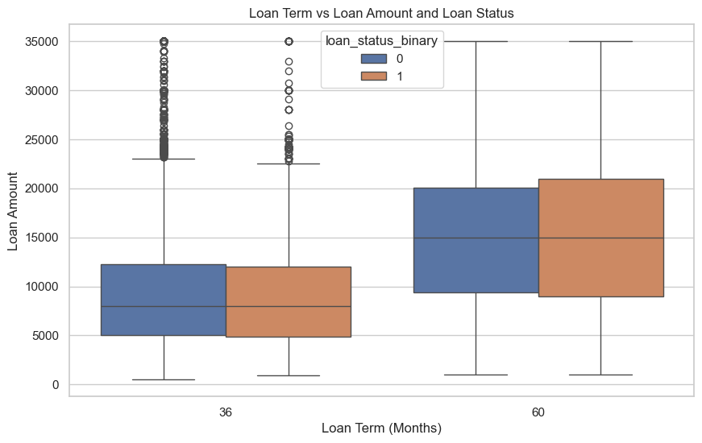
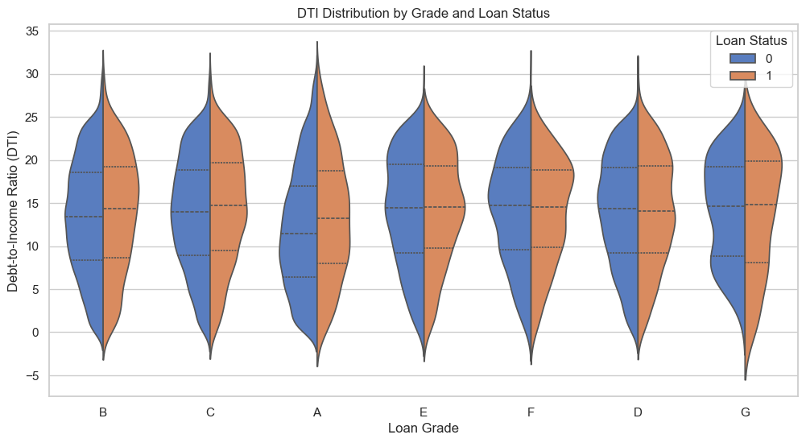
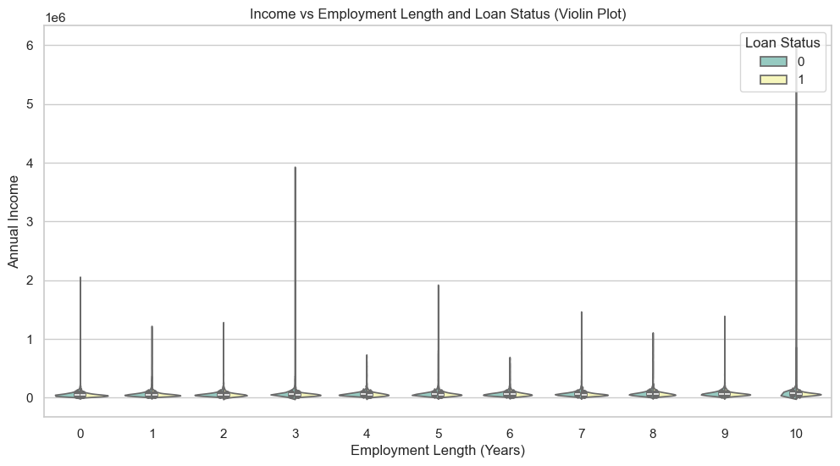
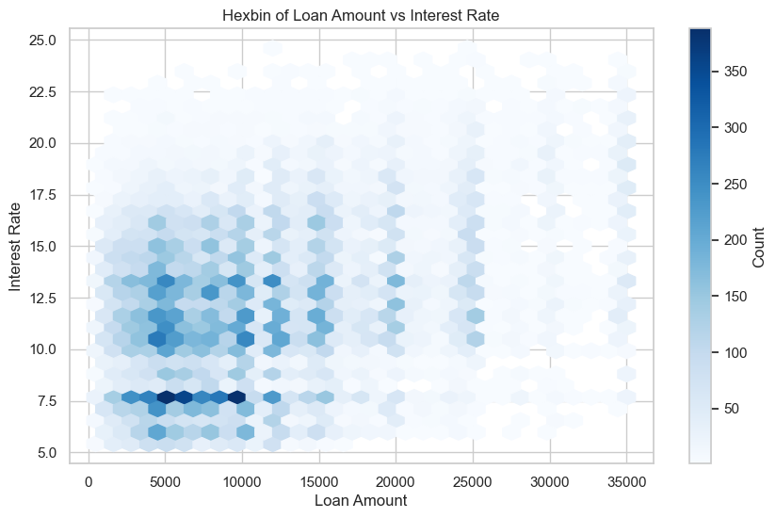

Slide 17
Driving Factors

Slide 18
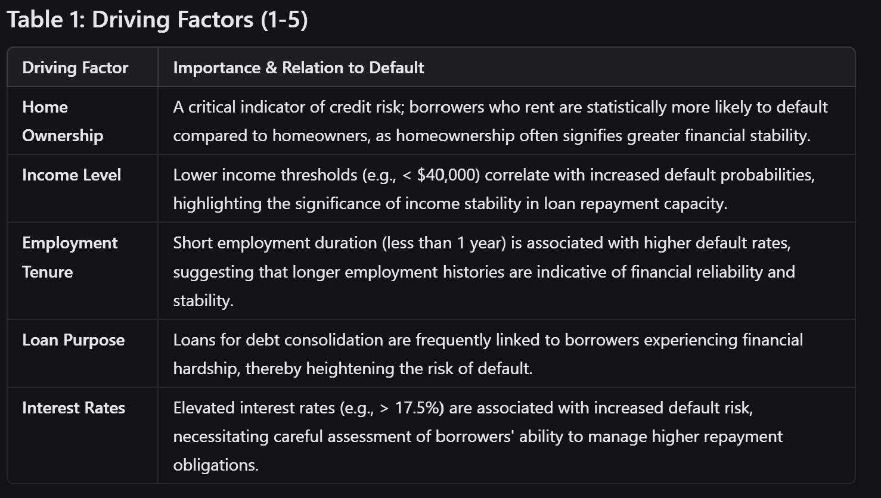

Slide 19
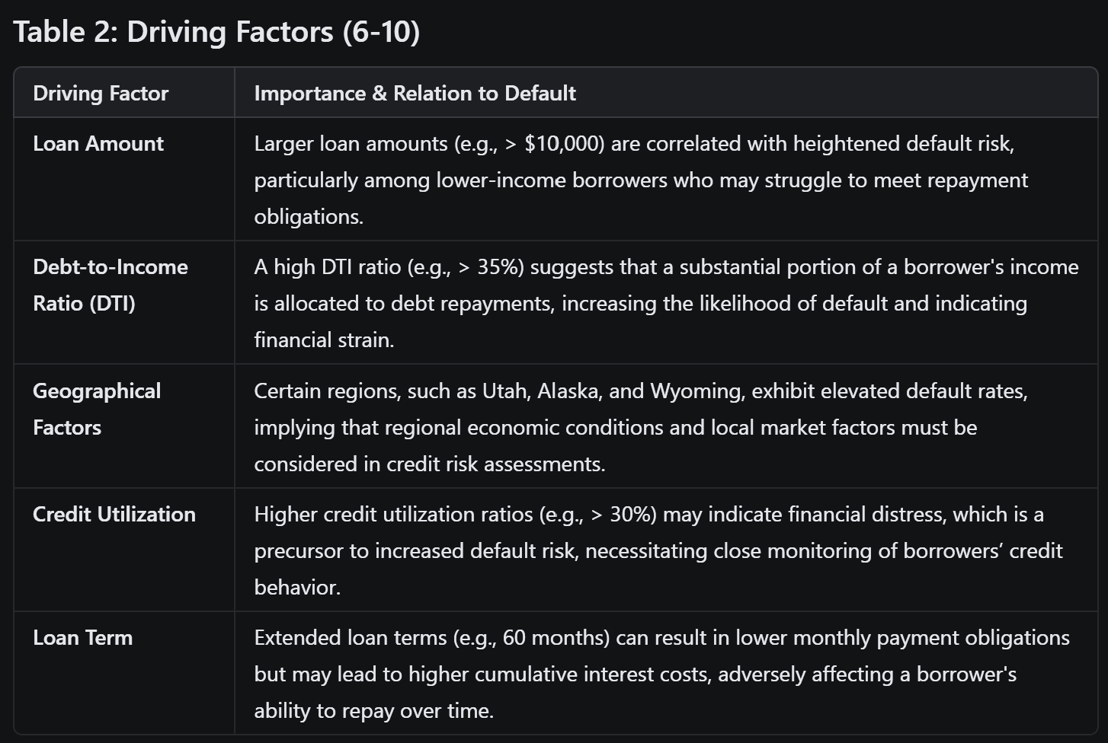

Slide 20
Recommendations

Slide 21
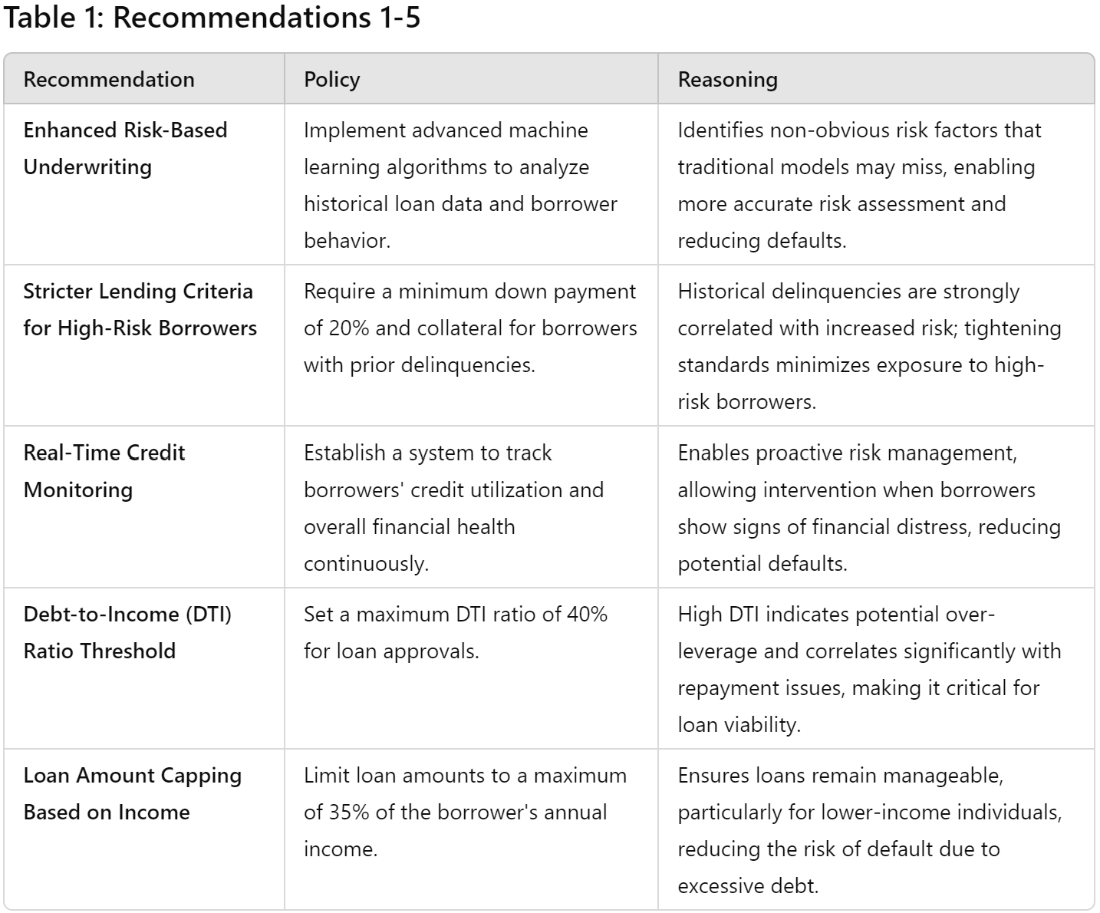

Slide 22
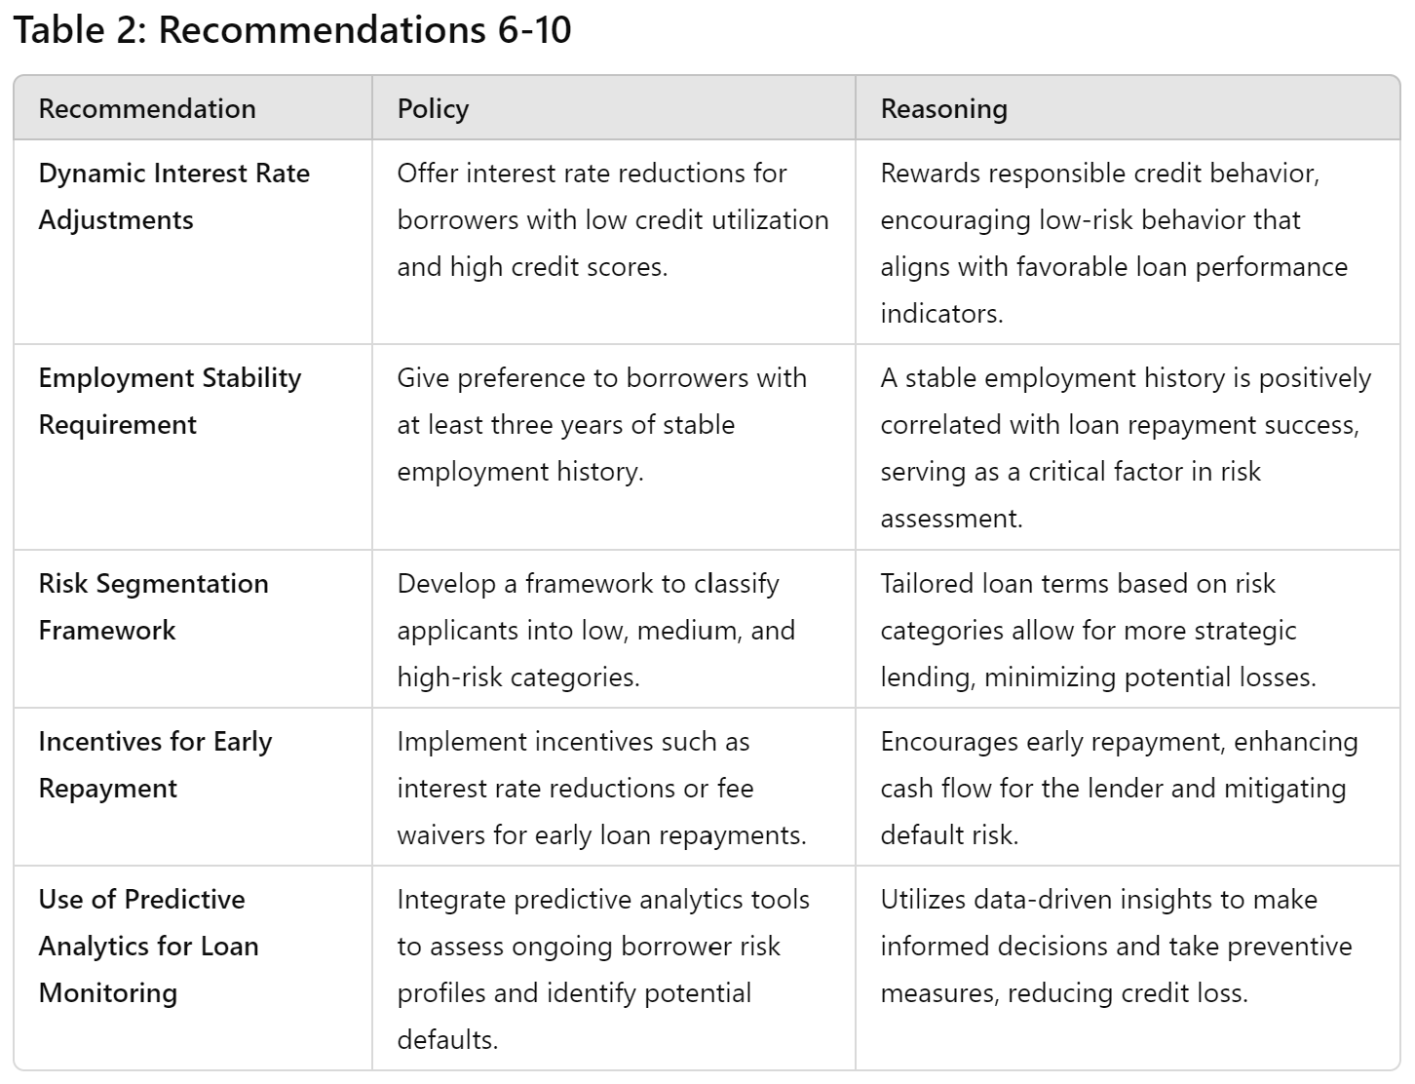

Slide 23
Thank You

