Slide 1



ATLIQ MOTORS
ELECTRIC VEHICLES ANALYSIS IN INDIA

Slide 2
Contents Overview
Introduction
Problem Statement
Dashboard Preview
Primary Research Questions
Secondary Research Questions
Conclusion

Slide 3
Company Insight:
AtliQ Motors is an US based automotive company specializing in Electric Vehicles(EVs).
With its smart and innovative Thinking AtliQ Motors has become one of the top players in
EV market in North America.

Slide 4
Problem Statement:
Over the past 5 years, the company has achieved a 25% market share in North America EV and hybrid vehicles
segment. As a part of its expansion strategy, AtliQ Motors is exploring entry into the Indian market,
where their current market share is less than 2%.
Target:
Conducting advanced analysis over how to make the current market share competitive within India’s rapidly
evolving EV market.

Slide 5
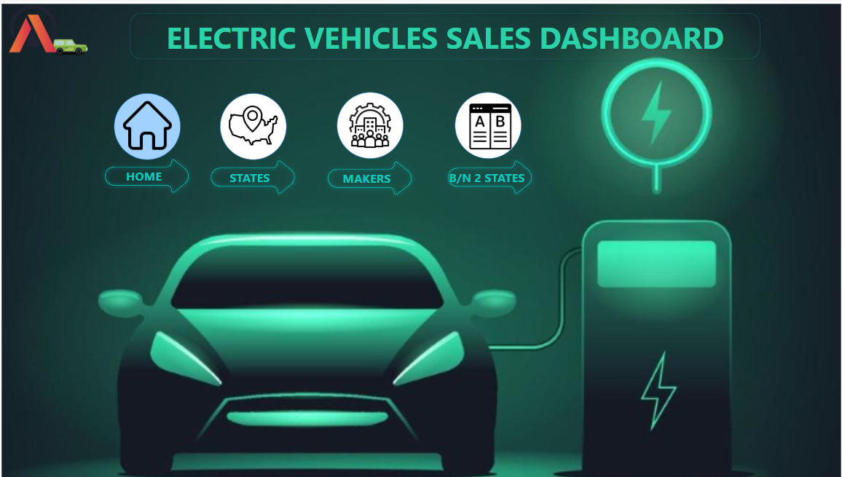

Slide 6
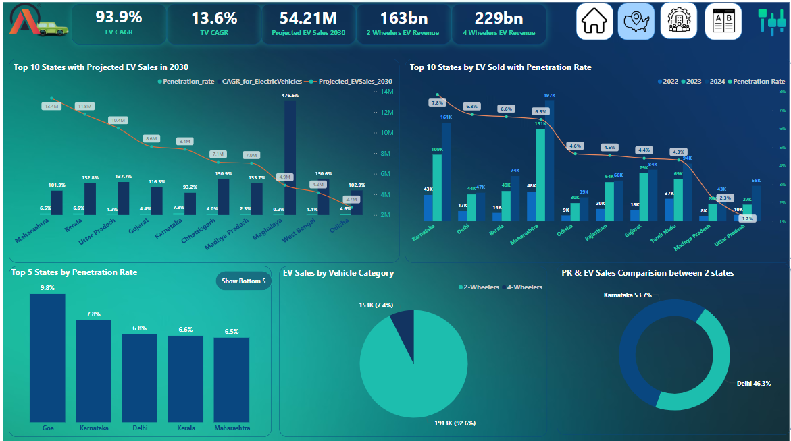

Slide 7
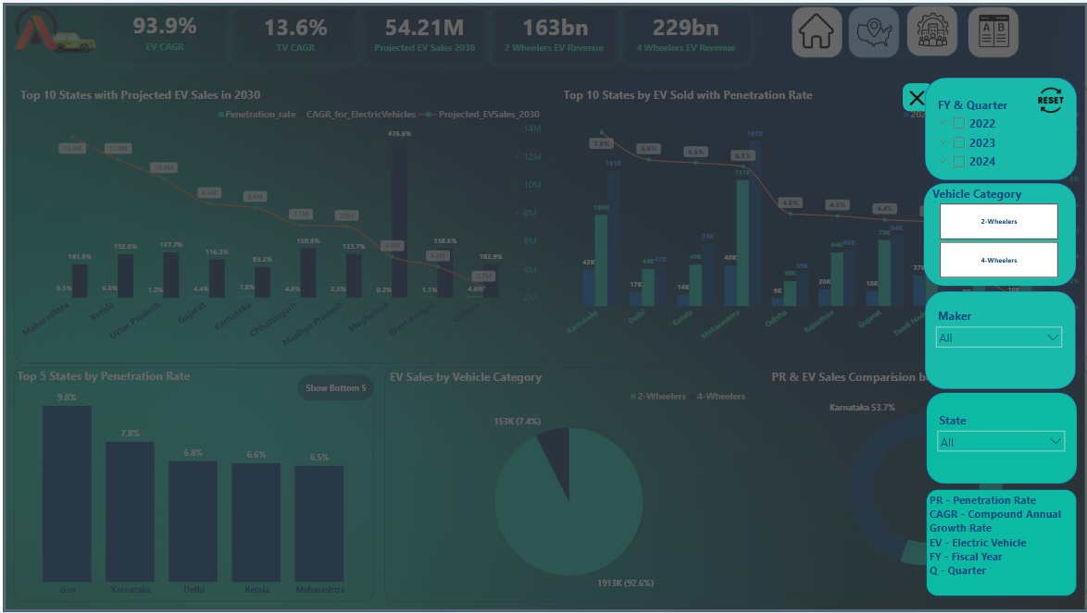

Slide 8
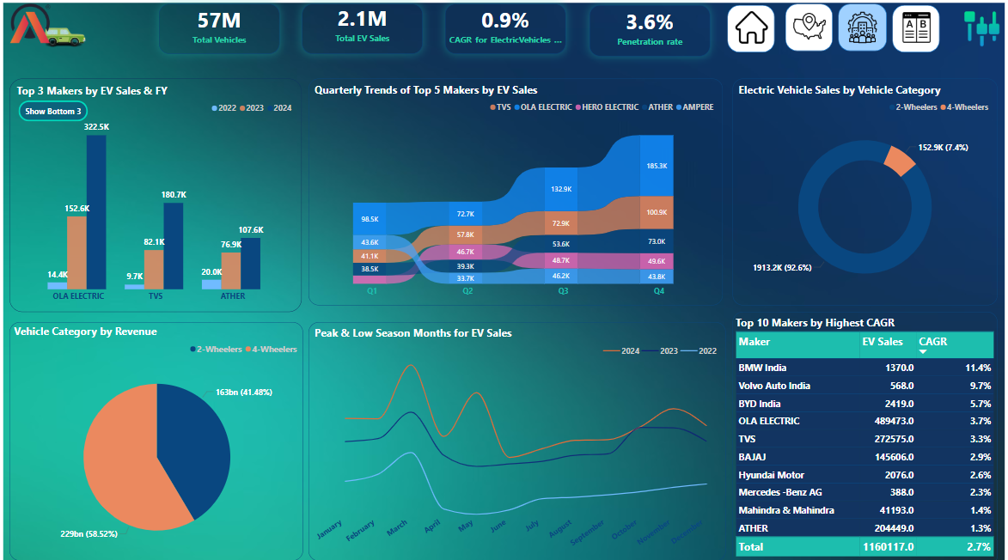

Slide 9
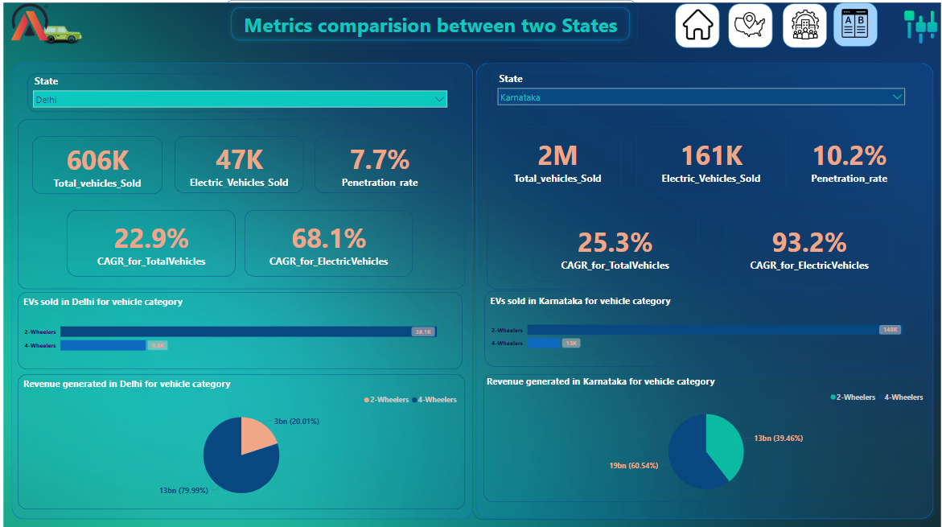

Slide 10
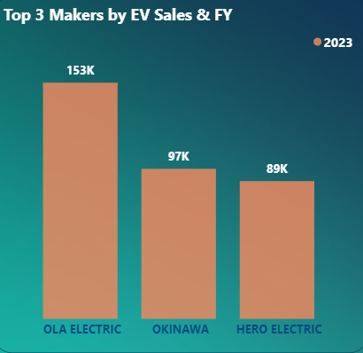
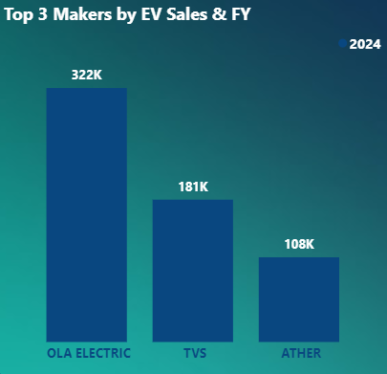
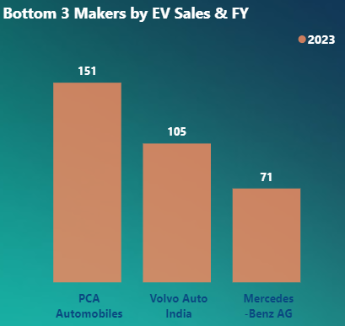
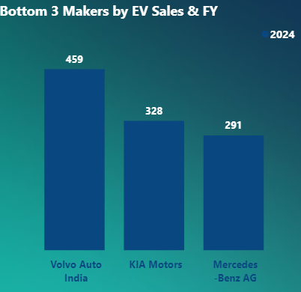
Primary Research Questions
1. List the top 3 and bottom 3 makers for the fiscal years 2023 and 2024 in terms of the number of 2-wheelers sold.

Slide 11
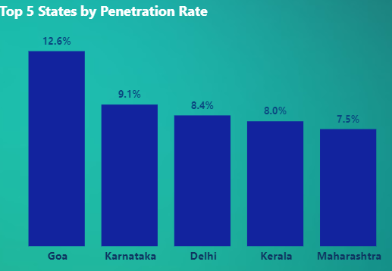
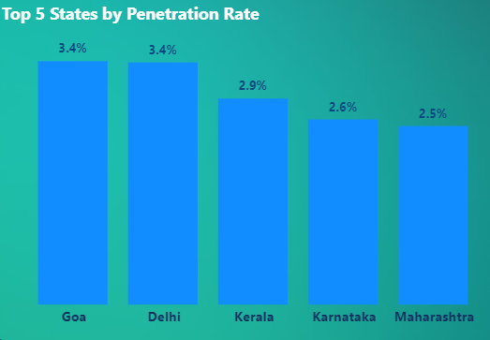
2. Identify the top 5 states with the highest penetration rate in 2-wheeler and 4-wheeler EV sales in FY 2024.
2- Wheelers
4- Wheelers

Slide 12
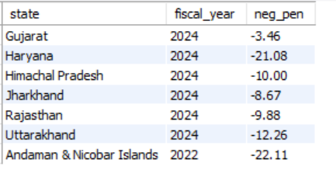
3. List the states with negative penetration (decline) in EV sales from 2022 to 2024?

Slide 13
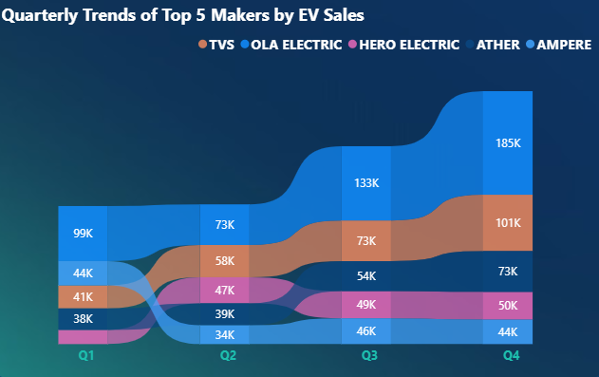
4. What are the quarterly trends based on sales volume for the top 5 EV makers (4-wheelers) from 2022 to 2024?

Slide 14
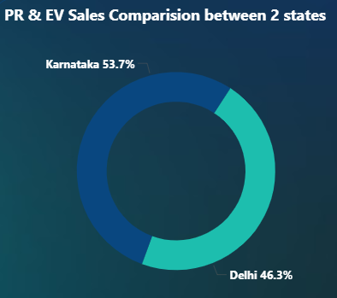
5. How do the EV sales and penetration rates in Delhi compare to Karnataka for 2024?

Slide 15
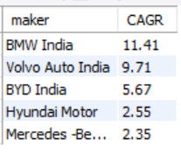
6. List down the compounded annual growth rate (CAGR) in 4-wheeler units for the top 5 makers from 2022 to 2024.

Slide 16
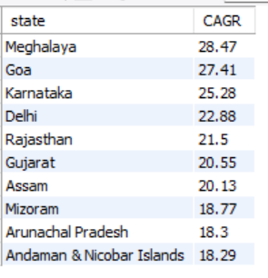
7. List down the top 10 states that had the highest compounded annual growth rate (CAGR) from 2022 to 2024
in total vehicles sold.

Slide 17
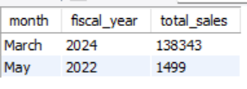
8. What are the peak and low season months for EV sales based on the data from 2022 to 2024?

Slide 18
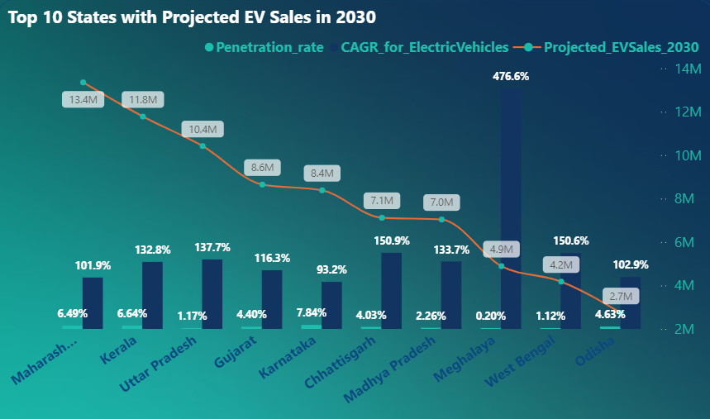
9. What is the projected number of EV sales (including 2-wheelers and 4- wheelers) for the top 10 states
by penetration rate in 2030, based on the compounded annual growth rate (CAGR) from previous years?

Slide 19
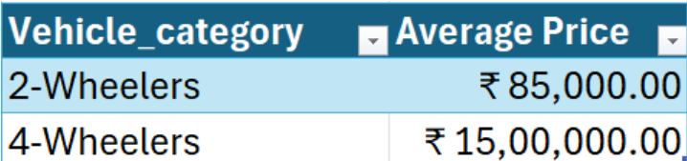
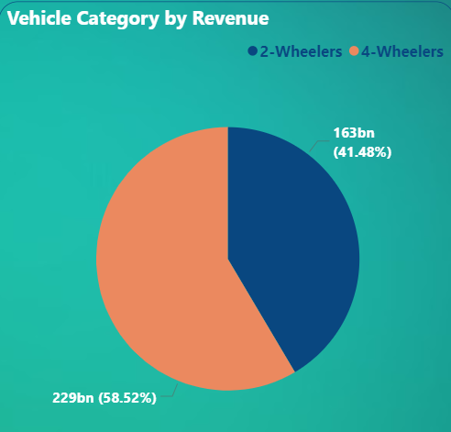
10. Estimate the revenue growth rate of 4-wheeler and 2-wheelers EVs in India for 2022 vs 2024 and 2023 vs 2024
assuming an average unit price.

Slide 20
Secondary Research Questions
What are the primary reasons for customers choosing 4-wheeler EVs in 2023 and 2024
(cost savings, environmental concerns, government incentives)?
Cost Savings: EVs offer significant reductions in operating expenses. Electricity is generally cheaper than gasoline or diesel, leading to lower fuel costs. Additionally, EVs have fewer moving parts, resulting in reduced maintenance expenses over time.
Environmental Concerns: With growing awareness of environmental issues, many consumers are opting for EVs to decrease their carbon footprint. EVs produce zero tailpipe emissions, contributing to improved air quality and a reduction in greenhouse gas emissions.
Government Incentives: Various governments have implemented policies to encourage EV adoption. These include financial incentives such as tax credits, grants, and subsidies, as well as non-monetary benefits like access to bus lanes, reduced tolls, and exemptions from certain driving restrictions.

Slide 21
2. How do government incentives and subsidies impact the adoption rates of 2-wheelers and 4-wheelers? Which states in India provided most subsidies?
Government incentives and subsidies have significantly boosted the adoption rates of both 2-wheeler and 4-wheeler electric vehicles (EVs) in India by reducing upfront costs and enhancing affordability. For instance, subsidies have been shown to lower EV prices by 10-15%, making them more accessible to consumers.
Among Indian states, Maharashtra and Gujarat have been particularly proactive in offering substantial subsidies to EV buyers. Maharashtra provides incentives up to ₹25,000 for electric two-wheelers and up to ₹2.5 lakh for electric four-wheelers. Similarly, Gujarat offers subsidies up to ₹20,000 for two-wheelers and up to ₹1.5 lakh for four-wheelers.
These state-level incentives, combined with central government schemes, have played a crucial role in accelerating EV adoption across the country.

Slide 22
3. How does the availability of charging stations infrastructure correlate with the EV sales and penetration rates in the top 5 states?
The availability of charging infrastructure is positively correlated with electric vehicle (EV) sales and penetration rates in India's leading states.
States like Maharashtra and Karnataka, which have invested significantly in charging infrastructure, report higher EV adoption rates. For instance, Maharashtra leads in both EV sales and the number of charging stations, indicating that accessible charging options can boost consumer confidence and drive EV adoption.
Conversely, states with limited charging infrastructure, such as Gujarat, exhibit lower EV penetration rates, suggesting that inadequate charging facilities may hinder EV adoption.
Overall, enhancing charging infrastructure appears to be a key factor in promoting higher EV sales and penetration rates across different regions.

Slide 23
4. Who should be the brand ambassador if AtliQ Motors launches their EV/Hybrid vehicles in India and why?
The ideal brand ambassador for AtliQ Motors' EV/Hybrid vehicles in India would be –
Virat Kohli/Ms Dhoni
Amir Khan/Akshay Kumar
Deepika Padukone
They all are widely recognized, influential, and symbolize youth, energy, and a commitment to fitness and sustainability, aligning well with the eco-friendly and modern image of EVs. Additionally, their strong social media presence ensures broad reach and high engagement, helping to promote the brand effectively.

Slide 24
5. Which state of India is ideal to start the manufacturing unit? (Based on subsidies provided, ease of doing business, stability in governance etc.)
Establishing an electric vehicle (EV) manufacturing unit in India requires careful consideration of factors such as government subsidies, ease of doing business, and political stability. Based on these criteria, Gujarat emerges as an ideal location for AtliQ Motors' manufacturing operations.
Key Advantages of Gujarat:
Attractive Subsidies and Incentives: Gujarat offers substantial subsidies to EV manufacturers, including capital interest subsidies and stamp duty reimbursements, making it financially advantageous for setting up manufacturing units.
Ease of Doing Business: The state consistently ranks high in ease of doing business indices, reflecting a supportive regulatory environment, efficient administrative processes, and investor-friendly policies.
Stable Governance: Gujarat's political stability and proactive government initiatives have fostered a conducive environment for industrial growth, particularly in the EV sector.
Robust Infrastructure: The state boasts well-developed infrastructure, including reliable power supply, transportation networks, and proximity to ports, facilitating efficient manufacturing and distribution operations.

Slide 25
Conclusion and Recommendations to AtliQ Motors
Focus on Affordable EV Models with High Range
Launch affordable 2-wheelers and 4-wheelers with competitive pricing and an
optimal range (150-200 km for 2-wheelers, 300+ km for 4-wheelers). This will cater to the mass market,
especially in Tier 2 and Tier 3 cities, where demand is growing.
Invest in Charging Infrastructure Partnerships
Collaborate with local governments and private players to expand charging networks. Offering home chargers and fast-charging stations can increase consumer confidence and drive sales.
Leverage Government Incentives & Set Up in EV-Friendly States
Set up the manufacturing unit in Gujarat or Maharashtra, which offer the best incentives, infrastructure, and ease of doing business. Additionally, take advantage of state and central government subsidies to reduce production costs and offer competitive prices.

Slide 26
THANK YOU

