Slide 1
Python for Data Science

Slide 2
Dataset types
Most data commonly found in academic and industrial projects can be broadly classified into the following categories:
Structured (typically quantitative)
Cross-sectional
Time series
Panel
Unstructured
Textual (Tweets, Facebook posts, Internet searches)
Images, audios, videos

Slide 3
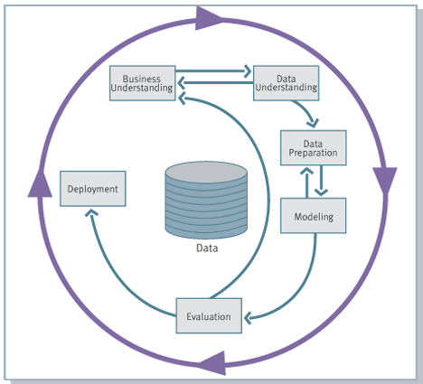
CRISP-DM
CRoss Industry Standard Process for Data Science
A Data Science process model that describes commonly used DM approaches
It is the leading and generally accepted methodology used in data Science

Slide 4
The phases of CRISP-DM
Phase | Duration
1. Business understanding | 10-20%
2. Data understanding | 20-30%
3. Data preparation | 50-70%
4. Modeling | 10-20%
5. Evaluation | 10-20%
6.Deployment | 5-10%
Notes:
Business Understanding This initial phase focuses on understanding the project objectives and requirements from a business perspective, and then converting this knowledge into a data Science problem definition, and a preliminary plan designed to achieve the objectives.
Data Understanding The data understanding phase starts with an initial data collection and proceeds with activities in order to get familiar with the data, to identify data quality problems, to discover first insights into the data, or to detect interesting subsets to form hypotheses for hidden information
Data Preparation The data preparation phase covers all activities to construct the final dataset (data that will be fed into the modeling tool(s)) from the initial raw data. Data preparation tasks are likely to be performed multiple times, and not in any prescribed order. Tasks include table, record, and attribute selection as well as transformation and cleaning of data for modeling tools.
Modeling In this phase, various modeling techniques are selected and applied, and their parameters are calibrated to optimal values. Typically, there are several techniques for the same data Science problem type. Some techniques have specific requirements on the form of data. Therefore, stepping back to the data preparation phase is often needed
Evaluation At this stage in the project you have built a model (or models) that appears to have high quality, from a data analysis perspective. Before proceeding to final deployment of the model, it is important to more thoroughly evaluate the model, and review the steps executed to construct the model, to be certain it properly achieves the business objectives. A key objective is to determine if there is some important business issue that has not been sufficiently considered. At the end of this phase, a decision on the use of the data Science results should be reached
Deployment Creation of the model is generally not the end of the project. Even if the purpose of the model is to increase knowledge of the data, the knowledge gained will need to be organized and presented in a way that the customer can use it. Depending on the requirements, the deployment phase can be as simple as generating a report or as complex as implementing a repeatable data Science process. In many cases it will be the customer, not the data analyst, who will carry out the deployment steps. However, even analyst will not carry out the deployment effort it is important for the customer to understand up front what actions will need to be carried out in order to actually make use of the created models.

Slide 5
Another framework: SEMMA
Sample,
Explore,
Modify,
Model,
Assess

Slide 6
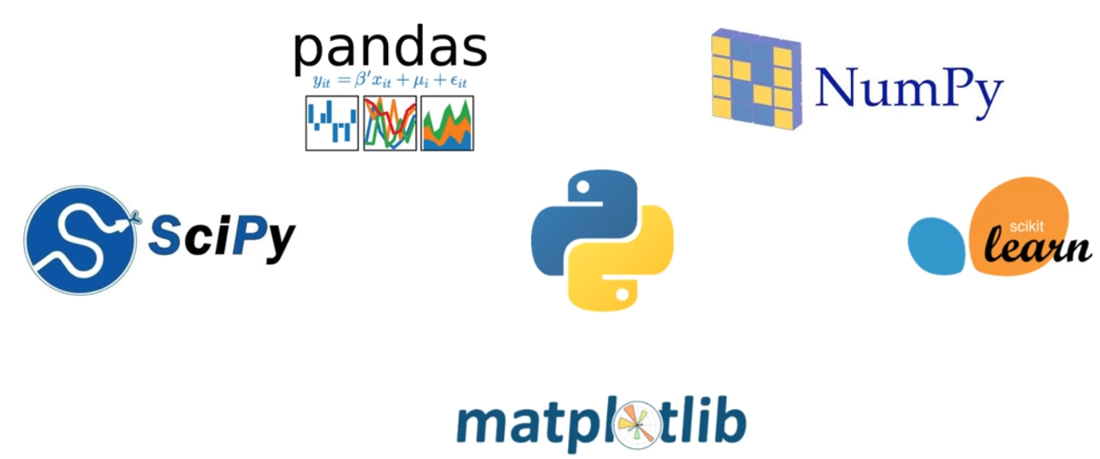
Python libraries for Data Science

Slide 7
Additional libraries
Tensorflow, Keras
BeautifulSoup, Scrapy
Seaborn
Note: A module is a collection of code or functions that uses the .py extension.
A Python library or package is a set of related modules bundled together.

Slide 8
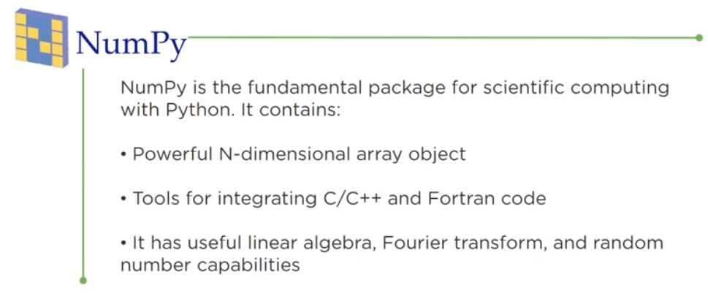
Numpy

Slide 9
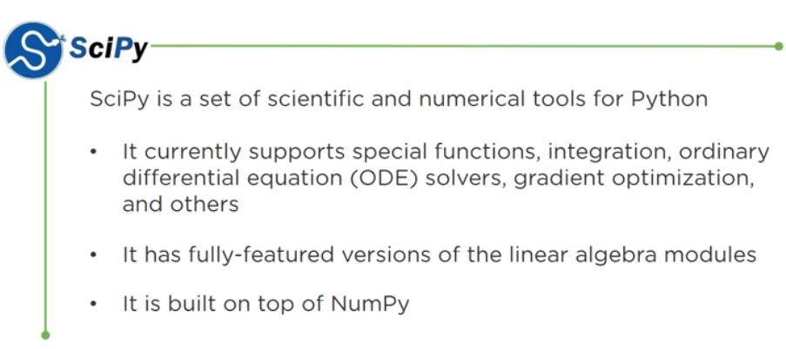
Scipy

Slide 10
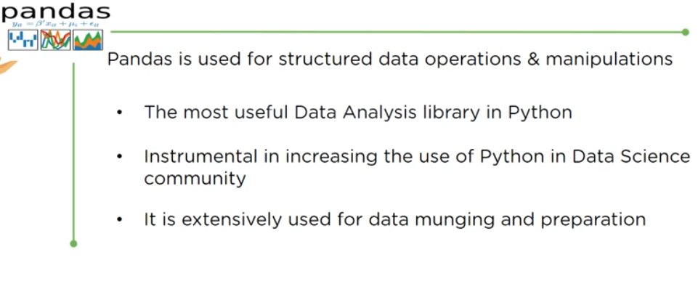
Pandas

Slide 11
MACHINE LEARNING

Slide 12

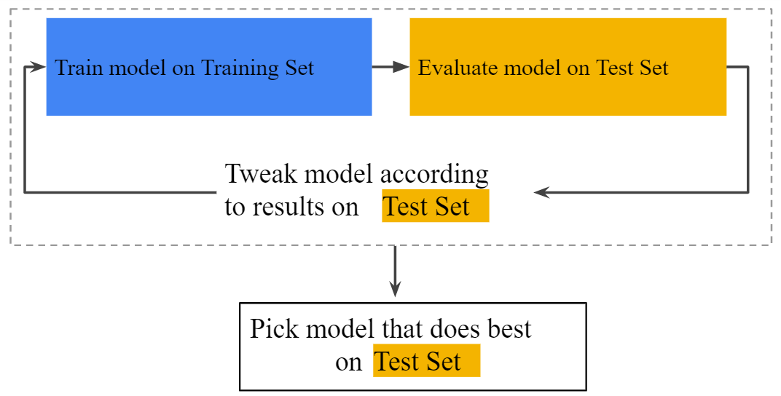
Data splitting

Slide 13
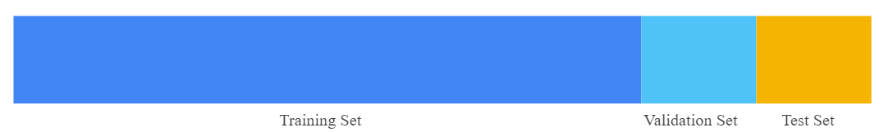
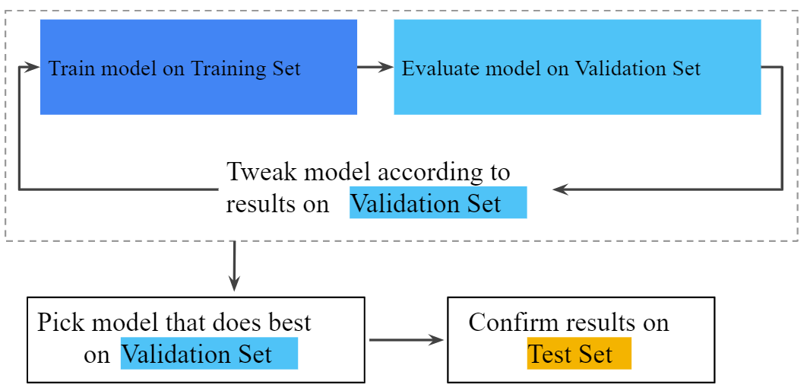
Data splitting 2

Slide 14
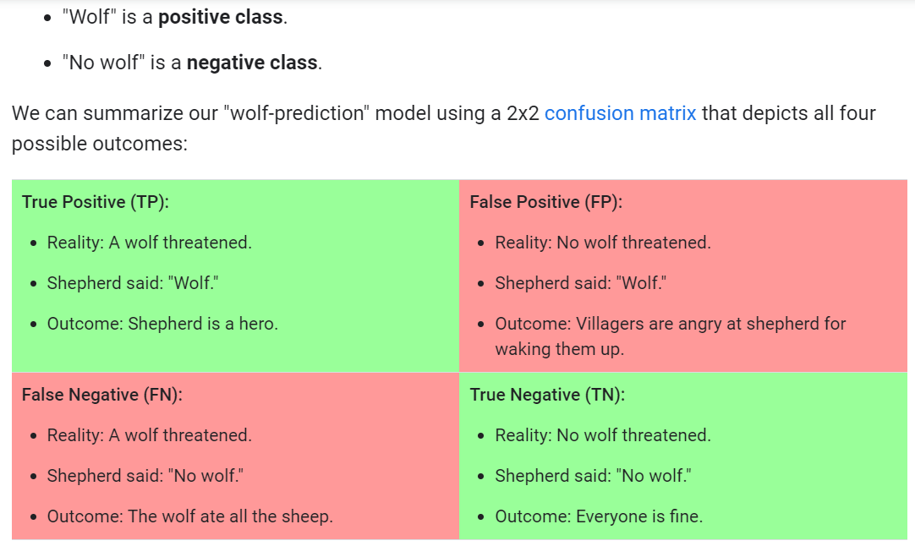
Classification

Slide 15
Useful resources and Tips

