Slide 1
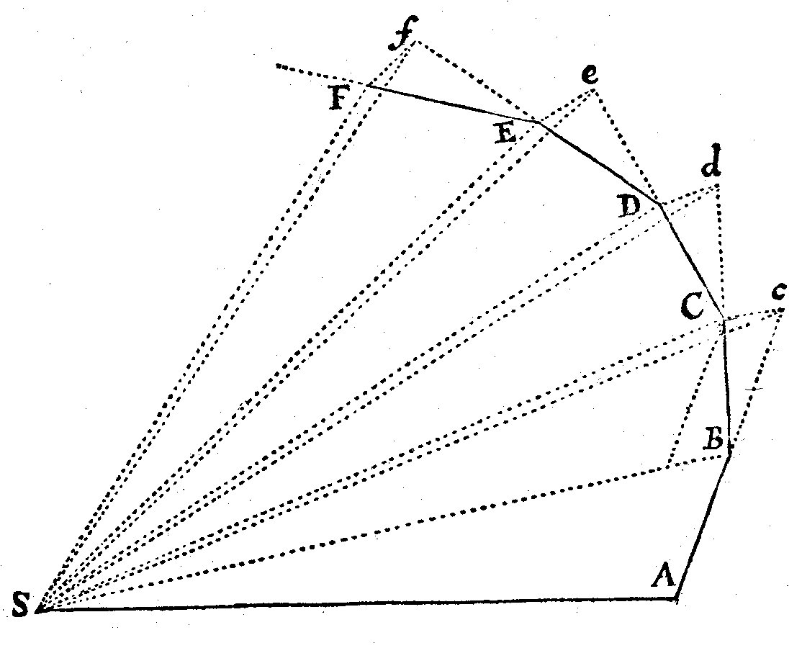
Building Models with AMUSE

Slide 2
imports
import numpy
from amuse.community.mercury.interface import MercuryWayWard
from amuse.ext.solarsystem import Solarsystem
from amuse.support.units import units
from amuse.plot import *
def planetplot():
sun, planets = Solarsystem.new_solarsystem()
timerange = units.day(numpy.arange(0, 120 * 365.25, 12))
instance = MercuryWayWard()
instance.initialize_code()
instance.central_particle.add_particles(sun)
instance.orbiters.add_particles(planets)
instance.commit_particles()
channels = instance.orbiters.new_channel_to(planets)
for time in timerange:
err = instance.evolve_model(time)
channels.copy()
planets.savepoint(time)
instance.stop()
for planet in planets:
t, x = planet.get_timeline_of_attribute_as_vector("x")
t, y = planet.get_timeline_of_attribute_as_vector("y")
plot(x, y,'.')
native_plot.show()
if __name__ == "__main__":
planetplot()
initial
conditions
setup code
evolve
process

