Slide 1
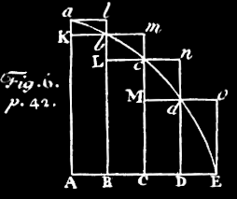
Building Models with AMUSE
introductory tutorial

Slide 2

GD & SE
BHtree
hermite0
phiGRAPE
twobody
smallN
octgrav
mercury
huayno
mmc
sse
bse
evtwin
mesa
http://www.amusecode.org/doc/reference/available-codes.html

Slide 3
GD

Slide 4
import numpy
from amuse.community.mercury.interface import MercuryWayWard
from amuse.ext.solarsystem import Solarsystem
from amuse.support.units import units
from amuse.support.data.values import VectorQuantity as Vq
from amuse.plot import *
imports
def integrate_and_store():
initial
conditions
sun, planets = Solarsystem.new_solarsystem()
timerange = Vq.argange(0|units.day, 120|units.yr, 1|units.day))
setup code
instance = MercuryWayWard()
instance.initialize_code()
instance.central_particle.add_particles(sun)
instance.orbiters.add_particles(planets)
instance.commit_particles()
channels = instance.orbiters.new_channel_to(planets)
evolve
for time in timerange:
err = instance.evolve_model(time)
channels.copy()
planets.savepoint(time)
instance.stop()
return planets
def plotdata(planets):
process
for planet in planets:
t, x = planet.get_timeline_of_attribute_as_vector("x")
t, y = planet.get_timeline_of_attribute_as_vector("y")
plot(x, y,'.')
native_plot.show()
if __name__ == "__main__":
planets = integrate_and_store()
plotdata(planets)

Slide 5
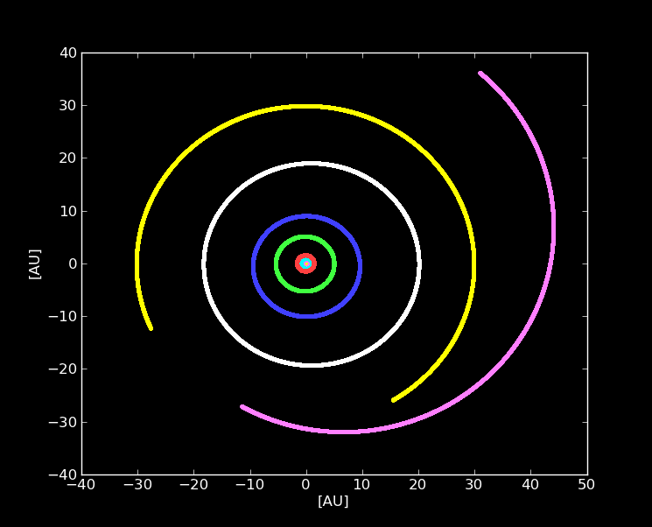

Slide 6
SE

Slide 7
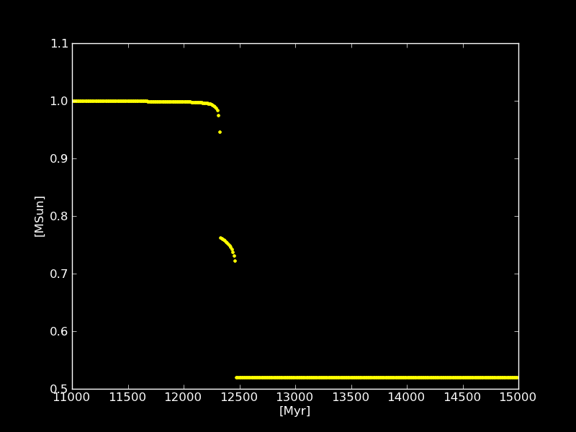
import numpy
from amuse.community.sse.interface import SSE
from amuse.support.data import core
from amuse.support.units import units
from amuse.ext.solarsystem import Solarsystem
from amuse.plot import *
def plottillagb():
sse = SSE()
sun, planets = Solarsystem.new_solarsystem()
sse.particles.add_particles(sun)
sse.commit_particles()
channel = sse.particles.new_channel_to(sun)
channel.copy()
timerange = units.Myr(numpy.arange(11000, 15000,10))
masses = []|units.MSun
for time in timerange:
sse.evolve_model(time)
channel.copy()
masses.append(sse.particles[0].mass)
sse.stop()
plot(timerange, masses,'.')
native_plot.show()
if __name__ in ("__main__", "__plot__"):
plottillagb()

Slide 8
def plottillagb():
sse = SSEWithMassEvolve()
sse.commit_parameters()
sun, planets = Solarsystem.new_solarsystem()
sse.particles.add_particles(sun)
sse.commit_particles()
channel = sse.particles.new_channel_to(sun)
channel.copy()
massrange = units.MSun(numpy.arange(1, 0.8 ,-0.001))
masses = []|units.MSun
timerange = [] | units.Myr
for mass in massrange:
#sse.evolve_model(time)
sse.evolve_mass(mass)
timerange.append(sse.evolve_mass(mass))
channel.copy()
masses.append(sse.particles[0].mass)
sse.stop()
plot(massrange, timerange,'.')
native_plot.show()
if __name__ == "__main__":
plottillagb()
class SSEWithMassEvolve(SSE):
def __init__(self, **options):
SSE.__init__(self, convert_nbody = None, **options)
def evolve_mass(self, mass):
timestep = 1.0 | units.Myr
current_mass = self.particles[0].mass
current_time = self.particles[0].age
while current_mass >= mass:
current_time += timestep
self.evolve_model(current_time)
current_mass = self.particles[0].mass
return current_time

Slide 9
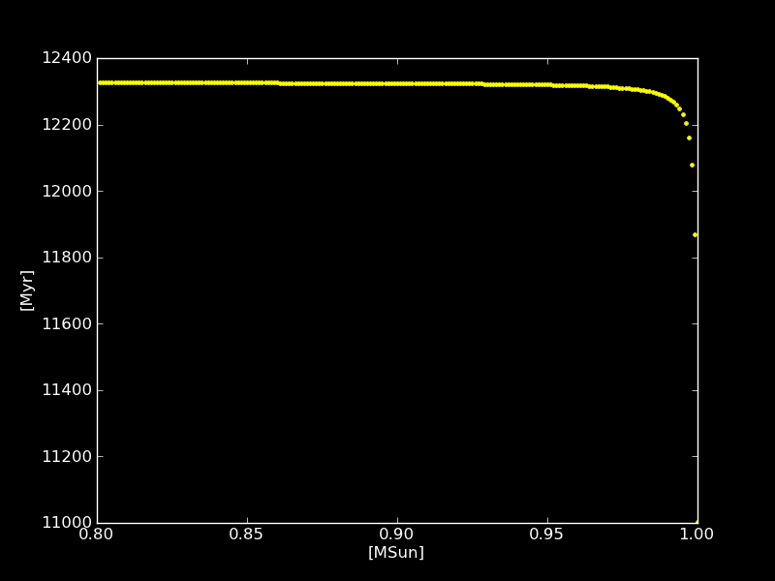

Slide 10
sun, planets = Solarsystem.new_solarsystem()
gd, se = setup_codes(sun, planets)
channelp = gd.orbiters.new_channel_to(planets)
channels = se.particles.new_channel_to(sun)
prev_mass = sun[0].mass
massrange = units.MSun(numpy.arange(0.9, 0.89999 ,-1e-9))
masses = []|units.MSun
timerange = [] | units.Myr
for i, mass in enumerate(massrange):
time, dummymass = se.evolve_mass(mass)
err = gd.evolve_model(gdtime)
channelp.copy()
planets.savepoint(time)
channels.copy()
gd.central_particle.mass = sun[0].mass
gd.stop()
se.stop()

Slide 11
