Slide 1



A gentle introduction to AMUSE
Gas Cooling using the AMUSE package
Inti Pelupessy - Arjen van Elteren - Marcell Marosvolgyi
Nathan de Vries - Simon Portegies Zwart

Slide 2
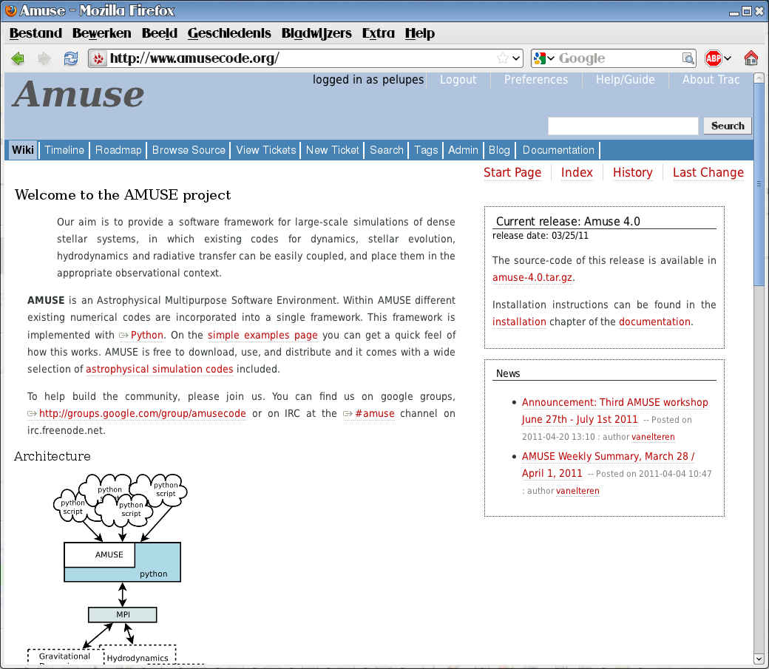
Astrophysical Multipurpose Software Environment
www.amusecode.org

Slide 3
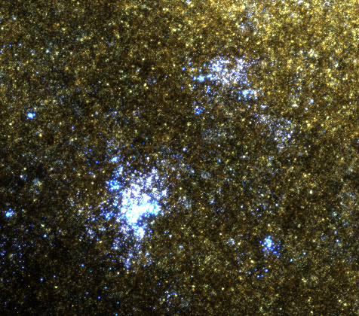
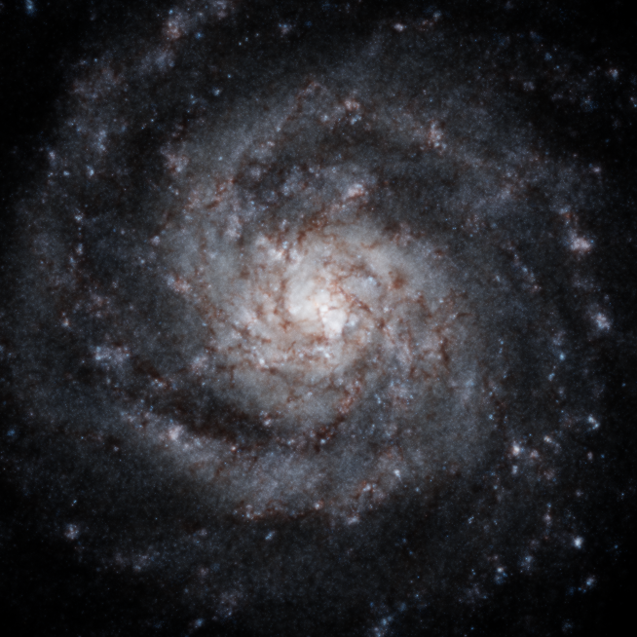
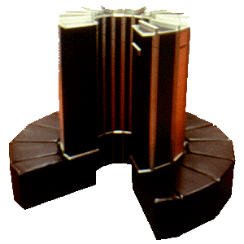
Introduction – what is AMUSE?
- An instrument to perform astrophysical experiments
spanning multiple physical domains and a wide range
in temporal and spatial scales.
- Combines existing codes into a loosely coupled but
consistent software environment,
- successor to/derived from MUSE
- development started May 2009

Slide 4
Introduction – approach & design philosophy
- Build on legacy codes, use code 'as is'
- Coupling using MPI interface
- Couple physical interfaces, not algorithmic
- Standarized interfaces for each domain
- Automate as much as possible
- tests for all components

Slide 5
The user script
from amuse.support.units import nbody_system
from amuse.ext.plummer import MakePlummerModel
from amuse.community.phiGRAPE.interface import PhiGRAPE
parts=MakePlummerModel(1000).result
interface=PhiGRAPE(mode=”gpu”)
interface.particles.add_particles(parts)
interface.evolve_model(100. | nbody_system.time)
print interface.kinetic_energy+interface.potential_energy
“imports”
“initial cond.”
“instantiate
code”
“evolve”
“analysis”

Slide 6
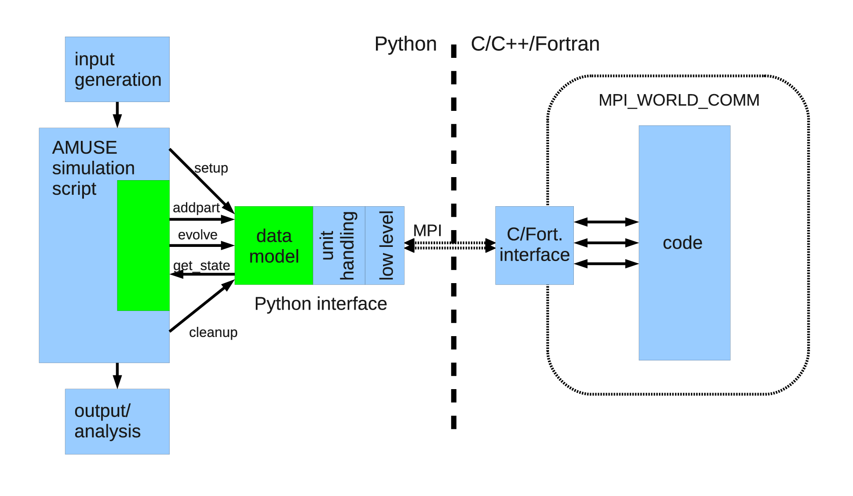
AMUSE interface design

Slide 7
Overview of AMUSE: Interface
Based on function/subroutine calls
Function calls are remote, from python application to legacy code application
MPI is used to transfer data from python to the legacy code
Python interface is defined as a python class, some special syntax needed to specify the remote functions (python decorator @legacy_function)

Slide 8
MPI – how it works 1
interface
class
defined
during
integration
generic
handling
function
calls
main
event-loop
(generated)
legacy
code
existing
or
defined
functions
MPI
method
calls
function
call
python
C++ or Fortran 90

Slide 9
Overview of AMUSE – interface
Why not SWIG/ f2py?
- problems with multiple instances:
memory & thread safety issues
- parallelization
MPI:
- processes in separate executables (possibly on
different machines)
- no direct memory access
- slightly more involved (however: automated build)

Slide 10
Overview of AMUSE: interface
Every MPI exchange starts with a fixed with header, detailing the following messages and the function to call.
Parameters are encoded into arrays of a specific type (doubles, floats, integers)
These arrays are send using MPI's Bcast, Send and Recieve functions
The legacy code runs in an event loop executing and waiting for messages

Slide 11
Example
Python script
x = Interface()
result = x.sum(10.5, 31.5)
print result
C code
double sum(double x, double y) {
return x+y;
}
Python Definition
class Interface(LegacyInterface):
@legacy_function
def sum():
function = RemoteFunction()
function.add_parameter('x', 'd', function.IN)
function.result_type = 'd'
return function

Slide 12
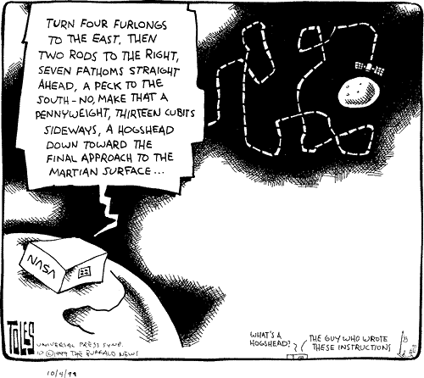
Overview of AMUSE – unit handling

Slide 13
Overview of AMUSE – unit handling
- AMUSE includes a module for unit algebra
- assignment of units enforced throughout in
high level interface
- converters for different unit systems &
unitless codes or underspecified unit systems
(Nbody, G=1 units)
>>>from amuse.units.units import *
>>>from amuse.units.imperial import *
>>>print (1 | furlong) + (11 | yard)
1.05 furlong
>>>def vescape(r):
return (2*G*MSun/r)**(0.5)
>>>v=vescape(1 | AU)
>>>print 'v_escape:', v.in_(km/s)
v_escape: 42.1232150935 km / s

Slide 14
Overview of AMUSE – data model
Low level: arrays for communication
High level:
Data model, object oriented way to talk with codes
- data consists of particle sets with attributes
- utility functions on particle sets
- refer to data stored in memory, in code or on disk
- keep track of history (timestamps)

Slide 15
AMUSE status:
- release 4.0
- base framework: MPI interface, units, data model
- (almost) fully implemented domains:
gravitational dynamics (9+ codes),
stellar evolution (4),
hydrodynamics (2 SPH, 3 grid)
- radiative transfer domain WIP (4 codes)
- various ways to couple codes
- documentation, website & examples
- coming up: december workshop
- 2011-2014: high performance AMUSE development

Slide 16
Example:
Radiative hydro simulations with AMUSE
- AMUSE hydro domain added in release 3.0
- AMUSE radiative transfer domain added in 3.2
Application:
implementation of
radiative hydro code
- very small additional
code (< 50 lines)
- uses high level interfaces
Radhydro integration step
dt/2
dt/2
hydro
hydro
pos
ρ
u
rad. transfer

Slide 17
def update_pos_rho(sys,pa):
p=pa.copy()
p.rho=3./4/numpy.pi*8*p.mass/p.radius**3
channel = p.new_channel_to(sys.particles)
channel.copy_attributes(["x","y","z","rho"])
def update_u(sys,pa):
p=pa.copy()
channel = p.new_channel_to(sys.particles)
channel.copy_attributes(["u"])
def radhydro_evolve(sph,rad,tend,dt):
t=0. | units.Myr
while t<tend-dt/2:
sph.evolve_model(t+dt/2)
update_pos_rho(rad,sph.gas_particles)
rad.evolve_model(t+dt)
update_u(sph,rad.particles)
sph.evolve_model(t+dt)

Slide 18
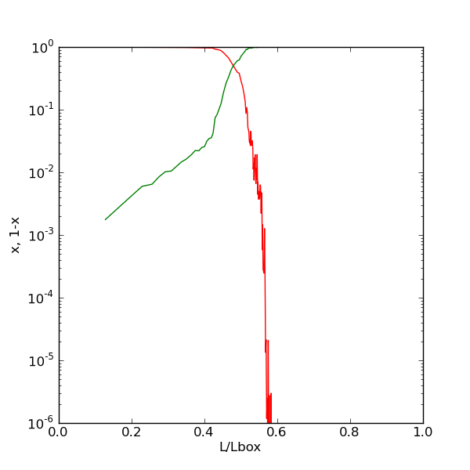
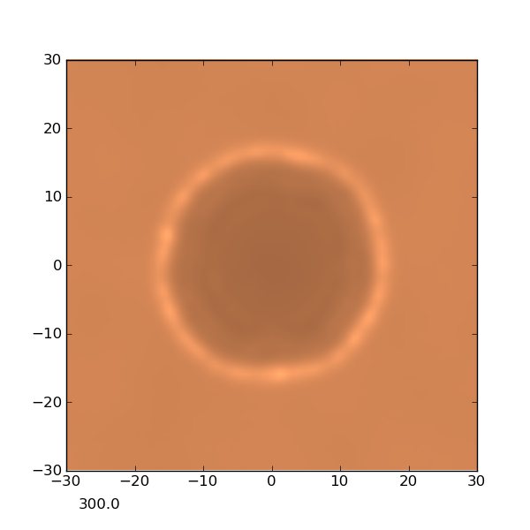
Radiative hydrodynamics:
Iliev radiative transfer test 5
- expanding HII region in constant density
- fully dynamic
- test of capability: comparison with
dedicated codes
- no thermal solver (in development)
Results:
- match of ionization front pos. and v
- excellent performance
(100k: 3hr, single worksation)
- 95% time in rad solver,
- most of remaining time in
hydro solver.

Slide 19
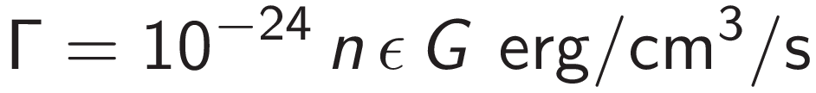
Exercise: a simple ISM model
we set up a simple ism model where the cooling is given by the following approximate analytic expression (T<106 K):
with a=3.24, and b=0.17 (different a and b can approximate different x_{e})
heating is by photo electric heating:
assume an electron fraction x_{e}=0.1, a radiation field G=10 (in units of the Habing field) and a constant heating efficiency =0.05
Goal is to implement a solver for the thermal evolution in python, given the above heating and cooling and couple this to Gadget using the AMUSE interface.

Slide 20
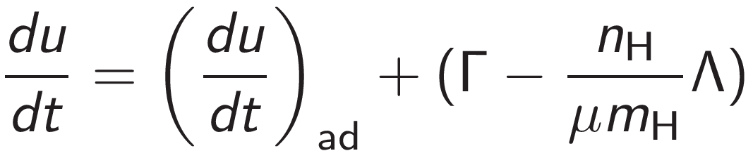
Exercise: a simple ISM model
1) plot the cooling function as a function of temperature T
2) The equilibrium T is determined by Γ = n Λ(T). Plot Γ and n Λ(T) and determine the temperature (n=0.1)
3) nearby regions of the ISM are often in pressure equilibrium (if a region is overpressurized it will expand) redo the plot of 2) but under the assumption of constant pressure (with P=5000 K cm⁻³), redo for P=100 and 10⁴ K cm⁻³. What do you observe about the equilibrium points?
4) optional: construct a plot of P vs n in equilibrium
5) the internal energy equation is:
write a routine in Python/AMUSE that integrates this equation for a given Δt starting from a value u, with a given (du/dt)_{ad}

Slide 21
Exercise: a simple ISM model
6) using the routine written in 5) and the skeleton AMUSE script couple the thermal solver to the SPH code Gadget (compiled for isothermal SPH w/o self gravity in a periodic box)
7) given the initial condition script construct a box of L=100 parsec (input: n,T for a random box of particles with average n, constant T), run the code with an n in bistable regime and with a density outside it, plot slices of the density distribution with intervals of 1 Myr

