Slide 1
AMUSE
Astrophysical Multiscale Software Environment
INTRODUCTION TO THE SOFTWARE
Arjen van Elteren

Slide 2
Goal
Phyisics:
To create an instrument for performing astrophysical experiments spanning multiple physical domains and a wide range in temporal and spatial scales.
Software:
Combining existing, proven codes into a loosely coupled but consistent software environment, without changing the legace codes (much)!

Slide 3
Design – overview
Stellar Evolution
Hydrodynamics
Radiative Transfer
Gravity
AMUSE
Combining existing codes
With an extensive support framework
To provide a generic framework
For doing astrophysical experiments
INPUT
OUTPUT
Compare models
Unit handling
Data conversion
Initial conditions

Slide 4
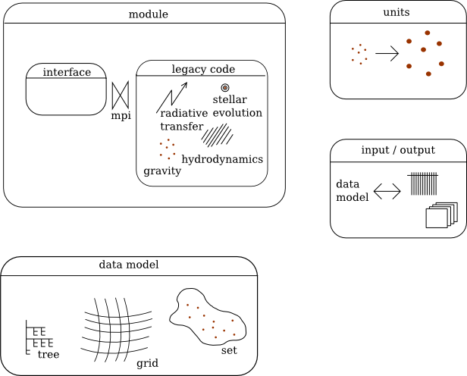
Design – blocks

Slide 5
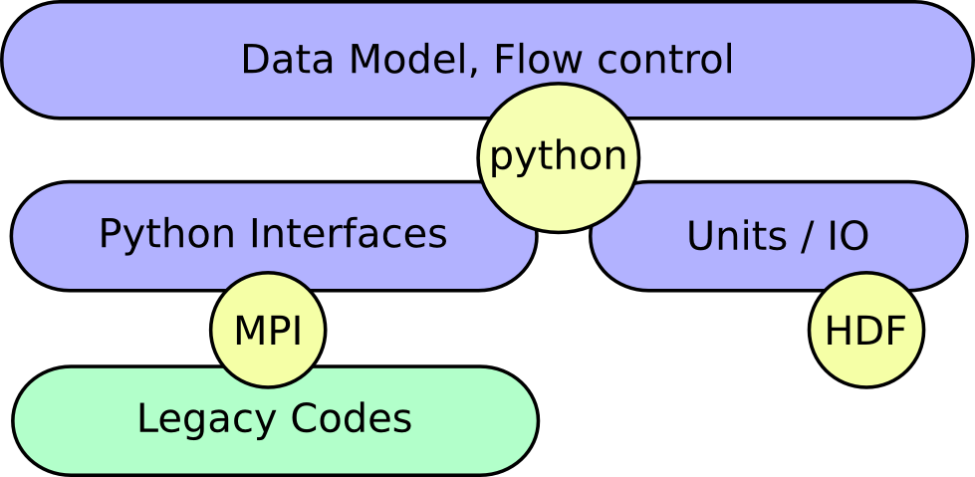
Design – levels

Slide 6
Code
Python
Legacy codes, C/C++, Fortran
Interface between python and legacy code via MPI
Organised in directory stucture

Slide 7
Directory Structure
trunk
  src, source code of the environment and included legacy modules
  test, source code of all unittesting code and examples
  support + bin, code for building and testing the software
  doc, installation documentation, tutorials and reference documentation

Slide 8
SRC directory
Everything in one master package called amuse
This package is divided in sub-packages
  legacy, contains all the legacy codes, for each legacy code a sub-package, not divided in physical domains
  support, code for the unit handling, data model, input/output
  domain, domain specific definitions of interfaces, attributes and parameters (tentative)

Slide 9
TEST directory
Contains directories for different unit tests, contains examples directory
  examples, applications using the AMUSE framework
  legacy_tests, unittests for the legacy codes. Tests of the MPI interfaces and very simple problems (sun and earth for gravitational dynamics)
  core_tests, tests of the support package (units handling, IO, data model)

Slide 10
Interfacing Legacy Code
Based on function/subroutine calls
Function calls are remote, from python application to legacy code application
Function calls are over MPI, MPI is used to transfer data from python to the legacy code
Python interface is defined as a python class, some special syntax needed to specify the remote functions (python decorator @legacy_function)

Slide 11
Example
Python Definition
class Interface(LegacyInterface):
@legacy_function
def sum():
function = RemoteFunction()
function.add_parameter('x', 'd', function.IN)
function.result_type = 'd'
return function
C code
double sum(double x, double y) {
return x+y;
}
Python script
x = new Interface()
result = x.sum(10.5, 31.5)
print result

Slide 12
MPI – how it works 1
interface
class
defined
during
integration
generic
handling
function
calls
main
event-loop
generated!
legacy
code
existing
or
defined
functions
MPI
method
calls
function
call
python
C++ or Fortran 90

Slide 13
MPI – how it works 2
Every MPI exchange starts with a fixed with header, detailing the following messages and the function to call.
Parameters are encoded into arrays of a specific type (doubles, floats, integers)
These arrays are send using MPI's Bcast, Send and Recieve functions

Slide 14
MPI – parallel code
Communication with legacy code is over a “special” intracommunication channel

Slide 15
MPI – final words
MPI is also used to start the legacy code (MPI 2 spawn)
TODO:
  Events to send back information to the python script (collision partners, diagnostic values)
  We can send arrays, need also handling to put these arrays directly into the legacy codes (now we use a loop)
  Use MPI to interact with python classes

Slide 16
Interface – next level
Use legacy functions to interact with:
  parameters, code wide specific settings, usually only changed at the start of a calculation
  data (attributes of particles or of gridpoints), set the initial conditions, retrieve the latest calculated values
  evolve, let the legacy code evolve the model
  diagnostics, get important information about the state of the code (energy, time, ...)
  services, calculate values based on the model (gravity on a given point)

Slide 17
Interface – next level
All values in a python script have units
  legacy code only knows about numbers, units are implicit
  next level combines the numbers with units into values, or strips the units from the values to get the numbers to send to the legacy code
Legacy codes may know about ids
  next level connects ids to objects (stars, gas particles) with attributes

Slide 18
Interface – next level
Legacy code knows about current time (or just as much history as is needed for the calculation)
  next level adds history, i.e. the value of an attribute at a specific model time is stored.
Legacy code is defined in functions
  next level definitions are based on interface (data transfer, model update, gravity service)

Slide 19
Units and Values
Units are defined in a base system
Default base system is SI (kg, m, s, K, A, mol, cd)
Units can be composed of other units (m/s)
Units can be derived from other units (parsec)
Another base system is NBODY (G=1)
Converter to go from nbody to SI and back
Value is a number combined with a unit
All operations work on values

Slide 20
Units and Values – example
Units
>>> parsec = named('parsec','pc', 3.08568025e16 * m)
>>> kparsec = 1000 * parsec
>>> print kparsec
unit<1000 * parsec>
>>> value1 = 10 | kparsec
>>> print value1
10 1000 * parsec
>>> value2 = 1 | parsec
>>> print value2
1 parsec
>>> value2 + value1
value<10001.0 parsec>
>>> (value2 + value1).in_(kparsec)
value<10.001 1000 * parsec>
>>>
>>> convert = nbody_to_si(1 | MSun, 1 | parsec)
>>> l = 10 | length
>>> l
value<10 nbody length>
>>> convert.to_si(l)
value<3.08568025e+17 m>
>>> convert.to_si(l).in_(parsec)
value<10.0 parsec>

