Slide 1
Employee Data Analysis using Excel
STUDENT NAME: AMUTHANI.S.M
REGISTER NO: 52783770E9BFE65897E42D47AE30B4DC 312208641 DEPARTMENT: B.COM(GENERAL)
COLLEGE: MEENAKSHI COLLEGE FOR WOMEN

Slide 2
PROJECT TITLE
Employee Performance Analysis Based On Departments, Employee Type And FTE using Excel

Slide 3


AGENDA
1.Problem Statement 2.Project Overview 3.End Users
4.Our Solution and Proposition 5.Dataset Description 6.Modelling Approach 7.Results and Discussion 8.Conclusion
3/21/2024 Annual Review

Slide 4

PROBLEM
STATEMENT
The purpose of Full-Time Equivalent (FTE) is to standardize the measurement of employee work hours, regardless of whether they work
full-time or part-time, in order to better manage, allocate, and analyze workforce resources.

Slide 5

PROJECT OVERVIEW
Employee analysis involves examining various aspects of the workforce to gain insights that can help in decision - making, improving efficiency, and enhancing employee satisfaction.

Slide 6

WHO ARE THE END USERS?
HUMAN RESOURCE DEPARTMENTS
MANAGEMENT AND LEADERSHIP
TEAM LEADERS AND SUPERVISORS
EMPLOYEES
EXECUTIVE LEADERSHIP
BUSINESS ANALYSTS
RECRUITERS

Slide 7

OUR SOLUTION AND ITS VALUE PROPOSITION
FILTERING- REMOVE VALUES
PIVOT TABLE - SUMMARY OF EMPLOYEE PERFORMANCE
BAR DIAGRAM - FINAL REPORT

Slide 8
Dataset Description
EMPLOYEE DATA SET- NAN MUDHALVAN PORTAL
9 FEATURES IN EXCEL: EMPLOYEE ID- ALPHANUMERIC(TEXT) NAME- ALPHABETICAL(TEXT) GENDER- ALPHABETICAL(TEXT) DEPARTMENT - ALPHABETICAL(TEXT) SALARY - NUMERICAL
START DATE - ALPHANUMERIC(TEXT)
FTE- NUMERICAL
EMPLOYEE TYPE- ALPHABETICAL(TEXT)
EMPLOYEE LOCATION- ALPHABETICAL(TEXT)
3 FEATURES USED:
DEPARTMENT - ALPHABETICAL(TEXT)
FTE- NUMERICAL
EMPLOYEE TYPE- ALPHABETICAL(TEXT)

Slide 9

THE "WOW" IN OUR SOLUTION
Effective data visualization makes it easier to present complex data in an engaging and understandable way.
Well-presented data can have a significant impact on decision-makers, helping to drive change and innovation.
3/21/2024 Annual Re
view
9

Slide 10
MODELLING
STEP -1
DOWNLOAD THE EMPLOYEE DATASET AND OPEN THE EMPLOYEE DATASET IN EXCEL.
STEP -2
SELECT THE ENTIRE DATA AND CLICK ON DATA AND CLICK ON FILTER OPTION.
STEP -3
FILTER FTP FROM A TO Z ORDER.
STEP -4
SELECT THE ENTIRE DATA AND CLICK ON INSERT AND CLICK ON PIVOT TABLE TO CREATE PIVOT TABLE.
10

Slide 11
STEP -5
DRAG THE NEEDED DATA AND CREATE A PIVOT TABLE.
STEP -6
SELECT THE PIVOT TABLE AND CLICK ON INSERT.
STEP-7
NOW CLICK ON THE CHART THAT YOU WANT.
STEP -8
THE CHART IS CREATED.

Slide 12
RESULTS
1.TABLE
Sum of FTE Row Labels | Column Labels Accounting | Business Development | Engineering | Human Resources |  | Marketin g |  | Grand Total
Fixed Term | 4 | 4 | 1.8 | 3.4 | 0.3 | 13.5
Permane nt | 10.8 | 13.9 | 6 | 4.7 | 7.5 | 42.9
Temporar y | 1.6 | 2 | 4 | 1.8 | 0.8 | 10.2
Grand Total | 16.4 | 19.9 | 11.8 | 9.9 | 8.6 | 66.6
12

Slide 13
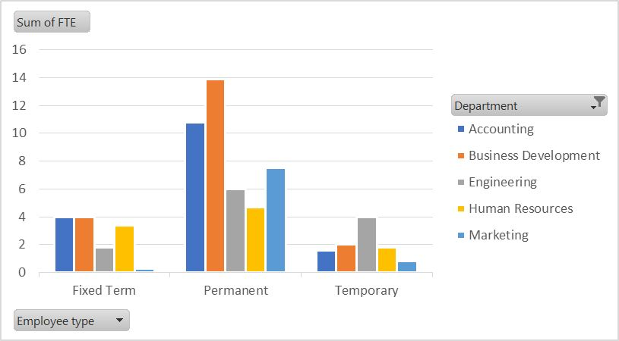
2. BAR DIAGRAM

Slide 14
conclusion
The dataset reveals the overall composition of the workforce, including demographics such as gender, salary, employee type and work location This information is crucial for understanding the diversity and experience level within the organization.
The analysis aids in workforce planning by forecasting future staffing needs based on current trends and organizational growth projections. This enables better preparation for scaling operations or restructuring the workforce.

