Slide 1

JavaScript - Loops
Chitradevi M
Technical Trainer
KGiSL Micro College
KGiSL Campus, Coimbatore – 641 035.

Slide 2
JavaScript Loops
The JavaScript loops are used to iterate the piece of code using for, while, do while or for-in loops. It makes the code compact. It is mostly used in array.
There are two types of loops in JavaScript.
Entry Control Loop
Exit Control Loop
Entry Control Loop
for loop
while loop
Exit Control Loop
do-while loop

Slide 3
JavaScript For loop
The JavaScript for loop iterates the elements for the fixed number of times. It should be used if number of iteration is known. The syntax of for loop is given below.
for (initialization; condition; increment)
{
code to be executed
}

Slide 4
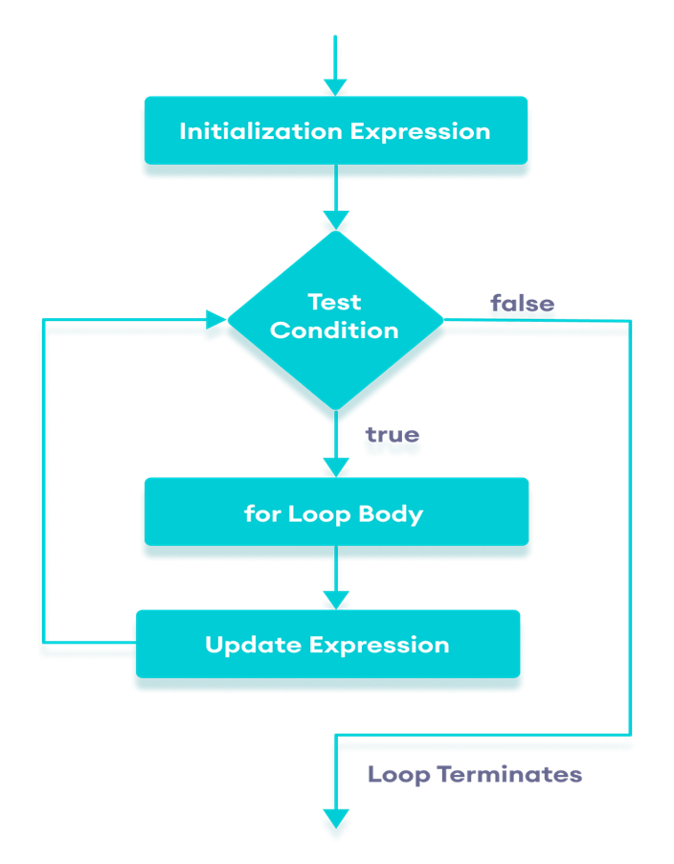
<!DOCTYPE html>
<html>
<body>
<script>
for (let i=1; i<=5; i++)
{
console.log(i + "<br/>")
}
</script>
</body>
</html>

Slide 5
JavaScript while loop
The JavaScript while loop iterates the elements for the infinite number of times. It should be used if number of iteration is not known.
The syntax of while loop is given below.
while (condition)
{
code to be executed
}

Slide 6
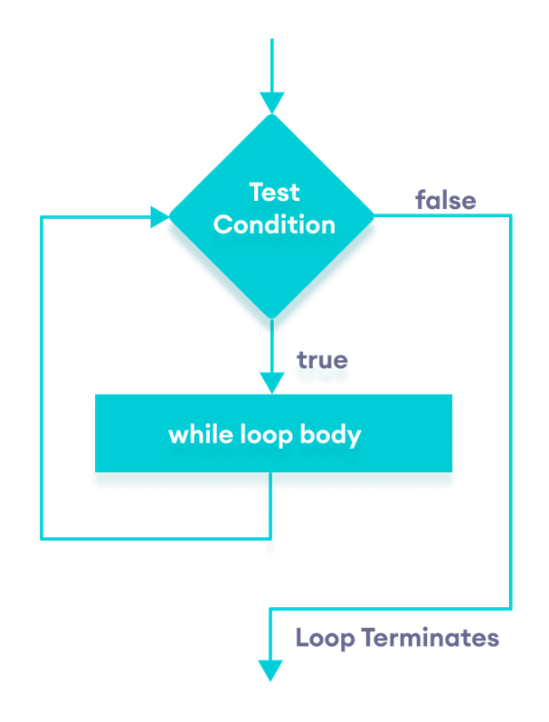
<!DOCTYPE html>
<html>
<body>
<script>
let i=11;
while (i<=15)
{
console.log(i + "<br/>");
i++;
}
</script>
</body>
</html>

Slide 7
JavaScript do while loop
The JavaScript do while loop iterates the elements for the infinite number of times like while loop. But, code is executed at least once whether condition is true or false.
The syntax of do while loop is given below.
do{
code to be executed
}while (condition);

Slide 8
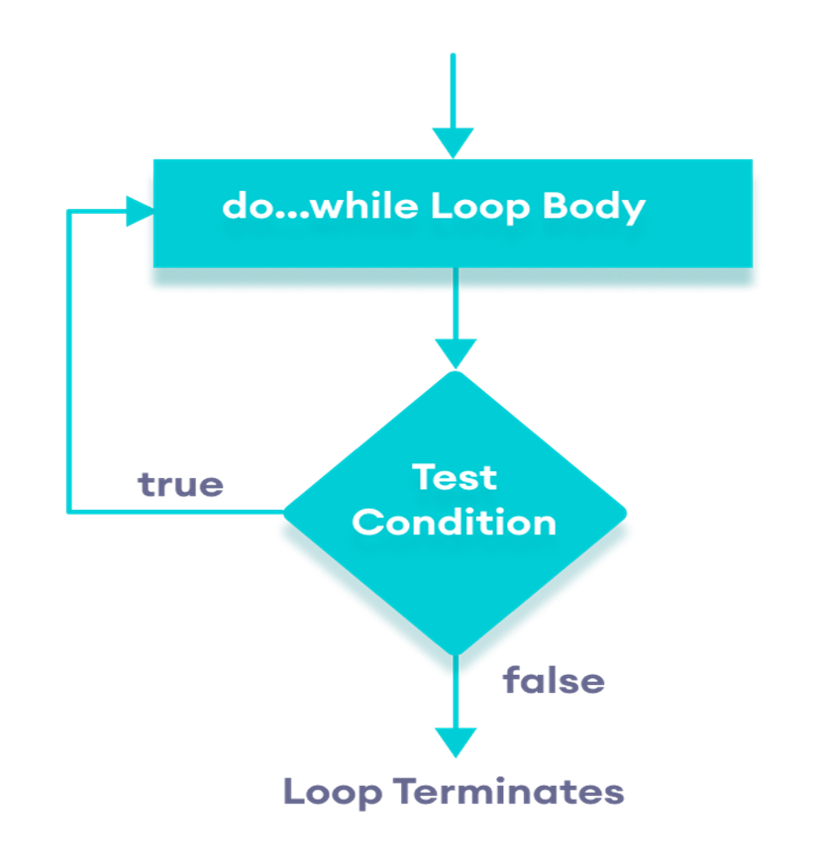
<!DOCTYPE html>
<html>
<body>
<script>
let i=21;
do{
console.log(i + "<br/>");
i++;
}while (i<=25);
</script>
</body>
</html>

