Slide 1


Welcome you all
Math Functions
D.Sakthivel
Assistant Professor & Trainer,
KG Micro College
KGiSL Campus, Coimbatore – 641 035.

Slide 2
Math Funcions

Slide 3
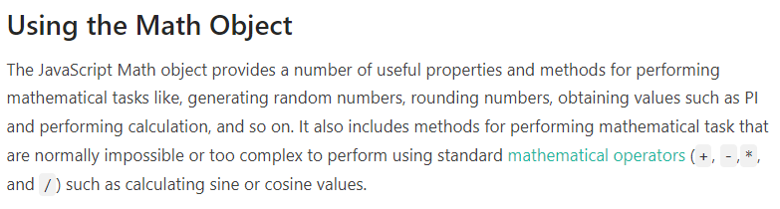

Slide 4
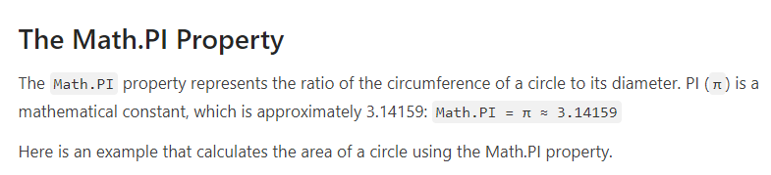
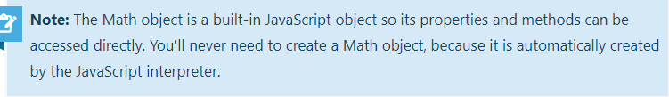
/ Printing PI value
document.write(Math.PI); // Prints: 3.141592653589793
// Function to calculate circle area function calculateCircleArea(radius)
{
var area = (Math.PI) * radius * radius; return area;
}
document.write(calculateCircleArea(5)); // Prints: 78.53981633974483
document.write(calculateCircleArea(10)); // Prints: 314.1592653589793

Slide 5
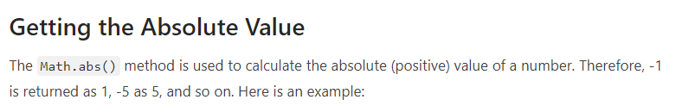
document.write(Math.abs(-1)); // Prints: 1 document.write(Math.abs(1)); // Prints: 1 document.write(Math.abs(-5)); // Prints: 5 document.write(Math.abs(-10.5)); // Prints: 10.5

Slide 6
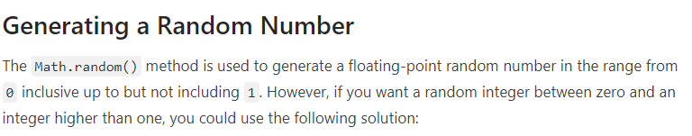
document.write(Math.random()); // Expected output: a number between 0 and 1
// Function to create random integer
function getRandomInt(max)
{
return Math.floor(Math.random() * max);
}
document.write(getRandomInt(3)); // Expected output: 0, 1 or 2
document.write(getRandomInt(1)); // Expected output: 0

Slide 7
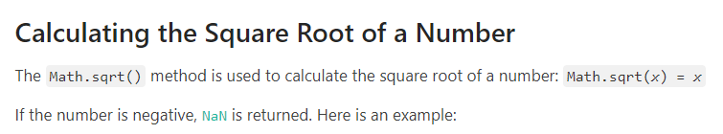
document.write(Math.sqrt(4)); // Prints: 2 document.write(Math.sqrt(16)); // Prints: 4 document.write(Math.sqrt(0.25)); // Prints: 0.5 document.write(Math.sqrt(-9)); // Prints: NaN
/* Function to calculate hypotenuse. Hypotenuse is the longest side of a right-angled triangle. */
function calculateHypotenuse(a, b)
{
return Math.sqrt((a * a) + (b * b));
}
document.write(calculateHypotenuse(3, 4)); // Prints: 5 document.write(calculateHypotenuse(5, 12)); // Prints: 13

Slide 8
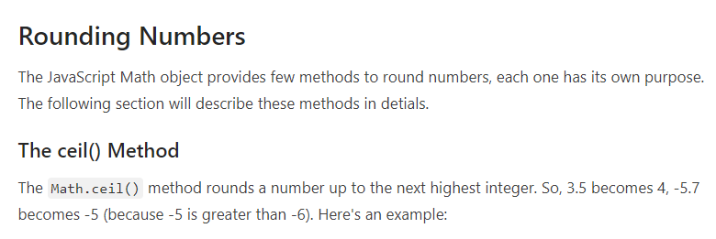
document.write(Math.ceil(3.5)); // Prints: 4 document.write(Math.ceil(-5.7)); // Prints: -5 document.write(Math.ceil(9.99)); // Prints: 10 document.write(Math.ceil(-9.99)); // Prints: -9 document.write(Math.ceil(0)); // Prints: 0

Slide 9
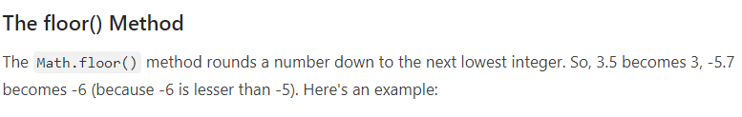
document.write(Math.floor(3.5)); // Prints: 3 document.write(Math.floor(-5.7)); // Prints: -6 document.write(Math.floor(9.99)); // Prints: 9 document.write(Math.floor(-9.99)); // Prints: -10 document.write(Math.floor(0)); // Prints: 0

Slide 10
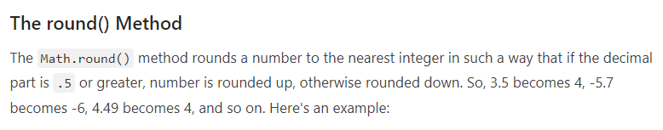
document.write(Math.round(3.5)); // Prints: 4 document.write(Math.round(-5.7)); // Prints: -6 document.write(Math.round(7.25)); // Prints: 7 document.write(Math.round(4.49)); // Prints: 4 document.write(Math.round(0)); // Prints: 0

Slide 11
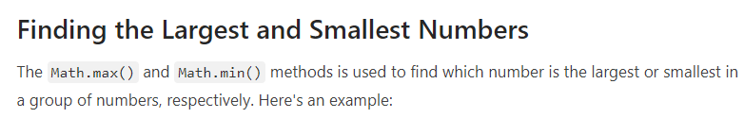

document.write(Math.max(1, 3, 2)); // Prints: 3 document.write(Math.max(-1, -3, -2)); // Prints: -1 document.write(Math.min(1, 3, 2)); // Prints: 1 document.write(Math.min(-1, -3, -2)); // Prints: -3
var numbers = [1, 3, 2]; document.write(Math.max.apply(null, numbers)); // Prints: 3 document.write(Math.min.apply(null, numbers)); // Prints: 1

Slide 12
var numbers = [1, 3, 2]; document.write(Math.max(...numbers)); // Prints: 3 document.write(Math.min(...numbers)); // Prints: 1

Slide 13
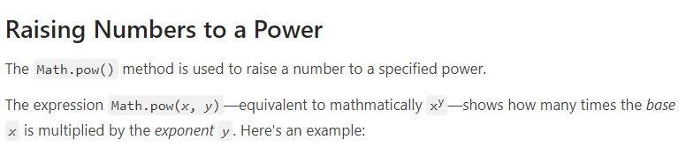

document.write(Math.pow(3, 2)); // Prints: 9 document.write(Math.pow(0, 1)); // Prints: 0 document.write(Math.pow(5, -2)); // Prints: 0.04 document.write(Math.pow(16, 0.5)); // Prints: 4 (square root of 4) document.write(Math.pow(8, 1/3)); // Prints: 2 (cube root of 8)

Slide 14
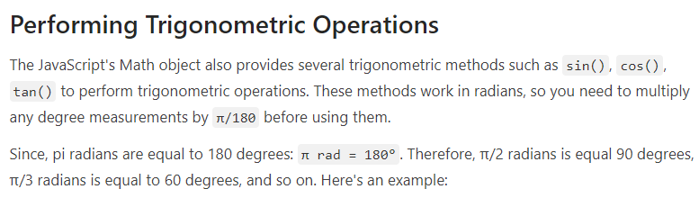
document.write(Math.sin(0 * Math.PI / 180)); // Prints: 0 document.write(Math.sin(90 * Math.PI / 180)); // Prints: 1 document.write(Math.cos(0 * Math.PI / 180)); // Prints: 1 document.write(Math.cos(180 * Math.PI / 180)); // Prints: -1 document.write(Math.tan(0 * Math.PI / 180)); // Prints: 0

Slide 15
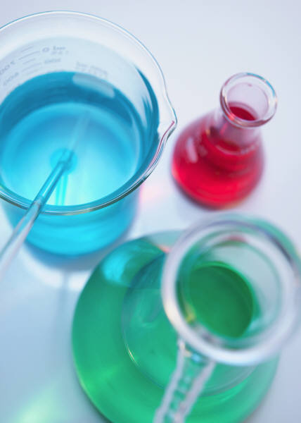
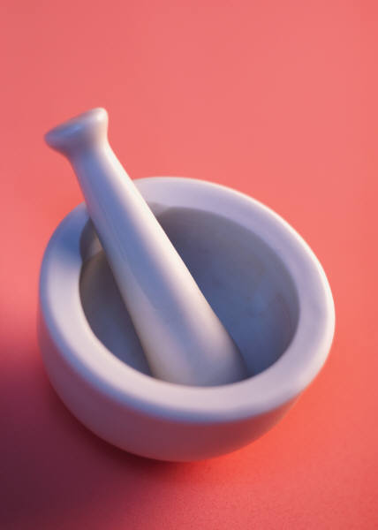
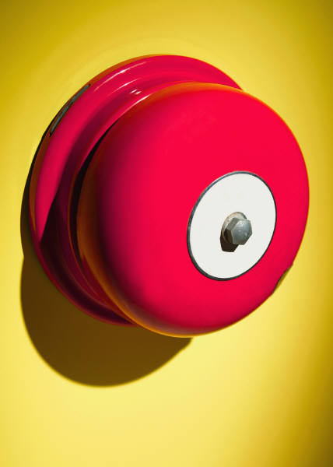
Thank You

