Slide 1


Welcome you all
Advanced JavaScript
D.Sakthivel
Assistant Professor & Trainer,
KGiSL Micro College
KGiSL Campus, Coimbatore – 641 035.

Slide 2
JavaScript ECMA Script 6
What is ECMA Script 6 (or ES6)?
JavaScript Regular Expressions
The var, let ,const Keyword
Arrow Functions
Spread Operator
REST
Destructuring
JSON

Slide 3

What is ECMA Script 6 (or ES6)?
ECMAScript 2015 (or ES6) is the sixth and major edition of the ECMAScript language specification standard.
It defines the standard for the JavaScript implementation.
ES6 brought significant changes to the JavaScript language.
It introduces several new features such as, block-scoped variables, new loop for iterating over arrays and objects, template literals, and many other enhancements to make JavaScript programming easier and more fun.

Slide 4
JavaScript Regular Expressions
What is Regular Expression?
Regular Expressions, commonly known as "regex" or "RegExp", are a specially formatted text strings used to find patterns in text.
Regular expressions are one of the most powerful tools available today for effective and efficient text processing and manipulations.
For example, it can be used to verify whether the format of data i.e. name, email, phone number, etc. entered by the user is correct or not, find or replace matching string within text content, and so on.
JavaScript supports Perl style regular expressions.
Why Perl style regular expressions?
Because Perl (Practical Extraction and Report Language) was the first mainstream programming language that provided integrated support for regular expressions and it is well known for its strong support of regular expressions and its extraordinary text processing and manipulation capabilities.

Slide 5
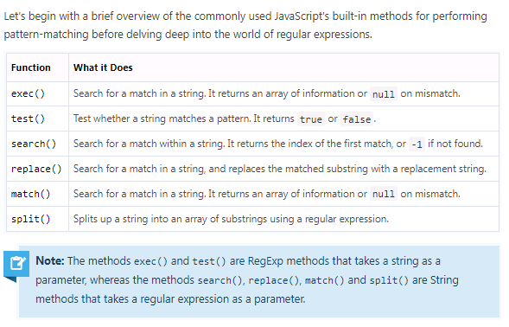
JavaScript Regular Expressions

Slide 6
JavaScript Regular Expressions
Defining Regular Expressions
In JavaScript, regular expressions are represented by RegExp object, which is a native JavaScript object like String, Array, and so on.
There are two ways of creating a new RegExp object — one is using the literal syntax, and the other is using the RegExp() constructor.
The literal syntax uses forward slashes (/pattern/) to wrap the regular expression pattern, whereas the constructor syntax uses quotes ("pattern").

Slide 7
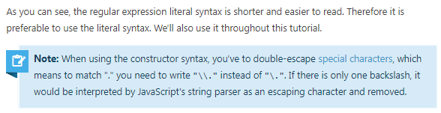
JavaScript Regular Expressions
The following example demonstrates both ways of creating a regular expression that matches any string that begins with "Mr.".
Example
// Literal syntax
var regex = /^Mr\./;
// Constructor syntax
var regex = new RegExp("^Mr\\.");

Slide 8
Pattern Matching with Regular Expression
Regular expression patterns include the use of letters, digits, punctuation marks, etc., plus a set of special regular expression characters (do not confuse with the HTML special characters).
The characters that are given special meaning within a regular expression, are: . * ? + [ ] ( ) { } ^ $ | \.
You will need to backslash these characters whenever you want to use them literally.
For example, if you want to match ".", you'd have to write \..
All other characters automatically assume their literal meanings.
The following sections describe the various options available for formulating patterns:

Slide 9
Character Classes
Square brackets surrounding a pattern of characters are called a character class e.g. [abc].
A character class always matches a single character out of a list of specified characters that means the expression [abc] matches only a, b or c character.
Negated character classes can also be defined that match any character except those contained within the brackets.
A negated character class is defined by placing a caret (^) symbol immediately after the opening bracket, like [^abc], which matches any character except a, b, and c.

Slide 10
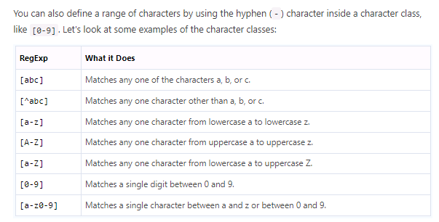

Slide 11
The following example will show you how to find whether a pattern exists within a string or not using the regular expression with the JavaScript test() method:
Example
var regex = /ca[kf]e/;
var str = "He was eating cake in the cafe.";
// Test the string against the regular expression if(regex.test(str))
{
alert("Match found!");
}
Else
{
alert("Match not found.");
}
Further, you can add the global flag g to a regular expression to find all matches in a string:
Example
var regex = /ca[kf]e/g;
var str = "He was eating cake in the cafe.";
var matches = str.match(regex);
alert(matches.length); // Outputs: 2

Slide 12
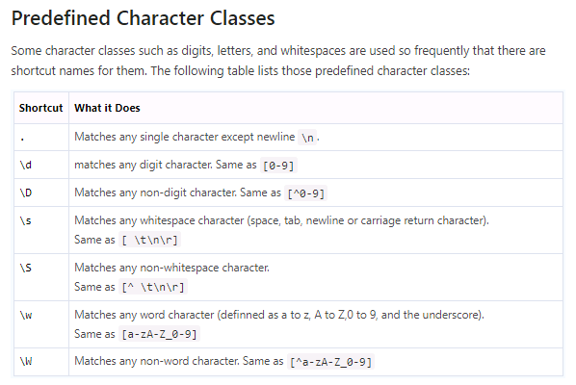

Slide 13
The following example will show you how to find and replace space with a hyphen character in a string using regular expression with the JavaScript replace() method:
Example
var regex = /\s/g;
var replacement = "-";
var str = "Earth revolves around\nthe\tSun";
// Replace spaces, newlines and tabs document.write(str.replace(regex, replacement) + "<hr>");
// Replace only spaces
document.write(str.replace(/ /g, "-"));

Slide 14
Repetition Quantifiers
In the previous section we've learnt how to match a single character in a variety of fashions.
But what if you want to match on more than one character? For example, let's say you want to find out words containing one or more instances of the letter p, or words containing at least two p's, and so on.
This is where quantifiers come into play. With quantifiers you can specify how many times a character in a regular expression should match.
Quantifiers can be applied to the individual characters, as well as classes of characters, and groups of characters contained by the parentheses.

Slide 15
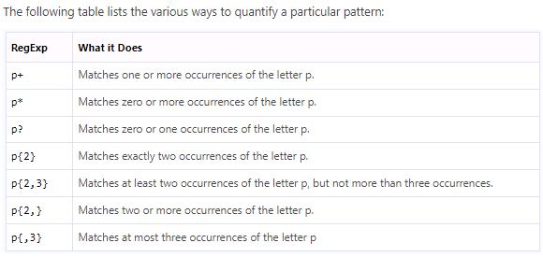
Repetition Quantifiers

Slide 16
Repetition Quantifiers
The regular expression in the following example will splits the string at comma, sequence of commas, whitespace, or combination thereof using the JavaScript split() method:
Example
var regex = /[\s,]+/;
var str = "My favourite colors are red, green and blue";
var parts = str.split(regex); // Loop through parts array and display substrings
for(var part of parts)
{
document.write("<p>" + part + "</p>");
}

Slide 17
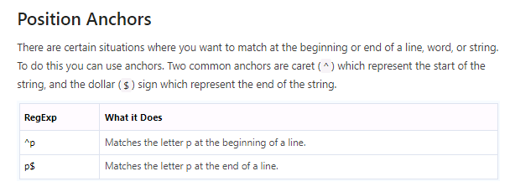

Slide 18
The regular expression in the following example will match only those names in the names array which start with the letter "J" using the JavaScript test() function:
Example
var regex = /^J/;
var names = ["James Bond", "Clark Kent", "John Rambo"]; // Loop through names array and display matched names for(var name of names)
{
if(regex.test(name))
{
document.write("<p>" + name + "</p>")
}
}

Slide 19
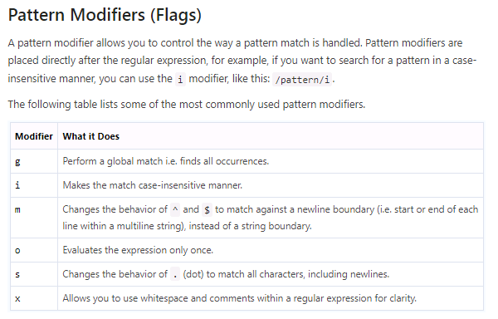

Slide 20
The following example will show you how to use the g and i modifiers in a regular expression to perform a global and case-insensitive search with the JavaScript match() method.
Example
var regex = /color/gi;
var str = "Color red is more visible than color blue in daylight."; var matches = str.match(regex); // global, case-insensitive match console.log(matches); // expected output: ["Color", "color"]
Similarly, the following example shows how to match at the beginning of every line in a multi-line string using the ^ anchor and m modifier with the JavaScript match() method.
Example
var regex = /^color/gim;
var str = "Color red is more visible than \ncolor blue in daylight.";
var matches = str.match(regex); // global, case-insensitive, multiline match
console.log(matches); // expected output: ["Color", "color"]

Slide 21
Alternation
Alternation allows you to specify alternative version of a pattern. Alternation in a regular expression works just like the OR operator in an if-else conditional statement.
You can specify alternation using a vertical bar (|). For example, the regexp /fox|dog|cat/ matches the string "fox", or the string "dog", or the string "cat". Here's an example:
Example
var regex = /fox|dog|cat/;
var str = "The quick brown fox jumps over the lazy dog."; var matches = str.match(regex);
console.log(matches); // expected output: ["fox", index: 16, ...]
Note: Alternatives are evaluated from left to right until a match is found. If the left alternative matches, the right alternative is ignored completely even if it has a match.

Slide 22
Grouping
Regular expressions use parentheses to group subexpressions, just like mathematical expressions. Parentheses allow a repetition quantifier to be applied to an entire subexpression.
For example, in regexp /go+/ the quantifier + is applied only to the last character o and it matches the strings "go", "goo", and so on. Whereas, in regexp /(go)+/ the quantifier + is applied to the group of characters g and o and it matches the strings "go", "gogo", and so on.
Example
var regex = /(go)+/i;
var str = "One day Gogo will go to school.";
var matches = str.match(regex); // case-insensitive match console.log(matches); // expected output: ["Gogo", "go", index: 8, ...]

Slide 23
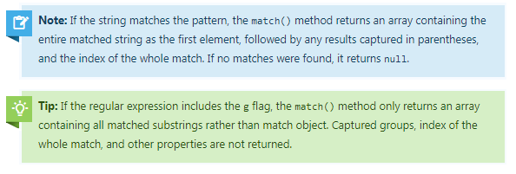

Slide 24
Word Boundaries
A word boundary character ( \b) helps you search for the words that begins and/or ends with a pattern.
For example, the regexp /\bcar/ matches the words beginning with the pattern car, and would match cart, carrot, or cartoon, but would not match oscar.
Similarly, the regexp /car\b/ matches the words ending with the pattern car, and would match oscar or supercar, but would not match cart.
Likewise, the /\bcar\b/ matches the words beginning and ending with the pattern car, and would match only the word car.
The following example will highlight the words beginning with car in bold:
Example
var regex = /(\bcar\w*)/g;
str = "Words begining with car: cart, carrot, cartoon. Words ending with car: oscar, supercar.";
var replacement = '<b>$1</b>';
var result = str.replace(regex, replacement); document.write(result);

Slide 25
The let Keyword
ES6 introduces the new let keyword for declaring variables.
Prior to ES6, the only way to declare a variable in JavaScript was the var keyword.
Let's see what's the difference between them is.
There are two critical differences between the var and let.
Variables declared with the var keyword are function-scoped and hoisted at the top within its scope,

Slide 26
The let Keyword
whereas variables declared with let keyword are block-scoped ({}) and they are not hoisted.
Block scoping simply means that a new scope is created between a pair of curly brackets i.e. {}.
Therefore, if you declare a variable with the let keyword inside a loop, it does not exist outside of the loop, as demonstrated in the
Example
// ES6 syntax
for(let i = 0; i < 5; i++) {
console.log(i); // 0,1,2,3,4
}
console.log(i); // undefined
// ES5 syntax
for(var i = 0; i < 5; i++) {
console.log(i); // 0,1,2,3,4
}
console.log(i); // 5
As you can see in the above example the variable i in the first block is not accessible outside the for loop.
This also enables us to reuse the same variable name multiple times as its scope is limited to the block ({}), which results in less variable declaration and more cleaner code.

Slide 27
The const Keyword
The new const keyword makes it possible to define constants. Constants are read-only, you cannot reassign new values to them. They are also block-scoped like let.
Example
const PI = 3.14;
console.log(PI); // 3.14
PI = 10; // error
However, you can still change object properties or array elements:

Slide 28
Example
// Changing object property value
const PERSON = {name: "Peter", age: 28};
console.log(PERSON.age); // 28
PERSON.age = 30;
console.log(PERSON.age); // 30
// Changing array element
const COLORS = ["red", "green", "blue"];
console.log(COLORS[0]); // red
COLORS[0] = "yellow";
console.log(COLORS[0]); // yellow

Slide 29
The for...of Loop
The new for...of loop allows us to iterate over arrays or other iterable objects very easily. Also, the code inside the loop is executed for each element of the iterable object. Here's an example:
Example
// Iterating over array
let letters = ["a", "b", "c", "d", "e", "f"];
for(let letter of letters) {
console.log(letter); // a,b,c,d,e,f
}
// Iterating over string
let greet = "Hello World!";
for(let character of greet) {
console.log(character); // H,e,l,l,o, ,W,o,r,l,d,!
}
The for...of loop doesn't work with objects because they are not iterable. If you want to iterate over the properties of an object you can use the for-in loop.

Slide 30
Arrow Functions
Arrow Functions are another interesting feature in ES6. It provides a more concise syntax for writing function expressions by opting out the function and return keywords.
Arrow functions are defined using a new syntax, the fat arrow (=>) notation.
Example
// Function Expression
var sum = function(a, b) {
return a + b;
}
console.log(sum(2, 3)); // 5
// Arrow function
var sum = (a, b) => a + b;
console.log(sum(2, 3)); // 5

Slide 31
As you can see there is no function and return keyword in arrow function declaration.
You can also skip the parentheses i.e. () in case when there is exactly one parameter, but you will always need to use it when you have zero or more than one parameter.
Additionally, if there's more than one expression in the function body, you need to wrap it braces ({}). In this case you also need to use the return statement to return a value.
There are several variations of how you can write arrow functions. Here are the most commonly used:

Slide 32
Example
Try this code »
// Single parameter, single statement
var greet = name => alert("Hi " + name + "!");
greet("Peter"); // Hi Peter!
// Multiple arguments, single statement
var multiply = (x, y) => x * y;
alert(multiply(2, 3)); // 6
// Single parameter, multiple statements
var test = age => {
if(age > 18) {
alert("Adult");
} else {
alert("Teenager");
}
}
test(21); // Adult
// Multiple parameters, multiple statements
var divide = (x, y) => {
if(y != 0) {
return x / y;
}
}
alert(divide(10, 2)); // 5
// No parameter, single statement
var hello = () => alert('Hello World!');
hello(); // Hello World!
There is an important difference between regular functions and arrow functions.
Unlike a normal function, an arrow function does not have its own this, it takes this from the outer function where it is defined.
In JavaScript, this is the current execution context of a function.

Slide 33
To understand this clearly, let's check out the following examples:
Example
function Person(nickname, country) {
this.nickname = nickname;
this.country = country;
this.getInfo = function() {
// Outer function context (Person object)
return function() {
// Inner function context (Global object 'Window')
alert(this.constructor.name); // Window
alert("Hi, I'm " + this.nickname + " from " + this.country);
};
}
}
var p = new Person('Rick', 'Argentina');
var printInfo = p.getInfo();
printInfo(); // Hi, I'm undefined from undefined

Slide 34
Rewriting the same example using ES6 template literals and arrow function:
Example
function Person(nickname, country) {
this.nickname = nickname;
this.country = country;
this.getInfo = function() {
// Outer function context (Person object)
return () => {
// Inner function context (Person object)
alert(this.constructor.name); // Person
alert(`Hi, I'm ${this.nickname} from ${this.country}`);
};
}
}
let p = new Person('Rick', 'Argentina');
let printInfo = p.getInfo();
printInfo(); // Hi, I'm Rick from Argentina

Slide 35
As you can clearly see, the this keyword in the above example refers to the context of the function enclosing the arrow function which is Person object (line no-9), unlike the previous example where it referred to the global object Window (line no-9).

Slide 36
The Rest Parameters
ES6 introduces rest parameters that allow us to pass an arbitrary number of parameters to a function in the form of an array.
This is particularly helpful in situations when you want to pass parameters to a function but you have no idea how many you will need.
A rest parameter is specified by prefixing a named parameter with rest operator (...) i.e. three dots.
Rest parameter can only be the last one in the list of parameters, and there can only be one rest parameter.
Take a look at the following example, to see how it works:
Example
function sortNames(...names) {
return names.sort();
}

Slide 37
The Rest Parameters
alert(sortNames("Sarah", "Harry", "Peter")); // Harry,Peter,Sarah
alert(sortNames("Tony", "Ben", "Rick", "Jos")); // John,Jos,Rick,Tony
When the rest parameter is the only parameter in a function, it gets all the arguments passed to the function, otherwise it gets the rest of the arguments that exceeds the number of named parameters.
Example
function myFunction(a, b, ...args) {
return args;
}
alert(myFunction(1, 2, 3, 4, 5)); // 3,4,5
alert(myFunction(-7, 5, 0, -2, 4.5, 1, 3)); // 0,-2,4.5,1,3
Note: Don't confuse the term rest parameters with the REST (REpresentational State Transfer).
This has nothing to do with RESTful web services.

Slide 38
The Spread Operator
The spread operator, which is also denoted by (...), performs the exact opposite function of the rest operator.
The spread operator spreads out (i.e. splits up) an array and passes the values into the specified function, as shown in the following example:
Example
Try this code »
function addNumbers(a, b, c) {
return a + b + c;
}
let numbers = [5, 12, 8];
// ES5 way of passing array as an argument of a function
alert(addNumbers.apply(null, numbers)); // 25
// ES6 spread operator
alert(addNumbers(...numbers)); // 25

Slide 39
The Spread Operator
The spread operator can also be used to insert the elements of an array into another array without using the array methods like push(), unshift() concat(), etc.
Example
let pets = ["Cat", "Dog", "Parrot"];
let bugs = ["Ant", "Bee"];
// Creating an array by inserting elements from other arrays
let animals = [...pets, "Tiger", "Wolf", "Zebra", ...bugs];
alert(animals); // Cat,Dog,Parrot,Tiger,Wolf,Zebra,Ant,Bee

Slide 40
Destructuring Assignment
The destructuring assignment is an expression that makes it easy to extract values from arrays, or properties from objects, into distinct variables by providing a shorter syntax.
There are two kinds of destructuring assignment expressions—the array and object destructuring assignment.
The array destructuring assignment
Prior to ES6, to get an individual value of an array we need to write something like this:

Slide 41
Example
// ES5 syntax
var fruits = ["Apple", "Banana"];
var a = fruits[0];
var b = fruits[1];
alert(a); // Apple
alert(b); // Banana
In ES6, we can do the same thing in just one line using the array destructuring assignment:
Example
// ES6 syntax
let fruits = ["Apple", "Banana"];
let [a, b] = fruits; // Array destructuring assignment
alert(a); // Apple
alert(b); // Banana

Slide 42
Example
// ES6 syntax
let fruits = ["Apple", "Banana", "Mango"];
let [a, ...r] = fruits;
alert(a); // Apple
alert(r); // Banana,Mango
alert(Array.isArray(r)); // true

Slide 43
The object destructuring assignment
In ES5 to extract the property values of an object we need to write something like this:
Example
// ES5 syntax
var person = {name: "Peter", age: 28};
var name = person.name;
var age = person.age;
alert(name); // Peter
alert(age); // 28

Slide 44
The object destructuring assignment
But in ES6, you can extract object's property values and assign them to the variables easily like this:
Example
// ES6 syntax
let person = {name: "Peter", age: 28};
let {name, age} = person; // Object destructuring assignment
alert(name); // Peter
alert(age); // 28
Most of the features we've discussed above are supported in the latest version of the major web browsers such as Google Chrome, Mozilla Firefox, Microsoft Edge, Safari, etc.
Alternatively, you can use the online transpilers (source-to-source compilers) like Babel free of cost to transpile your current ES6 code to ES5 for better browser compatibility without leaving out the benefits of enhanced syntax and capabilities of ES6.

Slide 45
What is JSON
JSON stands for JavaScript Object Notation.
JSON is extremely lightweight data-interchange format for data exchange between server and client which is quick and easy to parse and generate.
Like XML, JSON is also a text-based format that's easy to write and easy to understand for both humans and computers, but unlike XML, JSON data structures occupy less bandwidth than their XML versions

Slide 46
What is JSON
JSON is based on two basic structures:
Object: This is defined as an unordered collection of key/value pairs (i.e. key:value).
Each object begins with a left curly bracket { and ends with a right curly bracket }.
Multiple key/value pairs are separated by a comma ,.
Array: This is defined as an ordered list of values.
An array begins with a left bracket [ and ends with a right bracket ].
Values are separated by a comma ,.
In JSON, property names or keys are always strings, while the value can be a string, number, true or false, null or even an object or an array.
Strings must be enclosed in double quotes " and can contain escape characters such as \n, \t and \. A JSON object may look like this:

Slide 47
Example
{
"book": {
"name": "Harry Potter and the Goblet of Fire",
"author": "J. K. Rowling",
"year": 2000,
"genre": "Fantasy Fiction",
"bestseller": true
}
}
Whereas an example of JSON array would look something like this:
Example
{
"fruits": [
"Apple",
"Banana",
"Strawberry",
"Mango"
]
}
Tip: A data-interchange format is a text format which is used to interchange or exchange data between different platforms and operating systems. JSON is the most popular and lightweight data-interchange format for web applications.

Slide 48
Parsing JSON Data in JavaScript
In JavaScript, you can easily parse JSON data received from the web server using the JSON.parse() method.
This method parses a JSON string and constructs the JavaScript value or object described by the string.
If the given string is not valid JSON, you will get a syntax error.
Let's suppose we've received the following JSON-encoded string from a web server:
Example
{"name": "Peter", "age": 22, "country": "United States"}
Now, we can simply use the JavaScript JSON.parse() method to convert this JSON string into a JavaScript object and access individual values using the dot notation (.), like this:

Slide 49
Parsing JSON Data in JavaScript
Example
// Store JSON data in a JS variable
var json = '{"name": "Peter", "age": 22, "country": "United States"}';
// Converting JSON-encoded string to JS object
var obj = JSON.parse(json);
// Accessing individual value from JS object
alert(obj.name); // Outputs: Peter
alert(obj.age); // Outputs: 22
alert(obj.country); // Outputs: United State
Please check out the tutorial on PHP JSON parsing to learn, how to return JSON data from a web server in response, as well as, how to encode/decode JSON data on server side using PHP.

Slide 50
Parsing Nested JSON Data in JavaScript
JSON objects and arrays can also be nested.
A JSON object can arbitrarily contains other JSON objects, arrays, nested arrays, arrays of JSON objects, and so on.
The following example will show you how to parse a nested JSON object and extract all the values in JavaScript.
Example
/* Storing multi-line JSON string in a JS variable
using the new ES6 template literals */
var json = `{
"book": {
"name": "Harry Potter and the Goblet of Fire",
"author": "J. K. Rowling",
"year": 2000,
"characters": ["Harry Potter", "Hermione Granger", "Ron Weasley"],
"genre": "Fantasy Fiction",
"price": {
"paperback": "$10.40", "hardcover": "$20.32", "kindle": "$4.11"
}
}
}`;

Slide 51
// Converting JSON object to JS object
var obj = JSON.parse(json);
// Define recursive function to print nested values
function printValues(obj) {
for(var k in obj) {
if(obj[k] instanceof Object) {
printValues(obj[k]);
} else {
document.write(obj[k] + "<br>");
};
}
};
// Printing all the values from the resulting object
printValues(obj);
document.write("<hr>");
// Printing a single value
document.write(obj["book"]["author"] + "<br>"); // Prints: J. K. Rowling
document.write(obj["book"]["characters"][0] + "<br>"); // Prints: Harry Potter
document.write(obj["book"]["price"]["hardcover"]); // Prints: $20.32

Slide 52
Encoding Data as JSON in JavaScript
Sometimes JavaScript object or value from your code need to be transferred to the server during an Ajax communication.
JavaScript provides JSON.stringify() method for this purpose which converts a JavaScript value to a JSON string, as shown below:

Slide 53
Stringify a JavaScript Object
The following example will show you how to convert a JavaScript object to JSON string:
Example
// Sample JS object
var obj = {"name": "Peter", "age": 22, "country": "United States"};
// Converting JS object to JSON string
var json = JSON.stringify(obj);
alert(json);
The output of the above example will look something like this:
{"name":"Peter","age":22,"country":"United States"}
Note: Although, JavaScript and JSON objects look quite similar, but they are not exactly the same. For example, in JavaScript, object property names can be enclosed in single quotes ('...') or double quotes ("..."), or you can omit the quotes altogether. But, in JSON, all property names must be enclosed in double quotes.

Slide 54
Stringify a JavaScript Array
Similarly, you can convert the JavaScript arrays to JSON strings, like this:
Example
// Sample JS array
var arr = ["Apple", "Banana", "Mango", "Orange", "Papaya"];
// Converting JS array to JSON string
var json = JSON.stringify(arr);
alert(json);
The output of the above example will look something like this:
["Apple","Banana","Mango","Orange","Papaya"]
Warning: Do not use eval() function to evaluate JSON data (e.g., including function definitions in JSON string and converting them back into executable functions with eval() method), as it allows attacker to inject malicious JavaScript code into your application.

Slide 55



Thank You

