Slide 1


Welcome you all
JavaScript String
D.Sakthivel
Assistant Professor & Trainer,
KG Micro College
KGiSL Campus, Coimbatore – 641 035.

Slide 2
String Funcions

Slide 3
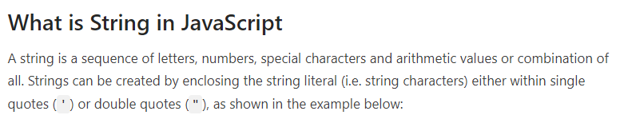
var myString = 'Hello World!'; // Single quoted string var myString = "Hello World!"; // Double quoted string
You can use quotes inside a string, as long as they don't match the quotes surrounding the string:
var str1 = "it's okay";
var str2 = 'He said "Goodbye"';
var str3 = "She replied 'Calm down, please'";
var str4 = 'Hi, there!"; // Syntax error - quotes must match

Slide 4
var str1 = 'it\'s okay';
var str2 = "He said \"Goodbye\"";
var str3 = 'She replied \'Calm down, please\'';

Slide 5
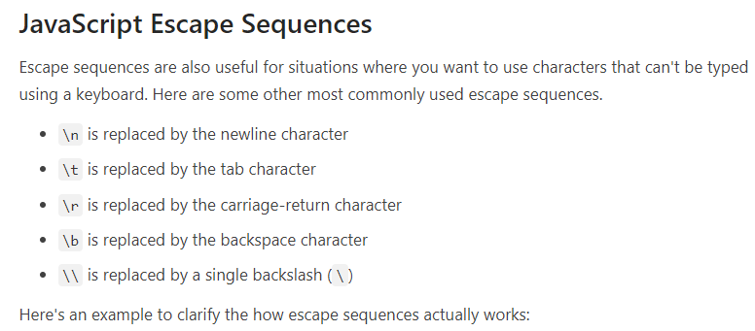
var str1 = "The quick brown fox \n jumps over the lazy dog.";
document.write("<pre>" + str1 + "</pre>"); // Create line break
var str2 = "C:\Users\Downloads";
document.write(str2); // Prints C:UsersDownloads
var str3 = "C:\\Users\\Downloads";
document.write(str3); // Prints C:\Users\Downloads

Slide 6
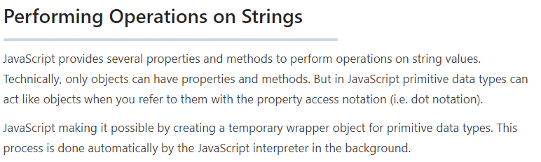
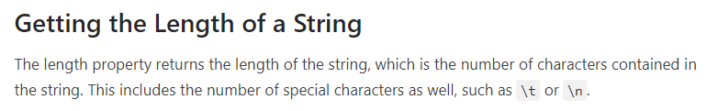

var str1 = "This is a paragraph of text.";
document.write(str1.length); // Prints 28
var str2 = "This is a \n paragraph of text.";
document.write(str2.length); // Prints 30, because \n is only one character

Slide 7
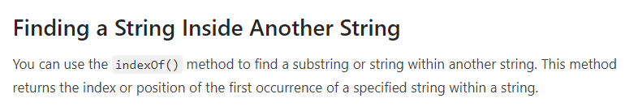
var str = "If the facts don't fit the theory, change the facts.";
var pos = str.indexOf("facts");
alert(pos); // 0utputs: 7
var str = "If the facts don't fit the theory, change the facts.";
var pos = str.lastIndexOf("facts");
alert(pos); // 0utputs: 46

Slide 8


var str = "If the facts don't fit the theory, change the facts.";
// Searching forwards
var pos1 = str.indexOf("facts", 20);
alert(pos1); // 0utputs: 46
// Searching backwards
var pos2 = str.lastIndexOf("facts", 20);
alert(pos2); // 0utputs: 7

Slide 9
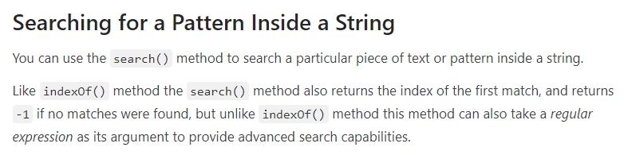

var str = "Color red looks brighter than color blue.";
// Case sensitive search
var pos1 = str.search("color");
alert(pos1); // 0utputs: 30
// Case insensitive search using regexp
var pos2 = str.search(/color/i);
alert(pos2); // 0utputs: 0

Slide 10
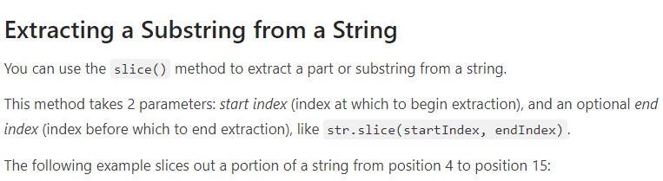
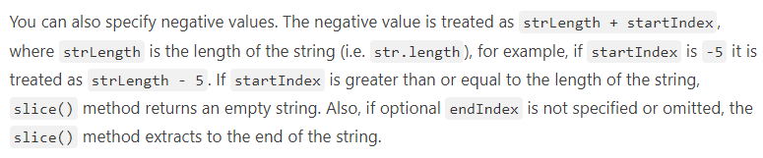
var str = "The quick brown fox jumps over the lazy dog."; var subStr = str.slice(4, 15);
document.write(subStr); // Prints: quick brown

Slide 11
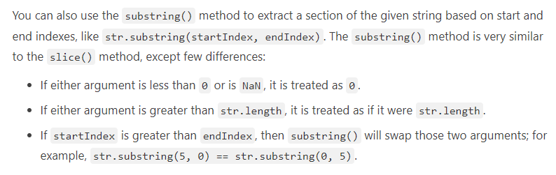
var str = "The quick brown fox jumps over the lazy dog."; document.write(str.slice(-28, -19)); // Prints: fox jumps document.write(str.slice(31)); // Prints: the lazy dog.

Slide 12
var str = "The quick brown fox jumps over the lazy dog."; document.write(str.substring(4, 15)); // Prints: quick brown document.write(str.substring(9, 0)); // Prints: The quick document.write(str.substring(-28, -19)); // Prints nothing document.write(str.substring(31)); // Prints: the lazy dog.

Slide 13
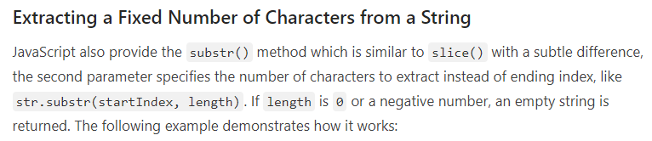
var str = "The quick brown fox jumps over the lazy dog."; document.write(str.substr(4, 15)); // Prints: quick brown fox document.write(str.substr(-28, -19)); // Prints nothing document.write(str.substr(-28, 9)); // Prints: fox jumps document.write(str.substr(31)); // Prints: the lazy dog.

Slide 14
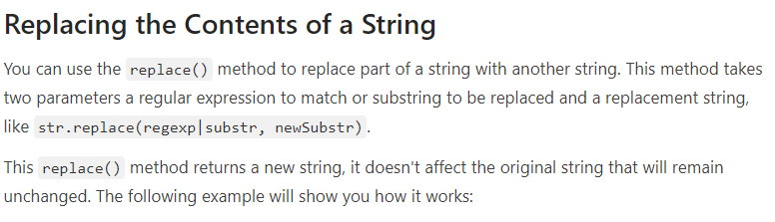
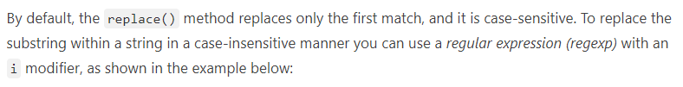
var str = "Color red looks brighter than color blue.";
var result = str.replace("color", "paint");
alert(result); // 0utputs: Color red looks brighter than paint blue.
var str = "Color red looks brighter than color blue.";
var result = str.replace(/color/i, "paint");
alert(result); // 0utputs: paint red looks brighter than color blue.

Slide 15
var str = "Color red looks brighter than color blue.";
var result = str.replace(/color/ig, "paint");
alert(result); // 0utputs: paint red looks brighter than paint blue.

Slide 16

var str = "Hello World!";
var result = str.toUpperCase();
document.write(result); // Prints: HELLO WORLD!
var str = "Hello World!";
var result = str.toLowerCase();
document.write(result); // Prints: hello world!

Slide 17

var hello = "Hello";
var world = "World";
var greet = hello + " " + world;
document.write(greet); // Prints: Hello World
var wish = "Happy";
wish += " New Year";
document.write(wish); // Prints: Happy New Year

Slide 18
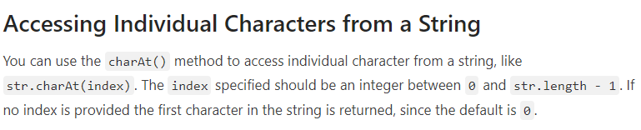
var str = "Hello World!";
document.write(str.charAt()); // Prints: H document.write(str.charAt(6)); // Prints: W document.write(str.charAt(30)); // Prints nothing document.write(str.charAt(str.length - 1)); // Prints: !

Slide 19

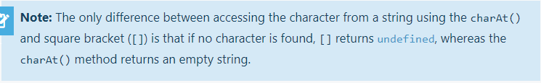
var str = "Hello World!";
document.write(str[0]); // Prints: H document.write(str[6]); // Prints: W document.write(str[str.length - 1]); // Prints: ! document.write(str[30]); // Prints: undefined

Slide 20
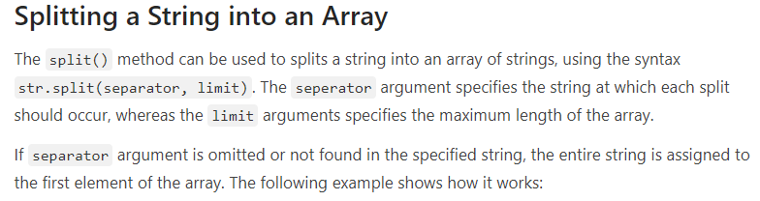
var fruitsStr = "Apple, Banana, Mango, Orange, Papaya";
var fruitsArr = fruitsStr.split(", ");
document.write(fruitsArr[0]); // Prints: Apple document.write(fruitsArr[2]); // Prints: Mango document.write(fruitsArr[fruitsArr.length - 1]); // Prints: Papaya
// Loop through all the elements of the fruits array
for(var i in fruitsArr)
{
document.write("<p>" + fruitsArr[i] + "</p>");
}

Slide 21
var str = "INTERSTELLAR";
var strArr = str.split("");
document.write(strArr[0]); // Prints: I
document.write(strArr[1]); // Prints: N document.write(strArr[strArr.length - 1]); // Prints: R
// Loop through all the elements of the characters array and print them
for(var i in strArr)
{
document.write("<br>" + strArr[i]);
}

Slide 22

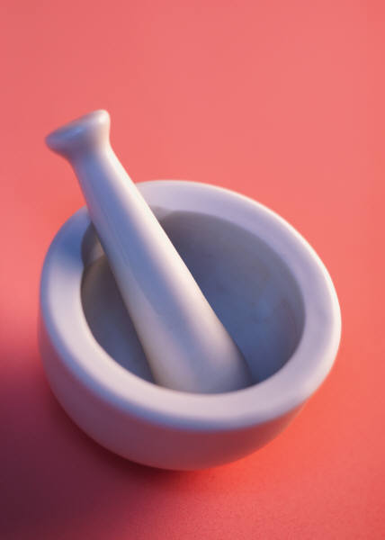
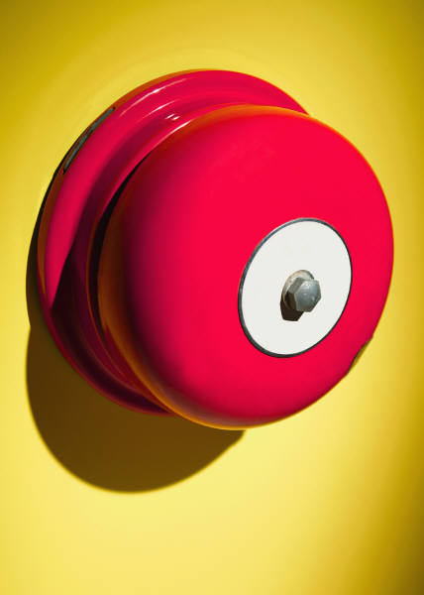
Thank You

