Slide 1

Agenda
DOM-Introduction
Structure of DOM
Methods
Events
EventListener

Slide 2

Introduction
DOM – Document Object Model
JS can access and change all the elements of an HTML document.
When web page is loaded, the browser creates a DOM of the page
The HTML DOM model is constructed as tree of “Objects”.
The root elements that represents the HTML document.
DOM has properties and methods.
Help of the document object, we can create dynamic content to our page.
DOM can access the program and scripts to dynamically access and update the contents, structure and styles of documents.
It is object of “window”, Ex: window.document

Slide 3
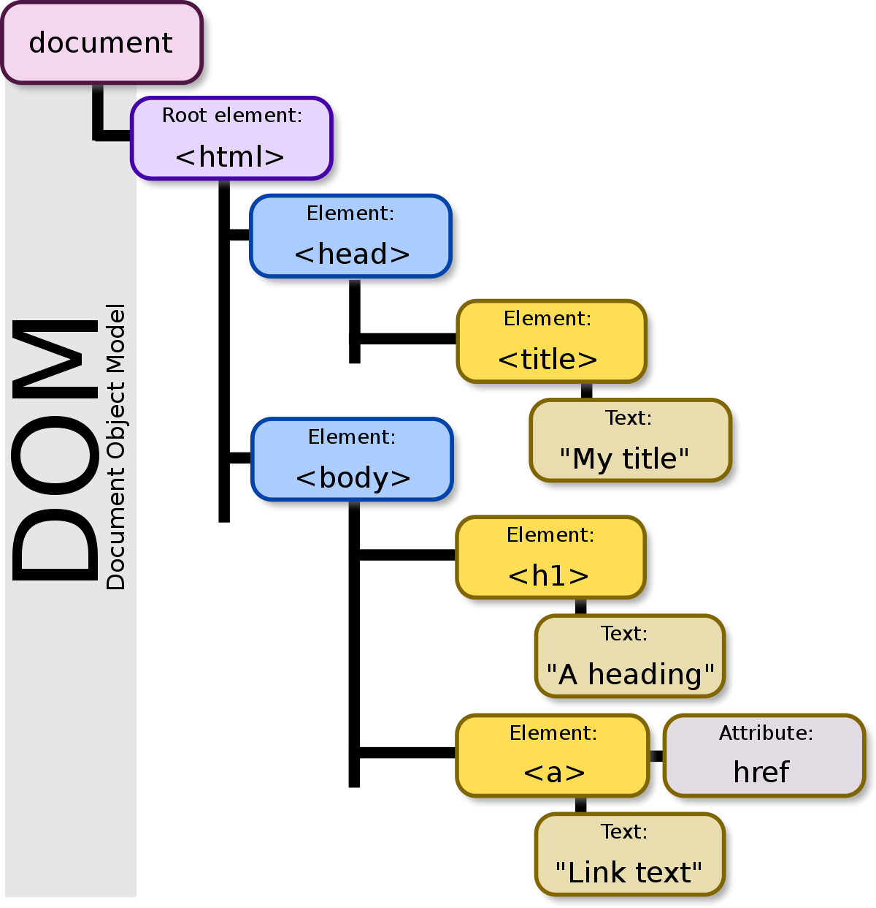
Structure of DOM

Slide 4
Dom-methods

Slide 5
Methods of DOM
We can access and change the content of document by its methods
Method is action you can do (like add or deleting an HTML elements)
write(“string”)
writeIn(“string”)
getElementById()
getElementByName()
getElementByTagName()
getElementByClassName()

Slide 6
Write and writeln Method
Write(“string”)
Write some text directly to the HTML
Ex: document.write(“write method”);
Writeln(“string”)
Write some text directly to the HTML, with addition of writing a newline character
Ex: document.writeln(“writeln method”);

Slide 7
Document.getElementById Method
document.getElementById() method returns the elements of specified id
We can get the value of input text. But we need to define id for input field
<script type="text/javascript">
function getcube(){
var number=document.getElementById("number").value;
alert(number*number*number);
}
</script>
<form>
Enter No:<input type="text" id="number" name="number"/><br/>
<input type="button" value="cube" onclick="getcube()"/>
</form>

Slide 8
Document.getElementByName Method
document.getElementByName() method returns collections of elements of specified name
This method return live NodeList
<script type="text/javascript">
function totalelements()
{
var allgenders=document.getElementsByName("gender");
alert("Total Genders:"+allgenders.length);
}
</script>
<form>
Male:<input type="radio" name="gender" value="male">
Female:<input type="radio" name="gender" value="female">
<input type="button" onclick="totalelements()" value="Total Genders">
</form>

Slide 9
Document.getElementByTagName
document.getElementByTagName() method returns collections of elements of specified tag name
This method return HTMLCollection
<script type="text/javascript">
function countpara(){
var totalpara=document.getElementsByTagName("p");
alert("total p tags are: "+totalpara.length);
}
</script>
<p>Here we are going to count total number of paragraphs by getElementByTagName() method.</p>
<p>This is a pragraph</p>
<p>Let's see the simple example</p>
<button onclick="countpara()">count paragraph</button>

Slide 10
Document.getElementByClassName
document.getElementByTagName() method returns collections of elements of specified class name
This method return HTMLCollection
This property is read-only
<script type="text/javascript">
function UseClassName(){
const collection = document.getElementsByClassName("example");
collection[1].innerHTML = "Hello World!";
}
</script>
<div class="example">Element1</div>
<div class="example">Element2</div>
<button onclick=“UseClassName()"> UseClassName </button>

Slide 11
innerHTML Property
This property used to write dynamic HTML on the HTML document
This property sets or returns the HTML content of an elements
<script type="text/javascript" >
function showcommentform() {
var data="Name:<input type='text' name='name'><br>Comment:<br><textarea rows='5' cols='80'></textarea>
<br><input type='submit' value='Post Comment'>";
document.getElementById('mylocation').innerHTML=data;
}
</script>
<form name="myForm">
<input type="button" value="comment" onclick="showcommentform()">
<div id="mylocation"></div>
</form>

Slide 12
innerText Property
The innerText property can be used to write the dynamic text on the html document.
It is used mostly in the web pages to generate the dynamic content such as writing the validation message, password strength etc.
<script type="text/javascript" >
function validate() {
var msg;
if(document.myForm.userPass.value.length>5){
msg="good";
}
else{
msg="poor";
}
document.getElementById('mylocation').innerText=msg;
}
</script>
<form name="myForm">
<input type="password" value="" name="userPass" onkeyup="validate()">
Strength:<span id="mylocation">no strength</span>
</form>

Slide 13
Dom-events

Slide 14
DOM-EVENTS
onclick
ondblclick
onfocus
onblur
onsubmit
onmouseover
onmouseout
onmousedown
onmouseup
onload
onunload
onscroll
onresized
onreset
onkeydown
onkeypress
onkeyup

Slide 15
onclick Event
When user click the button then we can call the function by using onclick event
<button onclick=“add()”>add</button>
We can assign an onclick event to button element
Document.getElementById(“addId”).onclick = add

Slide 16
onchange Event
onchange event is often used in combination with validation of inputs fields
<h2>JavaScript HTML Events</h2>
Enter your name: <input type="text" id="fname" onchange="upperCase()">
<p>When you leave the input field, a function is triggered which transforms the input text to upper case.</p>
<script>
function upperCase() {
const x = document.getElementById("fname");
x.value = x.value.toUpperCase();
}
</script>

Slide 17
onmouseover and onmouseout Event
Event can be used to trigger a function when user mouse over or out of , an HTML elemnt
<div onmouseover="mOver(this)" onmouseout="mOut(this)"
style="background-color:#D94A38;width:120px;height:20px;padding:40px;">
Mouse Over Me</div>
<script>
function mOver(obj) {
obj.innerHTML = "Thank You"
}
function mOut(obj) {
obj.innerHTML = "Mouse Over Me"
}
</script>

Slide 18
Dom-eventlistener

Slide 19
DOM-EventListener
addEventListener() method attaches an events handler to specified element.
Syntax: element.addEventListener(event, function, useCapture)
<button id="myBtn">Try it</button>
<p id="demo"></p>
<script>
document.getElementById("myBtn").addEventListener("click", displayDate);
function displayDate() {
document.getElementById("demo").innerHTML = Date();
}
</script>

Slide 20
DOM-EventListener
<p>This example uses the addEventListener() method to attach a click event to a button.</p>
<button id="myBtn">Try it</button>
<script>
document.getElementById("myBtn").addEventListener("click", function() {
alert("Hello World!");
});
</script>

Slide 21
DOM-EventListener
<p>This example uses the addEventListener() method to add two click events to the same button.</p>
<button id="myBtn">Try it</button>
<script>
var x = document.getElementById("myBtn");
x.addEventListener("click", myFunction);
x.addEventListener("click", someOtherFunction);
function myFunction() {
alert ("Hello World!");
}
function someOtherFunction() {
alert ("This function was also executed!");
}

Slide 22
DOM-EventListener
<button id="myBtn">Try it</button>
<p id="demo"></p>
<script>
var x = document.getElementById("myBtn");
x.addEventListener("mouseover", myFunction);
x.addEventListener("click", mySecondFunction);
x.addEventListener("mouseout", myThirdFunction);
function myFunction() {
document.getElementById("demo").innerHTML += "Moused over!<br>";
}
function mySecondFunction() {
document.getElementById("demo").innerHTML += "Clicked!<br>";
}
function myThirdFunction() {
document.getElementById("demo").innerHTML += "Moused out!<br>";
}
</script>

Slide 23
DOM-EventListener
<p>This example uses the addEventListener() method on the window object.</p>
<p>Try resizing this browser window to trigger the "resize" event handler.</p>
<p id="demo"></p>
<script>
window.addEventListener("resize", function(){
document.getElementById("demo").innerHTML = Math.random();
});
</script>

Slide 24
DOM-removeEventListener
<div id="myDIV">
<p>This div element has an onmousemove event handler that displays a random number every time you move your mouse inside this orange field.</p>
<p>Click the button to remove the div's event handler.</p>
<button onclick="removeHandler()" id="myBtn">Remove</button>
</div>
<p id="demo"></p>
<script>
document.getElementById("myDIV").addEventListener("mousemove", myFunction);
function myFunction() {
document.getElementById("demo").innerHTML = Math.random();
}
function removeHandler() {
document.getElementById("myDIV").removeEventListener("mousemove", myFunction);
}
</script>

