Slide 1
STAR-RIS for 6G Vehicular Networks
SAC-Based Joint Beamforming and Phase Shift Design
Presented by: Chakresh Puchi
Advisor: Anal Paul
Department of Computer Science and Engineering
Yuan Ze University, Taiwan

Slide 2
Introduction and Motivation
6G vehicular networks need very high speed and very low delay
Self-driving and connected cars need gigabit-class links even at high speed
Reconfigurable Intelligent Surface (RIS) is a smart panel that improves signal without extra power-hungry hardware
Main limit of a normal RIS:
It can send the signal to only one side of the road
Cars on the other side get almost no signal
This is a big problem on divided highways and roads with cars on both sides
We need a surface that covers both sides, and reacts fast to moving cars
2

Slide 3
STAR-RIS Concept and Research Gaps
STAR-RIS = Simultaneously Transmitting And Reflecting RIS
Each element reflects part of the signal AND lets part pass through, at the same time
This gives full coverage to both sides of the road from one panel
Three gaps this paper addresses:
Gap 1: Past work uses one-side RIS only; we use STAR-RIS with SAC
Gap 2: Past work ignores car position and speed; we include both
Gap 3: Past work ignores real hardware behaviour; we model it (PDA)
3

Slide 4
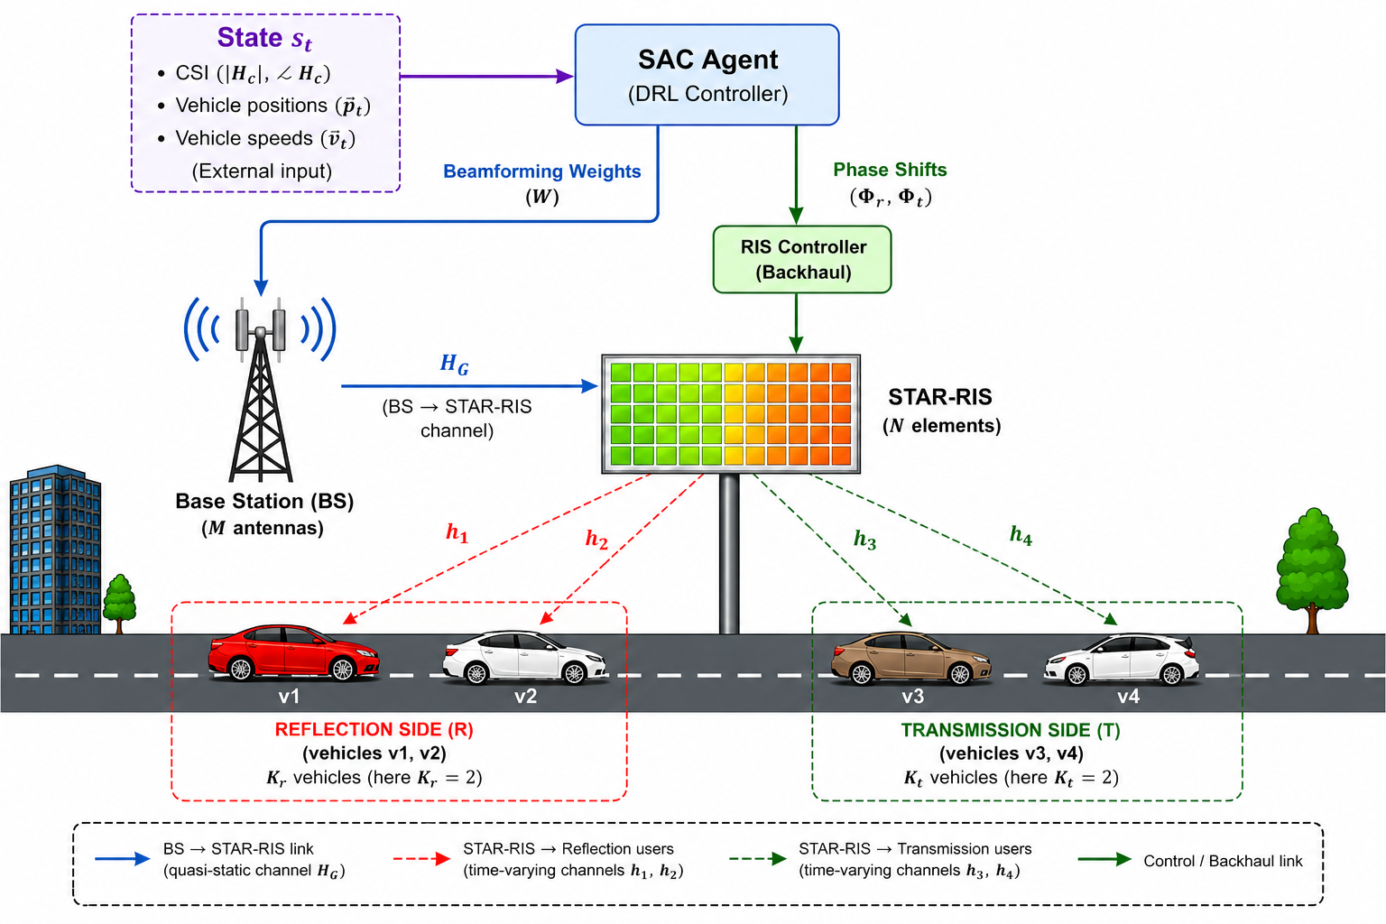
System Model
Base station (BS) with M antennas sends the signal
STAR-RIS panel with L elements sits between BS and cars
Cars split into two groups:
Reflection side — v1, v2 (near side)
Transmission side — v3, v4 (far side)
SAC agent decides beamforming (at BS) and phase shifts (at RIS)
RIS controller applies these settings continuously
4

Slide 5
Channel Model: BS to STAR-RIS Link
H_G = ( ρ · d_BR^(−β) )^(1/2) · H̃_G , H̃_G ~ CN(0, I)
What it describes:
The wireless link between the base station (BS) and the STAR-RIS panel
Key terms:
H_G = the channel itself (what we are solving for)
ρ (rho) = reference path loss at 1 metre distance (a fixed constant)
d_BR = distance between the BS and the RIS, in metres
β (beta) = path-loss exponent — controls how fast signal weakens with distance
H̃_G = random fading part; CN(0,I) means drawn from a standard random (Gaussian) distribution
How it works:
Distance term (ρ·d_BR^−β) shrinks as d_BR grows — farther means weaker
Square root converts this power-loss value into an amplitude value
Multiplying by H̃_G adds small random environmental fading on top
Why it is useful:
This channel is a basic building block used inside the SINR formula (Slide 7)
5

Slide 6
STAR-RIS Hardware Constraint
| φ_r,n |² + | φ_t,n |² ≤ 1
What it describes:
The physical power-splitting rule that every element on the STAR-RIS panel must obey
Key terms:
φ_r,n (phi r n) = reflection coefficient of element n — controls the reflected signal
φ_t,n (phi t n) = transmission coefficient of element n — controls the transmitted signal
| · |² = magnitude squared — converts each coefficient into a real power value
n = index of one element; this same rule applies to all L elements separately
≤ 1 = at most 100% of incoming power; can be less (some lost as heat) but never more
How it works:
Each element receives a fixed amount of incoming signal power
It must split that power between reflecting and transmitting — total cannot exceed 100%
Why it is useful:
Keeps the model physically realistic — prevents the SAC agent from learning an impossible, unphysical solution
6

Slide 7
Problem Formulation: Signal Quality (SINR)
γ_k^(s) =
| h_k^T Φ_s H_G w_k |²
Σ_(j≠k) | h_k^T Φ_s H_G w_j |² + σ_w²
What it describes:
How clean and strong the signal is for one specific vehicle k
Key terms:
γ_k^(s) (gamma) = SINR for vehicle k on side s (r = reflection, t = transmission)
h_k = channel from the RIS to vehicle k; H_G = channel from BS to RIS
Φ_s (capital phi) = the RIS phase-shift matrix for side s
w_k = beamforming vector aimed at vehicle k; w_j = beamforming for other vehicles j
σ_w² (sigma) = background receiver noise power
How it works:
Top = signal power that actually reaches vehicle k, the one we want
Bottom = interference leaking in from other vehicles' signals, plus noise
Why it is useful:
Higher SINR directly gives a higher data rate for that vehicle (Shannon's law)
7

Slide 8
Proposed Method: SAC Algorithm
SAC = Soft Actor-Critic, a deep reinforcement learning method
The agent has two parts:
Actor — decides the action (beamforming + phases)
Critic — judges how good that action was
Why SAC works well here:
It keeps exploring many options during training, not just one
This avoids getting stuck on a weak, one-sided solution
It reacts in a single fast step — sub-millisecond decisions
This is why SAC beats TD3 in our results (96.66 vs 91.42 bps/Hz)
8

Slide 9
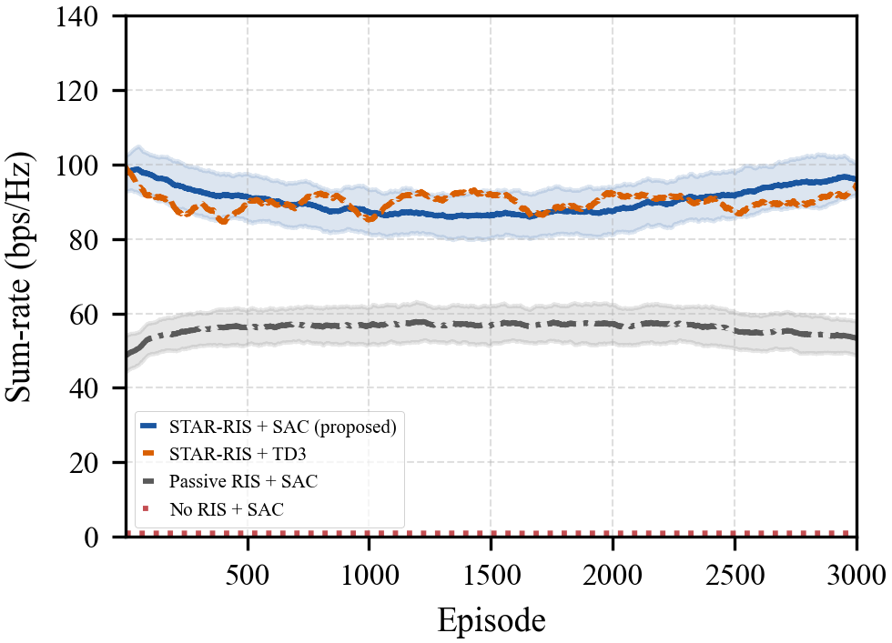
Simulation Setup and Results
Setup:
4 BS antennas, 32 STAR-RIS elements, 4 vehicles
5.9 GHz, 1000 m ring road, 3000 training episodes
Key results:
SAC + STAR-RIS: 96.66 bps/Hz (proposed)
+79% over passive RIS, +5.7% over TD3
Jain fairness index: 0.99 (near-perfect)
Stable across speeds from 20 to 160 m/s
9

Slide 10
Conclusion and Future Work
Conclusion:
SAC jointly optimizes beamforming and dual-side phase shifts
STAR-RIS gives full coverage; fairness reward balances both sides
Sub-millisecond decisions suit real vehicular speeds
Future work:
Multi-cell deployments, Doppler-aware channel modeling
Integrated sensing and communication, lightweight models
Thank You — Questions Welcome
Chakresh Puchi | Advisor: Anal Paul | Yuan Ze University
10

