Slide 1
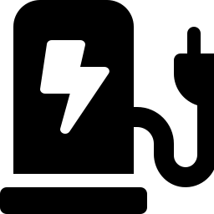
Smarter EV Chargers:
Predicting Problems Before They Happen
An AI + Wireless Communication idea for EV charging networks
Prepared by Avinash

Slide 2

The Problem
EV chargers break down without warning
Drivers arrive to a dead charger — no heads-up, no backup plan.
Fixing them after they fail is expensive
A technician has to travel out, diagnose, then repair — all after the damage is done.
Downtime hurts trust in EVs
If chargers feel unreliable, people hesitate to switch to electric vehicles.

Slide 3

The Idea (In Simple Words)
Give every charger a way to “talk” about its own health — all the time, automatically.
1. Sense
2. Send
3. Predict
Small sensors inside the charger track temperature, voltage, and wear.
That data is sent wirelessly to the cloud — no cables, no manual checks.
An AI model looks for early warning signs and flags problems before failure.

Slide 4
Why This Is Really a Wireless
Communication Problem
The AI can only predict a failure if the data actually arrives — on time, and in one piece. That's a wireless communication challenge, not just a software one.
Getting data out of remote places
Many chargers sit in basements, highways, or rural areas with weak cellular signal.
Choosing the right wireless link
Cellular, Wi-Fi, or long-range low-power networks (like LoRa) each trade off range, cost, and speed differently.
Keeping the link reliable
Dropped or delayed packets mean the AI sees late or missing data — and misses the warning sign.

Slide 5

How It Works, Step by Step
Charger
Wireless link
Cloud AI
Alert
Sensors watch temperature, voltage, connector wear
Data sent over cellular / Wi-Fi / LoRa network
Model compares data to normal patterns
Technician is warned before the charger fails

Slide 6

Why It Matters
Fewer breakdowns
Lower repair costs
Problems get fixed before drivers ever see a dead charger.
Planned maintenance is cheaper than emergency repairs.
More trust in EVs
Better use of technicians
Reliable chargers make people more comfortable going electric.
Teams are sent only where they're actually needed.

Slide 7

Challenges & Next Steps
Test which wireless network (cellular vs. LoRa vs. Wi-Fi) works best for different charger locations
Build a small AI model using real charger fault data
Pilot on a handful of chargers before scaling to a full network

