Slide 1



Conditionals - If
Using if, else if, and else
Company confidential

Slide 2

What is an If?
If
An if statement is a fundamental concept in programming used to make decisions in code. It allows a program to execute certain blocks of code only if a specified condition is true.

Slide 3
What is an If?
Keyword
Boolean
Action
Notes:
An if statement is made up of several parts; these are:
The if keyword signifies that it is a conditional if.
The boolean condition is what is being evaluated for truth.
The action is executed if the condition evaluates to true.

Slide 4
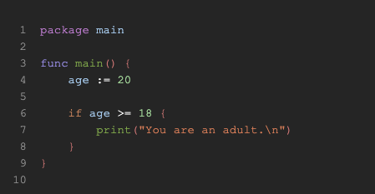
What is an If?
Real example
Boolean
Keyword
Action
Notes:
Here you can see a real-world example using age.
We set a variable called age to 20
. Then, we use an if statement to evaluate whether age is greater than or equal to 18.
If it is, then we print “You are an adult”.
If age was less than 18, then the code inside the if would not have been executed.
As 20 is greater than 18 the code inside the if statement executes and “You are an adult” gets printed out.

Slide 5

Else & Else If
Company confidential

Slide 6
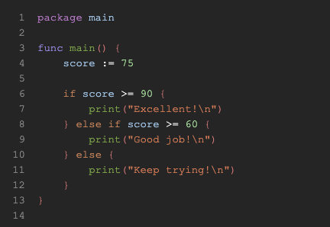
What is an Else?
Else & Else If
Boolean
Keyword
Action
Keyword
Boolean
Notes:
The Else statement defines a block of code that runs only if the if condition is false.
Else if allows you to check multiple conditions in sequence. It's used when you want to test a second (or third, etc.) condition if the first if condition is false.
These work just like in many other programming languages, but with Go's specific syntax rules.
Key Points:
No parentheses () around the condition.
Curly braces {} are required, even for single-line blocks.

Slide 7

Short Statement with if
Go allows a short statement before the condition, useful for initializing variables:
Short Statement
Notes:
In Go, a short statement with if lets you declare and initialise a variable just for use within the if (and optional else) block. This is useful for keeping your code clean and scoped tightly.

Slide 8
Get the future you want
Conditionals Quiz
Notes:
Now that we’ve completed the lab, let's take a quick quiz together to see if we understand this topic.

Slide 9
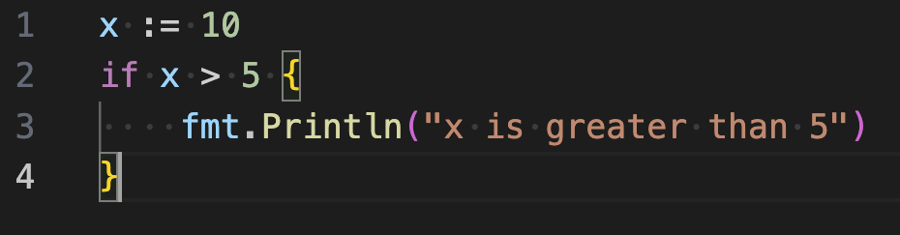
1. What will the following code print?
10 is greater than 5
x is greater than 5
5 is greater than 5

Slide 10
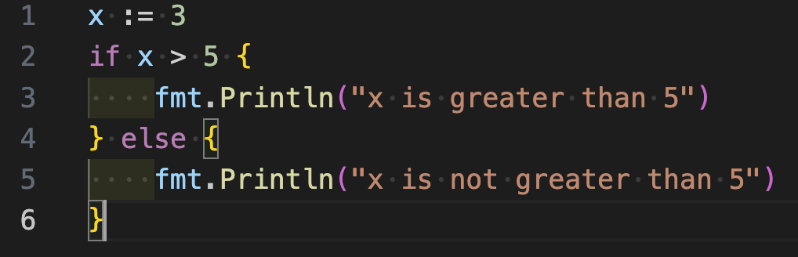
2. What is the output of this code?
x is greater than 5
5 is greater than 5
x is not greater than 5

Slide 11
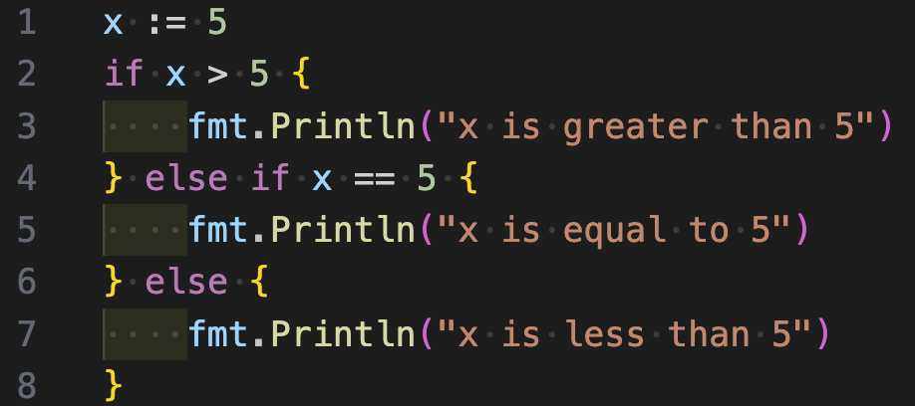
3. What does this code print?
x is equal to 5
x is greater than 5
x is less than 5

Slide 12
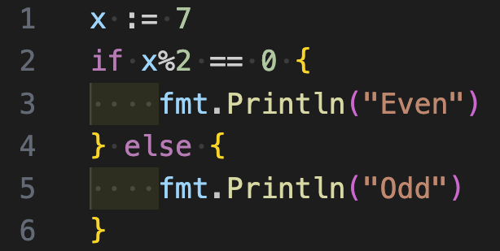
4. What is the output of this code?
Even
Odd

Slide 13
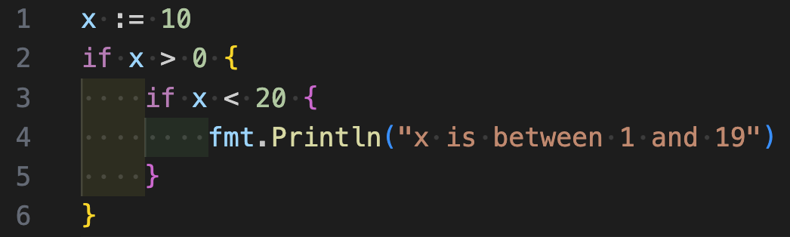
5. What will this code print?
10 is between 1 and 19
0 is between 1 and 19
x is between 1 and 19

Slide 14
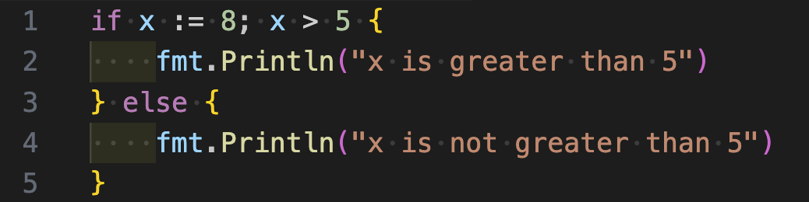
6. What is the output of this code?
8 is greater than 5
x is greater than 5
x is not greater than 5

Slide 15
Get the future you want
Conditionals Quiz
Answers
Notes:
Now that we’ve completed the lab, let's take a quick quiz together to see if we understand this topic.

Slide 16
1. What will the following code print?
10 is greater than 5
x is greater than 5
5 is greater than 5

Slide 17
2. What is the output of this code?
x is greater than 5
5 is greater than 5
x is not greater than 5

Slide 18
3. What does this code print?
x is equal to 5
x is greater than 5
x is less than 5

Slide 19
4. What is the output of this code?
Even
Odd

Slide 20
5. What will this code print?
10 is between 1 and 19
0 is between 1 and 19
x is between 1 and 19

Slide 21
6. What is the output of this code?
8 is greater than 5
x is greater than 5
x is not greater than 5

Slide 22
Get the future you want
Lab
Notes:
Let's move over to Gitlab to look at the lab you will be working on next: https://gitlab.platform-engineering.com/devops-academy-linux-basics/golang-academy/-/tree/main/labs/conditionals-if

Slide 23
Get the future you want
Questions?
Notes:
Any further questions before we move on?
Next, Khusro will be going through Arrays with you.

Slide 24
About Capgemini
Capgemini is a global business and technology transformation partner, helping organizations to accelerate their dual transition to a digital and sustainable world, while creating tangible impact for enterprises and society. It is a responsible and diverse group of 340,000 team members in more than 50 countries. With its strong over 55-year heritage, Capgemini is trusted by its clients to unlock the value of technology to address the entire breadth of their business needs. It delivers end-to-end services and solutions leveraging strengths from strategy and design to engineering, all fueled by its market leading capabilities in AI, generative AI, cloud and data, combined with its deep industry expertise and partner ecosystem. The Group reported 2024 global revenues of €22.1 billion.
Get the future you want | www.capgemini.com

