Slide 1

Tests
Golang Academy

Slide 2
How do I know my code works?
Well, for smaller projects, you can just run the thing and see if it does what you want it to
But you’ll find this highly inefficient when the project is sufficiently large
Ideally, we should write us some unit tests

Slide 3
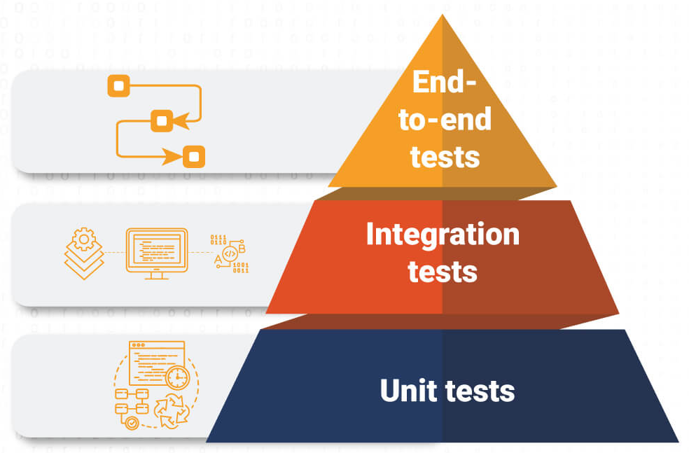
How do I know my code works?
At the moment, we’re only concerned with unit testing
This will test the smallest units of code we have
Could be a function, or a single path through a function, or a module
Notes:
Generally, go through the pyramid with a couple of examples

Slide 4
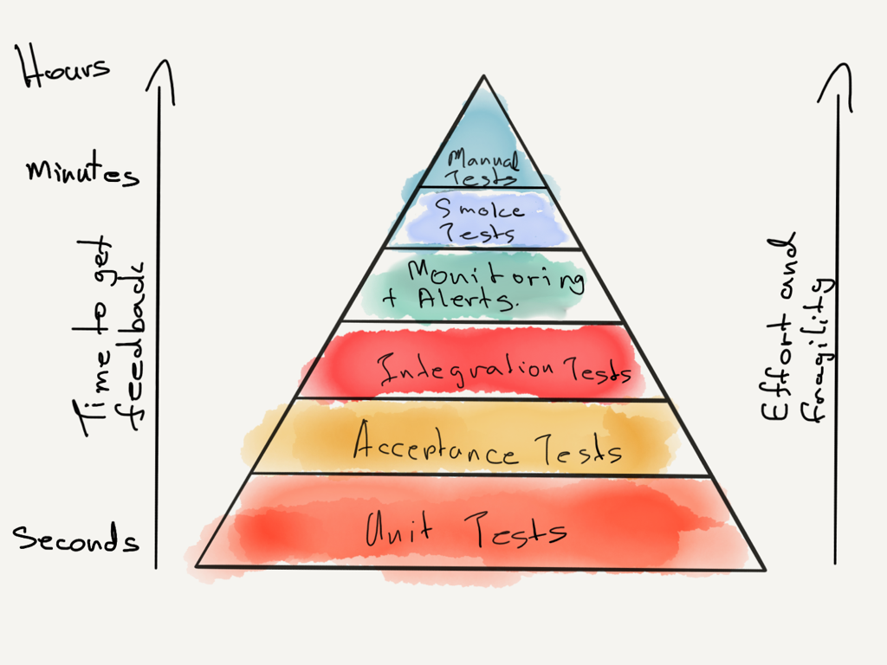
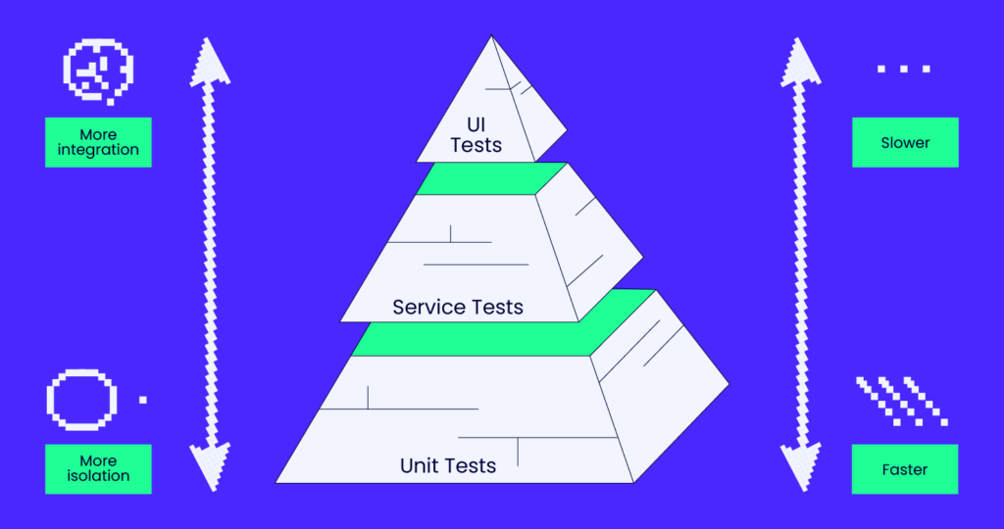
Is that the only pyramid of testing?

Slide 5
Every language has a slightly different way of doing testing
Rust puts unit tests alongside the code
// my-source-file.rs
// ... regular code...
#[cfg(test)]
mod tests {
use super::*;
// ... test code...
}
Lua and C don’t really have one… so you tend to roll your own… or pinch someone else’s
Java duplicates the file tree under test
/src/main/java/com/capgemini/service/Code.java
/src/test/java/com/capgemini/service/CodeTest.java

Slide 6
What about Go?
Go more follows Python or Javascript’s approach
Create a sibling file with _test at the end of the basename
/pkg/module/file.go
/pkg/module/file_test.go
And your tests for file.go will be in file_test.go

Slide 7
And inside the file?
A lot of languages and frameworks provide convenience functions for comparisons
But Go kinda just leaves it up to you to implement
import "testing"
func TestAdd(t *testing.T) {
exp := 5
act := Add(3, 2)
if exp != act {
t.Errorf(
"Addition not working, expected %d, got %d",
exp, act,
)
}
}
Notes:
Talk about the test context pointer being for reporting

Slide 8
Demo Running a simple test go test

Slide 9
Where’s the convenience?
As mentioned, most testing frameworks provide assertions and convenience functions for many common testing operations
Go’s standard library testing functionality does not…
But there are some frameworks out there that provide this
Testify being a common one
Notes:
There is a bit of a debate around their use, package size and “purity” being the main reasons…

