Slide 1

Variables
Golang Academy

Slide 2
What is a variable?
There’s no end of definitions out there for this…
“a piece of memory that stores a value that can be changed” (Lenovo)
“abstract storage location paired with an associated symbolic name” (Wikipedia)
A combination of the two of these might be the cleanest
“a name which can represent a value”

Slide 3
What is a variable?
There’s no end of definitions out there for this…
“a piece of memory that stores a value that can be changed” (Lenovo)
“abstract storage location paired with an associated symbolic name” (Wikipedia)
A combination of the two of these might be the cleanest
“a name which can represent a value”

Slide 4
A name which can represent a value
What do we mean by “name”?
Well, the name can be anything you fancy really…
my_variable
myOtherVariable

Slide 5
A name which can represent a value
What do we mean by “value”?
The value is what that name refers to…
my_variable = 6
myOtherVariable = "Hello"

Slide 6
A name which can represent a value
What do we mean by “can”?
The name may exist, the variable may be declared…
… without the name representing a value,
with a value being initialised or assigned a value
This explanation gives us two important terms:
Variable declaration: I declare that someVariable now exists
Variable initialisation: I assign ”Some value" to someVariable
Notes:
Initialised vs assigned

Slide 7
A name which can represent a value
What do we mean by “can”?
The name may exist, the variable may be declared…
… without the name representing a value,
with a value being initialised or assigned a value
This explanation gives us two important terms:
Variable declaration: I declare that someVariable now exists
Variable assignment: I assign "Some value" to someVariable

Slide 8
Variable Declaration
Every language has its own way of declaring variables…
… but we’re focused on Go
Go uses a keyword to denote the declaration of a variable…
…that keyword is var
Notes:
Discuss keywords?

Slide 9
Variable Declaration, the var Keyword
The most common syntax for variable declaration in Go would be
var name type
var is the keyword which allows one to interact with variables
name is the identifier for the variable being declared
type is the type of value this identifier will represent
e.g. var myVariable string
Notes:
Discuss keywords?

Slide 10
Variable Declaration, the var Keyword
Trick question for you based on the following code…
var myVariable string
Does myVariable have a value?
Notes:
Discuss keywords?

Slide 11
Variable Declaration, Default Values
When declaring a variable but not assigning a value to it…
… Go will initialise the variable with a default value based on the type
Type | Default value
int | 0
float | 0.0
bool | false
string | ""
Notes:
Many languages will do something like this, talk about “null” and “nil” and stuff

Slide 12
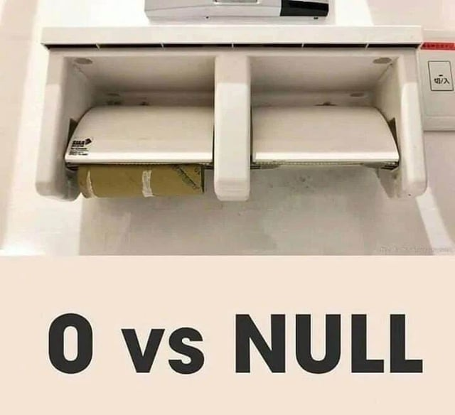
Variable Declaration, Default Values
A lot of object-oriented languages will do a similar thing,
but will initialise with a non-value, null being a common denotation for this
Go does have an analogous value, nil,
but Go only uses this as the default for a number of types, none of which we’re looking at in this session

Slide 13
Variable Assignment
So, how do we assign a custom value to our variable?
That’s where the standard equals sign (=) comes into play…
var myVariable string // declare
myVariable = "Hello" // assign

Slide 14
Variable Assignment
So, how do we assign a custom value to our variable?
That’s where the standard equals sign (=) comes into play…
var myVariable string // declare
myVariable = "Hello" // assign
Do we have to split it over two lines?

Slide 15
Variable Declaration and Assignment
No, we can declare and assign all at once!
var myVariable string = "Hello"
We can even omit the type…
var myVariable = "Hello"
…and allow the compiler to infer the type based on the value we give

Slide 16
Variable Declaration and Assignment
We can even declare and assign multiple variables in the same line
var myVariable, myOtherVariable int = 1, 2
If we use that type inference again, we can declare and assign variables of different types in the same line
var myVariable, myOtherVariable = "Hello", 2
Now, myVariable is a string and myOtherVariable is an int

Slide 17
Variable Declaration and Assignment
We can even declare and assign multiple variables in the same line
var myVariable, myOtherVariable int = 1, 2
If we use that type inference again, we can declare and assign variables of different types in the same line
var myVariable, myOtherVariable = "Hello", 2
Now, myVariable is a string and myOtherVariable is an int

Slide 18
Variable Declaration and Assignment
There’s a nice shorthand for the type-inferred form…
var myVariable = "Hello"
myVariable := "Hello"
This operator (:=) is very commonplace,
it declares and assigns as one and is a little less verbose…

Slide 19
Variables
There’s a lot more to go into…
… tips and tricks and the like…
… but we can leave those for later in the sessions.
For now, let’s move to the labs!

