Slide 1
Image Manipulation with node.js
Presenter: Amit Singhai

Slide 2
Contents of this workshop
Introduction
Inspiration behind this stuff
Pre-requisites before proceeding further
Hands on session – Basic
Hands on session – Advanced
Adding real time features with now.js
Face Detection
Options for performance
Future work

Slide 3
Introduction
Image manipulation/processing using “node.js” and “graphics magick” node module.
Using Opencv for little more fun.
What does this mean?? image manipulation???
Reading and changing image attributes
Effects & Transformations
Thumbnail generation / resizing
Drawing
Etc…….

Slide 4
Inspiration
Just want to contribute something to open source at application layer.

Slide 5


Pre-requisites
Node.js
- Created by Ryan Dahl in 2009
- Its open source
- Runs on Google V8
- Server side Java Script
- Event based IO
NPM
- to install node modules ( a kind of package manager)

Slide 6
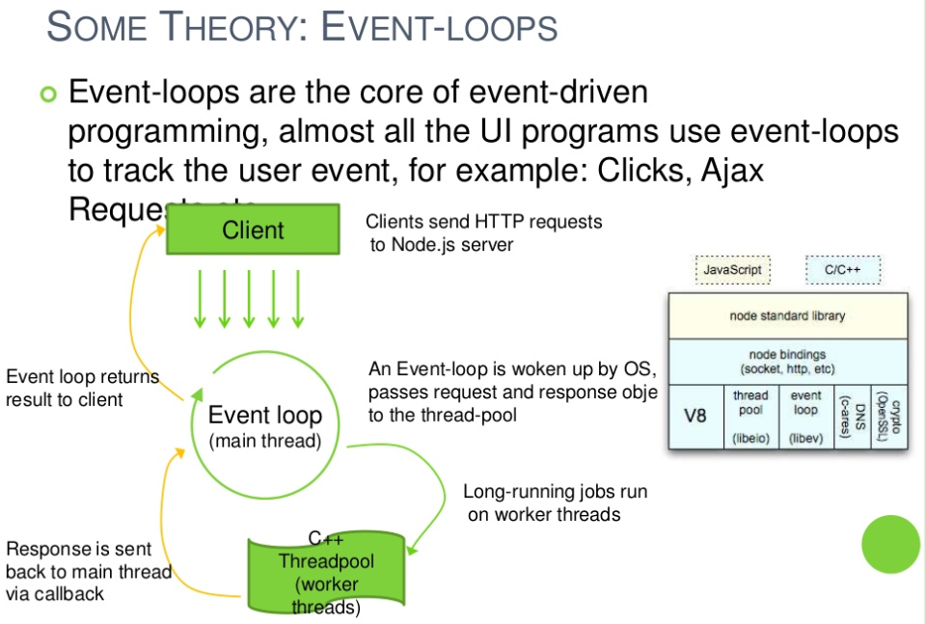

Slide 7
Pre-requisite
Graphics Magick or Image Magick
- It’s a software suit for image editing
- brew install imagemagick [sudo apt-get for ubuntu, yum for centos]
gm node module
- node module to access Graphics magick functionality using nodejs
- npm install gm

Slide 8
Pre-requisite
Now.js
- java script middleware
Ejs
- Html rendering in JSP style
Lets Have some hands-on
With Now and EJS

Slide 9
Hands on session – Basic
Logging image properties
Resizing
Croping
Format conversion
Lets Have some hands-on
Coding

Slide 10
Hands on session – Advanced
Effects
Transformations
Thumbnail generation
Lets Have some hands-on
Coding

Slide 11
Adding real time features with now.js
Lets Have some hands-on
Coding

Slide 12
Face detection with Node and opencv
brew install opencv
Sudo npm install opencv –g
var cv = require('opencv');
var COLOR = [0, 255, 0]; //default red
var thickness = 2; // default 1
cv.readImage('./mona.png', function(err, im) {
im.detectObject('../data/haarcascade_frontalface_alt2.xml', {}, function(err, faces) {
for(var k = 0; k < faces.length; k++) {
face = faces[k];
im.rectangle([face.x, face.y], [face.x + face.width, face.y + face.height], COLOR, 2);
}
im.save('./detected.png');
});
});

Slide 13
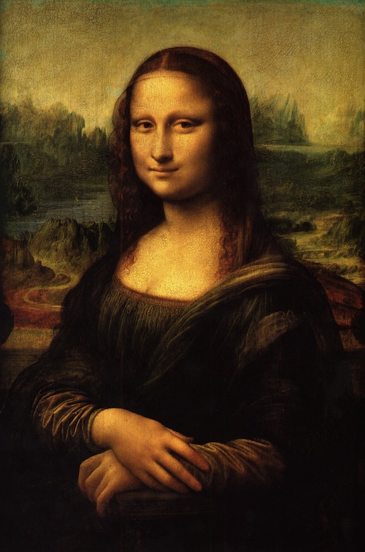
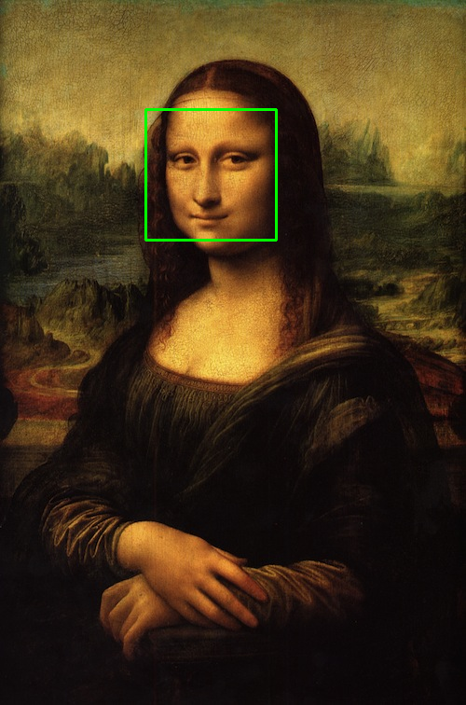
Face detection with Node and opencv

Slide 14
Options for performance
Use cluster module
2. http server and image processing are in separate instances of node

Slide 15
Ideas for Further enhancements
Running on embedded linux (possibly on raspberry-pi and make it open source)
Running on android by porting graphics magick and now.js to android
Adding some more features for smooth image streaming over the network
Dealing with very large images
iPhoto integration

Slide 16
Thank you
Mail: amitsinghai.jain@gmail.com
Code: http://github.com/amuxtux
Happily use it or if you want you may contribute.

