Slide 1
Surprise and learning in the human brain: what can we find in experimental data?
Anthony Jakob
Supervisor: Alireza Modirshanechi
June 2020

Slide 2
Background
Unexpected events are perceived as surprise
Repeated exposure to the same unexpected event may lead to it becoming expected
This procedure is believed to take place via surprise-modulated changes in synaptic plasticity

Slide 3
Goal
→ How is surprise reflected in brain activity?
What model underlies surprise-based learning in the human brain?
Surprise: Measure of how much the brain’s current belief differs from reality

Slide 4
Experimental setup
Dataset from Maheu, et al. (2019)
MEG of 18 participants
Binary sequence of auditory stimuli
4 blocks with various statistical properties
e.g., “KA”
e.g., “PI”
…
…
Time

Slide 5
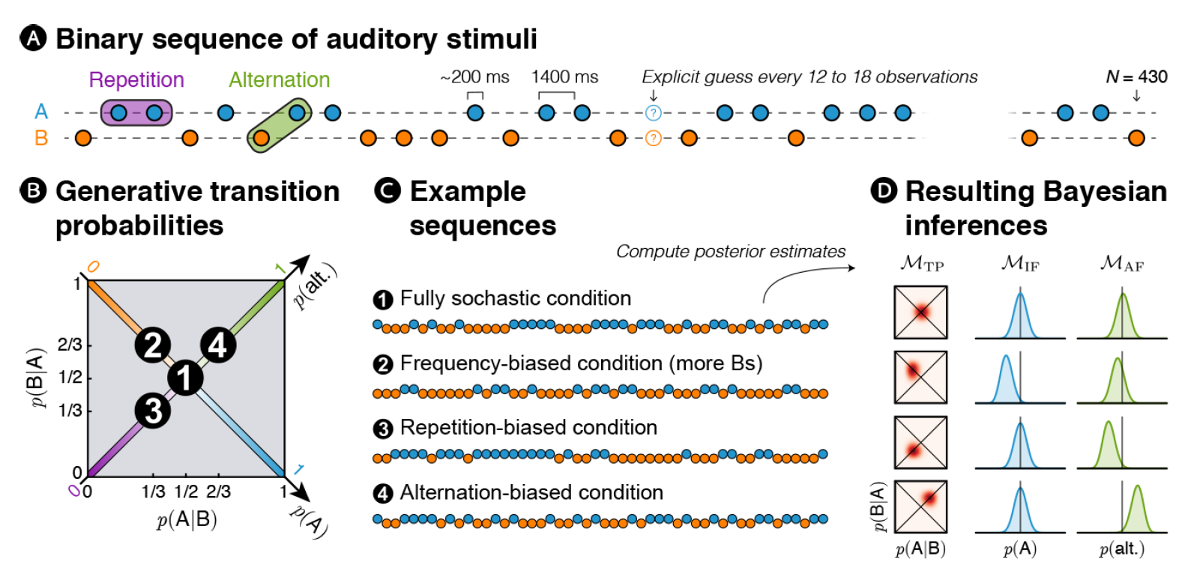
Figure 1, Maheu et al. (2019)

Slide 6
Outline
Background and introduction
Theory
Results: Replicating results from Maheu, et al. (2019)
Results: Our extension
Conclusion

Slide 7
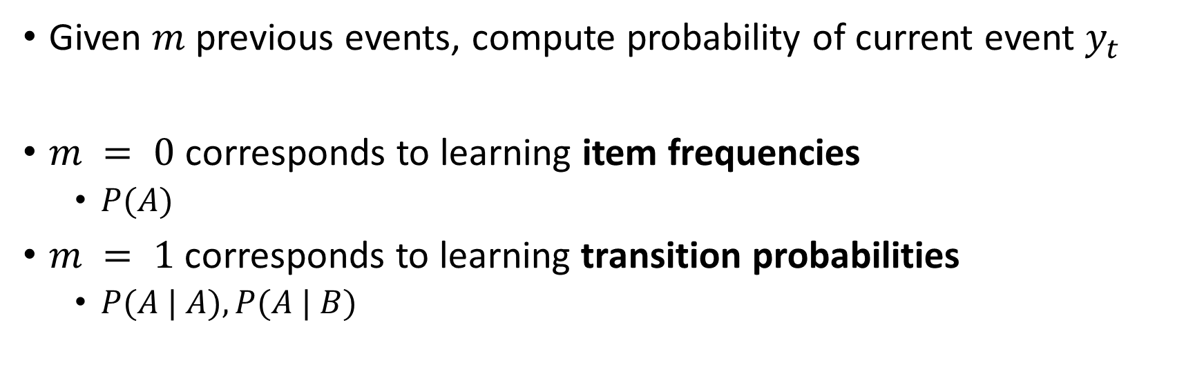



Inference model
Given $m$ previous events, compute probability of current event $y_{t}$
$m = 0$ corresponds to learning item frequencies
$P(A)$
$m = 1$corresponds to learning transition probabilities
$P(A | A), P(A | B)$
$$m$$
…
…
Time
$$y_{t−m:t−1}$$
$$y_{t}$$
Notes:
We consider that humans think in this way (inference).
M > 1 is our model.

Slide 8
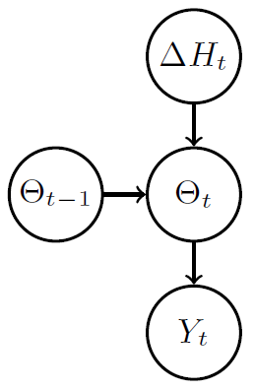
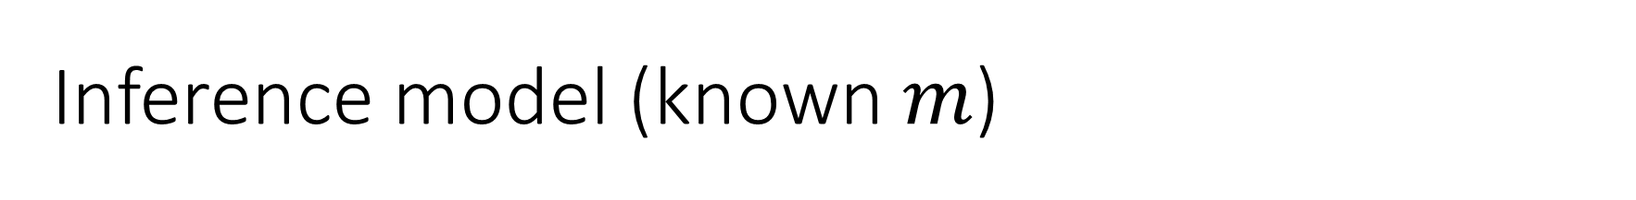


Inference model (known $m$)
Likelihood term
$$P\left(Y_{t}=1 \right| y_{t−m:t−1},{ Θ}_{t}=θ)=θ^{{(y}_{t−m:t−1})}$$
$ΔH_{t}$ stands for change points
Goal of inference: Update the belief $π^{\left(t\right)}\left(θ\right)$
$$Y_{t−m:t−1}$$
$$m$$
Figure 1, Liakoni et al. (2020)
…
…
Time
$$y_{t−m:t−1}$$
$$y_{t}$$
Notes:
Delta H: abrupt change.

Slide 9
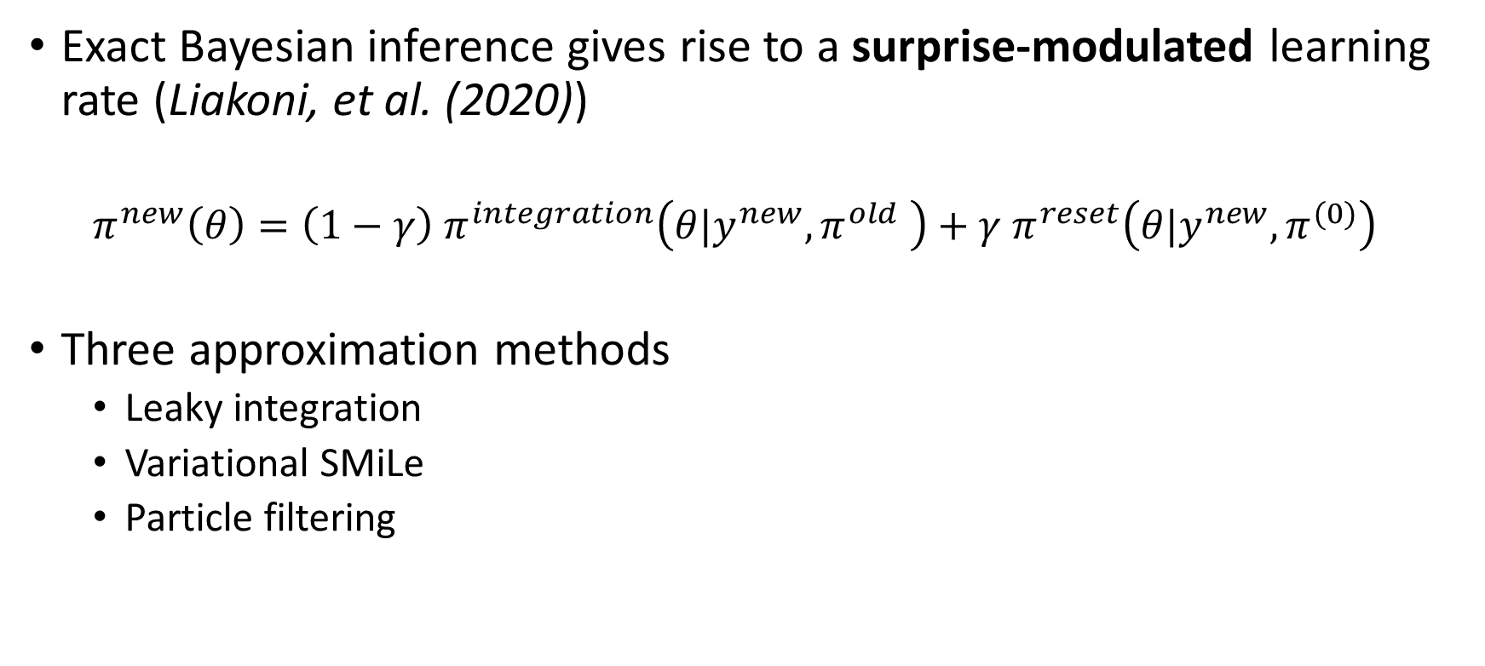
Learning rules
Exact Bayesian inference gives rise to a surprise-modulated learning rate (Liakoni, et al. (2020))
$$π^{new}\left(θ\right)=\left(1−γ\right) π^{integration}\left(θ|y^{new}, π^{old} \right)+γ π^{reset}\left(θ|y^{new}, π^{(0)}\right)$$
Three approximation methods
Leaky integration
Variational SMiLe
Particle filtering

Slide 10
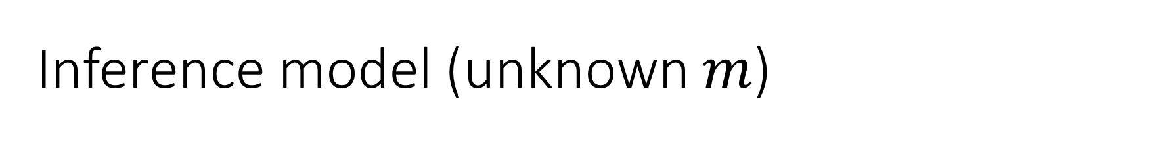


Inference model (unknown $m$)
Inference over $m$
Goal of inference: Update the belief $π^{\left(t\right)}\left(θ, m\right)$
Uniform prior over $m∈\{0, …,m^{∗}$}, $m^{∗} > 0$
$$m$$
…
…
Time
$$m$$
$$y_{t}$$
Notes:
Same trade-off for pi if there are abrupt changes in theta and m
(theta, m) = «new theta»

Slide 11
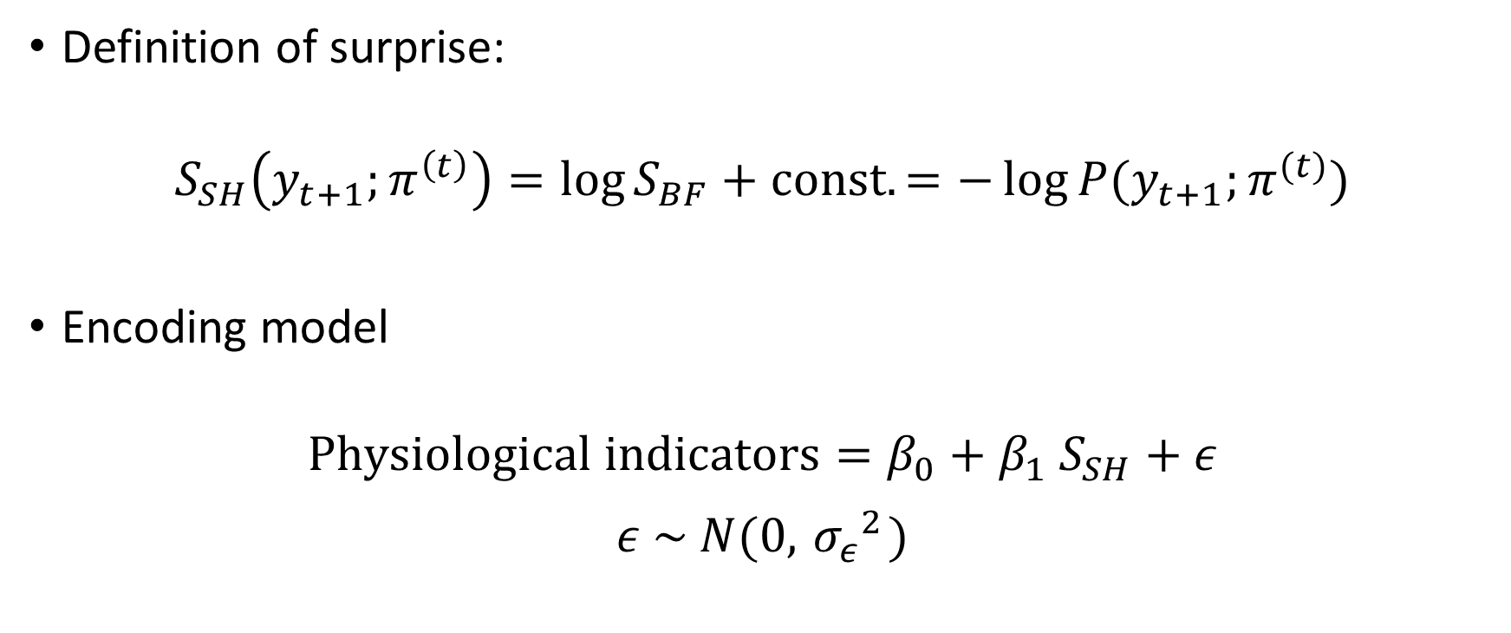
Surprise-coding model
Definition of surprise:
$$S_{SH}\left(y_{t+1};π^{\left(t\right)}\right)=\log{S_{BF}}+const.=−\log{P(y_{t+1};π^{(t)})}$$
Encoding model
$$Physiological indicators=β_{0}+β_{1} S_{SH}+ε$$
$$ε \sim N(0, { σ_{ε}}^{2})$$

Slide 12
Outline
Background and introduction
Theory
Results: Replicating results from Maheu, et al. (2019)
Results: Our extension
Conclusion

Slide 13
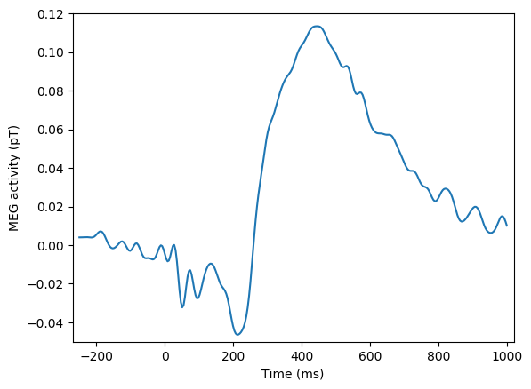
Intra-event timescale
Subject 13
Sensor 13
Two timescales: intra-event and inter-event
Notes:
This is for one time-point and sensor (give real info)
Choose one sensor, plot average activity of this sensor for all trials (x = time, y= amplitude) -> show figure on left side
This corresponds to y_t
Two timescales:
Time after trial
Time in trial
Only for leaky integration with paramter XY
M = 1
Bulletpoints on left side of figure to summarize info

Slide 14
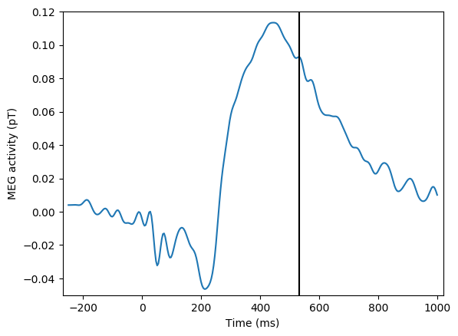
Intra-event timescale
Subject 13
Sensor 13
Two timescales: intra-event and inter-event
Notes:
This is for one time-point and sensor (give real info)
Choose one sensor, plot average activity of this sensor for all trials (x = time, y= amplitude) -> show figure on left side
This corresponds to y_t
Two timescales:
Time after trial
Time in trial
Only for leaky integration with paramter XY
M = 1
Bulletpoints on left side of figure to summarize info

Slide 15
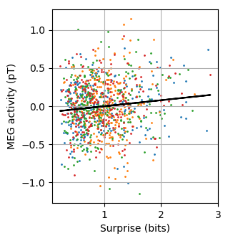


Mass-univariate trial-by-trial regression
Subject 13
Sensor 13
Timepoint 531 ms
Leaky integration
$ω=10$
$m = 1$
$$α=\exp{−\frac{1}{ω}}$$
Notes:
This is for one time-point and sensor (give real info)
Choose one sensor, plot average activity of this sensor for all trials (x = time, y= amplitude) -> show figure on left side
This corresponds to y_t
Two timescales:
Time after trial
Time in trial
Only for leaky integration with paramter XY
M = 1
Bulletpoints on left side of figure to summarize info

Slide 16
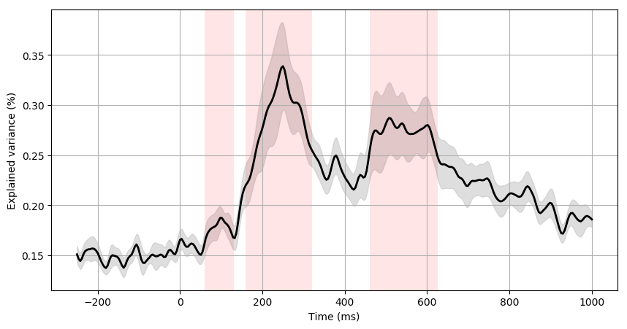

Maximum R² for leaky integration
1
2
3
Maximum R² over:
All sensors
All $ω$
$m∈[0, 1]$
Notes:
Maximum taken over all sensors and all omegas and m=0 and 1
Maheu only consider 0 and 1
Three windows
Bayesian model selection approach

Slide 17
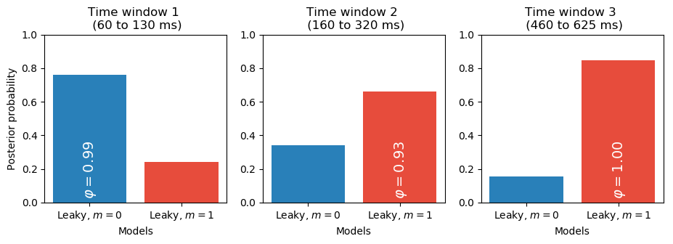

Bayesian model selection
Which $m$ explains the data better
Notes:
Explain posterior probability
Exceedance probability: prob that model y is better than model x
Bulletpoint: which m explains data better

Slide 18
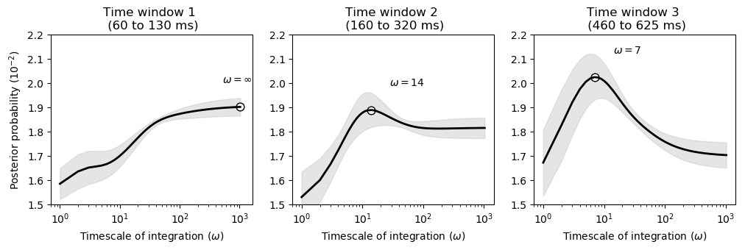


Bayesian model averaging
$$α=\exp{−\frac{1}{ω}}$$
Which $ω$ explains the data better
Notes:
Bulletpoint: which omega explain data better (similar to previous slide)
Give intuition of omega (omega is almost time-window of previous observations we integrate)

Slide 19
Outline
Background and introduction
Theory
Results: Replicating results from Maheu, et al. (2019)
Results: Our extension
Conclusion

Slide 20

Goals
Adding surprise-modulated learning rate
Effect of $m > 1$
Effect of inference over $m$

Slide 21


No inference over $m$
Consider $m$ fixed and known through time
Variable between subjects
$$m$$
…
…
Time
$$y_{t−m:t−1}$$
$$y_{t}$$

Slide 22
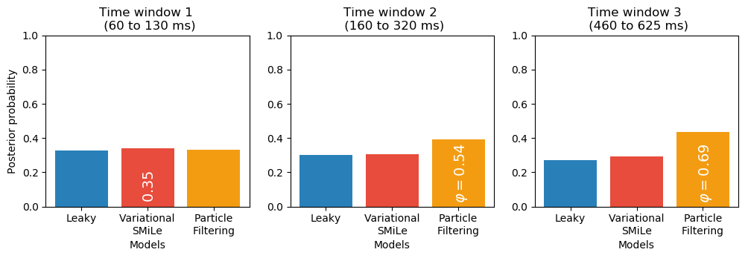
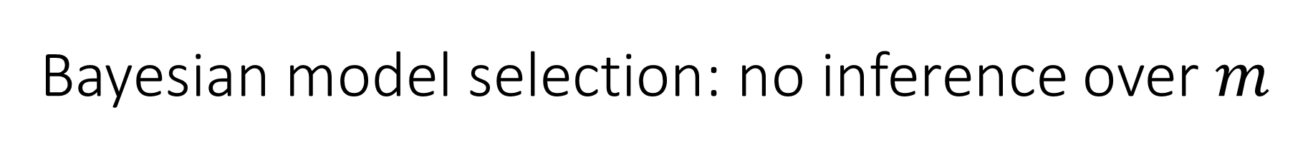
Bayesian model selection: no inference over $m$
Which learning model explains the data better
Notes:
Bulletpoint: which learning model explains data better (maximize over all parameters [omega, m] and [m_c, m])
→ Particle filtering is best

Slide 23
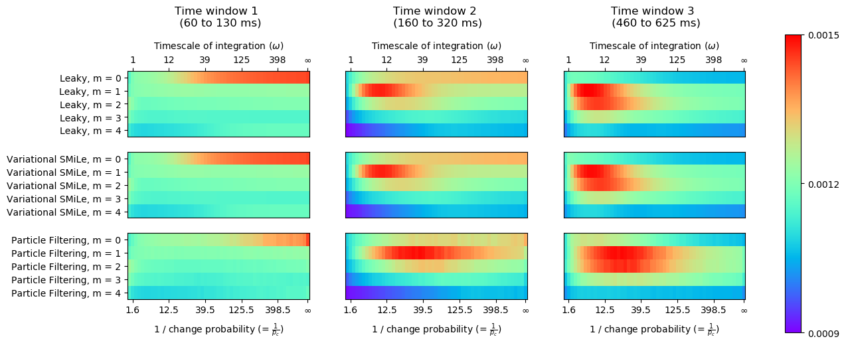
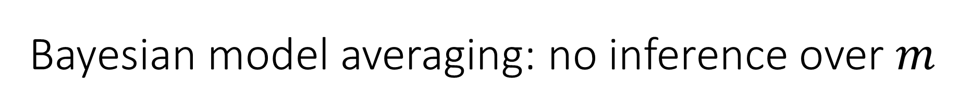
Bayesian model averaging: no inference over $m$
Which pair of parameters explain the data better
Notes:
Bulletpoint: which pair of omega and m_c explain the data best
Results is consistent with Maheu, m > 1 not explaining data better
Show parameters of 3 models from before

Slide 24

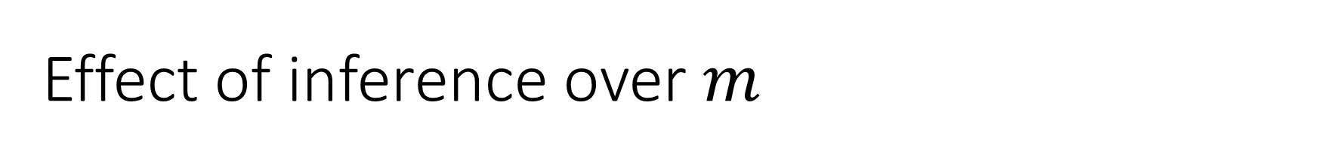
Effect of inference over $m$
Inferring $m$ through time
Potentially different priors ($m^{∗}$) for each subject
$$m$$
…
…
Time
$$m$$
$$y_{t}$$
24

Slide 25
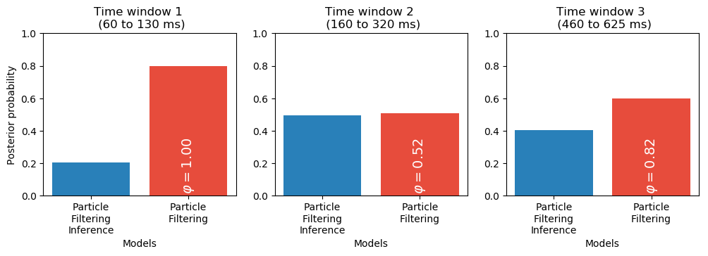

Bayesian model selection: effect of inference
Does a model with inference over $m$ explain the data better?
Notes:
We are fitting m* for all models
People can have different m* -> fit m* for different people at the same time
-> particle filtering inference has more robust behavior
-> then: let’s assume there is one fixed m*
-> check and display plots

Slide 26
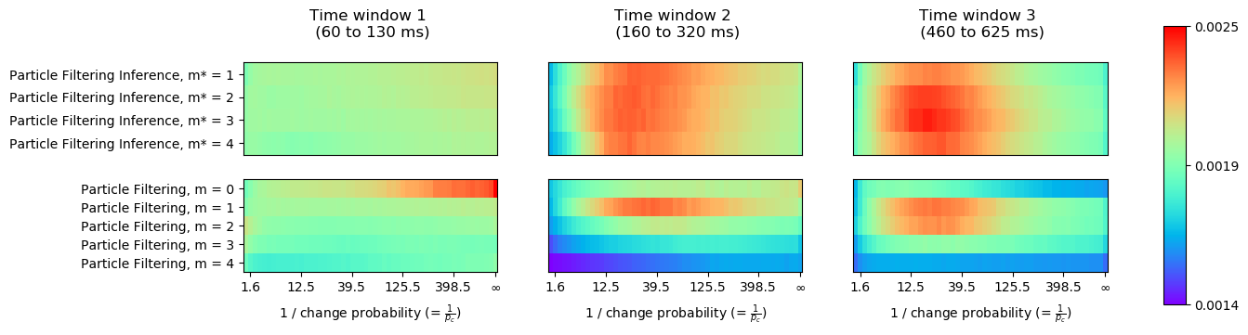

Bayesian model selection: effect of inference
Does a model with inference over $m$ explain the data better?
Notes:
We are fitting m* for all models
People can have different m* -> fit m* for different people at the same time
-> particle filtering inference has more robust behavior
- in the first time-window, inference doesn't add anything -> prefer to use previous models
- in the next time-windows, results are inconclusive, but
---> inference models are more robust across parameters, which is a benefit of inference

Slide 27

Effect of inference over $m$
Inferring $m$ through time
Same prior ($m^{∗}$) for all subjects
Effectively removing one free parameter
$$m$$
…
…
Time
$$m$$
$$y_{t}$$
27
Notes:
Mention: R^2 is less then 1% -> one more free parameter means outperforming other models

Slide 28
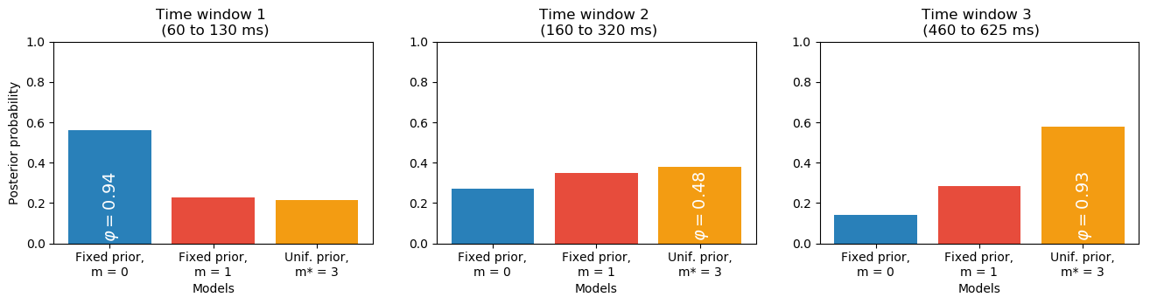

Bayesian model selection: effect of inference
We assume there is one fixed $m^{∗}$
Notes:
let’s assume there is one fixed m*

Slide 29
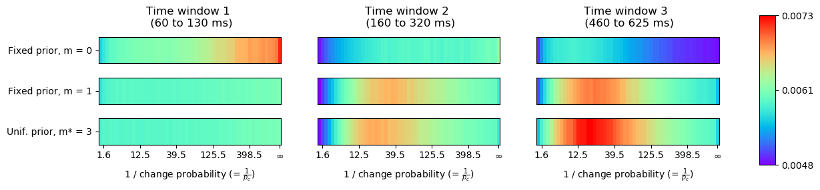
Bayesian model selection: effect of inference
We assume there is one fixed $m^{∗}$
Notes:
let’s assume there is one fixed m*

Slide 30
Outline
Background and introduction
Theory
Results: Replicating results from Maheu, et al. (2019)
Results: Our extension
Conclusion

Slide 31
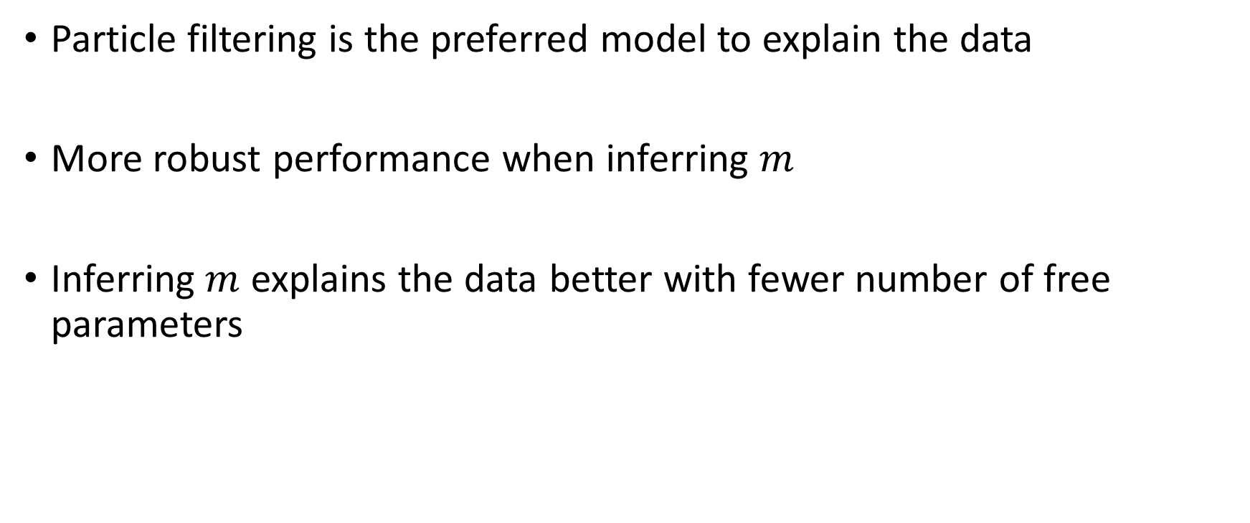
Conclusion
Particle filtering is the preferred model to explain the data
More robust performance when inferring $m$
Inferring $m$ explains the data better with fewer number of free parameters

Slide 32
Questions?

Slide 33
References
Maheu M, Dehaene S, Meyniel F. Brain signatures of a multiscale process of sequence learning in humans. Elife. 2019;8:e41541.
Liakoni V, Modirshanechi A, Gerstner W, Brea J. An Approximate Bayesian Approach to Surprise-Based Learning. arXiv preprint arXiv:1907.02936.

