Slide 1
Surprise and learning in the human brain: what can we find in experimental data?
Anthony Jakob
Supervisor: Alireza Modirshanechi
May 2020

Slide 2
Background
Unexpected events are perceived as surprise
Repeated exposure to the same unexpected event may lead to it becoming expected
This procedure is believed to be done via surprise-modulated changes in synaptic plasticity

Slide 3
Goal
Surprise: Measure of how much the brain’s current belief differs from reality
→ How is surprise reflected in brain activity?
What model underlies surprise-based learning in the human brain?

Slide 4
Experimental setup
Dataset from Maheu, et al. (2019)
EEG of 18 participants
Binary sequence of auditory stimuli
4 blocks with varying statistical properties
e.g., “KA”
e.g., “PI”
…
…
Time

Slide 5
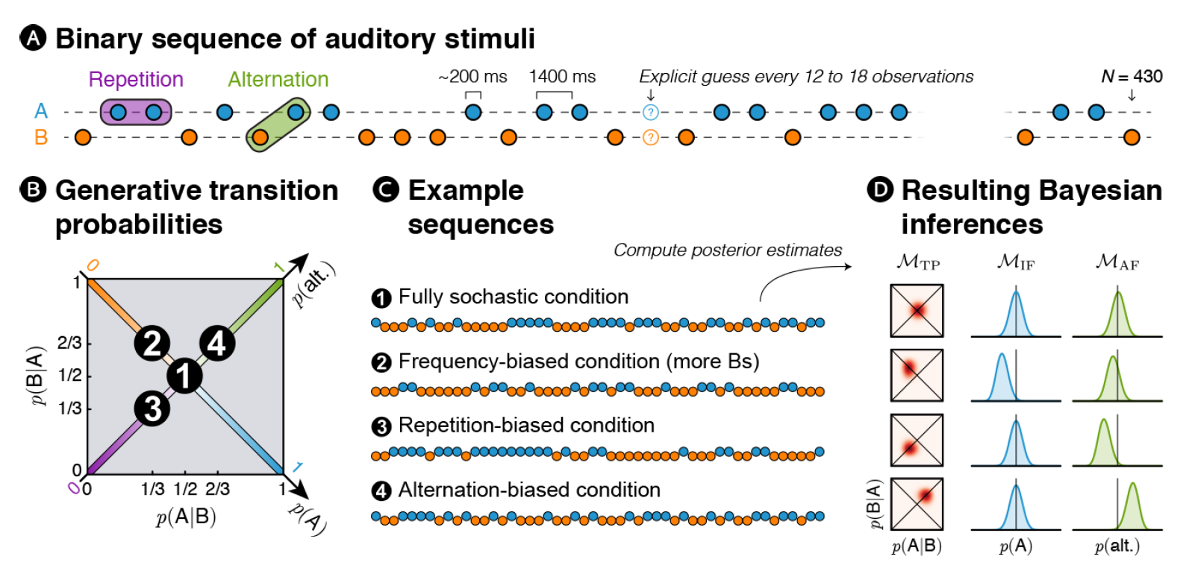
Figure 1, Maheu et al. (2019)

Slide 6
Outline
Background and introduction
Theory
Results: Replicating results from Maheu, et al.
Results: Our extension
Conclusion

Slide 7
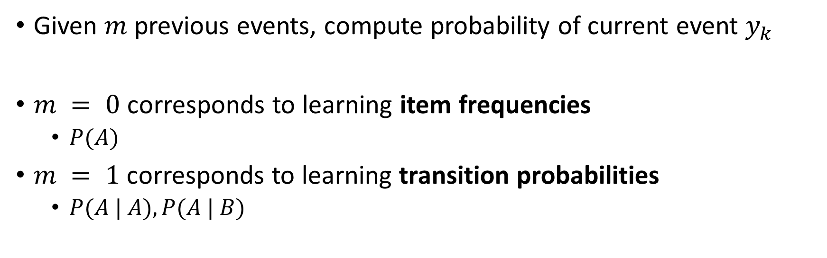



Inference model
Given $m$ previous events, compute probability of current event $y_{k}$
$m = 0$ corresponds to learning item frequencies
$P(A)$
$m = 1$corresponds to learning transition probabilities
$P(A | A), P(A | B)$
$$m$$
…
Time
$$y_{k−m:k−1}$$
$$y_{k}$$
Notes:
We consider that humans think in this way (inference).

Slide 8

Encoding model
Generative model
$y \sim θ$, $θ \sim π(θ)$
Exact online Bayesian update rule
$$π_{B}^{\left(t+1\right)}(θ)=\frac{P\left(y_{k+1} | θ\right)π^{\left(t\right)}(θ)}{P(y_{k+1};π^{\left(t\right)}\left(θ\right))}$$
$$π^{(t)}\left(θ\right)=Dir(θ;{ α}^{(t)})$$

Slide 9
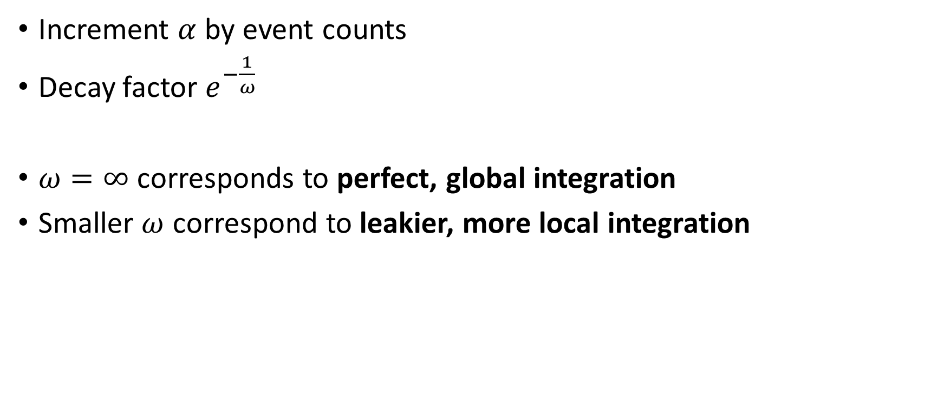
Encoding model: perfect/leaky integration
Increment $α$ by event counts
Decay factor $e^{−\frac{1}{ω}}$
$ω=∞$ corresponds to perfect, global integration
Smaller $ω$ correspond to leakier, more local integration

Slide 10
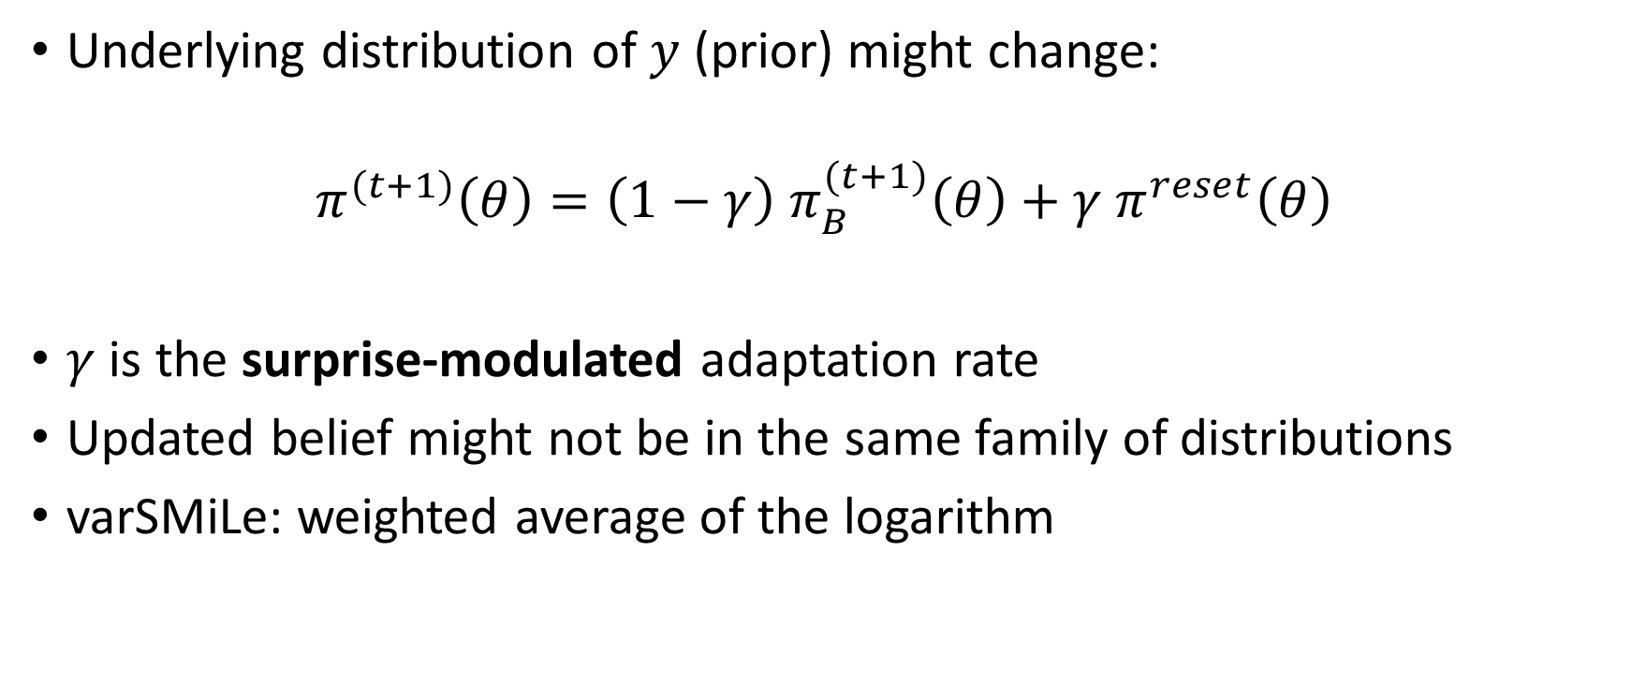
Encoding model: variational SMiLe
Underlying distribution of $y$ (prior) might change:
$$π^{(t+1)}\left(θ\right)=\left(1−γ\right) π_{B}^{(t+1)}\left(θ\right)+γ π^{reset}\left(θ\right)$$
$γ$ is the surprise-modulated adaptation rate
Updated belief might not be in the same family of distributions
varSMiLe: weighted average of the logarithm

Slide 11

Surprise
“Bayes Factor” surprise
$S_{BF}\left(y_{k+1};π^{\left(t\right)}\right)= \frac{P(y_{k+1};π^{\left(0\right)})}{P(y_{k+1};π^{\left(t\right)})}$
Shannon surprise
$S_{SH}\left(y_{k+1};π^{\left(t\right)}\right)=−\log{P(y_{k+1};π^{(t)})}$

Slide 12
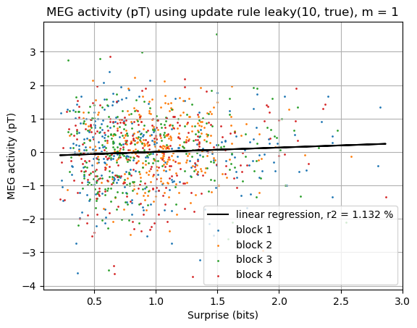
Mass-univariate trial-by-trial regression

Slide 13
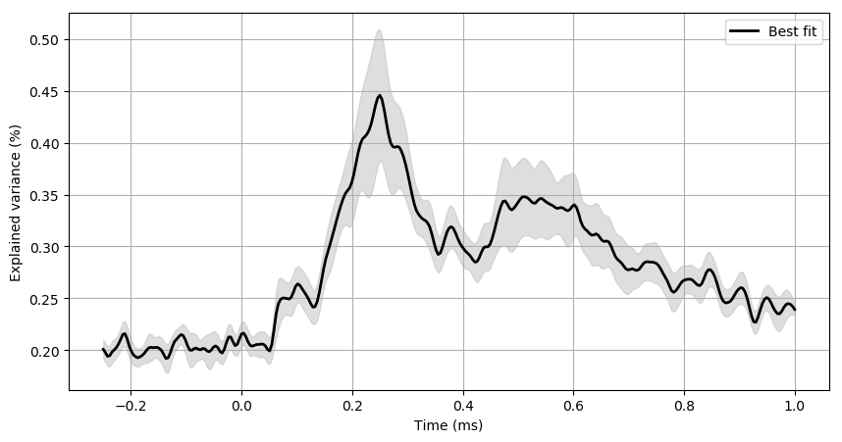
Maximum R²
1
2
3

Slide 14
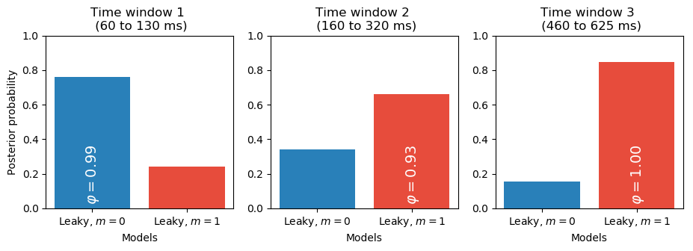
Bayesian model selection

Slide 15
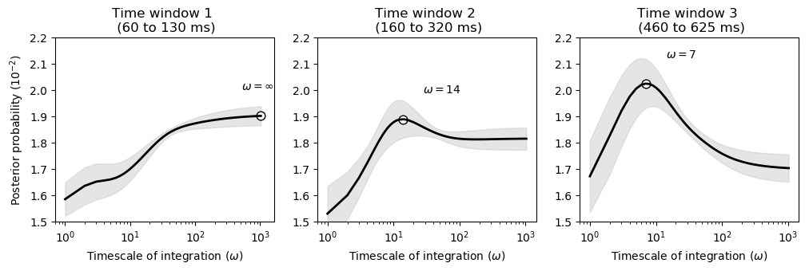
Bayesian model averaging

Slide 16
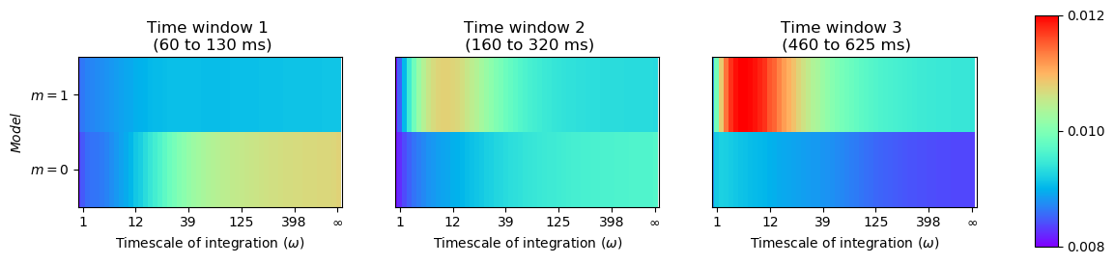
Bayesian model averaging

Slide 17
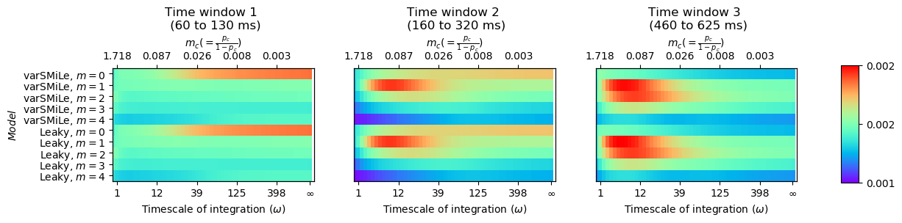
Bayesian model averaging

Slide 18
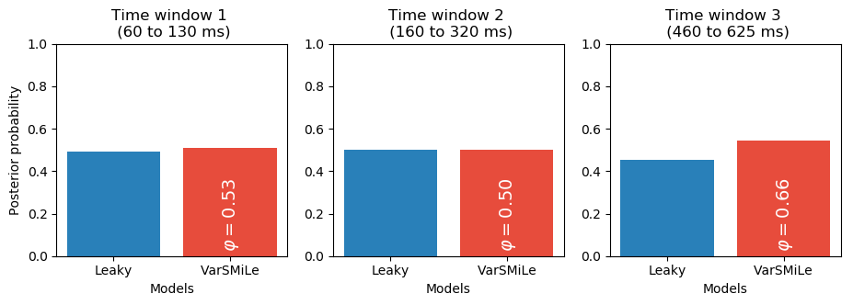
Bayesian model selection

Slide 19
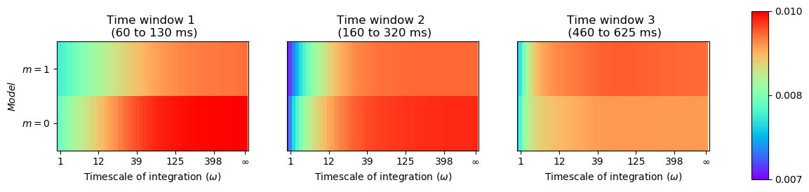
Bayesian model averaging for block 4 (alternation-biased)

Slide 20

Future perspectives
Inference on $m$

Slide 21
Questions?

