Slide 1
Writing Procedures in Assembly

Slide 2
Stored Program
The MIPS architecture is a stored program system.
This means that the instructions for the program are stored in memory.
The CPU fetches an instruction, decodes it, and then executes it.

Slide 3
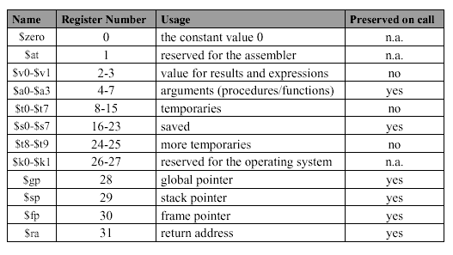
We examine some special registers:

Slide 4
Branches and Jumps
We’ve used Branches and Jumps to implement loops and make decisions.
What’s the difference between the two?
They act mostly the same, it’s the “underneath” that is different.

Slide 5
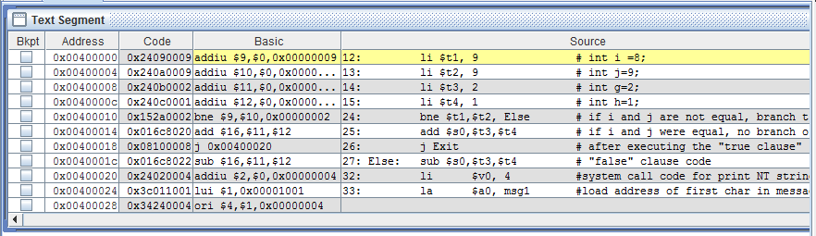
Branch vs. Jump
Branch uses an Offset from current line
Jump uses an absolute address

Slide 6
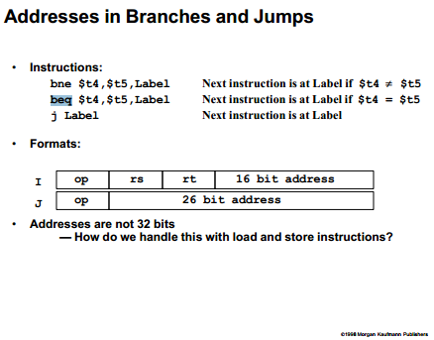
Branch vs. Jump Format

Slide 7
Subprograms
Procedures, Functions, and Methods all fall under the broad term “Subprogram” or “Subroutine”
A subprogram is a sequence of instructions that may be executed outside the regular flow of a program.
At the end of the subprogram, execution returns to the position immediately after the call.

Slide 8
Methods vs. Others
Methods differ from other subprograms as there is an underlying mechanism that implements polymorphism.
Transfer the flow of the code to another spot, pass parameters, return

Slide 9
Calling an Procedure
In assembly, we need to handle calls and parameters in registers:
$a0-$a3: argument registers
$v0-$v1: return value registers
$ra: return address register

Slide 10
Calling a Procedure
As with the branches and jumps, you need to direct flow to an address.
When the routine at that address is finished, go back to address *after* the call.
Caller – code that calls method
Callee –code that is called

Slide 11
Jump and Link
jal ProcedureLabel
Jumps to the label *and* saves the next address to the $ra register. This address is PC+4
jr $ra #jump to address in
#register. Used to
#return

Slide 12
Procedure Example
See MARS example

Slide 13
Procedure Calling
Steps required
Place parameters in registers
Transfer control to procedure
Acquire storage for procedure
Perform procedure’s operations
Place result in register for caller
Return to place of call
§2.8 Supporting Procedures in Computer Hardware

Slide 14
Conventions
A convention is a methodology programmers follow that is not enforced by the language.
Conventions have been found to improve software quality and ease of programming.
It is strongly advised to use programming conventions.

Slide 15
Procedure Conventions
First four arguments are passed through registers $a0-$a3. Any extra arguments are placed on the call stack.
The callee is not required to preserve $a0-$a3, $t0-$t9 will be preserved after a procedure call.
If the calling program wants these registers to be preserved, they must be saved off before the call.

Slide 16
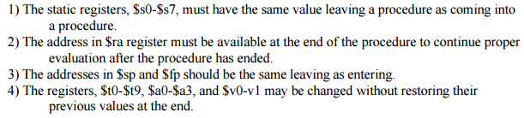
Conventions in other words:

Slide 17
Procedure Conventions
If the callee wants to use $s0-$s7 during it’s operating, the callee must preserve them at the start of execution and restore them before it returns control to the caller.
Again, this is a convention. MIPS assembly does not require you to save them. It is by convention that the programmer does this.

Slide 18
Procedure Convention
In addition to preserving $s0-$s7, the callee must save $fp and $ra.
$ra need only be saved if the procedure will call another procedure (aka it’s a nested procedure)

Slide 19
Register Usage
$a0 – $a3: arguments (reg’s 4 – 7)
$v0, $v1: result values (reg’s 2 and 3)
$t0 – $t9: temporaries
Can be overwritten by callee
$s0 – $s7: saved
Must be saved/restored by callee
$gp: global pointer for static data (reg 28)
$sp: stack pointer (reg 29)
$fp: frame pointer (reg 30)
$ra: return address (reg 31)

Slide 20
Procedure Call Instructions
Procedure call: jump and link
jal ProcedureLabel
Address of following instruction put in $ra
Jumps to target address
Procedure return: jump register
jr $ra
Copies $ra to program counter
Can also be used for computed jumps
e.g., for case/switch statements

Slide 21
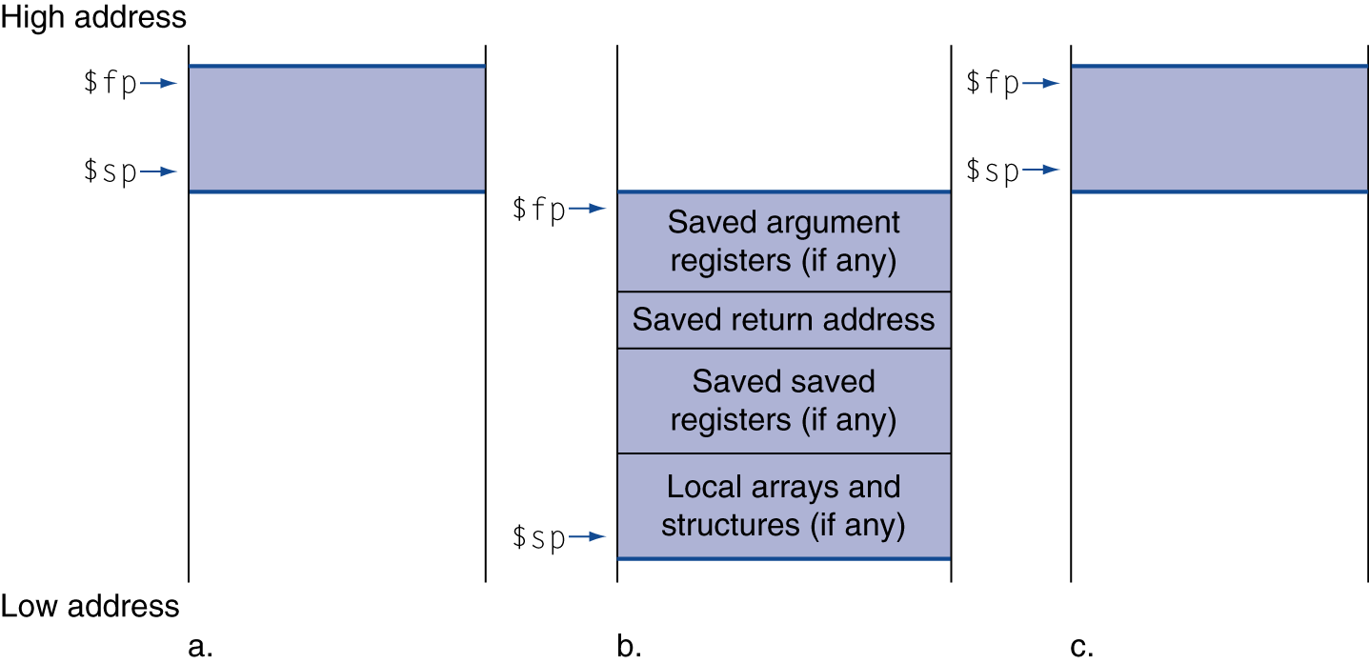
Local Data on the Stack
Local data allocated by callee
e.g., C automatic variables
Procedure frame (activation record)
Used by some compilers to manage stack storage

Slide 22
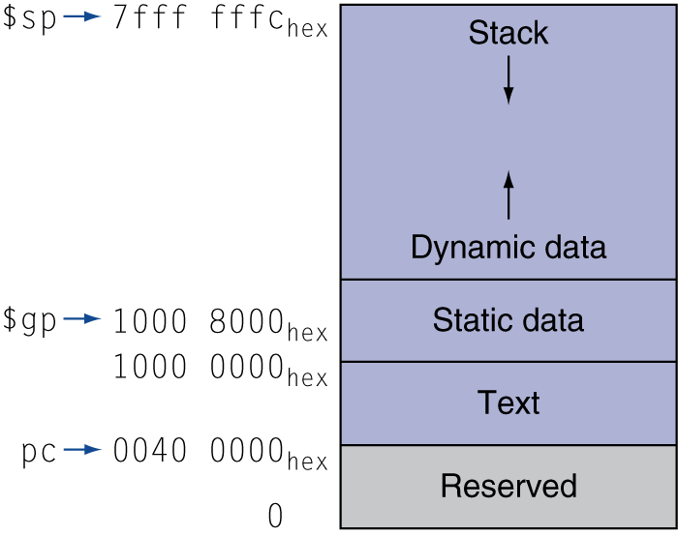
Memory Layout
Text: program code
Static data: global variables
e.g., static variables in C, constant arrays and strings
$gp initialized to address allowing ±offsets into this segment
Dynamic data: heap
E.g., malloc in C, new in Java
Stack: automatic storage

Slide 23
Heap / Stack Dynamics
The size of the dynamic segments is unknown at the start of the program.
They are as far apart as possible at the beginning to allow maximum growth of each.

Slide 24
Leaf Procedure Example
C code:
int leaf_example (int g, h, i, j) { int f; f = (g + h) - (i + j); return f; }
Arguments g, …, j in $a0, …, $a3
f in $s0 (hence, need to save $s0 on stack)
Result in $v0

Slide 25
Leaf Procedure Example
MIPS code:
leaf_example: addi $sp, $sp, -4 sw $s0, 0($sp) add $t0, $a0, $a1 add $t1, $a2, $a3 sub $s0, $t0, $t1 add $v0, $s0, $zero lw $s0, 0($sp) addi $sp, $sp, 4 jr $ra

Slide 26
Non-Leaf Procedures
Procedures that call other procedures
For nested call, caller needs to save on the stack:
Its return address
Any arguments and temporaries needed after the call
Restore from the stack after the call

Slide 27
Non-Leaf Procedure Example
C code:
int fact (int n) { if (n < 1) return 1; else return n * fact(n - 1); }
Argument n in $a0
Result in $v0

Slide 28
Non-Leaf Procedure Example
MIPS code:
fact: addi $sp, $sp, -8 # adjust stack for 2 items sw $ra, 4($sp) # save return address sw $a0, 0($sp) # save argument slti $t0, $a0, 1 # test for n < 1 beq $t0, $zero, L1 addi $v0, $zero, 1 # if so, result is 1 addi $sp, $sp, 8 # pop 2 items from stack jr $ra # and return L1: addi $a0, $a0, -1 # else decrement n jal fact # recursive call lw $a0, 0($sp) # restore original n lw $ra, 4($sp) # and return address addi $sp, $sp, 8 # pop 2 items from stack mul $v0, $a0, $v0 # multiply to get result jr $ra # and return

Slide 30
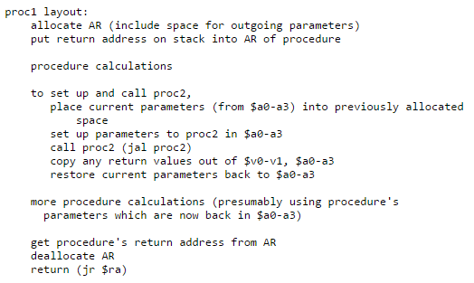
Calling a Procedure
http://pages.cs.wisc.edu/~cs354-2/beyond354/conventions.html

Slide 31
Great Reference
http://jjc.hydrus.net/cs61c/handouts/proced1.pdf

