Slide 1
Memory
Ch 5
Professor Ann Marie V Schilling

Slide 2
Gardening Example
I need to:
Pull weeds
Load them into a cart
Bring them to the woods
Plant new flowers
Lay mulch
How do I handle materials and tools?

Slide 3
Access Locality
Temporal Locality:
If an item is used, it will probably be used again soon
Spatial Locality:
If an item is used, items nearby will probably be used too.

Slide 4
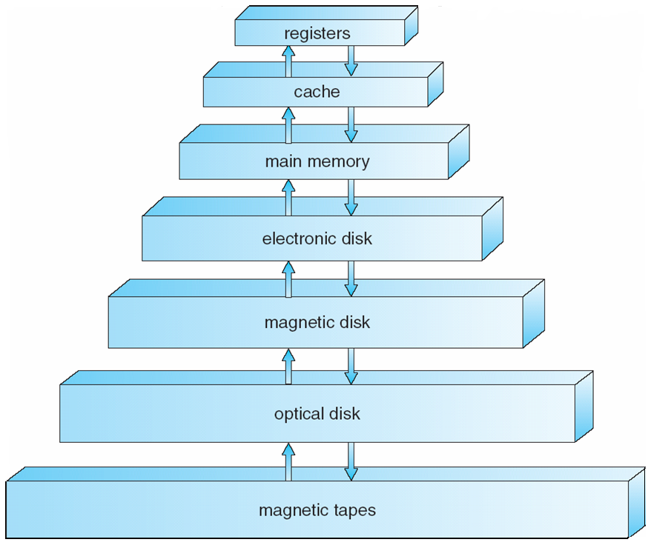
Storage Device Hierarchy
From Operating Systems Concepts w Java 8e
Silbershatz and Gagne

Slide 5
Types of Memory
Volatile - Storage is cleared with removal of power
Non-Volatile – Storage retains values when power removed.

Slide 6
Using Memory Hierarchy
In this section:
Interactions between levels
Using memory hierarchy for faster performance
Inspecting memory use to enhance performance

Slide 7
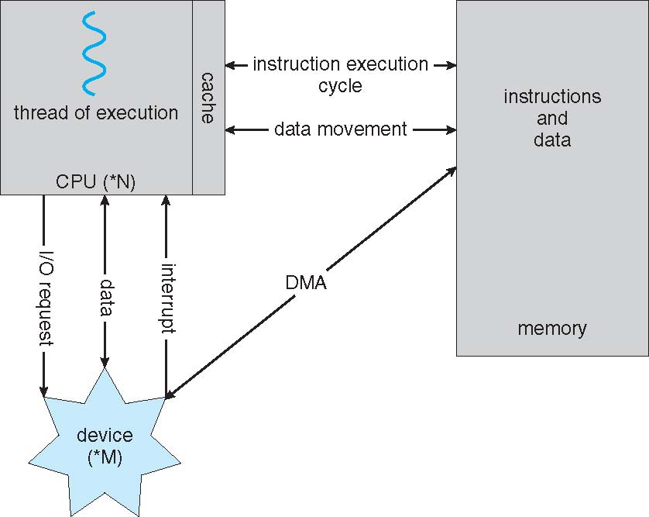
Hardware Abstraction
registers
From Operating Systems Concepts w Java 8e
Silbershatz and Gagne

Slide 8
Recall…
Fast storage is…
Closer to the CPU
More expensive
Smaller
Slow storage is…
Farther from the CPU
Cheaper
Larger

Slide 9
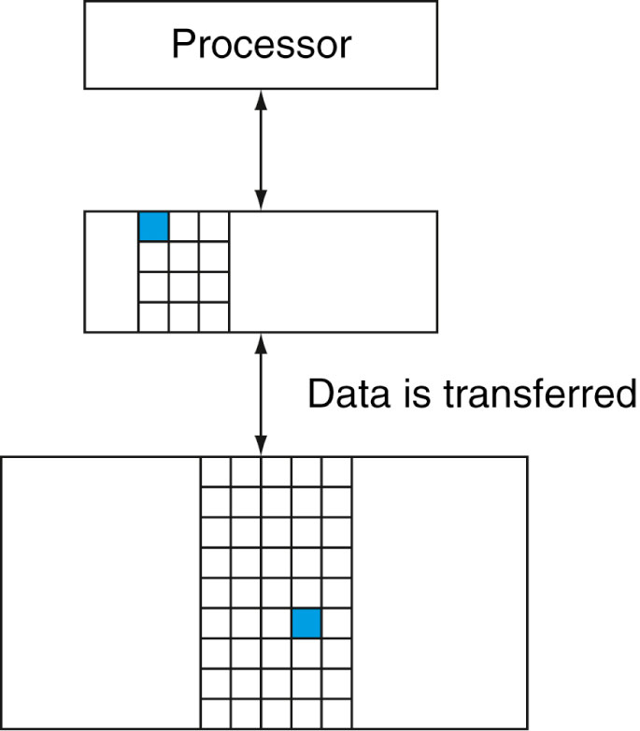
Level Interactions
When the processor needs data
from memory, it looks at the closest
storage device. If the data is not in
that storage device, the next level
is accessed and so forth
What types of memory accesses have we
Seen in MIPS?
FIGURE 5.2

Slide 10
Some definitions
Block:
The smallest unit of data that can be moved in an architecture
Hit Rate or Hit Ratio:
#Memory Hits / #Memory Accesses
Miss Rate or Miss Ratio:
#Memory Misses / #Memory Accesses

Slide 11
Memory Technologies
SRAM - v – fixed access time to datum
DRAM – v – denser and cheaper than SRAM, use a clock to synchronize accesses w/ processor
Flash – nv – bits can wear out so controller is needed to distribute where the bits are written
Magnetic – nv – cheapest, slowest

Slide 12
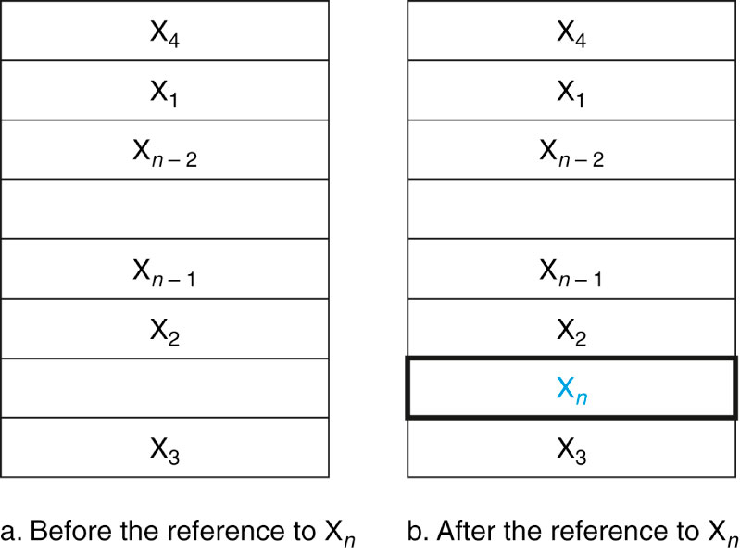
A Cache Miss Resolved

Slide 13
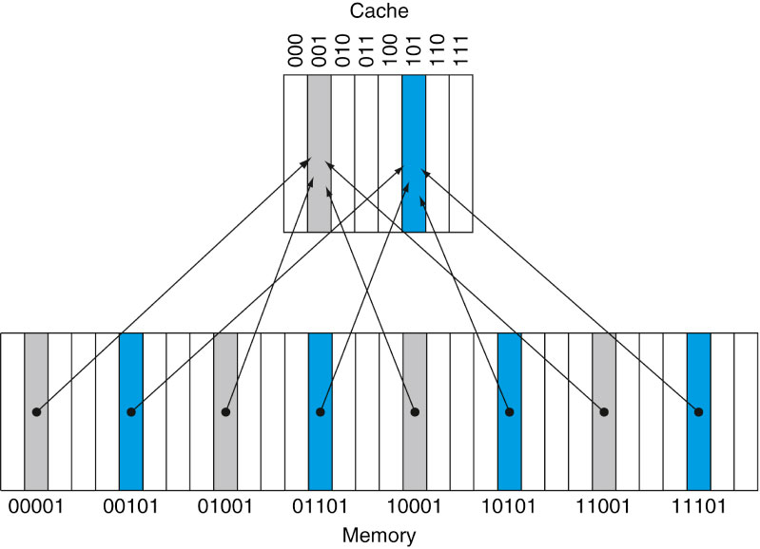
Direct Mapping
How do we determined where a block is stored when it resides in the cache?
Direct Mapping mods the block’s original address to get the cache address
Cache size is 8. Memory is 32. Location is Address mod 8

Slide 14
Direct Mapping
That’s all fine and good, but how do we know *which* of the four possible blocks is in the cache?
Add more info in the form of Tag and Index!
Tags contain the upper 2 bits of the 5 bit address and another valid bit.
For the address 11101, 111 is the Tag, 01 is the Index into the Cache

Slide 15
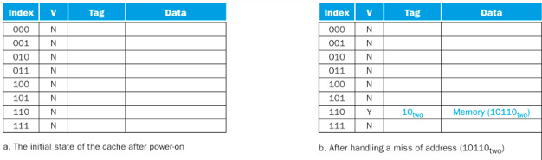
Cache in Action
Fig 5.9

Slide 16
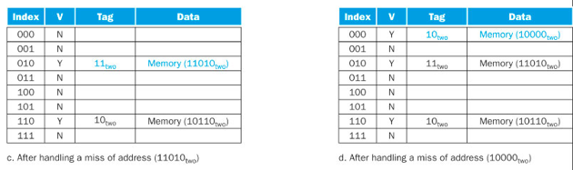
Cache in Action

Slide 17
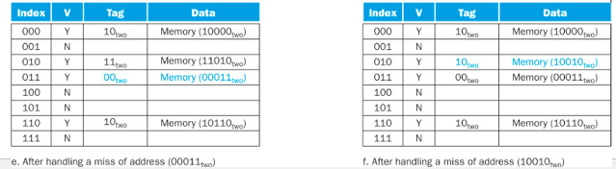
Cache in Action

Slide 18
Cache Specs in MIPS
MIPS blocks are 1 word, or 4 bytes.
Addresses are 32 bits long
Since the address references 4 bytes, we reserve the two least significant bits to designate which byte we are referencing (0,1,2,3)
This leaves us 30 bits – How do we use these for cache access?

Slide 19
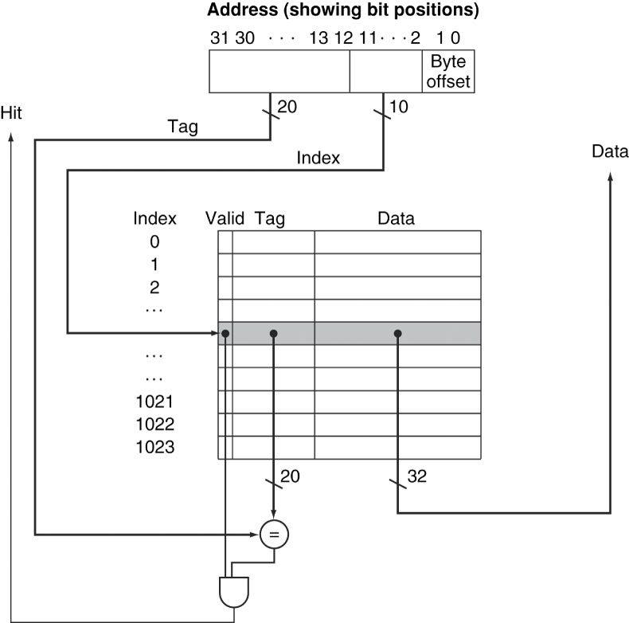
Cache Structure
How do we detect a miss?
If the bits in the tag field of the
Address don’t match those in the
Cache, it’s a miss

Slide 20
What do we do on a miss?
We are now ready to replace our Instruction Memory with a Cache… for old time’s sake….

Slide 21
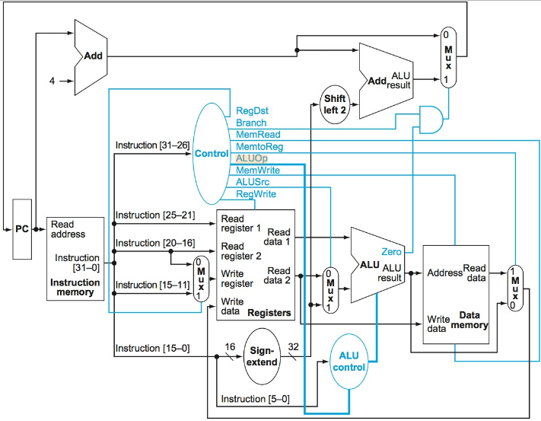
Our old friend, The Datapath
How do we handle a miss on the Instruction Memory cache?

Slide 22
Instruction cache miss
If a stale instruction is fetched, the register holding the instruction is incorrect, so we need to:
Back up one instruction (how?)
Tell main memory to read instruction into cache
Write to cache, updating tag data, updating stored data, turning on valid bit.
Restart instruction (how?)

Slide 23
Handling a Write
Case 1 – Write to cache, wait to write to memory
Case 2 – Write through to memory
Case 3 – Write miss

Slide 24
Write Through – Efficient?
Writing to main memory would take at least 100 cycles. Waiting for an update significantly slows processing
May use a buffer to store up the writes
If buffer is full, processor still has to stall

Slide 25
Exercise!
How many total bits are required for a direct-mapped cache with 16 KiB of data with 4-byte words, 4-word blocks, assuming a 32 bit address?
(Recall KiB is “kibibytpe” and is 210 (1024) bytes.)

Slide 26
Making Caches more efficient
Cache misses can stall the processor
…how could we possibly avoid them?
…what do you think our tradeoffs will be?

Slide 27
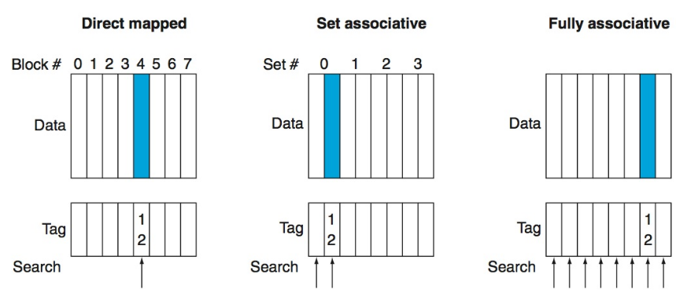
Three types of Association

Slide 28
Types of Association
Direct Mapped – Each memory location can go to only one location in the cache
Set Associative – Each memory location can go to a determined group of locations in the cache
Fully associative – Each memory location can go to any location in the cache

Slide 29
Types of Association - Tradeoffs
Direct Mapped – More misses
Set Associative – Balanced
Fully associative – Longer time to search

Slide 30
Association Tradeoffs in General
The higher the associativity, the lower the miss rate, but hit time may increase.

Slide 31
Locating Blocks in Asssociative Caches
Locating a block in a Direct Map is straightforward. Each address maps to only one location.
The memory address encodes the index of the data in the cache.
In an associative (either full- or set-) we need to efficiently find the block in the cache.

Slide 32
How to find?
Do we want to search the cache using some sort of search algorithm? Think….
If we don’t want to use an algorithm to find the block, what do we do?

Slide 33

How to find?
HARDWARE, baby….
For a four way set associative cache, four
Comparators are needed as well as a multiplexor to filter the data to the output lines

Slide 34
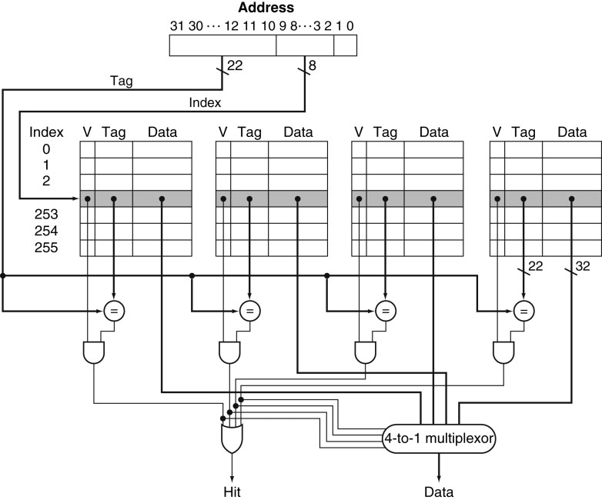
Four Way Associative

Slide 35
Fully associative
For a fully associative cache n comparators are needed – one for each row in the cache.

Slide 36
Replacement Policies
Consider a 4-way set associative cache:
A miss has been sensed and a block needs to come in from main memory. This block can be placed in one of its 4 designated spots in the cache.
Of course, if there is an empty spot, we’d place it there, but what if all spots are taken?

Slide 37
Replacement Policies
Random
Least Recently Used
First in First Out
Least Frequency Used

Slide 38

Reducing the Miss Penalty
A cache miss means we need to get data from main memory……
Or do we……?

Slide 39
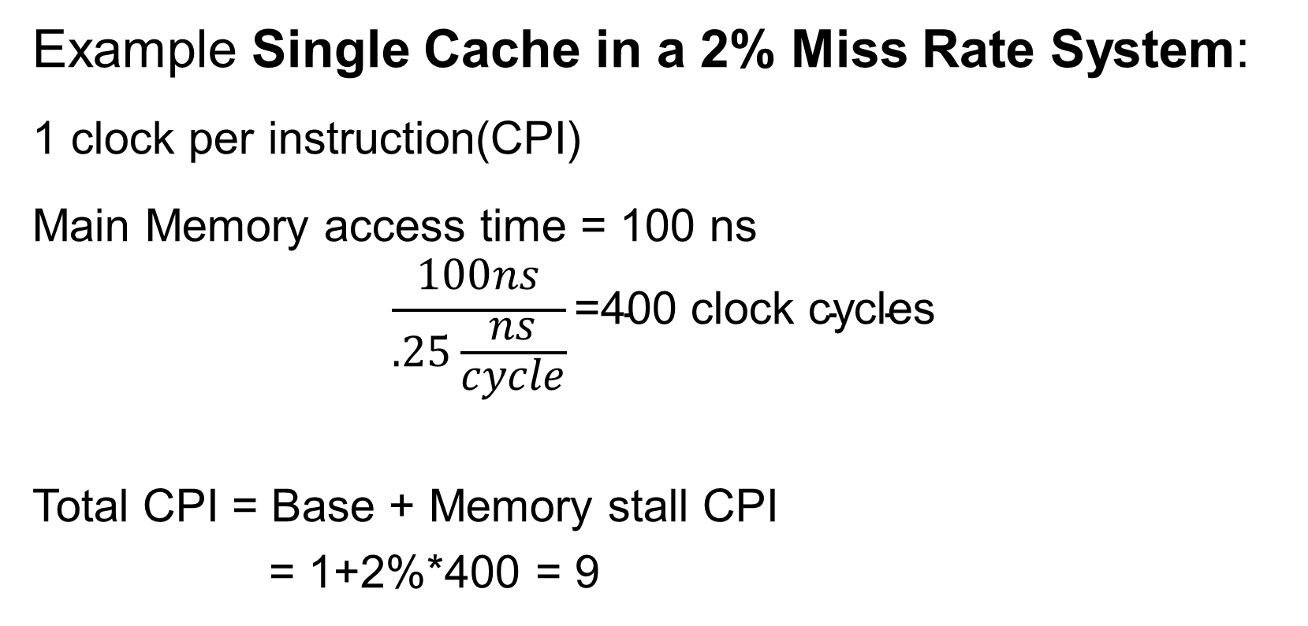
Reducing the Miss Penalty with Multilevel Cache
Example Single Cache in a 2% Miss Rate System:
1 clock per instruction(CPI)
Main Memory access time = 100 ns
$$\frac{100ns}{.25\frac{ns}{cycle}}\text{=}\text{40}\text{0 }\text{clock} \text{cycles}$$
Total CPI = Base + Memory stall CPI
= 1+2%*400 = 9

Slide 40
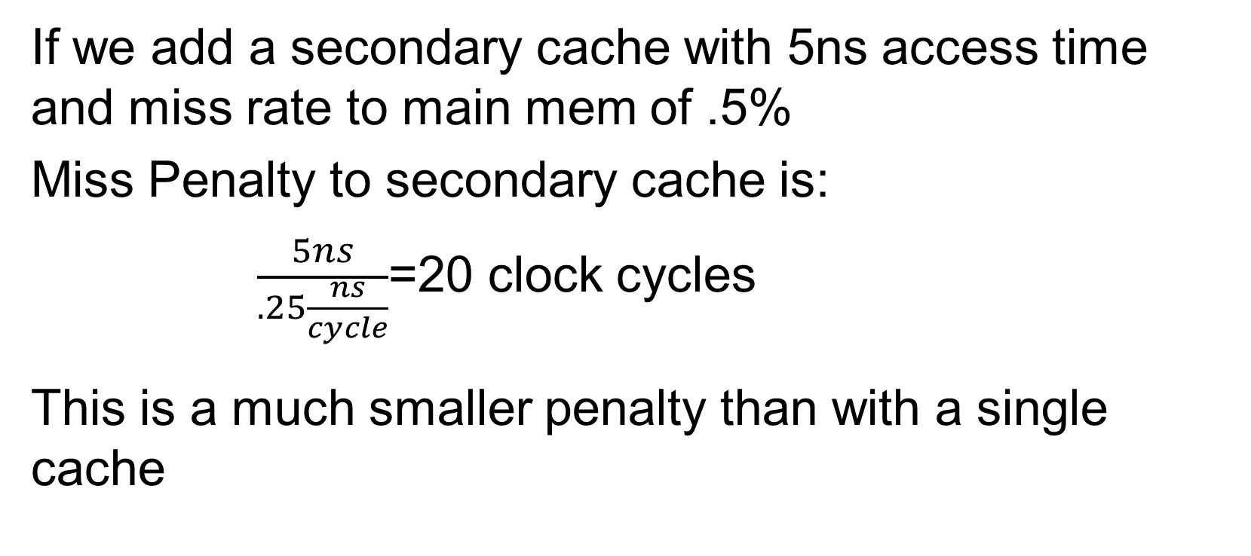
Reducing Miss Penalty
If we add a secondary cache with 5ns access time and miss rate to main mem of .5%
Miss Penalty to secondary cache is:
$\frac{5ns}{.25\frac{ns}{cycle}}$=20 clock cycles
This is a much smaller penalty than with a single cache

Slide 41
Reducing Miss Penalty
Total CPI = 1+Primary Stalls + Secondary Stalls
Total CPI = 1*2%*20 +.5%*400 = 1+.4+2 = 3.4

