Slide 1
Computer City: Sewers
An educational game to teach digital logic
Aaron Weeden
Fall 2009

Slide 2
Overview
Digital Logic
Game
Game demo
Design strategies
Future work
Questions

Slide 3
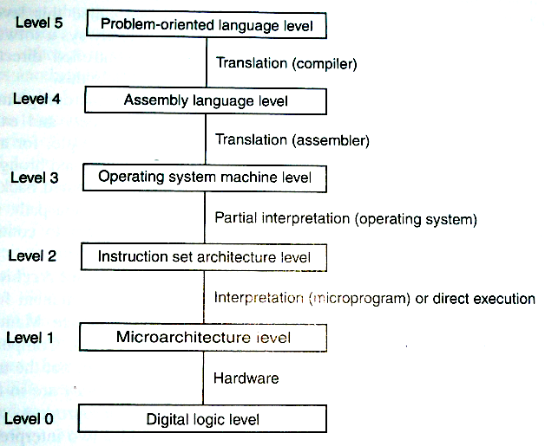
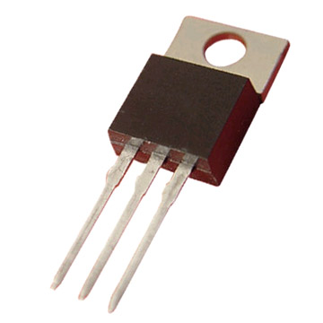
Digital Logic
Transistors
Binary values (0 and 1)

Slide 4



Digital Logic
Switches and gates
Circuits
0
1
Switch
Inverter
(NOT gate)
AND gate
OR gate

Slide 5
Digital Logic
0
1
1
1
0
1
0
0
1
0
1

Slide 6
Digital Logic
Truth tables
p
q
pANDq
0 0 0
0 1 0
1 0 0
1 1 1
Input
combinations
outputs

Slide 7
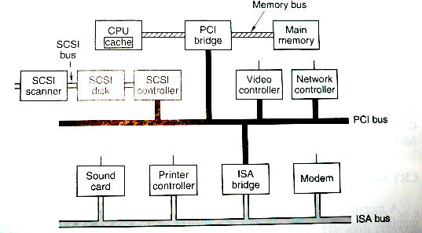


Game
Environment: Computer City
Environment: Sewer
Avatar: Bitty

Slide 8
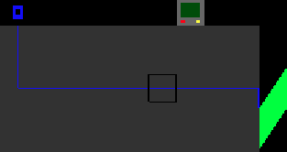
Game
Goal: Open doors
Goal: Collect blueprints

Slide 9
Design Strategies
Simple interface
Customizable
Unobscured view
Real-world representations of objects
Constant feedback

Slide 10
Future Work
Portability/Modularity
More rooms, more complex circuits
Sound
Playtesting

Slide 11
Thank you!
Questions?

