Slide 1
Genetic Insights from a Genetically Isolated Community
Alyssa Wheeler

Slide 2
About Myself
Graduate student
Bioinformatics
Healthcare research

Slide 3
Introduction
Plain people
Genetically isolated
Founder effect
Broader society
Leaving Plain community
Genetic databases
Healthcare providers

Slide 4
Project Goal
This study created a database from 210 Kish Valley Amish and Mennonite patient exomes. Then, exploratory data analysis was performed to identify meaningful gene variants with a focus on genes of interest identified by Dr. Morton.

Slide 5
Methods
VCF files
Annotated
Analysis with PLINK
Database Formatted
Part 1: Database Creation
Loaded into RStudio
Data Cleaning
Generate Tables and Figures
Filtering and More Tables and Figures
Part 2: Exploratory Data Analysis

Slide 6
Results

Slide 7
Database
Notes:
This is a searchable database of gene variants identified in the Kish Valley Amish and Mennonite community. It includes variant location, frequency, and the predicted impact of each variant using various bioinformatics tools. On this slide, is just the first 10 variants in the database as the database is too large to display the whole thing on the screen. But, this gives you an idea of the different variables that could be useful to someone searching through the database.

Slide 8
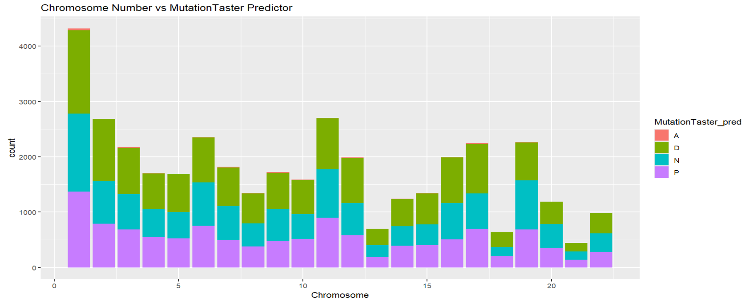
MutationTaster Predictor Results
Notes:
There were many predictor tools used in the analysis. Among these were SIFT, LRT, MutationTaster, MutationAssessor, and FATHMM. All of these tools used different metrics to try to determine whether a variant was disease-causing or tolerated, and they all had similar results. The MutationTaster predictor gives a good visual representation of these different graphs from the other tools also.
For this tool, “A” means it is known to be disease-causing, “D” represents potentially disease-causing, “N” means probably harmless, and “P” means automatically classified as harmless. As you can see there were not many classified as known disease-causing, but there were quite a few seen in green that are potentially disease-causing. These variants are the ones that should be focused on or prioritized base on not only this figure but also the ones from the other predictor tools.

Slide 9
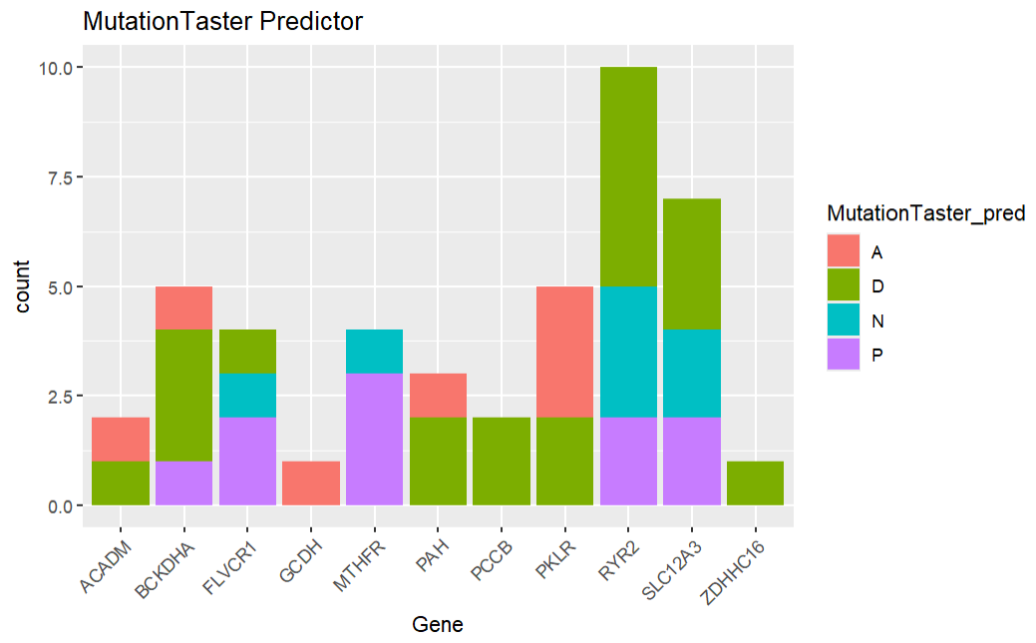
MutationTaster Predictions with Genes of Interest

Slide 10
PCCB had highest MAF
SNPid | Gene | Chr | MAF_percent | REVEL_score | CADD_raw | GERP++_NR
3:136048854:A:G | PCCB | 3 | 3.571429 | 0.919 | 5.072618 | 5.3
19:41930487:T:A | BCKDHA | 19 | 1.904762 | 0.953 | 5.097043 | 5.45
16:56919275:C:G | SLC12A3 | 16 | 1.428571 | 0.511 | 6.313977 | 5.4
12:103246653:C:T | PAH | 12 | 0.714286 | 0.985 | 6.13065 | 5.72
1:155261636:C:T | PKLR | 1 | 0.47619 | 0.947 | 5.750361 | 4.85
12:103234252:T:C | PAH | 12 | 0.238095 | 0.982 | 4.988886 | 5.63
12:103249091:C:T | PAH | 12 | 0.238095 | 0.89 | 5.048905 | 5.73
Notes:
This table shows the results of filtering for genes of interest and for only the harmful indicators in the predictor tools. The results are placed in descending order of the minor allele frequency (MAF). Minor allele frequency is the frequency at which the second-most common allele appears within a population.
To note, the PCCB gene had the highest MAF and REVEL score.
REVEL (rare exome variant ensemble learner) scores are based on a model that is trained on multiple predictive tools and are applied to missense variants to assess pathogenicity (Ioannidis et al., 2016). Among the genes of interest, all but one had a REVEL score above 0.8, indicating a high likelihood of disease causation, as REVEL scores range from 0 to 1.
CADD (Combined Annotation Dependent Depletion) scores are also used to predict the deleteriousness of gene variants as a higher score indicates that a variant is more likely to be damaging. CADD compares observed variants with simulated mutations and generates scores that correlate with both allelic diversity and disease association (University of Washington, n.d.). Within the genes of interest, the CADD scores centered around 5-6, indicating a lower likelihood of pathogenicity compared to more deleterious variants. GERP++ (Genomic Evolutionary Rate Profiling) scores identify constrained genomic regions by comparing observed substitutions to those expected under neutral evolution (Davydov et al., 2010). For the whole database, the highest GERP++ scores were about 9, while scores for the genes of interest were generally around 6. Since scores above 2 suggest a region is under selective pressure, these variants are considered deleterious and less likely to occur by random chance

Slide 11
Discussion
Database
Key genetic metrics
Resource for healthcare and broader society
Pathogenicity
Most likely disease causing: ACADM, BCKDHA, GCDH, PAH, PCCB, PKLR, RYR2, SLC12A3, and ZDHHC16
Neutral or harmless: FLVCR1 and MTHFR
Filtering for Harmful Predictions
Highest minor allele frequency: PCCB
CADD scores
Notes:
The resulting database includes key genetic metrics such as minor allele frequency, homozygosity, heterozygosity, and more. It serves as a valuable resource for both healthcare professionals and patients seeking a better understanding of gene function. The database can be used to estimate the prevalence of specific variants in the population to better understand their potential impact. Additionally, the database can be compared to variant data from outside populations to better understand disease risk and the frequency of specific mutations.
Analysis revealed a high concentration of potentially pathogenic variants on chromosome 1 across all predictive tools. Considering the large size of chromosome 1 compared to other chromosomes, it is not surprising to observe more gene variants on this chromosome. Chromosome 1 accounts for about 8% of the entire genome and is six times longer than chromosome 21, the smallest in the genome. This chromosome may need particular attention in future research. However, this concentration may be a result of the founder effect or reduced genetic diversity within this closed population.
Many of the genes of interests had variants that were disease causing and are listed here on the slide. There were also some genes that were mostly neutral or potentially harmless mutations as predicted by the predictor tools. This could either indicate these genes don’t need to be as prioritized in research, or if a patient is experiencing symptoms that are linked to these gene variants there is a possibility these are misclassified by the predictor tools or there are multiple gene mutations affecting the patient for those symptoms.
Looking at the table summarizing filtered results showing only the harmful predictions from each tool for Dr. Morton’s genes of interest. The PCCB gene variant displayed the highest minor allele frequency, suggesting a larger proportion of people in this population carried this mutation. As this mutation was determined to be disease-causing by all predictor tools, it should be prioritized among the genes of interest for future research.
In this table was also the CADD scores. the CADD scores were low for these genes (5-6). Meaning these gene variants may not be among the most deleterious genome-wide, but they still carry harmful consequences.

Slide 12
Conclusion
Prioritize harmful gene variants
Broader impacts
Improved healthcare
Notes:
Overall, the consistency across multiple prediction tools, allele frequency data, and conservation scores provides strong evidence for prioritizing the genes found to be harmful in this database for future clinical and functional studies. Further research would be necessary to establish the clinical significance of the variants. Importantly, findings from this closed population could have broader impacts, as the genetic background of the Plain community could overlap with parts of the general population. This could also be relevant given that some individuals from these communities have decided to leave their community and integrate into the broader society. This database and its findings could be incorporated into preventative care strategies and cost reduction efforts for not only the Plain population, but also other populations.

Slide 13
Limitations
Smalls sample size (210 individuals)
Predictor tool errors
Future research
Notes:
Despite these findings, this study had several limitations, the most significant being its small sample size of only 210 individuals. While this may be substantial for a closed or specific population, it limits the applicability of the findings to the broader population. As a result, the database may not be as applicable to the general public. But, it still includes known disease-causing variants that may be of relevance to wider groups. Another limitation lies in the tools used to predict variant pathogenicity, which are not perfect and are prone to errors. For instance, the LRT tool, which was not shown in any of the graphs in the slides, was unable to classify certain variants and marked them as “unknown.” These unclassified variants could still pose a risk and merit further investigation. Future research should examine how this database compares to those from other populations and how its findings could inform the prioritization of specific genetic variants in patient care.

Slide 14
Acknowledgements
Thank you to Dr. Lamendella, Dr. Morton, and Brittney McMullen for their help and guidance throughout this project

