Slide 1
Inflation, Cost of Living, and Real Wages

Slide 2
Inflation, Cost of Living, and Real Wages

Slide 3
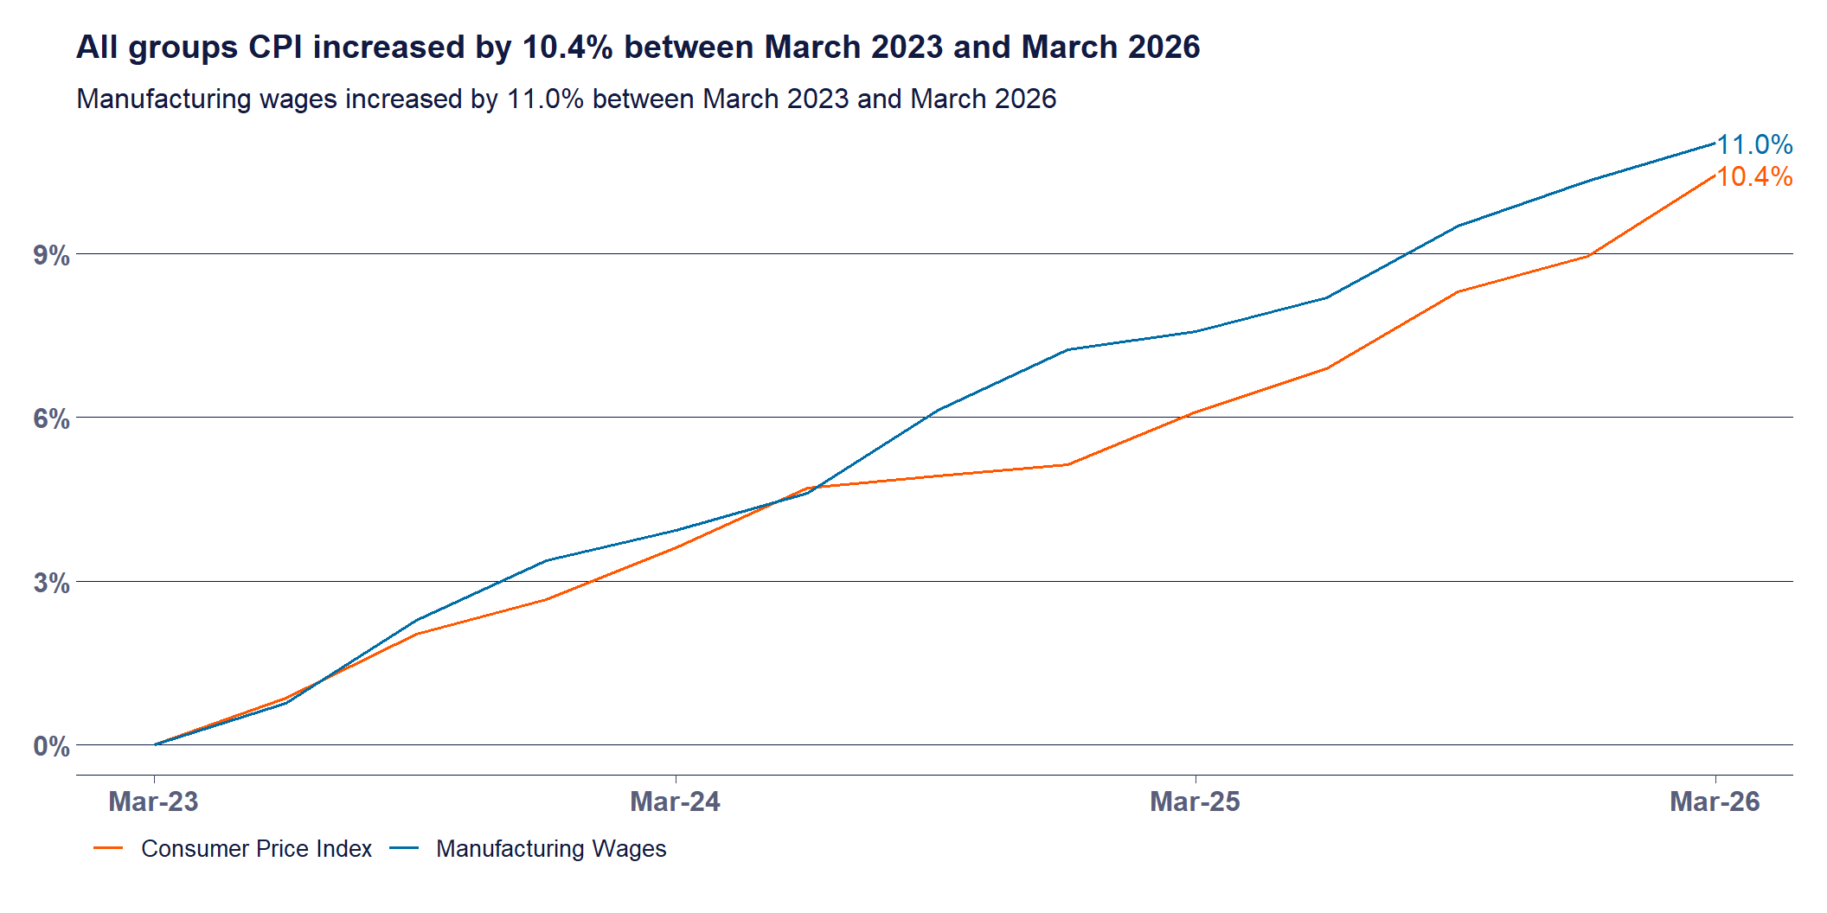
Overall Inflation Impact
Notes:
Since March 2023, prices have grown faster than wages.
So what’s the problem?

Slide 4
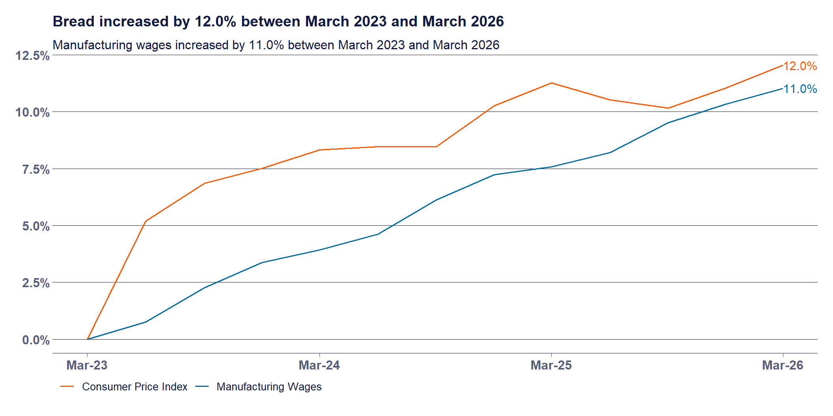
Bread

Slide 5
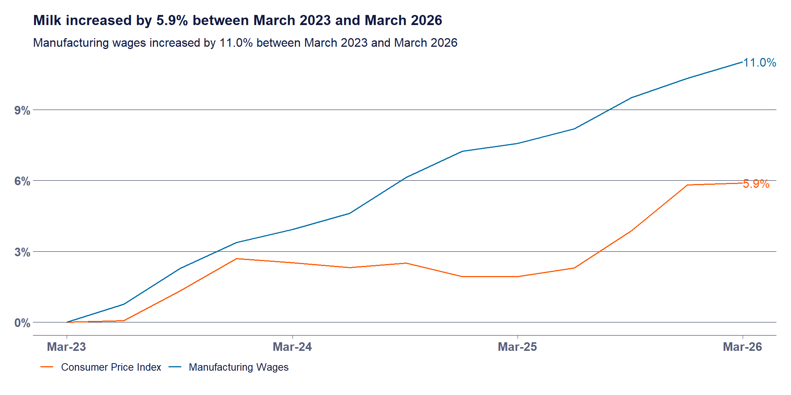
Milk

Slide 6
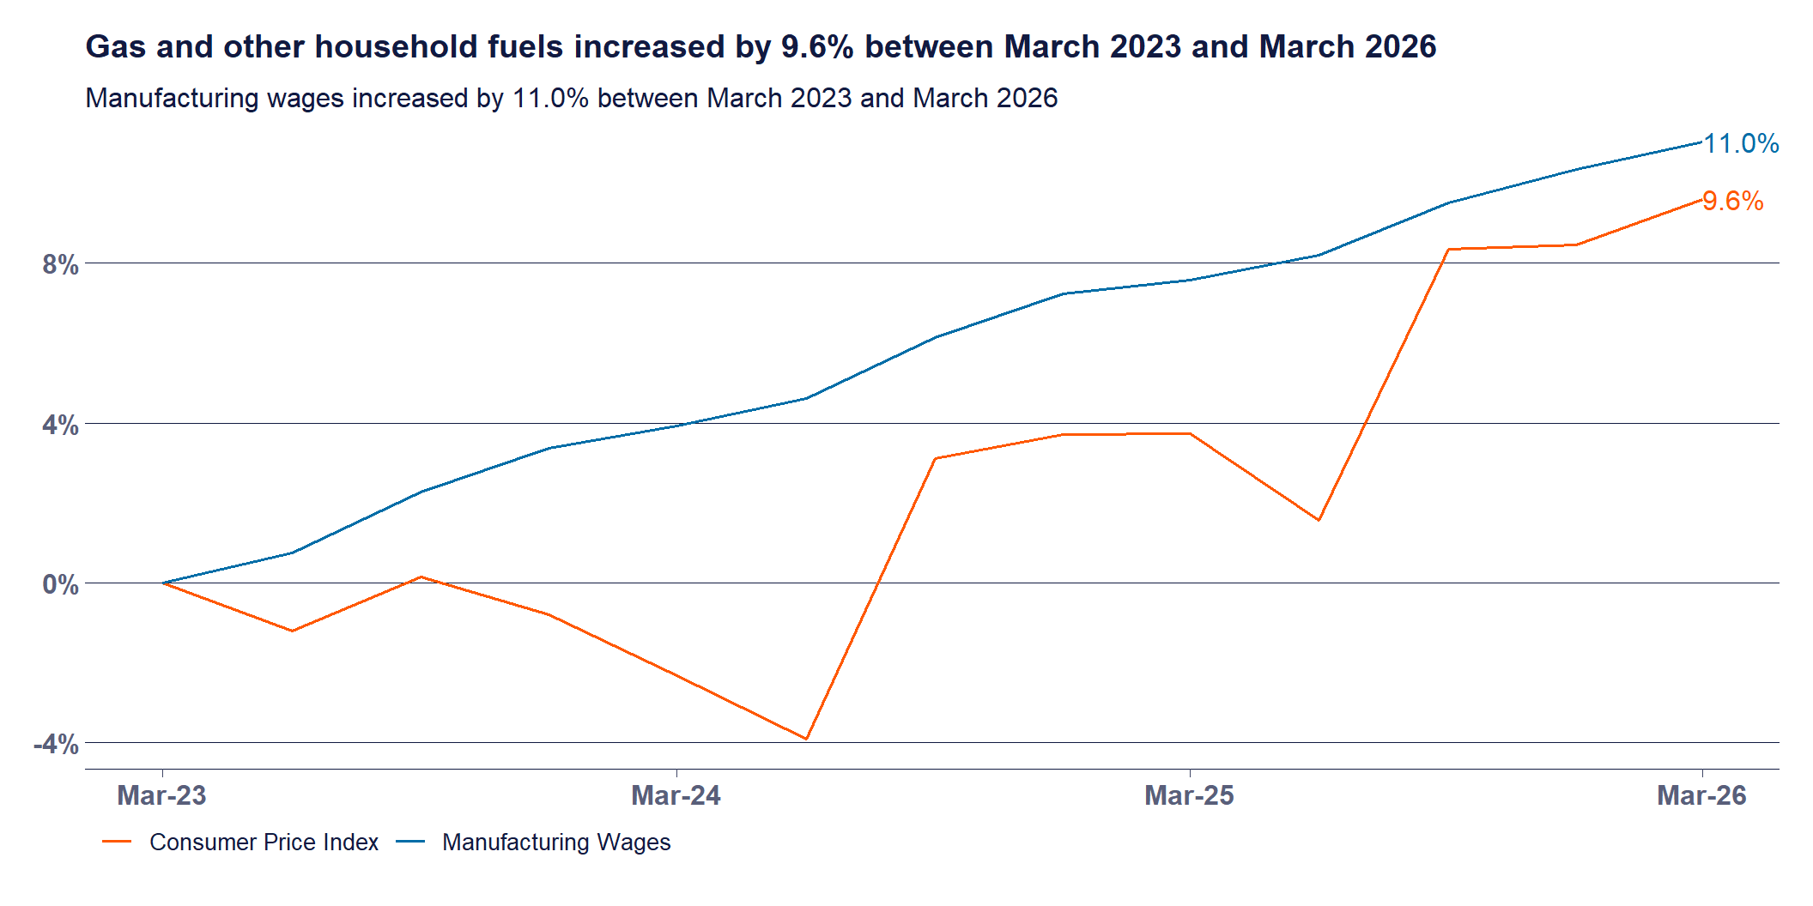
Gas

Slide 7
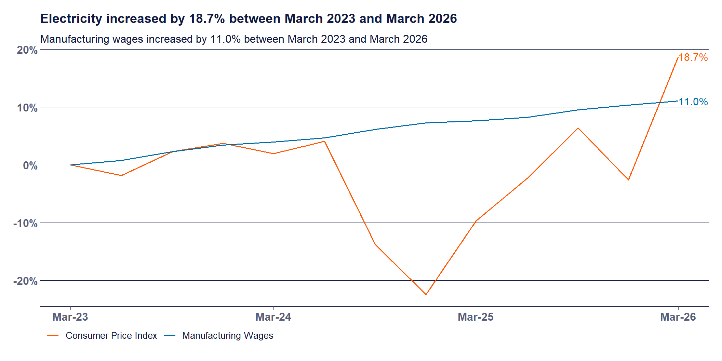
Electricity

Slide 8
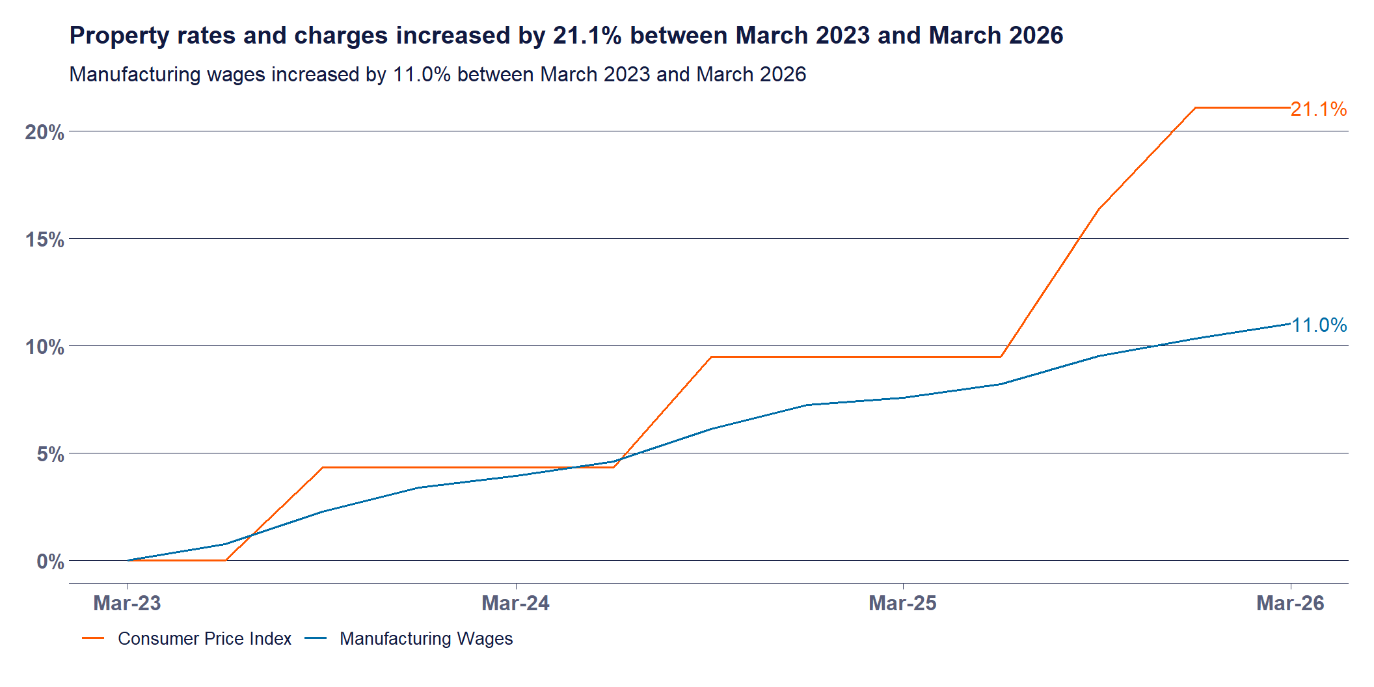
Property Rates

Slide 9
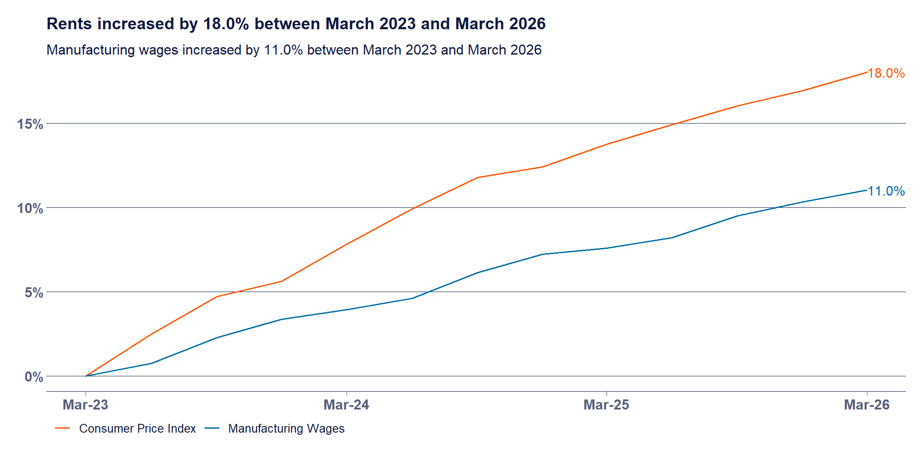
Rents

Slide 10
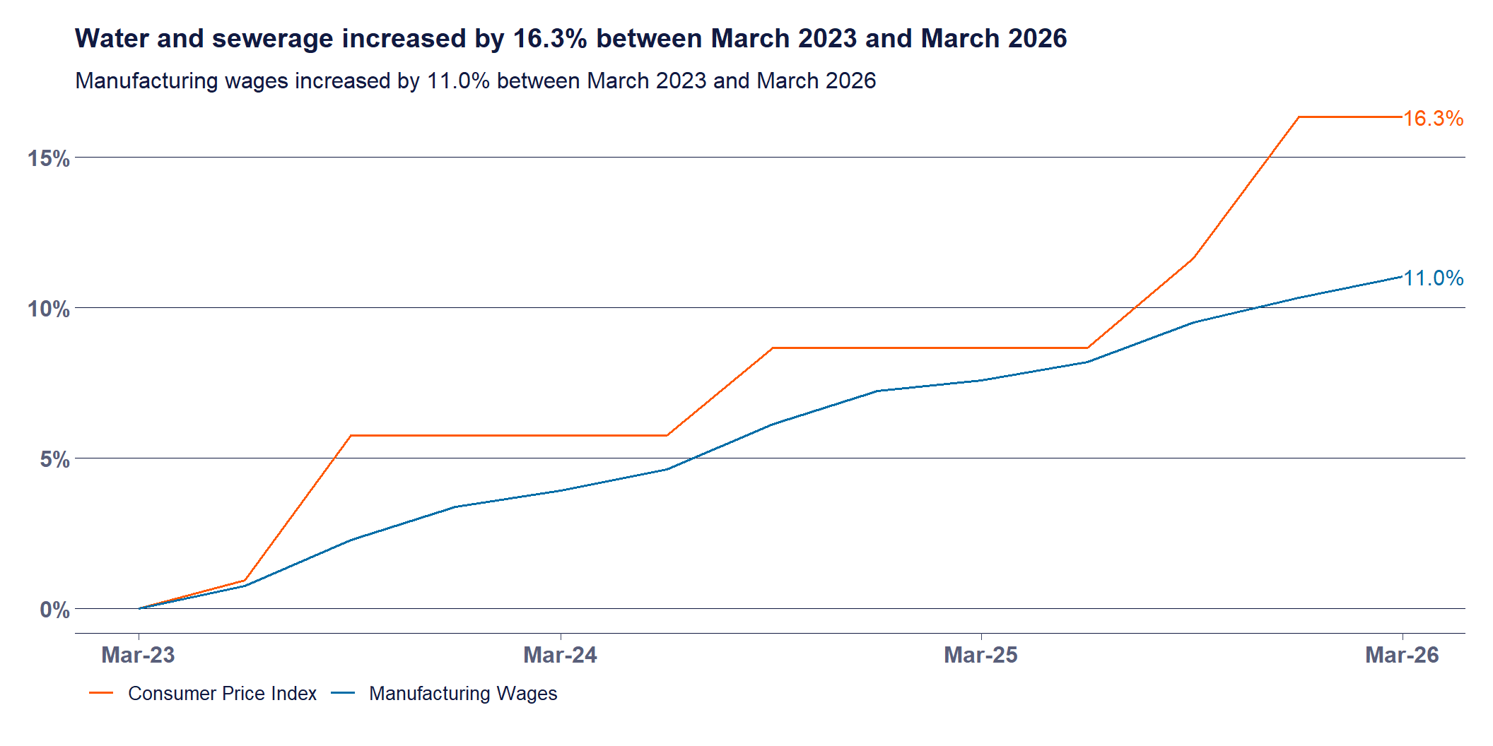
Water

Slide 11
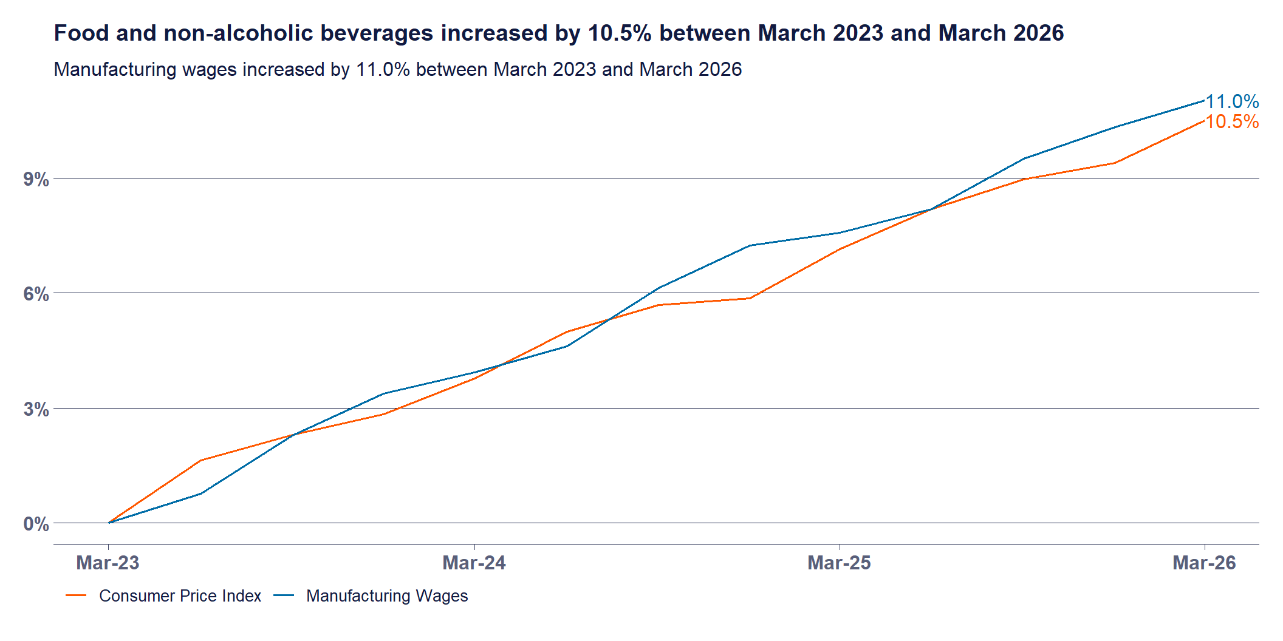
Food and Non-alcoholic Beverages

Slide 12
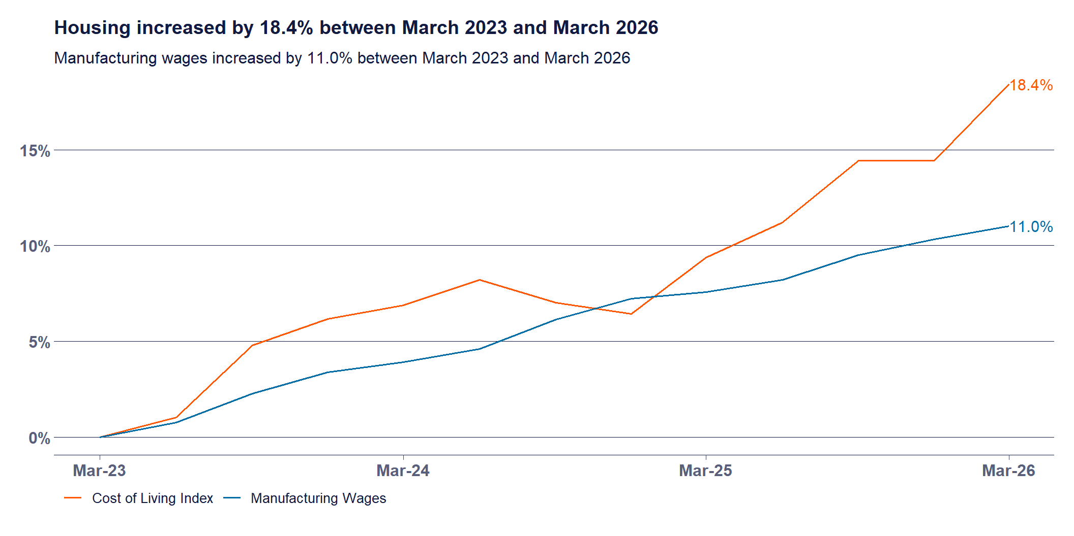
Housing - Including Mortgages

Slide 13
Summary
Notes:
Forget inflation. We’re talking about cost of living, not a measure created for the purposes of helping the RBA determine what interest rates should be. The CPI is designed to measure price inflation for the household sector as a whole and is not the ideal measure for assessing the changes in the purchasing power of the disposable incomes of households.
The Cost of Living Index can be interpreted as “How much would after tax incomes need to change to allow households to purchase the same quantity of goods and services between period A and period B”.

Slide 14
Change in living costs by product category
% change between March 2026 and March 2023
Price Category | % change
Insurance and financial services | 33.6%
Housing | 18.4%
Alcohol and tobacco | 17.9%
Education | 15.0%
All groups | 13.0%
Health | 12.5%
Wages | 11.0%
Food and non-alcoholic beverages | 10.5%
Clothing and footwear | 7.7%
Recreation and culture | 5.6%
Transport | 5.3%
Communication | 3.3%
Furnishings, household equipment and services | 2.7%
Change in living costs by product category
% change between March 2026 and March 2020
Price Category | % change
Insurance and financial services | 72.3%
Alcohol and tobacco | 35.1%
All groups | 28.5%
Housing | 27.1%
Health | 27.0%
Education | 26.2%
Transport | 25.4%
Food and non-alcoholic beverages | 25.3%
Wages | 20.6%
Recreation and culture | 19.2%
Furnishings, household equipment and services | 17.9%
Clothing and footwear | 9.4%
Communication | 1.7%

Slide 15
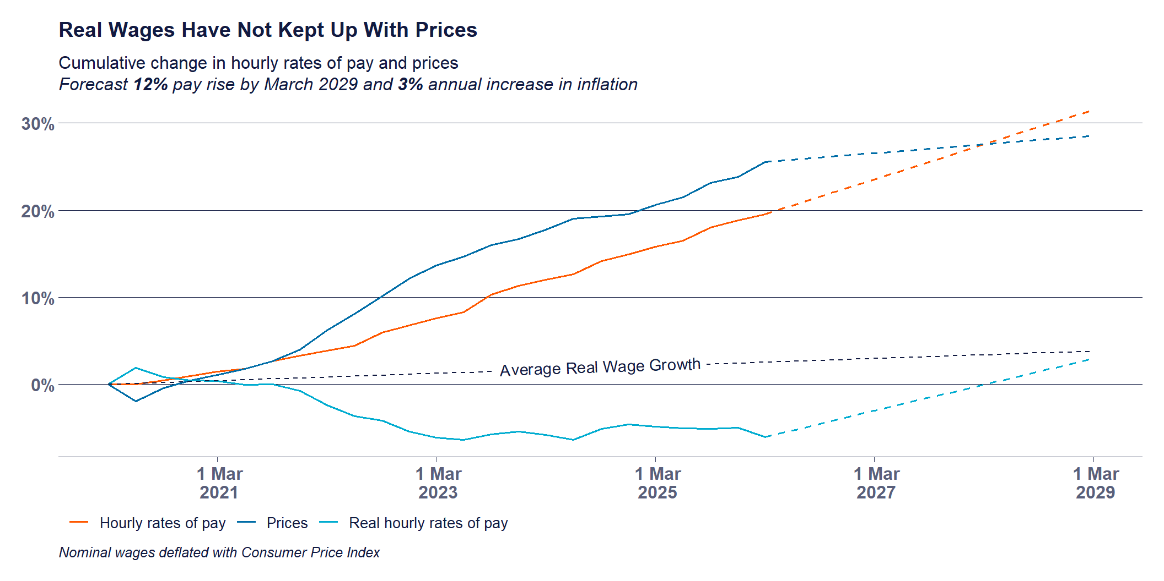
Inflation and Wages
Notes:
Looking only since 2023 suggests that wages have grown slightly faster than inflation. But the cost of living index shows that wages have not grown faster than the cost of living.
The problem with looking only since 2023 is it neglects the impact of high inflation between 2021 and 2023, where real wages were seriously eroded.

Slide 16
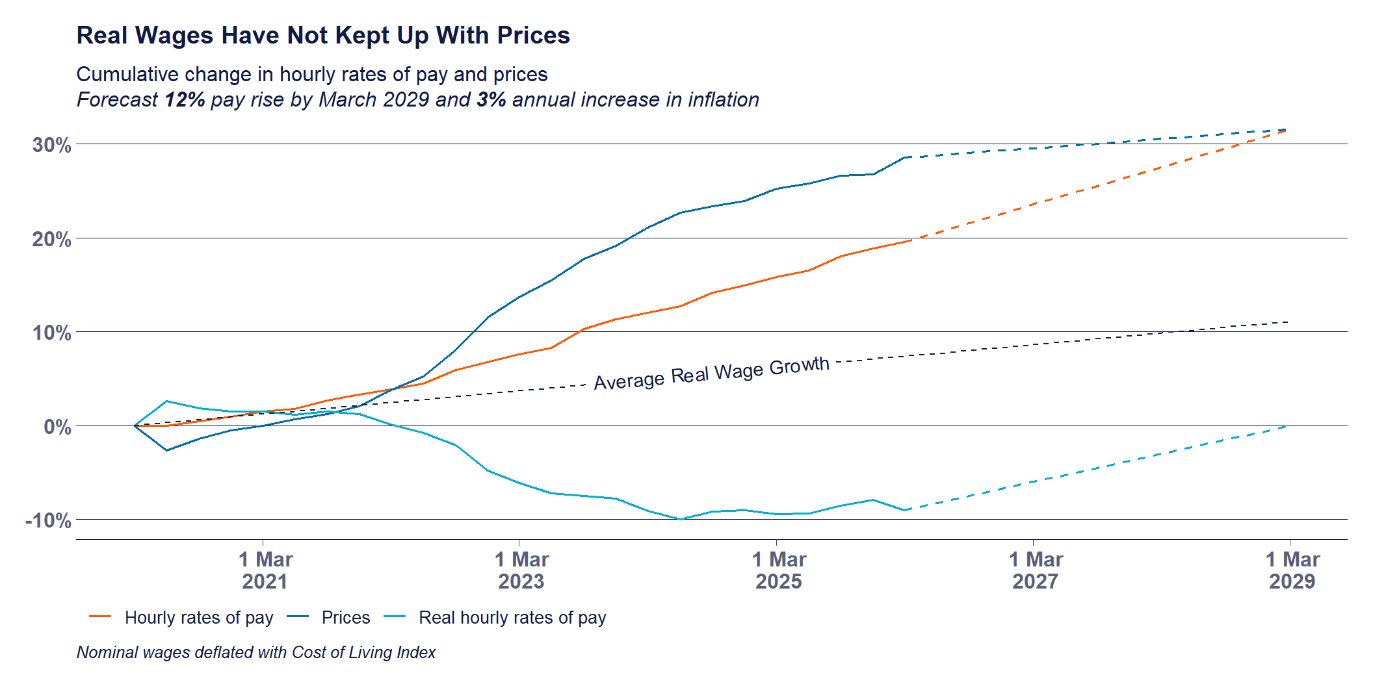
Cost of Living and Wages

