Slide 1
Economics and Political Economy
Useful Economics Hamish Gamble

Slide 2
Introduction to Economics

Slide 3
What is Economics?
A modern economist will tell you that economics is “the study of resource allocation under scarcity”
This definition deliberately hides the political dimension of economics.
Political economy is about the relationship between political and economic systems.
The economics of capitalism is reinforced and reflective of political power.

Slide 4
Labour Market Economics
How does our economy work?
Notes:
Step through example in course notes

Slide 5
The Economic System in Australia
Australia’s economy is a capitalist economy.
Production of commodities
Private ownership of the means of production
Production for profit
Notes:
In Australia, our economic system is called capitalism. The capitalist system is defined by:
commodity production
A commodity is something which satisfies human demand, and is not produced for personal consumption, but for exchange. Almost everything produced under capitalism is a commodity, and this includes the labour that we sell to the boss every day we go to work.
private ownership of the means of production
The means of production, such as land, tools, capital equipment, and a company itself are mostly privately owned in a capitalist economy. But not everyone has the same opportunity of ownership. Most workers do not own the company, the capital equipment, or even the product that they produce at work. And they are not in control of company or management decisions, or how to do the work.
production for profit
Production in a capitalist economy occurs because the capitalist (person or people who own the means of production) want to make profit. That is, they want to end up with more money than they start with.
Prompt the following discussion: Who in your workplace belongs to which class?

Slide 6
Production in Capitalism
Production occurs in the context of class conflict.
Both workers and capitalist want money.
Are the reasons the same?
Notes:
Prompt the following discussion: Why do you go to work?
For workers, it is pretty simple. We want money to buy something - a holiday, a new TV, a house etc. These are commodities that meet our needs and our wants. Workers sell their labour (which is a commodity) in exchange for money, which we exchange for the commotities that fulfil our needs and wants.
The capitalist on the other hand wants to generate a profit. Profit means that they end up with more money than they started with. Imagine a capitalist who has $100 that they want to invest into a coffee shop. With their $100, they buy $50 worth of materials like milk and coffee beans, and $50 worth of equipment - a coffee machine. The capitalist hires a worker to make coffee, and promises to pay them a wage at the end of the day. At the end of the day there’s $150 in the cash register.
Where did the extra money come from?
What would be a fair amount to pay the barista for their work?
What would be a fair amount for the capitlist to keep for themself?
Given the conflict, how can we manage the distribution of the $50 between worker and capitalist?
Ultimately, while the worker and the capitalist both want money - a shared interest, when we look at the motivations, we see that there is a conflict between the worker and the capitalist. And this conflict is built on the contradiction that it is workers who create value that is then stolen by the capitalist. The whole system is built on an exchange which is unfair. But what can you do about it? Without ownership of the inputs yourself, workers have to participate in the unequal exchange in order to be paid a wage to meet their needs.

Slide 7
Hot Topics

Slide 8
BREAKING NEWS

Slide 9
Inflation Tumbles!
https://youtu.be/mt2bVFkkMmQ

Slide 10
Inflation: Discussion
Why do you care about inflation?
Why does your boss care about inflation?
What is inflation measuring?
Does the video reflect your experience of inflation?
Notes:
Context
Inflation, under neo-liberalism has become the single most important economic priority.
This coincides with the increased dominance and ‘importance’ of the financial industry and the decline in productive industry like manufacturing.
Controlling inflation is More Important than:
full employment
reducing inequality
housing affordability
alleviating poverty
Instead of full employment, government and institutions now push the “non-accelerating inflation rate of unemployment” which suggests there is a minimum level of unemployment necessary in order to stop wages growth and rising inflation. Of course, we can’t measure the NAIRU, only show that it might exist, if a bunch of assumptions are made about how the economy works. Estimates from data suggest that it falls somewhere between 4 and 5%.
This means that it is explicit government policy to keep up-to 5% of the labour force out of work, in order to keep wages and inflation down.
Such policy MIGHT be palatable if there was a strong social safety net to support workers who lose their job and are looking for another one. Of course, we don’t even get that, with only the below poverty JobSeeker payment available.
But it is still a very inefficient use of the labour power that our economy has access to. Why shouldn’t someone who wants to work not have access to a job? It also means that policy is designed to discipline labour.
Which by the way, is why the budget in 2024, by the nominative party of labour, forecast that the plan was to tackle inflation by driving the unemployment rate UP to at least 4.5 percent by June 2025. Last weeks unemployment figures showed that unemployment unexpectedly had increased to 4.2%. It would be cold comfort for those who find themselves recently unemployed that they’re doing their part to combat inflation and keep wages down!

Slide 11
Productivity Crisis!
https://www.youtube.com/watch?v=MVErL94YLGM

Slide 12
Productivity: Discussion
Why do you care about productivity?
Why does the boss care about productivity?
What is productivity measuring?
Who benefits from increased productivity?
What factors influence how productive you feel at work?
Notes:
Productivity is possibly the most misunderstood economic indicator, but simultaneously one of the most spoken about. The newly elected government has set its focus on productivity, and productivity growth, and has got the Productivity Commission in on the action.
The Productivity Commission by the way, should be seen as a complete joke. It was created by the Howard government in the 1990s, and sits within the Treasury department.
In a FWC hearing in 2025, the chief economist of the Australian Chamber of Commerce and Industry (also a joke) was asked “what factors drove productivity”. He answered that “the Productivity Commission was currently examining those factors”. 35 years since their establishment, and the Productivity Commission is still examining what productivity even is!!!
As an example of how productivity is misunderstood, here’s a quote from the Australian Constructors Association (an industry group):
If we stay stuck on the current course, our living standards will go backward, with Australians working longer hours for less money.
Productivity has nothing to do with wages - and working longer hours contributes to decreasing productivity, not the other way around!!
As an aside, one of the ways to increase productivity in the construction industry would be to reform the apprentice system, pay higher wages, and encourage more people to become skilled tradespeople.
Open the room to discussion on the dot points
Productivity is about quantities, and not about costs. Its the rate at which we produce goods or services per unit of input. How many workers does it take to make a widget?
Productivity is also about technological progress. If a new technology enables the production of the same number of goods in fewer man-hours, that increases productivity. But these are the decisions of management, not the decisions of workers.
Measuring productivity is really hard. Output per worker-hour in industries which make a single output (like a car) is straightforward. But what about the interaction between capital and worker? How can you measure the output per capital-worker-hour? What does that even mean?
Speaking of the Productivity Commission, their report into productivity identified that estimates of productivity are constantly being revised - sometimes by 0.5 percentage points or more. The June quarter estimate of productivity growth was 0.5%. There is a huge potential for error - there’s a big difference between 0%, 0.5%, and 1.0%.
Estimates of productivity in non-market sectors like education, or health care, are even more ridiculous. What is the output you’re measuring? Number of students graduating? Number of patients discharged? If that’s the case, productivity would go up by reducing the number of teachers or the number of nurses.
Finally, real wages and productivity decoupled long ago. Increased productivity no longer translates with increases in real wages. That means that private business is getting more output per unit of input, but they are not passing that on to the workers who actually supply their labour. Instead, productivity growth contributes to increasing worker exploitation through increased profit margins. How that profit is spent is then up to the capitalist, not the worker.

Slide 13
Discussion: Economic Reports
Describe how the finance section is reported on the news
Why does the news include a finance report?

Slide 14
What Goes Unquestioned?

Slide 15
No one could imagine any alternative to the status quo, and politicians and citizens alike were resigned to maintaining the pretense of a functioning society.
Alexei Yurchack, Everything Was Forever, Until It Was No More: The Last Soviet Generation (2006)

Slide 16
What Goes Unquestioned?
https://www.youtube-nocookie.com/watch?v=KSS6wEb-fvA

Slide 17
Capitalist Realism
Capitalism is the only viable political and economic system.
Contradictions, and crises in our economy can be solved only through capitalist solutions, i.e. taxes, regulation
The actions of individuals can be explained by their individual wants, needs, and talents.

Slide 18
Implicit Acceptance
There is an imbalance in power between workers and bosses.
Efficient markets lead to optimal allocation of resources.
Competition is an inevitable part of human society.
Inequality is inevitable.

Slide 19
Chatting Economics

Slide 20
The purpose of studying economics is not to acquire a set of ready-made answers to economic questions, but to learn how to avoid being deceived by economists.

Slide 21
Inflation
Notes:
We’re going to talk about:
inflation
why “economic good news” doesn’t necessarily translate to how you feel
things your boss will use to justify why you shouldn’t get a pay rise
Hopefully give you confidence to talk about economic indicators, by letting you know the tricks that “economists” use.
Inflation, under neo-liberalism has become the single most important economic priority.
This coincides with the increased dominance and ‘importance’ of the financial industry and the decline in productive industry like manufacturing.
Controlling inflation is More Important than:
full employment
reducing inequality
housing affordability
alleviating poverty
Instead of full employment, government and institutions now push the “non-accelerating inflation rate of unemployment” which suggests there is a minimum level of unemployment necessary in order to stop wages growth and rising inflation. Of course, we can’t measure the NAIRU, only show that it might exist, if a bunch of assumptions are made about how the economy works. Estimates from data suggest that it falls somewhere between 4 and 5%.
This means that it is explicit government policy to keep up-to 5% of the labour force out of work, in order to keep wages and inflation down.
Such policy MIGHT be palatable if there was a strong social safety net to support workers who lose their job and are looking for another one. Of course, we don’t even get that, with only the below poverty JobSeeker payment available.
But it is still a very inefficient use of the labour power that our economy has access to. Why shouldn’t someone who wants to work not have access to a job? It also means that policy is designed to discipline labour.
Which by the way, is why the budget in 2024, by the nominative party of labour, forecast that the plan was to tackle inflation by driving the unemployment rate UP to at least 4.5 percent by June 2025

Slide 22
Inflation (or, the Consumer Price Index)
The CPI is a measure of changes in the price of a “basket” of goods and services.
The basket includes (among other things):
Food and non-alcoholic beverages, alcohol and tobacco, and housing
It represents the average inflation experience - and is not reflective of changes in cost of living.
Notes:
By their nature, averages are not representative of individuals. Statistical agencies have to make a lot of decisions when calculating price indices, including:
What goes into the basket?
How should like items be grouped?
How should each group be weighted into the overall?
How often should the weighting change?
Ultimately, the basket of goods and services does not represent the spending or expenditure patterns of any one individual.
There will be a disconnect between how the CPI is reported, and how you feel it as an individual.
For example, in 2025 the weight of tobacco in the CPI was reduced because tobacco sales fell as fewer people are smoking. That means increases in the price of cigarettes don’t impact on the overall CPI as much. So smokers will feel that prices are increasing faster than the CPI.
That doesn’t mean your feelings are wrong, or that you’re spending money ‘incorrectly’. It also means that we should not accept pay rises equal to changes in the CPI.
Note that I specified housing as a good/service that is included in the consumer price index. What would you expect that to measure? The cost of housing is measured as the price of a new home (excluding land). Mortgage payments are excluded.

Slide 23
Reporting Inflation - Index
CPI data is reported as an index, or as a % change compared to the previous quarter, or previous year.
an index shows how prices have changed relative to a value of 100 in a reference period.
Notes:
The ABS indexes the CPI such that the 2011/12 financial year = 100. All index numbers are reported relative to this period. That means that an index of 110 in March 2020 would mean that prices have increased by 10% since the 2011/12 financial year.

Slide 24
Reporting Inflation - Percentage Change
CPI data is reported as an index, or as a % change in since last month, last quarter, or last year.
A percentage change measures the relative change in prices compared to another period.
Notes:
Annual Change
The annual change is a measure of the price now compared to the price one year ago.
Change from Previous Quarter:
The change from previous quarter is a measure of the price now compared to the price 3 months ago.
Example 1
An annual change of 7.8% in December 2022 means prices in December 2022 were 7.8% higher than they were in December 2021.
Example 2
A change from previous quarter of -1.9% in June 2020 means that prices in June 2020 were 1.9% lower than they were in March 2020.

Slide 25
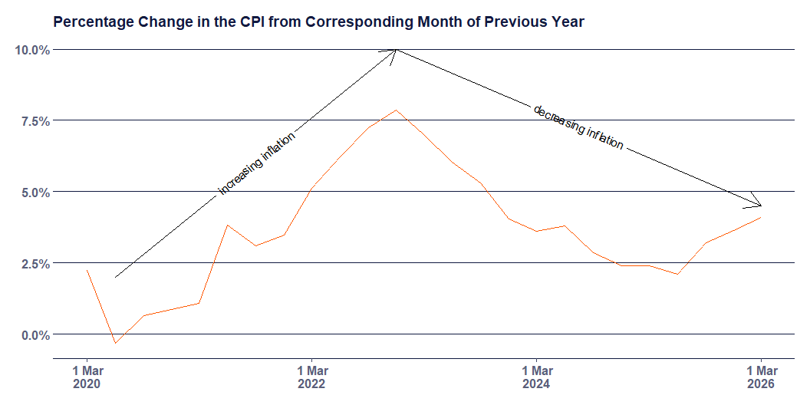
Inflation - Percentage Change
Notes:
This is the % change way of measuring inflation.
Inflation goes up when the % change in one period is higher than the last period
All the numbers (except for one in 2020) are positive. In fact, since the September quarter of 1948, inflation has only been negative 5 times.

Slide 26
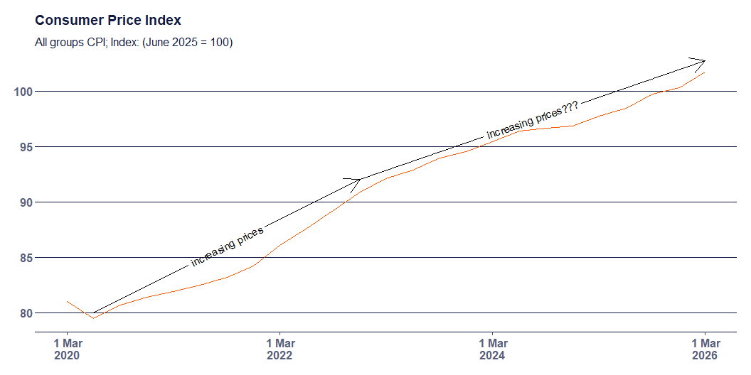
Inflation - Index
Notes:
Now looking at the index number approach.
Decreasing inflation is usually presented in the media as good news. But because inflation measures the rate of change of a rate of change (i.e. how much the change in prices changed), decreasing inflation just means that prices didn’t increase as fast.
The index measure shows you the effect of ‘cumulative’ inflation on prices.

Slide 27
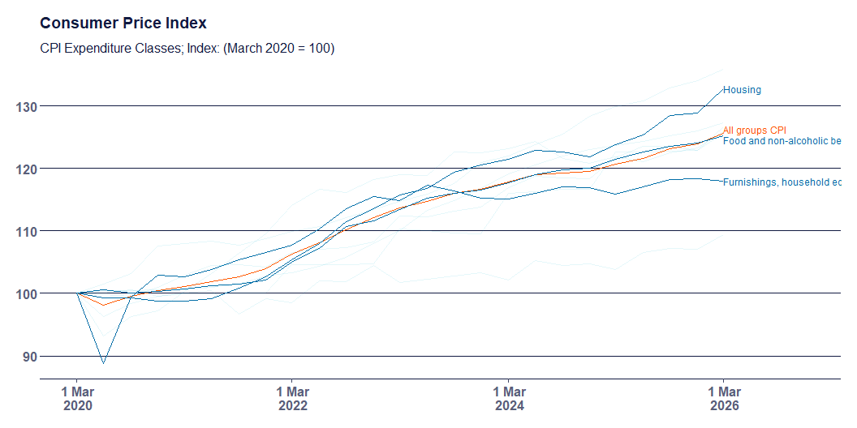
Inflation - By Type
Notes:
Reported inflation tends to focus on the overall average - but it’s collected at a highly disaggregated level, of 87 different groups.
Things that have increased faster than the average since March 2020 include: housing, food, alcohol and tobacco, health, transport, education, and insurance
Compared to things which have gone down? Clothing and footwear, and furnishings…
Other weird things about inflation - it hasn’t included mortgage repayments (since 1998).

Slide 28
Inflation - Cost of Living
Notes:
As mentioned previously, the CPI is not a measure of the cost of living. In fact there is no definitive cost of living measure collected by the ABS but the ABS does collect a living cost index, which looks at different household types expenditure patterns.
The living cost index asks “By how much would after tax money incomes need to change to allow households to purchase the same quantity of consumer goods and services that they purchased in the base period?”

Slide 29
Change in living costs by product category
% change between March 2026 and March 2025
Price Category | % change
Housing | 8.3%
Clothing and footwear | 5.5%
Alcohol and tobacco | 4.4%
Recreation and culture | 3.6%
Education | 3.4%
Health | 3.3%
Wages | 3.2%
Food and non-alcoholic beverages | 3.1%
Transport | 3.0%
All groups | 2.6%
Furnishings, household equipment and services | 2.0%
Communication | 1.7%
Insurance and financial services | −3.6%
Change in living costs by product category
% change between March 2026 and March 2020
Price Category | % change
Insurance and financial services | 72.3%
Alcohol and tobacco | 35.1%
All groups | 28.5%
Housing | 27.1%
Health | 27.0%
Education | 26.2%
Transport | 25.4%
Food and non-alcoholic beverages | 25.3%
Wages | 20.6%
Recreation and culture | 19.2%
Furnishings, household equipment and services | 17.9%
Clothing and footwear | 9.4%
Communication | 1.7%

Slide 30
Inflation - Wages
https://www.youtube.com/watch?v=g6-lciEvkpA

Slide 31
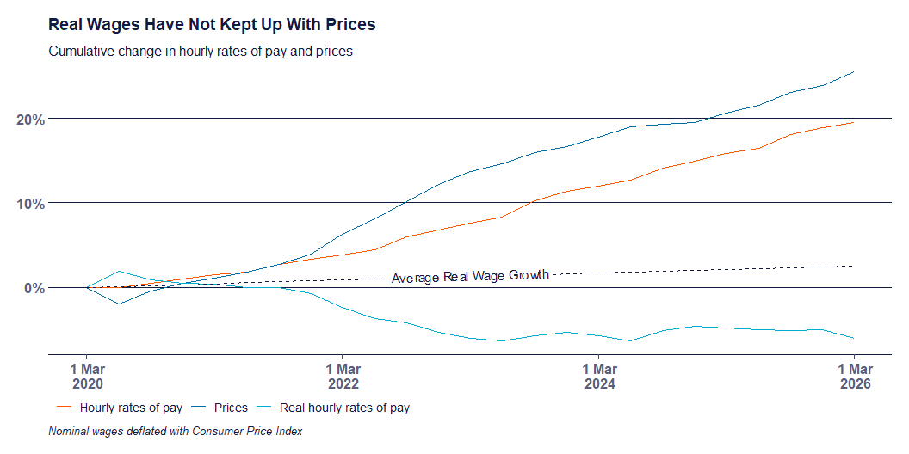
Inflation - Wages
Notes:
What is relevant to everyone is how well wages are keeping up with increased costs. It isn’t particularly worrisome if the price of everything doubles but your income also doubles.
Unfortunately it’s not really that easy to tell if this is happening or not.
Does it feel to you that things are more expensive relative to how much your earning?
Because the CPI is measured using a basket of goods, which is supposed to represent the ‘average’ consumer, it is guaranteed that your experience is different - because you buy different things in different proportions than the “representative” consumer.
But we can look at the “real” value of wages - how far their purchasing power goes. And here we have another trick of the economist. How do you convert “nominal” dollars - how much you earn today (or yesterday) into “real” dollars - how much does that dollar buy you?
What would this chart look like if you got a 6% pay rise for the next year, and inflation grew at the RBAs target of 2.5%?

Slide 32
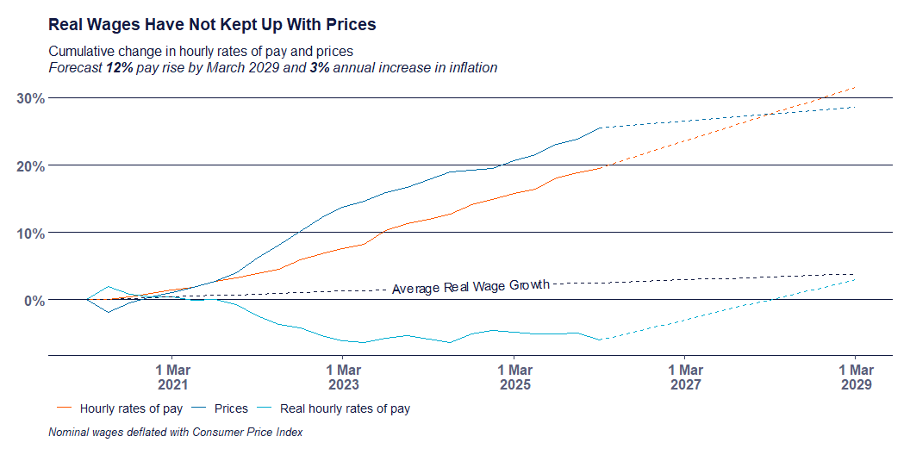
Inflation - Pay Increase
Notes:
We’re really far away from IMPROVING living standards.

Slide 33
What Inflation Is Not
Inflation is not a measure of the cost of living.
Decreasing inflation does not mean prices have gone down.
Inflation is not more important than any other economic indicator.

Slide 34
The AMWU and Wages

Slide 35
Increasing real wages is our core business.
It is about improving living standards. And making sure people aren’t getting left behind, or exploited by their employer.
Inflation has eroded real wage increases that we have collectively struggled for.

Slide 36
Productivity

Slide 37
Productivity
https://www.youtube.com/watch?v=00npeUY_1Vg

Slide 38
Productivity (or, output per hour worked)
Labour Productivity is a measure of Gross Domestic Product per hour worked.
But there are other inputs into production besides labour, including capital
Changes in output can occur even without changes to input
Notes:
We need to understand productivity - how it’s measured, and how bosses talk about it - because it is simultaneously misunderstood and over-emphasised in the media.
The newly elected government has set its focus on productivity, and productivity growth, and has got the Productivity Commission in on the action.
The Productivity Commission by the way, should be seen as a complete joke. It was created by the Howard government in the 1990s, and sits within the Treasury department.
In a FWC hearing in 2025, the chief economist of the Australian Chamber of Commerce and Industry (also a joke) was asked “what factors drove productivity”. He answered that “the Productivity Commission was currently examining those factors”. 35 years since their establishment, and the Productivity Commission is still examining what productivity even is!!!
For example, you could lose output in Agriculture from bad weather destroying a crop. Similarly, you could gain output in Mining because high prices make some difficult deposits worth mining.
Labour productivity is the most commonly reported productivity. It is relatively simple to measure and describe.

Slide 39
Measuring Productivity
It is relatively easy to measure and describe output per worker.
Measuring output per unit of labour and capital is much more complicated, and questionable.
What is a unit of labour-capital?
You should be sceptical of people (especially economists) who talk about productivity in the non-market sector.
Notes:
The non-market sector includes the Education and Health Care sectors. How is output measured in these sectors? Students graduating? Patients discharged? What would productivity look like? Students graduating per teacher? A measure like that would mean that productivity in the Education sector could be improved by fewer teachers and bigger classes. Anyone who works in Education would say that is not realistic.

Slide 40
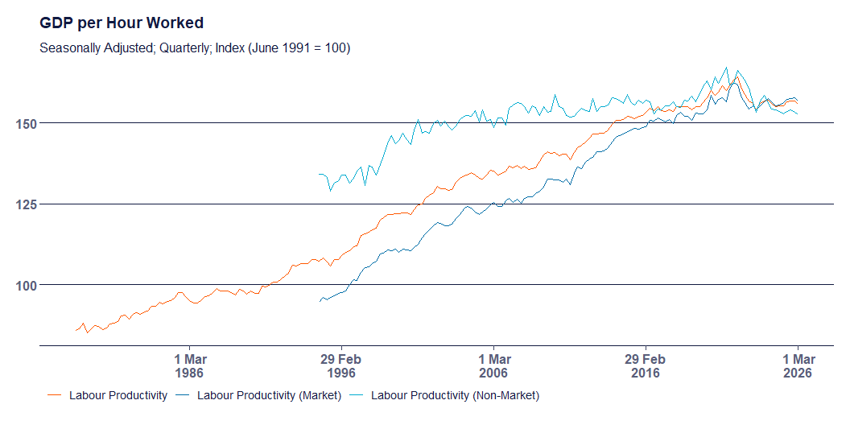
Productivity Trends
Notes:
GDP per hour worked, with June 1991 set as the base or reference year.
Growth was slowing prior to 2020 anyway, with the increases seen during then probably due to the pandemic.
This has been called a productivity ‘bubble’ which I think I agree with.
Periods of slow growth have been occurring since the 2000s really.
The market sector includes industries like manufacturing, mining, construction, and some services. Things that are produced and sold in the market.
The non-market sector

Slide 41
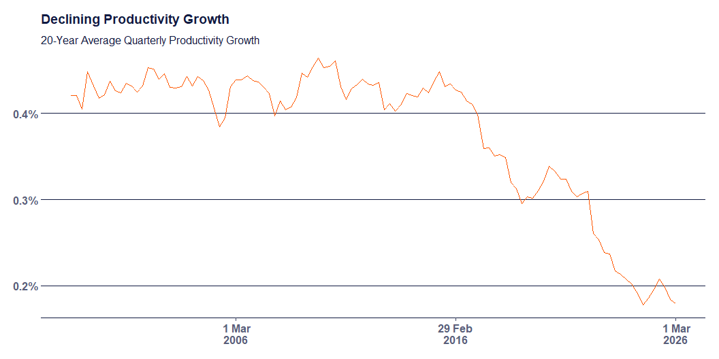
Productivity Trends
Notes:
Productivity is a volatile measure. It is better to measure it across a long time period.
The ABS uses a 20 year average “compound average growth rate” formula.
Clearly not a new problem
20-year average productivity growth was pretty stable up until about 2013
Significant declines since then. Covid rebound probably an illusion

Slide 42
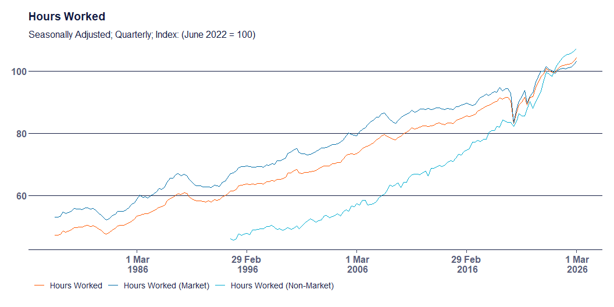
Hours Worked
Notes:
Productivity is measured as GDP per hour worked. So we need to look at what is happening with hours worked, and with GDP.
I don’t know about you but the increase in hours worked looks like it’s pretty steep.
What do we think could have caused that? Are you working more hours? Do you know people who are working more hours? Why?
Could it be people working more hours because they’re struggling to make ends meet because of inflation?
Even the Productivity Commission recognise that high hours worked is pulling productivity down

Slide 43
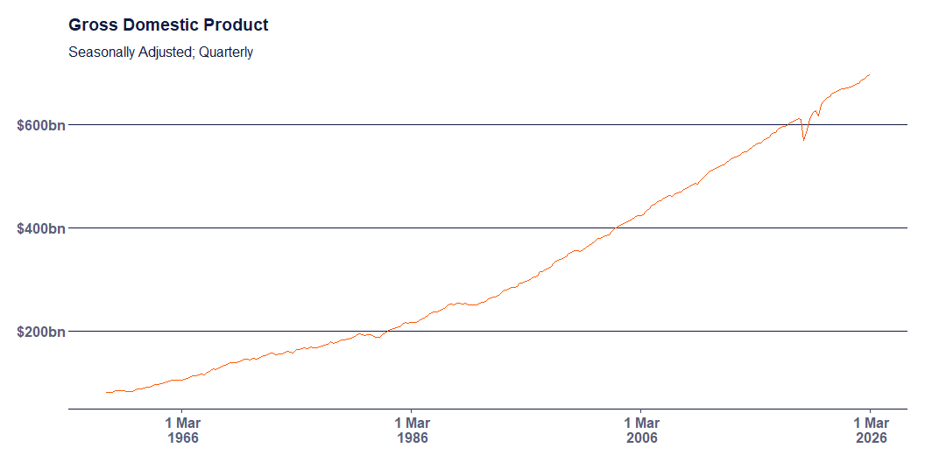
GDP

Slide 44
Workers Share
If productivity is a measure of output per hour, it would only be fair to compare that with how much compensation (in real terms) workers are getting per hour.

Slide 45
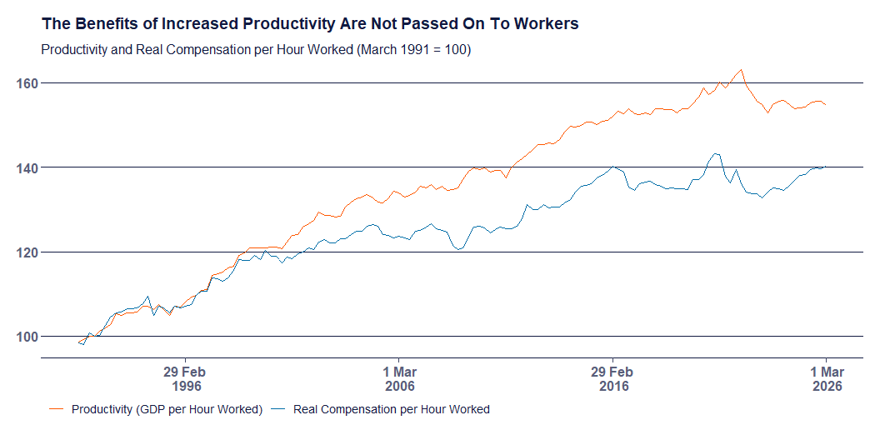
Workers Share
Notes:
Damn.

Slide 46
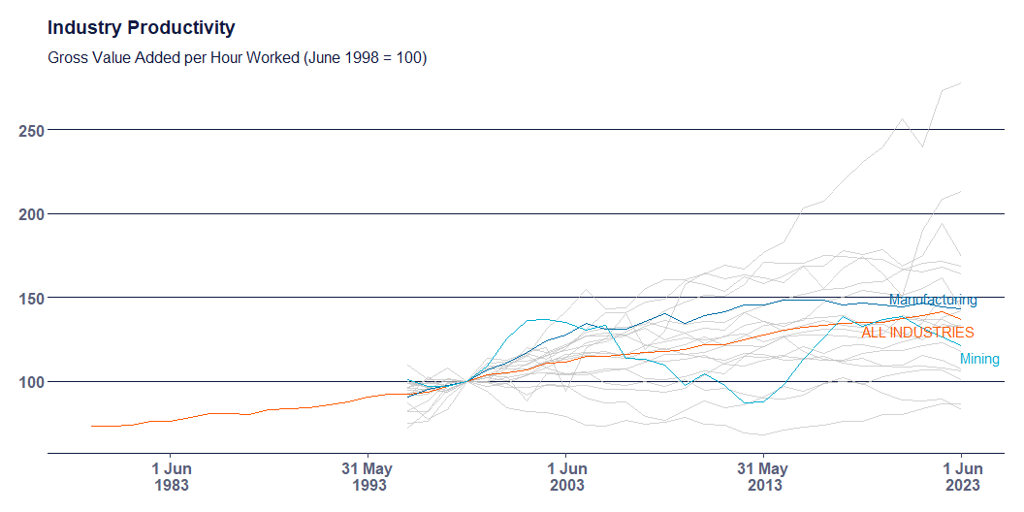
Industry Productivity
Notes:
Some sectors have experienced productivity growth, and others productivity declines.
The Mining sector tends to be a real drag on productivity.
Manufacturing outperforms the average.
Big productivity improvements in Information media and telecommunications, and Agriculture.
Productivity laggards? Non-market sector, like Health Care, Education, Real estate services.

Slide 47
What Productivity is Not
The amount it costs to produce one unit of output
Consistent across market and non-market sectors
Tied to real wages

Slide 48
Housing
Notes:
We’re going to talk about the housing market, house prices, and the changes made in relation to housing in the 2026 Budget

Slide 49
House Prices and Affordability
It is more difficult than ever for first home buyers.
Household income has not grown as fast as house prices
Saving for a deposit is also more difficult
Notes:
House prices have grown much faster than incomes in Australia. The median household income per year (before-tax) in September 2025 was estimated at about $105,000. Meanwhile, the median dwelling value was $860,000 and the median weekly rent was $670.
The average time required to save up a 20% deposit for the average dwelling is 11 years. While saving for the deposit, you’re committing 33% of your income on rent. After securing a loan, you’re committing 45% of your income just to service the mortgage.

Slide 50
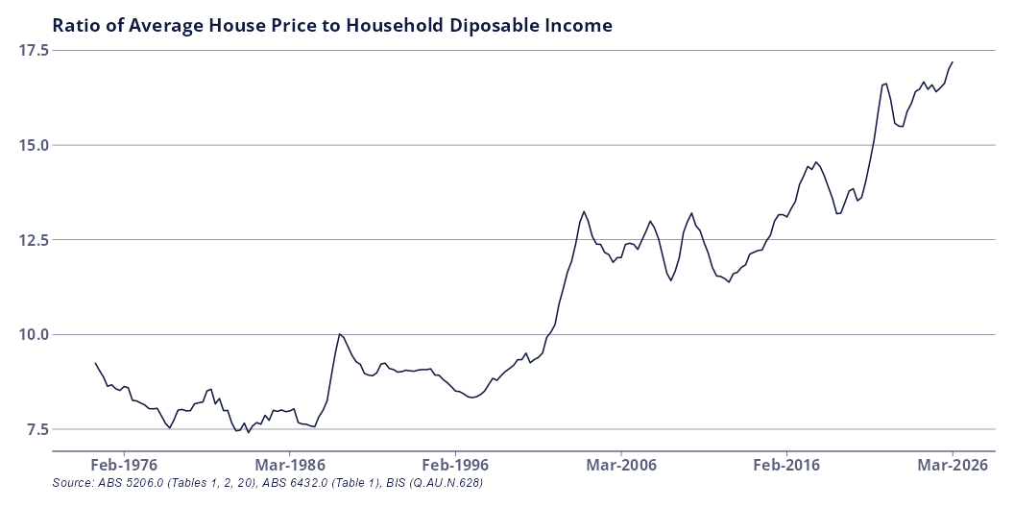
House Prices and Affordability - Historical
Notes:
How has the picture changed over time?

Slide 51
House Prices and Affordability - Historical
Year | Average House Price ($) | Average Per Capita Disposable Income ($)
1975 | $33,417 | $3,887
1985 | $83,905 | $10,508
1995 | $160,819 | $18,337
2005 | $354,508 | $29,420
2015 | $600,500 | $46,245
2025 | $1,044,350 | $62,771

Slide 52
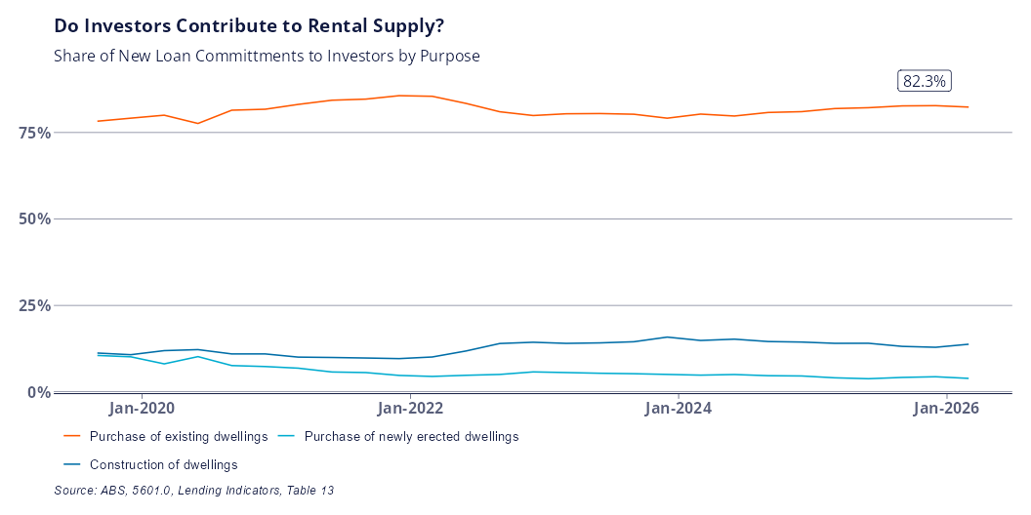
Investor Financing

Slide 53
Budget Changes
Negative gearing limited to new builds only from 1 July 2027.
Losses accrued in running an investment property can no longer reduce your taxable income.
A 30% minimum tax rate on capital gains is introduced.
The Capital Gains Tax Discount is replaced with cost-based indexation
Notes:
The changes announced in the budget mostly apply only to new investments made after 1 July 2027. The additional year is intended to allow time to make decisions about what to do with existing assets.
From a housing perspective, the key changes relate to negative gearing, and the capital gains tax discount - however these changes also apply across all asset classes which generate capital gains - including stocks, cryptocurrency, or other investments.
For new properties which are purchased after the budget, investors will no longer be able to deduct losses from the operation of their investment property (negative gearing) from their income tax. Instead, losses can be carried forward and used to reduce the amount of capital gains tax paid when the investment property is sold.
The 30% minimum tax rate on capital gains was introduced to prevent the scenario where you hold onto an asset while working, use negative gearing to reduce your taxable income, and then sell the property when your income is low, so that you’re in a lower income tax bracket.
Cost based indexation basically means you only pay tax on the real (ie discount inflation) gain accrued. The change in tax arrangements DOES apply to existing investors, but only for the growth which occurs after 1 July 2027. That means if you already own a property, the tax on any gains accrued between purchase and 1 July 2027 is still subject to the 50% discount.

Slide 54
Example
Capital Gain | Tax Rate | Notes
50,000 | 0 | Not taxed due to CGT discount
35,000 | 30% | The first 35,000 of the remaining 50,000 is taxed in the 45,001-135,000 bracket
15,000 | 37% | The remaining 15,00 is taxed in the 135,001-190,000 tax bracket
Notes:
A worker who earns $100,000 per year sells some capital asset (a house, shares, cryptocurrency) five years after purchase. They bought the asset for $100,000 and sold it for $200,000, earning a capital gain of $100,000.
At tax time, he pays income tax on $100,000 (from working) and $50,000 (from capital gains), and gets the other $50,000 tax free.
The tax on $150,000 income is $31,288 + 37 cents for every dollar over $135,000. The total tax bill is $36,838.
What’s the effective tax rate on the capital gain?
First 50k tax free, second 50k is taxed between the 35 and 37 brackets.
0 + 35% of 35,000 + 37% of 15,000 = $14,300 or 14.3%
What would the effective tax rate on $100,000 more labour income have been?
35% of 35,000 + 37% of 55,000+ 45% of 10,000 = $37,100 or 37%.

Slide 55
Likely Impact
The estimated impact on house prices and supply is minimal.
First home buyers should face less competition when purchasing established homes.
Changes only partially address the reasons why property investment was so popular.
Notes:
The balance was too in favour of wealth over income. These changes try to restore the balance by increasing the rate of taxation on capital gains.
Housing is a fundamental right and it should not have got this far.
However - people invested in housing in particular because it was a viable way at generating wealth. Stagnant wage growth means that it’s harder to get by and harder to become financially independent just through working alone. The changes reduce the incentive to invest, but do not adequately increase the incentive to work. The $250 tax break in 2027 doesn’t really cut it.

Slide 56
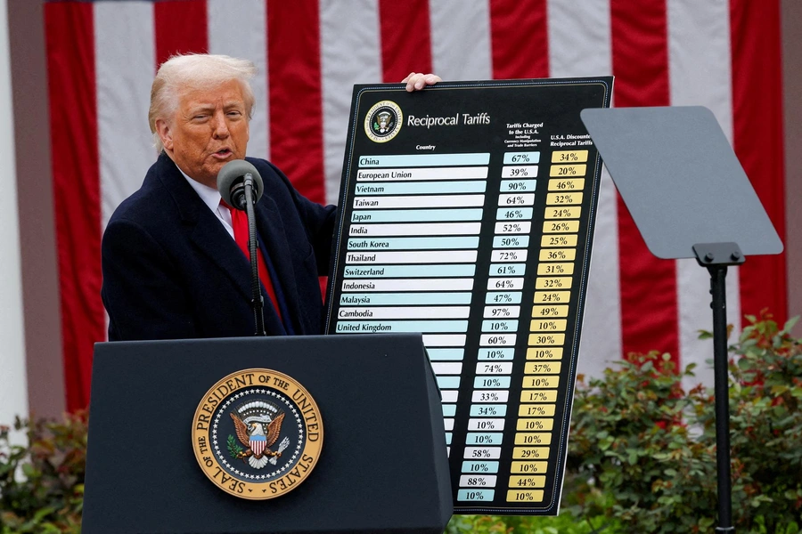
Tariffs

Slide 57
Definition
A tariff is essentially a tax charged on imported goods.
The tariff is paid by the importer, not the exporter.
Increased costs for the importer will be passed on to the final consumer.

Slide 58
Tariffs in the US
The argument goes something like this:
The US is ‘taken advantage of’ by countries who export more to the US than the import.
Dependence on foreign goods undermines domestic industry.
Putting up tariffs reduces demand for imports and increases demand for domestic production (through price changes)
Increase demand restores America’s manufacturing base.
Notes:
Trade surplus countries take advantage by using subsidies on domestic production, manipulate currency to keep their exchange rate low, and have their own tariffs on US imports.
There was a recent bit of news in the AFR:
Century Aluminum has urged US President Donald Trump’s top trade official to register the Albanese government’s $22.7 billion Future Made in Australia industrial policy, which aims to encourage onshore manufacturing, in its annual report on foreign trade barriers.
The impact on domestic industry (through price competition) resonates a lot with workers I think.
The impact of deindustrialisation on the US (and other western economies) is real, and has caused significant community disruption, and destruction. Former (and current) industrial towns in the Midwest have suffered real impacts.
Trump isn’t even arguing that the tariffs will bring back manufacturing jobs in the US, instead focusing on using AI, automation, and robotics to do the work.
So even if it’s successful, even if the argument is believable, there is no room in the policy for workers to share the benefits. There is certainly no guarantee that a revitalised manufacturing industry in the US, brought upon by tariffs, would bring back many if any manufacturing jobs.

Slide 59
Tariffs to Protect Industry
Tariffs are not new.
Protecting local industry has long been the policy of industrialising nations.
Tariffs have been used to protect new industries in developing/industrialising countries.
Britain relied on high tariffs to develop their industry. Once developed, tariffs were disavowed in favour of “free markets” and global trade.
Notes:
It’s a classic “pull the ladder up after you” situation.

Slide 60
Tariffs to Reindustrialise
America can probably extract concessions from the vassal states like South Korea and Japan.
But, the stated strategy is relying on automation, AI, and robotics to do the work - not people.
Globalisation means value chains are now spread across the world, so domestic prices will increase.
Without significant investment into domestic manufacturing, demand can’t actually be met by local industry.
Notes:
US manufacturing moved off-shore as capitalists sought higher profit through lower labour costs during a period where the US dollar was very high. The US dollar was very high because Paul Volcker increased interest rates to 19% to curb inflation (through demand destruction, i.e. make everyone unemployed and poor)
The question is - can tariffs work for a country trying to reindustrialise?
America is a special case. If it could work for anyone, it would be them.
They maintain economic, political, and military power over much of the rest of the world - especially across the west.
But the strategy still faces significant head winds, including:
Final product manufacturing in the US still requires intermediate inputs which are sourced from all over the world. So the price increase still gets passed on to domestic production!
There’s not sufficient domestic capabilities to meet consumers demand. But the price increases are already coming.
With no comprehensive industrial strategy, investment and onshoring just means that manufacturing firms would have to accept lower profits out of the kindness of their hearts. Do we think the capitalist would do that?
Even if it works for them, it is not going to be a viable strategy for the rest of us.

Slide 61
Tariffs to Protect Capital
The rate of profit has a tendency to fall over time.
Seeking constant productivity growth, capitalist investment focuses on machinery and technology at the expense of labour - reducing profit.
US tariffs are intended to protect US capital from more productive or lower cost competitors, and to shift the burden of declining profitability off shore.
This is a temporary solution.
Notes:
In response to declining profit, capitalists try to discipline labour, move production somewhere cheaper, inflates asset bubbles, and retreat behind protective barriers.
Most likely what is going on is that the capital class is using tariffs to try and protect their profits because they are no longer competitive.

Slide 62
What About Australia
Australia is a de-industrialised country.
Policies like Future Made in Australia and the National Reconstruction Fund are intended to rebuild an industrial base
How can we support these industries as they grow and become competitive?
Anti-Dumping Commission to support fair trade
targeted tariffs i.e. aluminium imports

Slide 63
Industrial Capabilities

Slide 64
What you make is what you know

Slide 65
Industrial Capabilities
Core concepts:
a country makes (or does) what it knows
products (or activities) represent combinations of knowledge
Capabilities are like letters in Scrabble
The more you have, the more words you can make
Rare letters create words worth more points

Slide 66

Products Embody Knowledge
An apple in the supermarket represents:
Horticulture
Pest control
Refrigeration
Logistics

Slide 67

Products Embody Knowledge
An iPhone represents:
Semiconductors
Software/Hardware Engineering
Materials science
Lenses
Marketing
Packaging

Slide 68
Measuring Industrial Capabilities
Export data reveals what a country makes
Comparison between countries reveals which capabilities are common, and which are rare
The presence of different capabilities in different countries allows a ranking called the Economic Complexity Index

Slide 69
Why Does It Matter?
The Economic Complexity Index is predictive of the direction of future economic growth.
Countries with higher complexity are predicted to grow faster
Useful tool to identify productive capabilities of a country.
Can be used to identify future opportunities and direct strategy.

Slide 70
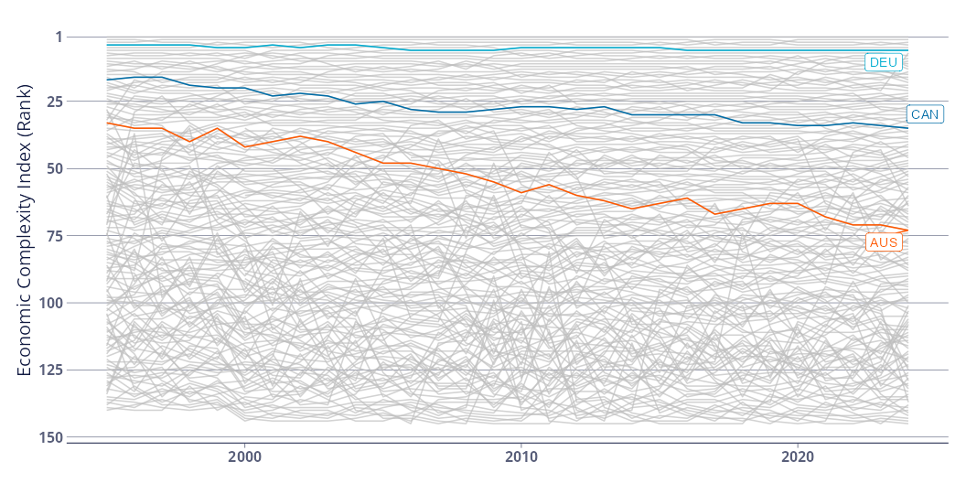
Why Does It Matter to Australia?
Notes:
Australia’s ranking in 2024 was 74th- Sandwiched between Madagascar and Uruguay
Australia’s exports are concentrated in only a few products
Australia’s exports are lower in average complexity
Australia does not have the industrial capabilities of other developed countries.

Slide 71
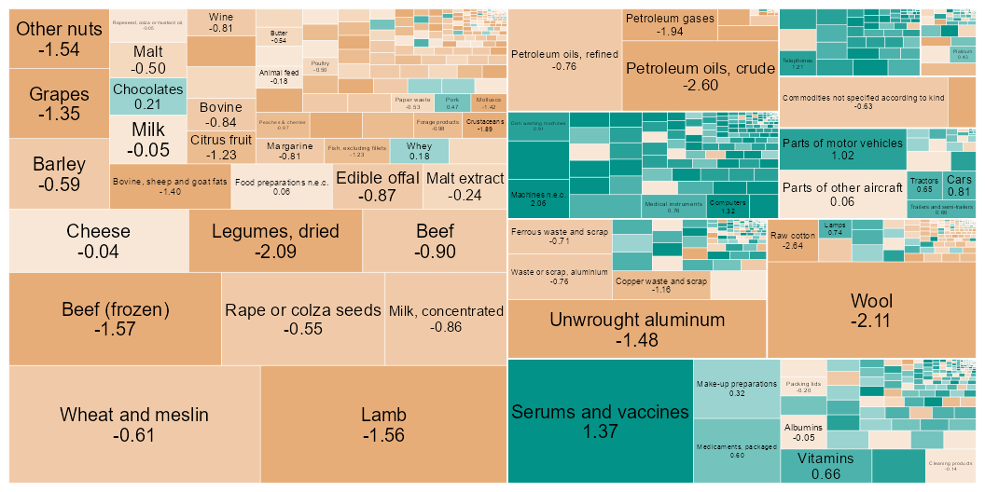
Why Does it Matter to Victoria?

Slide 72
What Can Be Done?
Recognise that there is a problem.
The lack of sufficient existing capabilities requires explicit and direct industrial policy.
Understand the connection between just transition, decarbonisation, and reindustrialisation.
Develop a policy agenda which explicitly outlines existing and future opportunities, and how to get there.
Notes:
The problem:
is real, will not be solved by the market and will not be solved with small tweaks and adjustments.
just transition and decarbonisation is an opportunity to PLAN something, and then to DO something.

Slide 73
The AMWU and a Future Made in Australia
The Future Made in Australia Act is a $22.7 billion investment into restoring an industrial base in Australia.
FMIA, which is public money, must be used to create secure, high-quality jobs. Not subsidise worker exploitation.
The AMWU is calling for the establishment of a manufacturing council, and tying strong conditions to businesses receiving public money
Notes:
As part of a Future Made in Australia, what do we want to see? What will we be campaigning for?
A Secure Australian Jobs Code
Establishing a Manufacturing Competitiveness Council
Demand local content
Mandate apprentice participation
Establish fair trade over free trade
Nationalise strategic infrastructure

Slide 74
Conditions for Employers
Guarantee of secure jobs, fair wages, and safe conditions
Collective bargaining as a requirement at workplaces who receive public money.
Use the state’s power in procurement to support local industry through local content targets.
Mandate apprentice participation
Notes:
This is about public money for a public good. Not subsidies to private capital to continue to exploit their workers. We are calling on the Labor government to mandate collective agreements for any businesses receiving public money, which reflect union rates of pay.
Local Content
Procurement is one of the most powerful levers we have for rebuilding our industrial base.
Public money must explicitly support local industry.
How do we make them enforceable?
Local content, local content targets, and local industry participation. The government can provide certainty to businesses looking to expand to supply infrastructure to the energy transition.
Skills and Apprentices
To rebuild our industrial base we need skilled manufacturing workers
Current apprentice requirements are toothless, letting employers off the hook

Slide 75
Manufacturing Competitiveness Council
Tripartite Manufacturing Competitiveness Council - with genuine union representation.
Ensure that all decisions about capital investment, skills, and industry strategy are made with worker input.
Establish and plan for the orderly transition of our economy - guided by human need, not market whims.

Slide 76
Fair Trade
Empower the Anti-Dumping Commission
Unfair trade, particular dumping, has significant negative effects on local industry. Especially in a country that is seeking to re-industrialise.
Establish an Independent Advocate for Fair Trade.

Slide 77
Nationalising Strategic Infrastructure
Infrastructure that is “too big to fail” or needed “in the national interest” can not be left in the hands of profit maximisers.
Perpetual bailouts and subsidies
Nationalisation can help us to achieve our strategic goals.
Notes:
The goal of economic sovereignty cannot be achieved if the nation’s most vital infrastructure remains subject to the profit demands of private capital. Labor must move to nationalise strategic infrastructure essential to the Future Made in Australia Act agenda, particularly in the energy and green manufacturing sectors

Slide 78
Economic Anxiety
Before we move onto the next section, I wanted to stop for a discussion about how you relate to the economy.
How do you feel about the “big picture” economy?
How do you feel about your economic situation?
How do your neighbours, mates, colleagues feel?
If you’re feeling anxious, I don’t blame you.
The world has become increasingly competitive, and isolated. The rise of neo-liberalism, the decline in the power of labour, and the increased concentration of wealth have been disastrous.
Workers are more precarious than ever:
gig economy, 0-hour contract, no protection, a safety net that isn’t safe at all.
Workers are forced to pursue their personal monetary interest, because you need to to survive. This competition, and precarity, are used to keep employees divided, and to try and minimise solidarity between workers. And it’s been happening since the 1980s. It is scary to put your head above the parapet and ask for better conditions because there is so much to lose.
Solidarity is more important than ever. We are powerful as a collective.
How do you feel about the “big picture” economy?
How do you feel about your economic situation?
How do your mates, neighbours, or colleagues feel?

Slide 79
Political Economy

Slide 80
It’s the economy, stupid!

Slide 81
Economics
https://www.youtube-nocookie.com/watch?v=pQPv5oUfsbg

Slide 82
What is The Economy?
Is the economy how much we produce in total?
Is the economy how much we produce per person?
Is the economy how well we meet the needs of society?
Is the economy how well the stock market is performing?

Slide 83
Who are Economists?
Too closely associated with business and finance
Love to explain why you’re wrong
Get paid too much to make predictions which don’t come true
Notes:
Economics was originally a philosophical subject. What happens when the economy interacts with the government? How do different classes interact? How do different classes experience the economy? It was a social science studying a social phenomenon.
In about the 1950s to 1960s, a new school of economists decided that adding maths equations to economics made it more rigorous, and more scientific, and more “true”. The economy is this abstract thing, which we can model using mathematics. If we change one parameter (like investment or the unemployment rate or interest rates) we can see what happens to other parameters. Predictions from the model are used to make predictions about society.

Slide 84
Political Economy
Notes:
What we call ‘economics’ today is very different from what would have been called economics in the 1960s, economics in the 1890s, economics in the 1600s, and economics prior to the invention of agriculture.
While we’ve always had “an economy”, it is only since the industrial revolution that the economy has been structured in a way which would be called capitalism.
The study of economics is ideological. It is a social science, not a hard science. There is no Nobel prize in economics (the Nobel Memorial Prize in Economic Sciences was not and is not one of the original 5).
Early economics was philosophical - looking at questions like:
What is work? What is production?
What is value?

Slide 85
Political Economy - Classical Economics
“Classical” economics is associated with the development of capitalism and the industrial revolution in the late 1700 and early 1800s.
Marxism was a response to the horrible working conditions under which labour was subjected during the industrial revolution - and the associated disparity between capital class and working class.
Notes:
Classical Economics
Prior to and during the industrial revolution, classical economics was developed, primarily through Adam Smith - advancing the theory of the divisibility of labour - that it is more productive for individuals to specialise in one part of the creation of a product, rather than the whole chain. Again - the economics is reflective of the political - increased work in factories, industrial revolution, factory work. Adam Smith is seen by some as the guy who invented free market economics. But Smith was strongly opposed to monopolies, and recognised the importance of class, compared to individual.
Some ideas have lasted longer than others. Smith’s division of labour is still popular today. Others, like Malthus who argued that any wages greater than that required to subside would fuel unstable population growth that absorbed any real income growth, have mostly died out.
Ricardo invented a theory of free trade which said that all economies are made better off by specialising in the industry they have comparative advantage which is only true in theory - but is still trotted out by free market advocates today.
Marxism was a response to the conditions under which labour was treated during the industrial period - long hours, terrible conditions, high death rates, child labour etc, as well as the growing and obvious disaprities in wealth between the owners of capital, and those who had to work for a living. One insight from Marxism about capitalism is “the tendency for the rate of profit to fall”, which says basically, over time, the rate of profit to the amount of invested capital decreases over time. I think that such a theory explains a lot about the development of capitalism and economics since the 1900s.
Neoclassical
Focus on the individual, and equilibrium in markets. Bring in mathematics and models to try and answer economic questions. Neoclassical theories are based on abstract ideas, rather than the visible realities. Stuff like:
Everyone is born with some endowment of labour power, skill, or another resource.
Everyone is born with a set of preferences which determine what they like to consume.
Technology converts endowments into usable goods and services.
Trading through markets makes sure that everything is optimal.
Which leads to the conclusion that:
the market fixes everything and;
profit represents the productivity of owned capital - and it is morally justifiable - just explain away the exploitation.
Brief interlude with Keynesianism (explicitly a response to the great depression)- the situation won’t resolve itself, and government can stop unemployment by boosting demand (govt spending, taxation, interest rates)
But the return in the 1970s of neoclassical economics (explicitly a response to the stagflation of the 1970s), consolidated today as neoliberalism returns us back to the market solving everyone’s problems.
The most important message is:
Economics reflects the the political ideology, not the other way around!
Economists (as social scientists) have ideas about ways that the economy should function

Slide 86
Political Economy - Modern Economics
Class analysis was neglected in the late 1800s and early 1900s in favour of analysis of individuals.
When thinking of economics, remember that it is ideological:
What kind of growth do we want?
Who should get the benefits of increased productivity?

Slide 87
Work and Value
Everything in the economy comes from some combination of work and the natural environment, but only work can “add value”
There have been many attempts to define value - but clearly productive labour is the only source of it.
Capital is not inherently ‘productive’, despite being paid profit.
Notes:
It is impossible to produce value without work. Even fully automated production lines require:
Labour to produce the equipment
Labour to monitor the equipment
Labour to repair the equipment
Profit represents a payment on private capital to the owner of that capital. But profit itself is not a productive activity - but a social relationship between owner, worker, and capital. Profit can be used to re-invest into more capital - and this was the fundamental driver of capitalism during the industrial revolution. Productivity increases from the increased division of labour rapidly increased profits. SOME of these profits were re-invested into production - both to maintain machinery, and to improve processes. Of course, some of the profits were consumed by the ‘capitalist fat cat’ - which is why they’re always depicted as such during this period.
Compare the labour theory of value, which is “objective”, with modern theories of value which are “subjective”

Slide 88
Class Consciousness and Solidarity
https://www.youtube.com/watch?v=dsoEf8Yqe3I

Slide 89
Class Consciousness
Capitalists understand the importance of class solidarity.
The boss is our class enemy.
When capitalism faces crisis, the playbook is always the same.
The working class must be divided or the position of the boss is at risk.
Notes:
Class solidarity is important - in a positive and negative sense. Capitalists maintain strong class consciousness and solidarity, and work hard to prevent solidarity forming in other classes.
When the economy was based on manufacturing and heavy industry like mining, steel working, and shipbuilding, it was very easy to characterize the classes.
A small number of people owned capital in the form of a factory, or mine - or occasionally - state run monopolies in sectors like automotive manufacturing - with very few ‘supervisors’.
The division of labour was stark - you had workers on one side and the bosses or state on the other. Most households were proletarian or “working class” and the bosses were the bourgeois or capitalist class.
See: the Simpsons nuclear power plant.
This period coincides with strong trade union membership, a strong sense of working class identity, and a strong understanding of the power that existed in its collectivism.
The theoretical underpinning behind class is rooted in the relationship between individual and the means of production. If you didn’t own the equipment which made the product you were working class.
Beyond the theoretical (or economical), there are social elements to class as well - including culture, pastimes, institutions, even where you live.
Post the 1960s, the decline in mining, construction, and manufacturing resulted in a change in the structure of the economy - away from manual work, and towards clerical, administrative, and supervisory work - the white collar. Advances in technology further resulted in increases in technician or supervisory, foreman style work at the expense of manual labour.
Ratio of services output to manufacturing output.
This has had a huge impact on trade union density.
Just as the capitalist today is aesthetically different from the factory owner of the industrial revolution, so too has the working class changed.
It isn’t as easy today to spot the capitalist class. Unlike in the industrial revolution, the company owner is unlikely to be on the factory floor - patrolling and keeping everyone in line. The modern capitalist tries to trade on the aesthetics of the working class. And the modern capitalist outsources the work of being a boss to middle management. People whose job it is to direct workers in the benefit of capital.
The concentration of wealth among the capital class however, has only increased since the industrial age. More and more wealth is held by fewer and fewer people. Owning shares, or investing in your superannuation fund, does not make you a member of the capitalist class. Because you are not in control of the decisions made.

Slide 90
Class Solidarity
As workers we have far more in common with each other, than we have with the boss. Even:
The children mining cobalt in the Congo
The workers in a call center in India

Slide 91
Income Inequality
https://www.youtube-nocookie.com/watch?v=QPKKQnijnsM

Slide 92
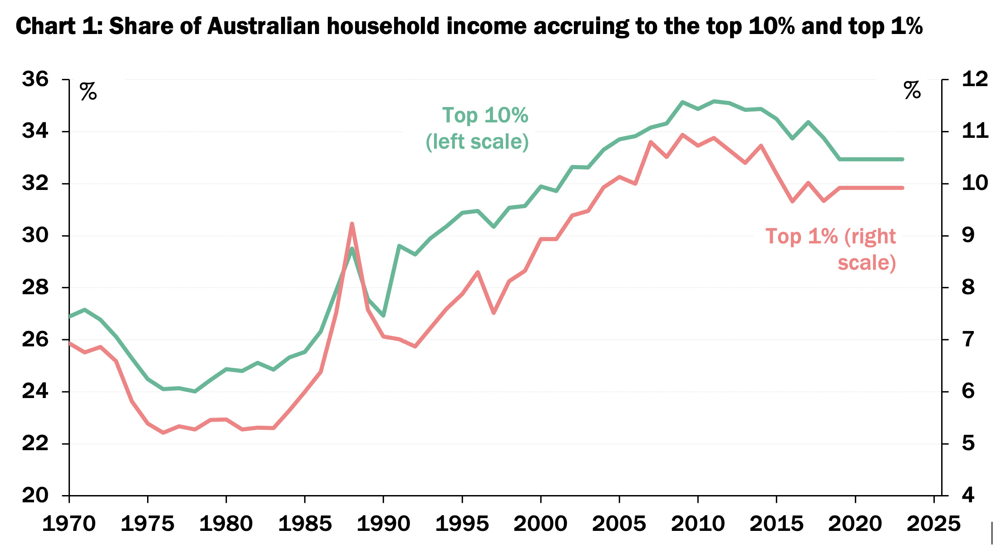
Income Inequality

Slide 93
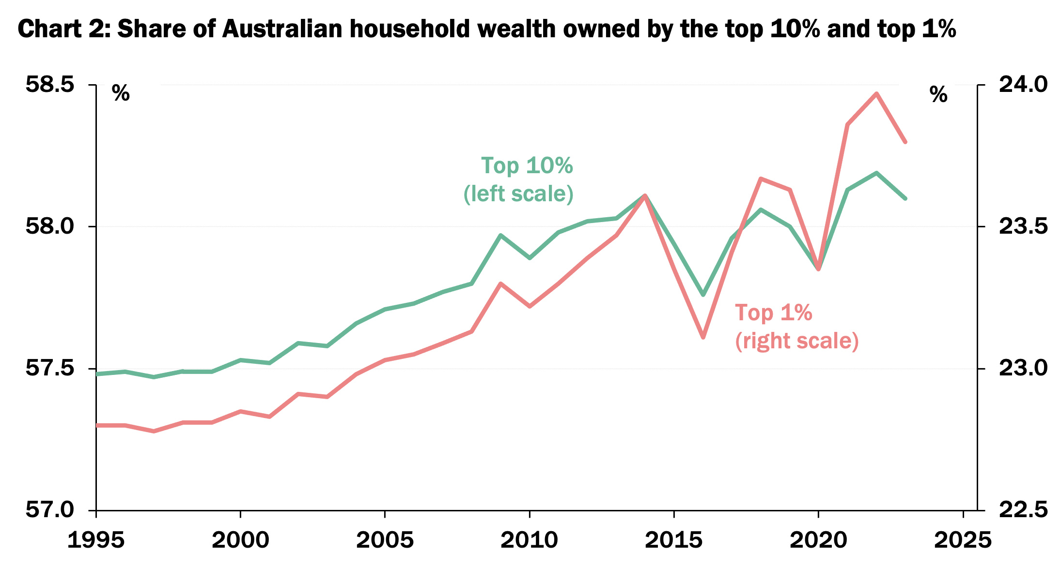
Wealth Inequality

Slide 94
What Is To Be Done?
Notes:
Power comes from recognising that productive labour is the only source of value created in the economy. Without workers, there are no products. Without products, there is no profit to be collected by the capitalist. Financial institutions might keep swapping IOUs but this doesn’t make for a happy or fed society.
Building labour power
Building labour density
Building class solidarity
Individual actions like voting, calling your local MP, protesting, signing a petition. Might work. But constrained by the choices we are offered, lobbying, one person can’t make a difference.
What actions can you take back to your workplace? Based on what we’ve discussed today.

