Slide 1
Housing

Slide 2
Housing
Notes:
We’re going to talk about the housing market, house prices, and the changes made in relation to housing in the 2026 Budget

Slide 3
House Prices and Affordability
It is more difficult than ever for first home buyers.
Household income has not grown as fast as house prices
Saving for a deposit is also more difficult
Notes:
House prices have grown much faster than incomes in Australia. The median household income per year (before-tax) in September 2025 was estimated at about $105,000. Meanwhile, the median dwelling value was $860,000 and the median weekly rent was $670.
The average time required to save up a 20% deposit for the average dwelling is 11 years. While saving for the deposit, you’re committing 33% of your income on rent. After securing a loan, you’re committing 45% of your income just to service the mortgage.

Slide 4
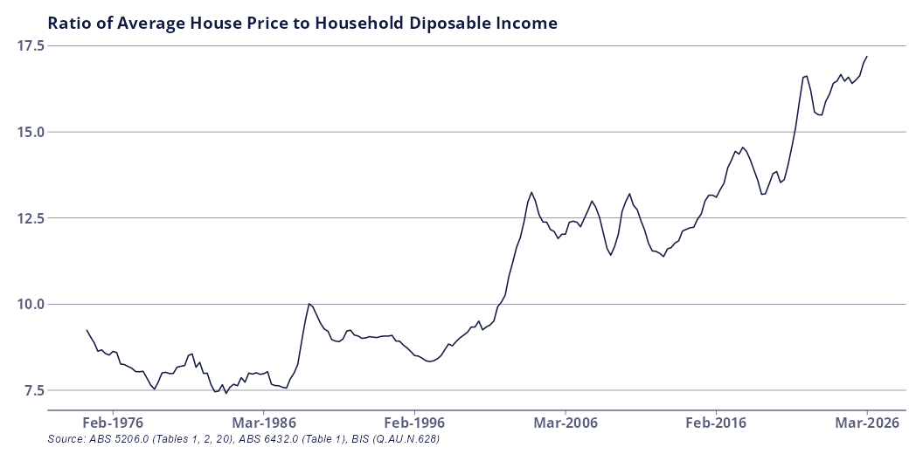
House Prices and Affordability - Historical
Notes:
How has the picture changed over time?

Slide 5
House Prices and Affordability - Historical
Year | Average House Price ($) | Average Per Capita Disposable Income ($)
1975 | $33,417 | $3,887
1985 | $83,905 | $10,508
1995 | $160,819 | $18,337
2005 | $354,508 | $29,420
2015 | $600,500 | $46,245
2025 | $1,044,350 | $62,771

Slide 6
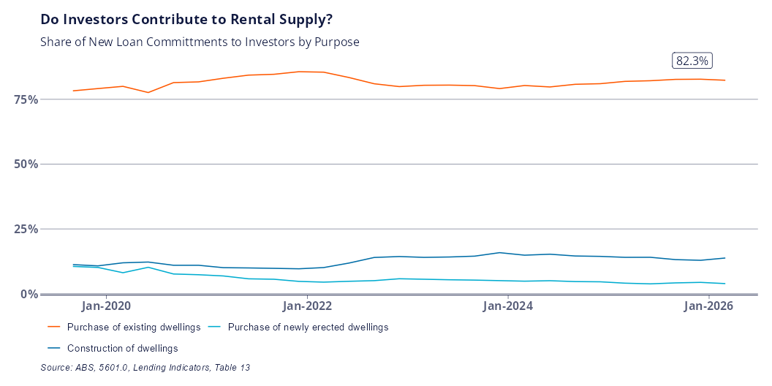
Investor Financing

Slide 7
Budget Changes
Negative gearing limited to new builds only from 1 July 2027.
Losses accrued in running an investment property can no longer reduce your taxable income.
A 30% minimum tax rate on capital gains is introduced.
The Capital Gains Tax Discount is replaced with cost-based indexation
Notes:
The changes announced in the budget mostly apply only to new investments made after 1 July 2027. The additional year is intended to allow time to make decisions about what to do with existing assets.
From a housing perspective, the key changes relate to negative gearing, and the capital gains tax discount - however these changes also apply across all asset classes which generate capital gains - including stocks, cryptocurrency, or other investments.
For new properties which are purchased after the budget, investors will no longer be able to deduct losses from the operation of their investment property (negative gearing) from their income tax. Instead, losses can be carried forward and used to reduce the amount of capital gains tax paid when the investment property is sold.
The 30% minimum tax rate on capital gains was introduced to prevent the scenario where you hold onto an asset while working, use negative gearing to reduce your taxable income, and then sell the property when your income is low, so that you’re in a lower income tax bracket.
Cost based indexation basically means you only pay tax on the real (ie discount inflation) gain accrued. The change in tax arrangements DOES apply to existing investors, but only for the growth which occurs after 1 July 2027. That means if you already own a property, the tax on any gains accrued between purchase and 1 July 2027 is still subject to the 50% discount.

Slide 8
Example
Capital Gain | Tax Rate | Notes
50,000 | 0 | Not taxed due to CGT discount
35,000 | 30% | The first 35,000 of the remaining 50,000 is taxed in the 45,001-135,000 bracket
15,000 | 37% | The remaining 15,00 is taxed in the 135,001-190,000 tax bracket
Notes:
A worker who earns $100,000 per year sells some capital asset (a house, shares, cryptocurrency) five years after purchase. They bought the asset for $100,000 and sold it for $200,000, earning a capital gain of $100,000.
At tax time, he pays income tax on $100,000 (from working) and $50,000 (from capital gains), and gets the other $50,000 tax free.
The tax on $150,000 income is $31,288 + 37 cents for every dollar over $135,000. The total tax bill is $36,838.
What’s the effective tax rate on the capital gain?
First 50k tax free, second 50k is taxed between the 35 and 37 brackets.
0 + 35% of 35,000 + 37% of 15,000 = $14,300 or 14.3%
What would the effective tax rate on $100,000 more labour income have been?
35% of 35,000 + 37% of 55,000+ 45% of 10,000 = $37,100 or 37%.

Slide 9
Likely Impact
The estimated impact on house prices and supply is minimal.
First home buyers should face less competition when purchasing established homes.
Changes only partially address the reasons why property investment was so popular.
Notes:
The balance was too in favour of wealth over income. These changes try to restore the balance by increasing the rate of taxation on capital gains.
Housing is a fundamental right and it should not have got this far.
However - people invested in housing in particular because it was a viable way at generating wealth. Stagnant wage growth means that it’s harder to get by and harder to become financially independent just through working alone. The changes reduce the incentive to invest, but do not adequately increase the incentive to work. The $250 tax break in 2027 doesn’t really cut it.

