Slide 1
Economics in the Real World

Slide 2
Who Am I?
Economist, National Research Centre
Research focus on industrial capabilities and economic complexity

Slide 3
Agenda
Inflation, Real Wages, and the Living Wage
Sovereign Capability, Economic Complexity and a Future Made in Australia
Notes:
Talk about inflation and real wages. What they are, how they are measured, and importantly - what they are not.
How does inflation and real wages link with the AMWU broader goals of a living wage, and increasing the minimum wage for apprentices.
Talk about sovereign capability. What it means, why it is important, and how we’re advocating for industry policy through FMIA and the Defence industry.

Slide 4
Inflation
Notes:
We’re going to talk about:
inflation
why “economic good news” doesn’t necessarily translate to how you feel
things your boss will use to justify why you shouldn’t get a pay rise
Hopefully give you confidence to talk about economic indicators, by letting you know the tricks that “economists” use.
Inflation, under neo-liberalism has become the single most important economic priority.
This coincides with the increased dominance and ‘importance’ of the financial industry and the decline in productive industry like manufacturing.
Controlling inflation is More Important than:
full employment
reducing inequality
housing affordability
alleviating poverty
Instead of full employment, government and institutions now push the “non-accelerating inflation rate of unemployment” which suggests there is a minimum level of unemployment necessary in order to stop wages growth and rising inflation. Of course, we can’t measure the NAIRU, only show that it might exist, if a bunch of assumptions are made about how the economy works. Estimates from data suggest that it falls somewhere between 4 and 5%.
This means that it is explicit government policy to keep up-to 5% of the labour force out of work, in order to keep wages and inflation down.
Such policy MIGHT be palatable if there was a strong social safety net to support workers who lose their job and are looking for another one. Of course, we don’t even get that, with only the below poverty JobSeeker payment available.
But it is still a very inefficient use of the labour power that our economy has access to. Why shouldn’t someone who wants to work not have access to a job? It also means that policy is designed to discipline labour.
Which by the way, is why the budget in 2024, by the nominative party of labour, forecast that the plan was to tackle inflation by driving the unemployment rate UP to at least 4.5 percent by June 2025

Slide 5
Inflation (or, the Consumer Price Index)
The CPI is a measure of changes in the price of a “basket” of goods and services.
The basket includes (among other things):
Food and non-alcoholic beverages, alcohol and tobacco, and housing
It represents the average inflation experience - and is not reflective of changes in cost of living.
Notes:
By their nature, averages are not representative of individuals. Statistical agencies have to make a lot of decisions when calculating price indices, including:
What goes into the basket?
How should like items be grouped?
How should each group be weighted into the overall?
How often should the weighting change?
Ultimately, the basket of goods and services does not represent the spending or expenditure patterns of any one individual.
There will be a disconnect between how the CPI is reported, and how you feel it as an individual.
For example, in 2025 the weight of tobacco in the CPI was reduced because tobacco sales fell as fewer people are smoking. That means increases in the price of cigarettes don’t impact on the overall CPI as much. So smokers will feel that prices are increasing faster than the CPI.
That doesn’t mean your feelings are wrong, or that you’re spending money ‘incorrectly’. It also means that we should not accept pay rises equal to changes in the CPI.
Note that I specified housing as a good/service that is included in the consumer price index. What would you expect that to measure? The cost of housing is measured as the price of a new home (excluding land). Mortgage payments are excluded.

Slide 6
Reporting Inflation - Index
CPI data is reported as an index, or as a % change compared to the previous quarter, or previous year.
an index shows how prices have changed relative to a value of 100 in a reference period.
Notes:
The ABS indexes the CPI such that the 2011/12 financial year = 100. All index numbers are reported relative to this period. That means that an index of 110 in March 2020 would mean that prices have increased by 10% since the 2011/12 financial year.

Slide 7
Reporting Inflation - Percentage Change
CPI data is reported as an index, or as a % change in since last month, last quarter, or last year.
A percentage change measures the relative change in prices compared to another period.
Notes:
Annual Change
The annual change is a measure of the price now compared to the price one year ago.
Change from Previous Quarter:
The change from previous quarter is a measure of the price now compared to the price 3 months ago.
Example 1
An annual change of 7.8% in December 2022 means prices in December 2022 were 7.8% higher than they were in December 2021.
Example 2
A change from previous quarter of -1.9% in June 2020 means that prices in June 2020 were 1.9% lower than they were in March 2020.

Slide 8
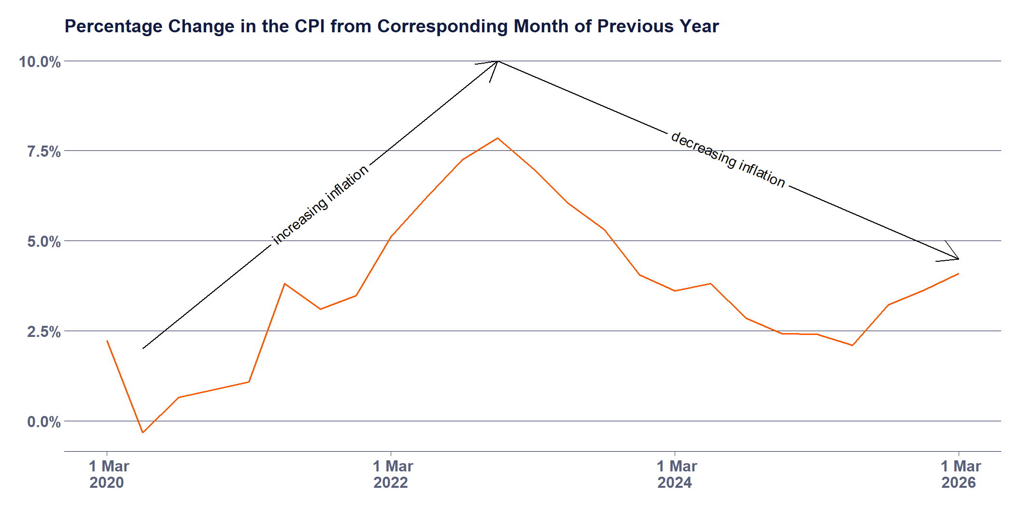
Inflation - Percentage Change
Notes:
This is the % change way of measuring inflation.
Inflation goes up when the % change in one period is higher than the last period
All the numbers (except for one in 2020) are positive. In fact, since the September quarter of 1948, inflation has only been negative 5 times.

Slide 9
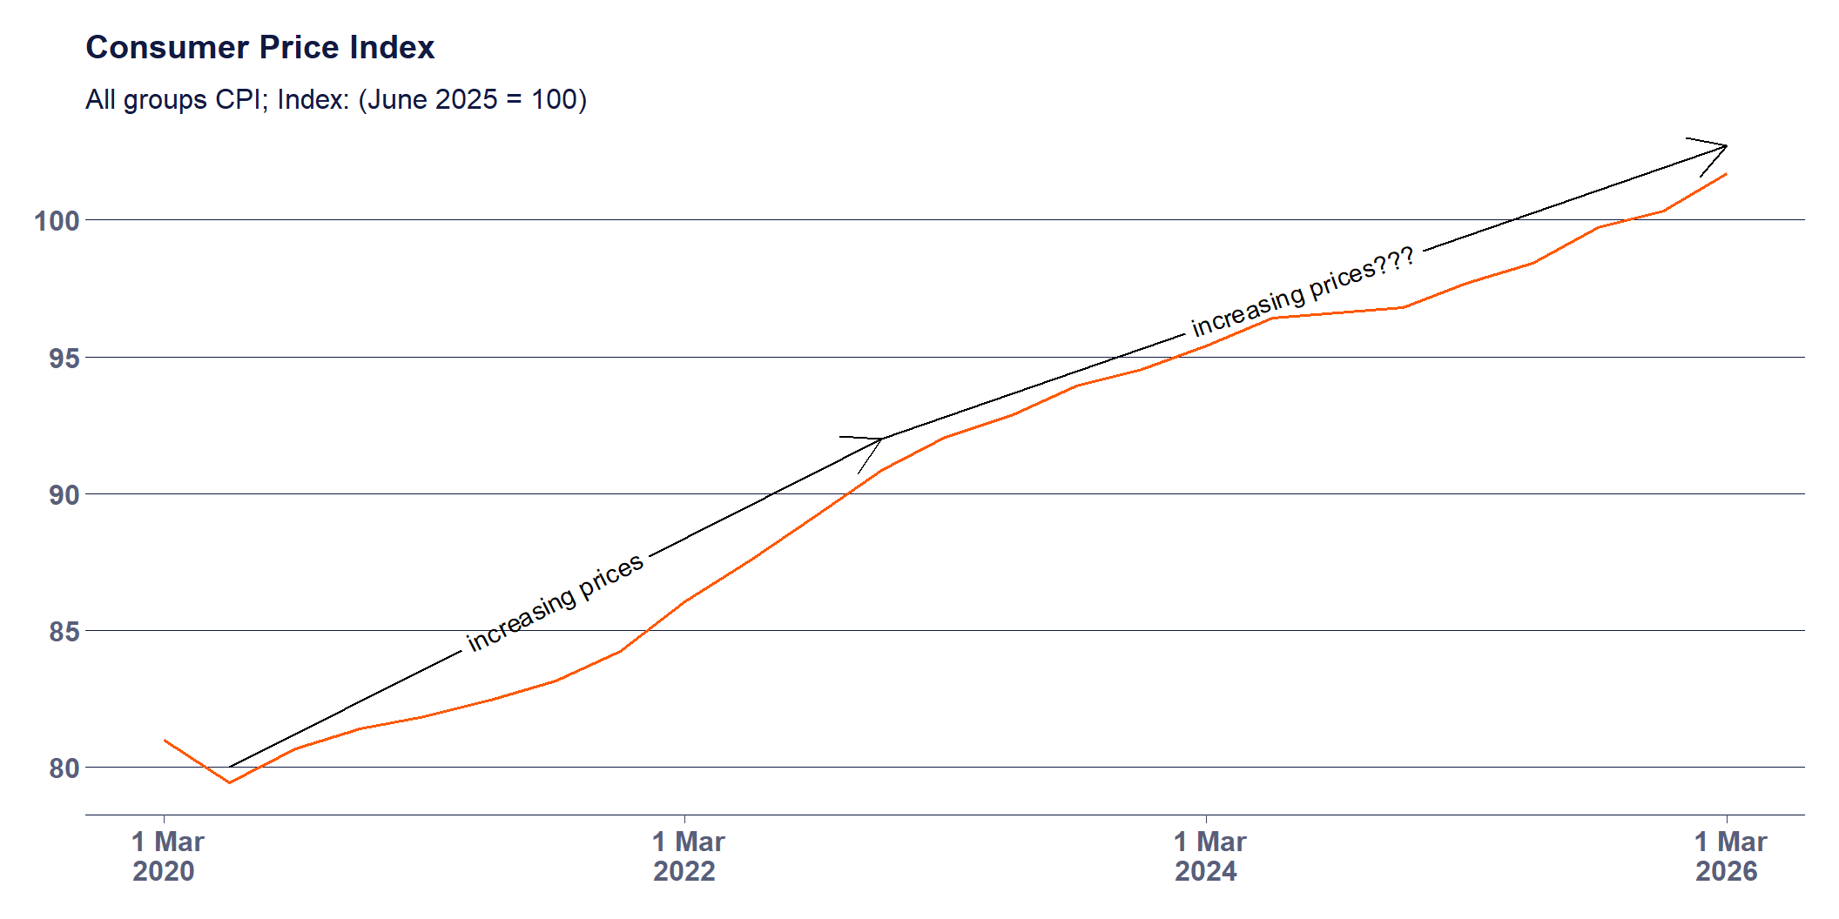
Inflation - Index
Notes:
Now looking at the index number approach.
Decreasing inflation is usually presented in the media as good news. But because inflation measures the rate of change of a rate of change (i.e. how much the change in prices changed), decreasing inflation just means that prices didn’t increase as fast.
The index measure shows you the effect of ‘cumulative’ inflation on prices.

Slide 10
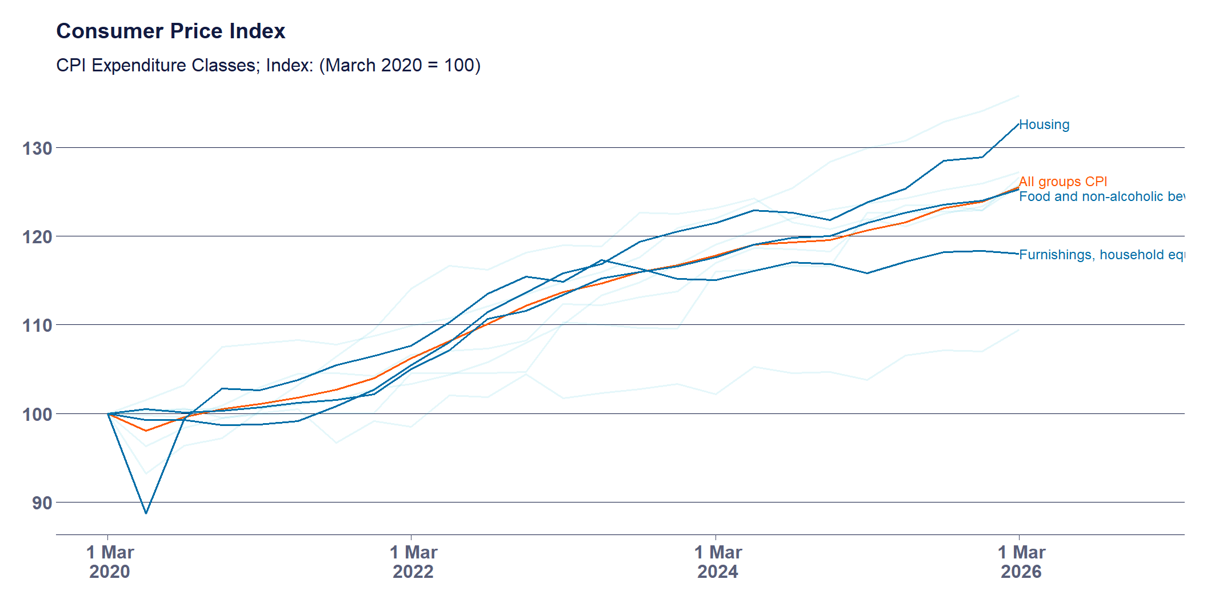
Inflation - By Type
Notes:
Reported inflation tends to focus on the overall average - but it’s collected at a highly disaggregated level, of 87 different groups.
Things that have increased faster than the average since March 2020 include: housing, food, alcohol and tobacco, health, transport, education, and insurance
Compared to things which have gone down? Clothing and footwear, and furnishings…
Other weird things about inflation - it hasn’t included mortgage repayments (since 1998).

Slide 11
Inflation - Cost of Living
Notes:
As mentioned previously, the CPI is not a measure of the cost of living. In fact there is no definitive cost of living measure collected by the ABS but the ABS does collect a living cost index, which looks at different household types expenditure patterns.
The living cost index asks “By how much would after tax money incomes need to change to allow households to purchase the same quantity of consumer goods and services that they purchased in the base period?”

Slide 12
Change in living costs by product category
% change between March 2026 and March 2025
Price Category | % change
Housing | 8.3%
Clothing and footwear | 5.5%
Alcohol and tobacco | 4.4%
Recreation and culture | 3.6%
Education | 3.4%
Health | 3.3%
Wages | 3.2%
Food and non-alcoholic beverages | 3.1%
Transport | 3.0%
All groups | 2.6%
Furnishings, household equipment and services | 2.0%
Communication | 1.7%
Insurance and financial services | −3.6%
Change in living costs by product category
% change between March 2026 and March 2020
Price Category | % change
Insurance and financial services | 72.3%
Alcohol and tobacco | 35.1%
All groups | 28.5%
Housing | 27.1%
Health | 27.0%
Education | 26.2%
Transport | 25.4%
Food and non-alcoholic beverages | 25.3%
Wages | 20.6%
Recreation and culture | 19.2%
Furnishings, household equipment and services | 17.9%
Clothing and footwear | 9.4%
Communication | 1.7%

Slide 13
Inflation - Wages
https://www.youtube.com/watch?v=g6-lciEvkpA

Slide 14
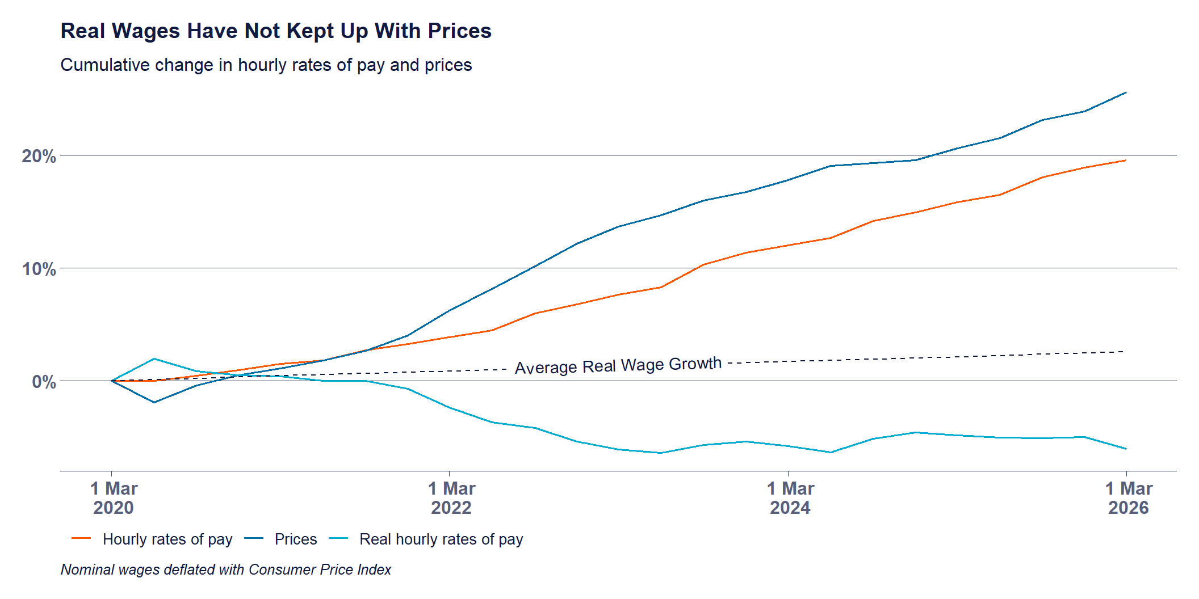
Inflation - Wages
Notes:
What is relevant to everyone is how well wages are keeping up with increased costs. It isn’t particularly worrisome if the price of everything doubles but your income also doubles.
Unfortunately it’s not really that easy to tell if this is happening or not.
Does it feel to you that things are more expensive relative to how much your earning?
Because the CPI is measured using a basket of goods, which is supposed to represent the ‘average’ consumer, it is guaranteed that your experience is different - because you buy different things in different proportions than the “representative” consumer.
But we can look at the “real” value of wages - how far their purchasing power goes. And here we have another trick of the economist. How do you convert “nominal” dollars - how much you earn today (or yesterday) into “real” dollars - how much does that dollar buy you?
What would this chart look like if you got a 6% pay rise for the next year, and inflation grew at the RBAs target of 2.5%?

Slide 15
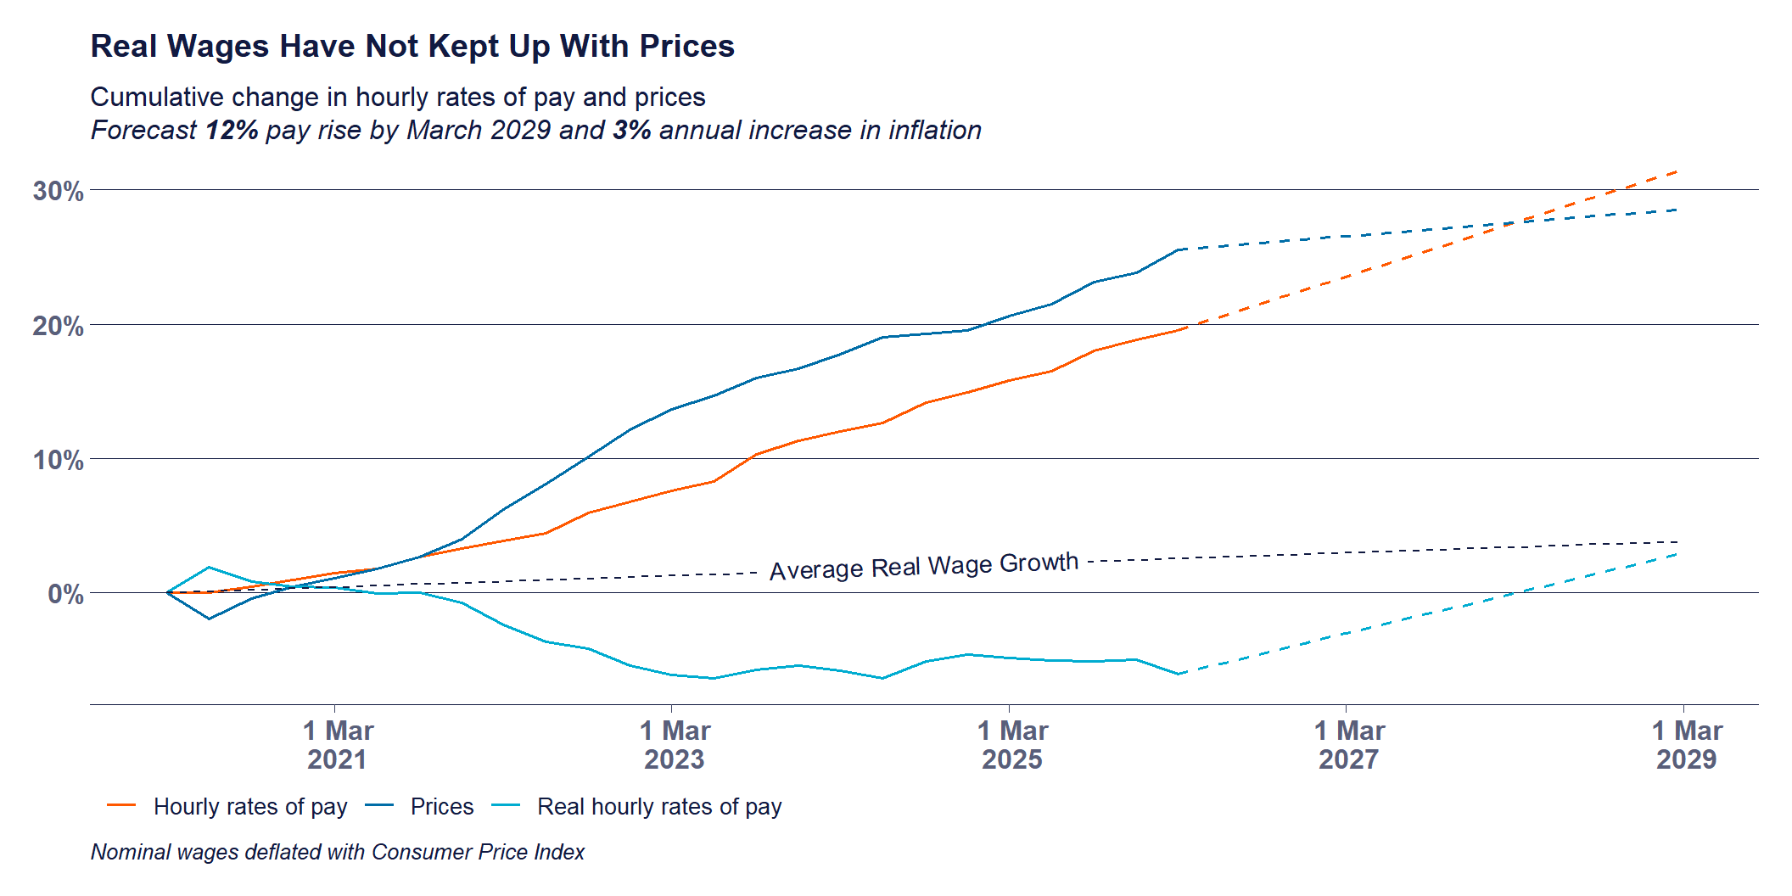
Inflation - Pay Increase
Notes:
We’re really far away from IMPROVING living standards.

Slide 16
What Inflation Is Not
Inflation is not a measure of the cost of living.
Decreasing inflation does not mean prices have gone down.
Inflation is not more important than any other economic indicator.

Slide 17
The AMWU and Wages

Slide 18
Increasing real wages is our core business.
It is about improving living standards. And making sure people aren’t getting left behind, or exploited by their employer.
Inflation has eroded real wage increases that we have collectively struggled for.

Slide 19
Industrial Capabilities

Slide 20
What you make is what you know

Slide 21
Industrial Capabilities
Core concepts:
a country makes (or does) what it knows
products (or activities) represent combinations of knowledge
Capabilities are like letters in Scrabble
The more you have, the more words you can make
Rare letters create words worth more points

Slide 22

Products Embody Knowledge
An apple in the supermarket represents:
Horticulture
Pest control
Refrigeration
Logistics

Slide 23

Products Embody Knowledge
An iPhone represents:
Semiconductors
Software/Hardware Engineering
Materials science
Lenses
Marketing
Packaging

Slide 24
Measuring Industrial Capabilities
Export data reveals what a country makes
Comparison between countries reveals which capabilities are common, and which are rare
The presence of different capabilities in different countries allows a ranking called the Economic Complexity Index

Slide 25
Why Does It Matter?
The Economic Complexity Index is predictive of the direction of future economic growth.
Countries with higher complexity are predicted to grow faster
Useful tool to identify productive capabilities of a country.
Can be used to identify future opportunities and direct strategy.

Slide 26
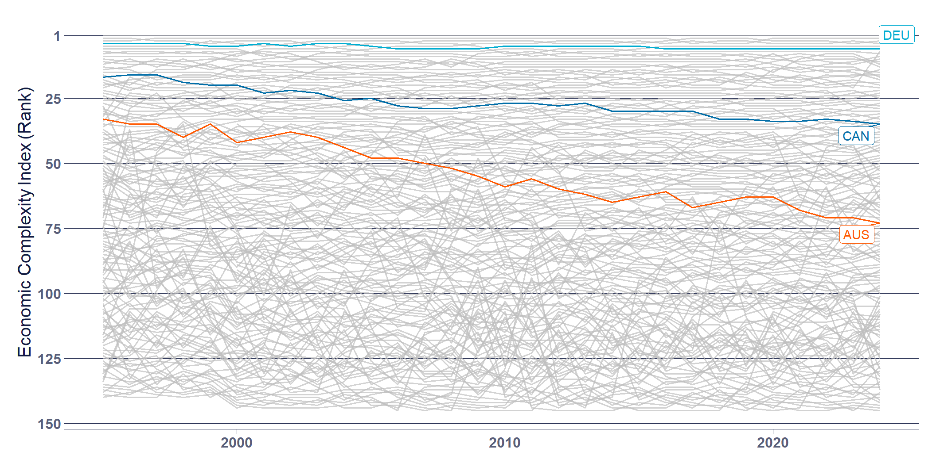
Why Does It Matter to Australia?
Notes:
Australia’s ranking in 2024 was 74th- Sandwiched between Madagascar and Uruguay
Australia’s exports are concentrated in only a few products
Australia’s exports are lower in average complexity
Australia does not have the industrial capabilities of other developed countries.

Slide 27
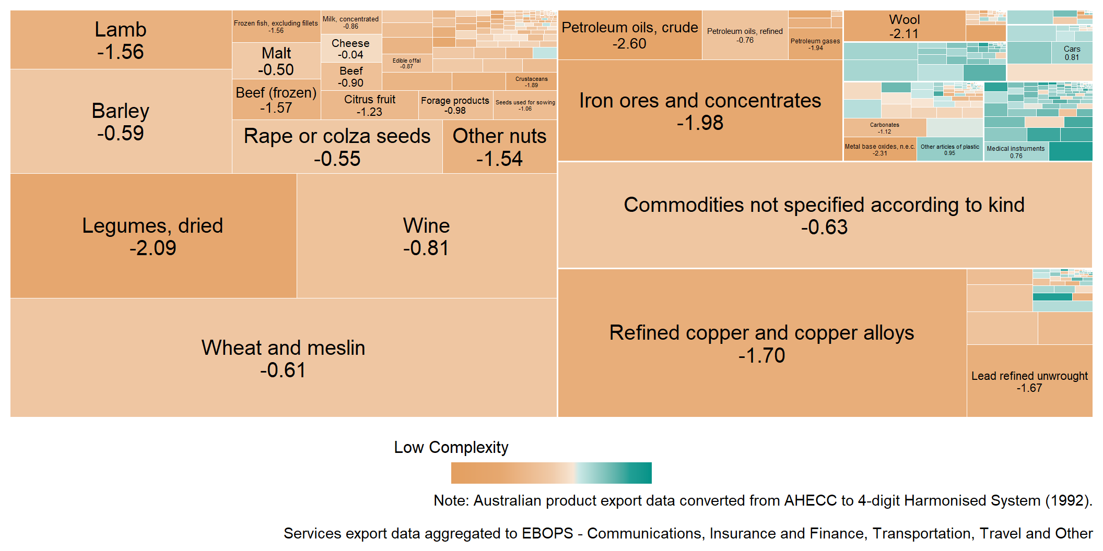
Why Does it Matter to South Australia?

Slide 28
What Can Be Done?
Recognise that there is a problem.
The lack of sufficient existing capabilities requires explicit and direct industrial policy.
Understand the connection between just transition, decarbonisation, and reindustrialisation.
Develop a policy agenda which explicitly outlines existing and future opportunities, and how to get there.
Notes:
The problem:
is real, will not be solved by the market and will not be solved with small tweaks and adjustments.
just transition and decarbonisation is an opportunity to PLAN something, and then to DO something.

Slide 29
The AMWU and a Future Made in Australia
The Future Made in Australia Act is a $22.7 billion investment into restoring an industrial base in Australia.
FMIA, which is public money, must be used to create secure, high-quality jobs. Not subsidise worker exploitation.
The AMWU is calling for the establishment of a manufacturing council, and tying strong conditions to businesses receiving public money
Notes:
As part of a Future Made in Australia, what do we want to see? What will we be campaigning for?
A Secure Australian Jobs Code
Establishing a Manufacturing Competitiveness Council
Demand local content
Mandate apprentice participation
Establish fair trade over free trade
Nationalise strategic infrastructure

Slide 30
Conditions for Employers
Guarantee of secure jobs, fair wages, and safe conditions
Collective bargaining as a requirement at workplaces who receive public money.
Use the state’s power in procurement to support local industry through local content targets.
Mandate apprentice participation
Notes:
This is about public money for a public good. Not subsidies to private capital to continue to exploit their workers. We are calling on the Labor government to mandate collective agreements for any businesses receiving public money, which reflect union rates of pay.
Local Content
Procurement is one of the most powerful levers we have for rebuilding our industrial base.
Public money must explicitly support local industry.
How do we make them enforceable?
Local content, local content targets, and local industry participation. The government can provide certainty to businesses looking to expand to supply infrastructure to the energy transition.
Skills and Apprentices
To rebuild our industrial base we need skilled manufacturing workers
Current apprentice requirements are toothless, letting employers off the hook

Slide 31
Manufacturing Competitiveness Council
Tripartite Manufacturing Competitiveness Council - with genuine union representation.
Ensure that all decisions about capital investment, skills, and industry strategy are made with worker input.
Establish and plan for the orderly transition of our economy - guided by human need, not market whims.

Slide 32
Fair Trade
Empower the Anti-Dumping Commission
Unfair trade, particular dumping, has significant negative effects on local industry. Especially in a country that is seeking to re-industrialise.
Establish an Independent Advocate for Fair Trade.

Slide 33
Nationalising Strategic Infrastructure
Infrastructure that is “too big to fail” or needed “in the national interest” can not be left in the hands of profit maximisers.
Perpetual bailouts and subsidies
Natioanalisation can help us to achieve our strategic goals.
Notes:
The goal of economic sovereignty cannot be achieved if the nation’s most vital infrastructure remains subject to the profit demands of private capital. Labor must move to nationalise strategic infrastructure essential to the Future Made in Australia Act agenda, particularly in the energy and green manufacturing sectors

Slide 34
Questions

