Slide 1
Industrial Capabilities

Slide 2
Industrial Capabilities

Slide 3
What you make is what you know

Slide 4
Industrial Capabilities
Core concepts:
a country makes (or does) what it knows
products (or activities) represent combinations of knowledge
Capabilities are like letters in Scrabble
The more you have, the more words you can make
Rare letters create words worth more points

Slide 5

Products Embody Knowledge
An apple in the supermarket represents:
Horticulture
Pest control
Refrigeration
Logistics

Slide 6

Products Embody Knowledge
An iPhone represents:
Semiconductors
Software/Hardware Engineering
Materials science
Lenses
Marketing
Packaging

Slide 7
Measuring Industrial Capabilities
Export data reveals what a country makes
Comparison between countries reveals which capabilities are common, and which are rare
The presence of different capabilities in different countries allows a ranking called the Economic Complexity Index

Slide 8
Why Does It Matter?
The Economic Complexity Index is predictive of the direction of future economic growth.
Countries with higher complexity are predicted to grow faster
Useful tool to identify productive capabilities of a country.
Can be used to identify future opportunities and direct strategy.

Slide 9
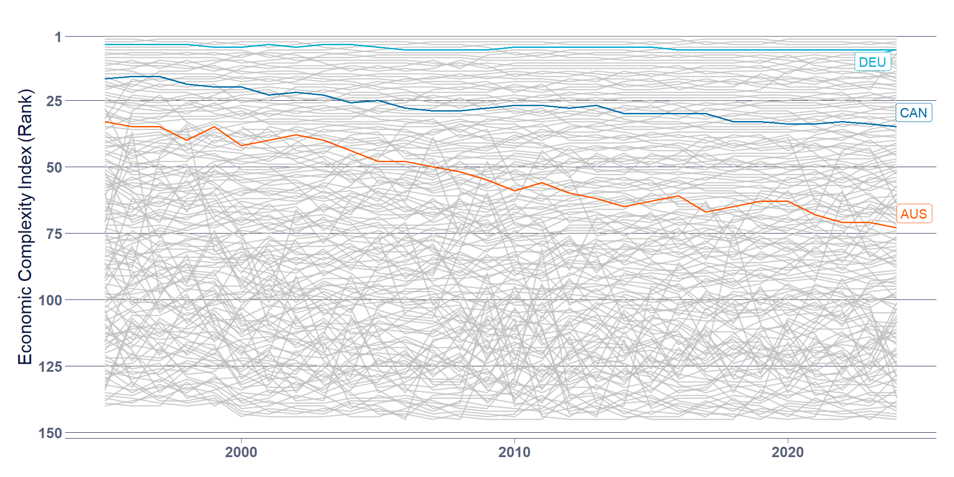
Why Does It Matter to Australia?
Notes:
Australia’s ranking in 2024 was 74th- Sandwiched between Madagascar and Uruguay
Australia’s exports are concentrated in only a few products
Australia’s exports are lower in average complexity
Australia does not have the industrial capabilities of other developed countries.

Slide 10
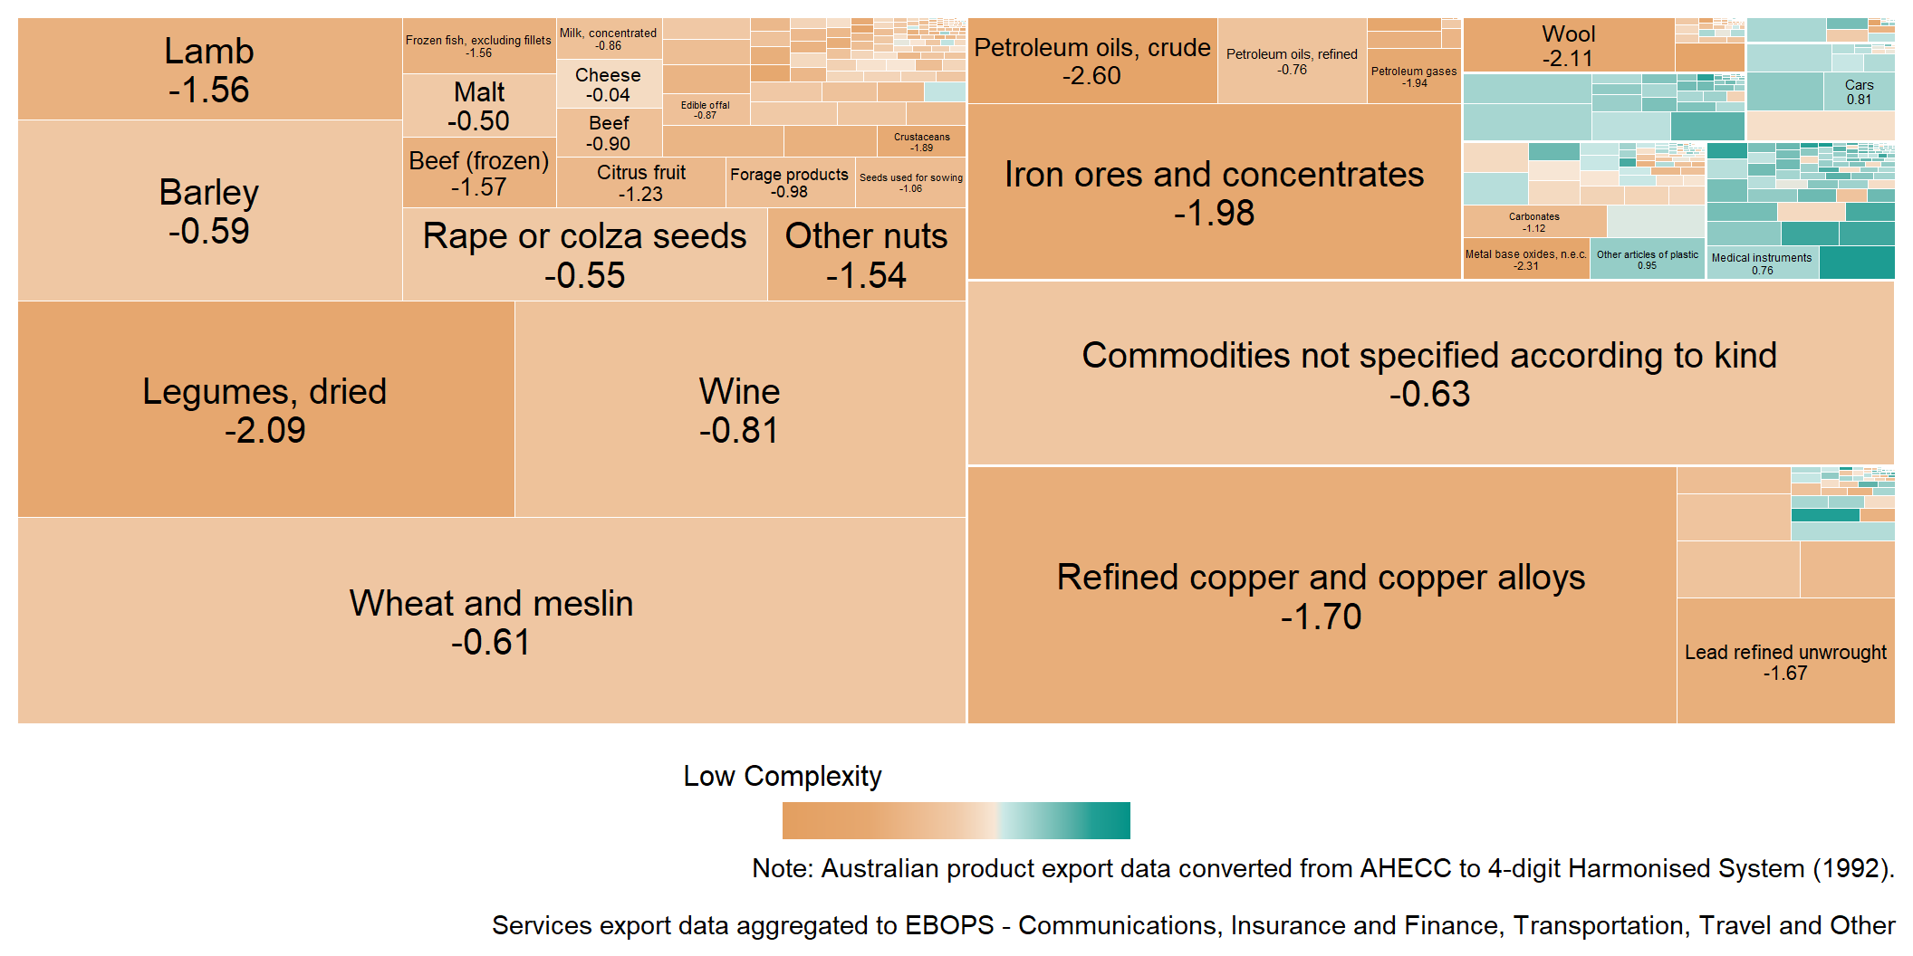
Why Does it Matter to South Australia?

Slide 11
What Can Be Done?
Recognise that there is a problem.
The lack of sufficient existing capabilities requires explicit and direct industrial policy.
Understand the connection between just transition, decarbonisation, and reindustrialisation.
Develop a policy agenda which explicitly outlines existing and future opportunities, and how to get there.
Notes:
The problem:
is real, will not be solved by the market and will not be solved with small tweaks and adjustments.
just transition and decarbonisation is an opportunity to PLAN something, and then to DO something.

Slide 12
The AMWU and a Future Made in Australia
The Future Made in Australia Act is a $22.7 billion investment into restoring an industrial base in Australia.
FMIA, which is public money, must be used to create secure, high-quality jobs. Not subsidise worker exploitation.
The AMWU is calling for the establishment of a manufacturing council, and tying strong conditions to businesses receiving public money
Notes:
As part of a Future Made in Australia, what do we want to see? What will we be campaigning for?
A Secure Australian Jobs Code
Establishing a Manufacturing Competitiveness Council
Demand local content
Mandate apprentice participation
Establish fair trade over free trade
Nationalise strategic infrastructure

Slide 13
Conditions for Employers
Guarantee of secure jobs, fair wages, and safe conditions
Collective bargaining as a requirement at workplaces who receive public money.
Use the state’s power in procurement to support local industry through local content targets.
Mandate apprentice participation
Notes:
This is about public money for a public good. Not subsidies to private capital to continue to exploit their workers. We are calling on the Labor government to mandate collective agreements for any businesses receiving public money, which reflect union rates of pay.
Local Content
Procurement is one of the most powerful levers we have for rebuilding our industrial base.
Public money must explicitly support local industry.
How do we make them enforceable?
Local content, local content targets, and local industry participation. The government can provide certainty to businesses looking to expand to supply infrastructure to the energy transition.
Skills and Apprentices
To rebuild our industrial base we need skilled manufacturing workers
Current apprentice requirements are toothless, letting employers off the hook

Slide 14
Manufacturing Competitiveness Council
Tripartite Manufacturing Competitiveness Council - with genuine union representation.
Ensure that all decisions about capital investment, skills, and industry strategy are made with worker input.
Establish and plan for the orderly transition of our economy - guided by human need, not market whims.

Slide 15
Fair Trade
Empower the Anti-Dumping Commission
Unfair trade, particular dumping, has significant negative effects on local industry. Especially in a country that is seeking to re-industrialise.
Establish an Independent Advocate for Fair Trade.

Slide 16
Nationalising Strategic Infrastructure
Infrastructure that is “too big to fail” or needed “in the national interest” can not be left in the hands of profit maximisers.
Perpetual bailouts and subsidies
Natioanalisation can help us to achieve our strategic goals.
Notes:
The goal of economic sovereignty cannot be achieved if the nation’s most vital infrastructure remains subject to the profit demands of private capital. Labor must move to nationalise strategic infrastructure essential to the Future Made in Australia Act agenda, particularly in the energy and green manufacturing sectors

