Slide 1
How telecom companies implement customer acquisition and retention in their companies
using Decision Tree

Slide 2
INTRODUCTION
Churn prediction is one of the most popular Big Data use cases in business. It consists of detecting customers who are likely to cancel a subscription to a service.
Churn in a prepaid service is actually a measure based on the lack of activity in the network over a period time, thus there is no formal notification from customer of ending a contract term, our goal is to infer when this lack of activity may happen in the future for each active customer
Churn is a problem for telecom companies because it is more expensive to acquire a new customer than to keep your existing one from leaving.
Churn prediction can be viewed as supervised classification problem where the behavior of previously know churners an non-churners are used to train a binary classified
Telecom companies today measure voluntary churn by a monthly figure, such as 1.9 percent or 2.1 percent.

Slide 3
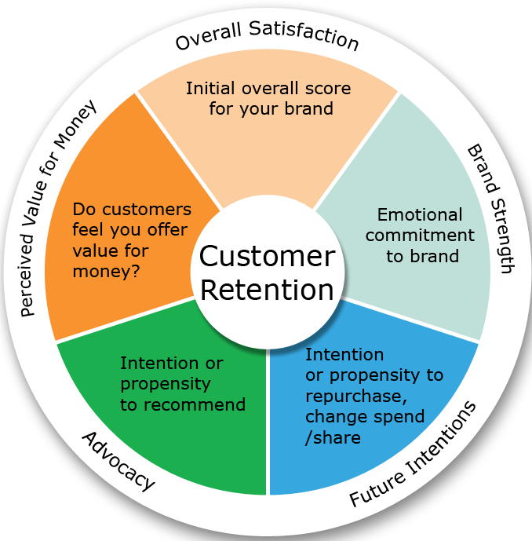
CUSTOMER RETENTION STRATEGY

Slide 4
Possible customer states
Each customer can be in one of the following states:
New, Active, Inactive or Churn
> T days without event
event
New
Active
Inactive
> Q days
without event
event
Churn

Slide 5
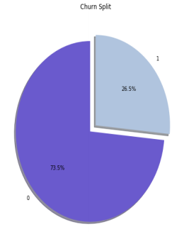
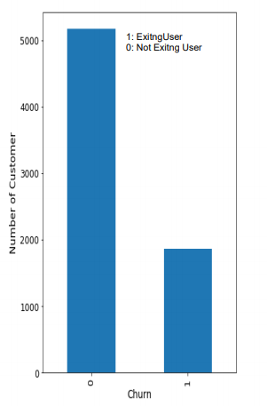
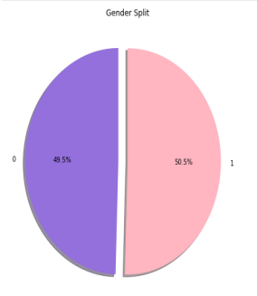
Identifying Personal Attributes of Customers for Churn Prediction
Based on the customer states we classify the users for analytics.

Slide 6
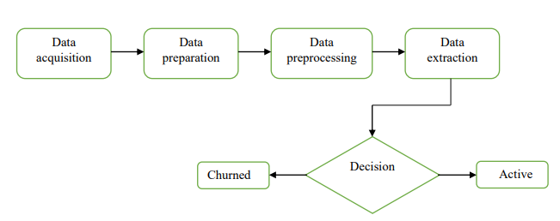
Churn prediction using Decision Trees
Decision Tree Analysis framework design, using this sort of design the provider is set to make the final decision amongst various possibilities. The Design rule set will let the Telecom provider identify and classify in the different categories of churners and active customers by setting a particular threshold value.

Slide 7
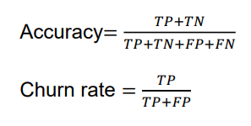
Classification Accuracy
TP (True Positive)- The number of instances when the predicted churner is truly a churner.
TN (True Negative)- The number of instances when the predicted non-churner is truly a nonchurner.
FP (False Positive)- The number of instances when the predicted churner is non-churner in real.
FN (False Negative)- The number of instances when the predicted non-churner is a churner in real.
Actual class/Predictive class | Churned | Non-churned
Churned | True Positive (TP) | False Negative (FN)
Non-churned | False Positive (FP) | True Negative(TN)

Slide 8
Analysis
There are three tree growing method in decision tree namely CHAID, CART and QUEST. Exhaustive CHAID is another variant of CHAID.
Exhaustive CHAID provides the most accurate results. This technique also has the minimum risk error associated with it.
Based on the analysis with respect to average churn risk score, we can get an accuracy of 95.23% using Decision tree.

Slide 9
HOW TO REDUCE CUSTOMER CHURN
Lean into your best customers.
Be proactive with communication.
Define a roadmap for your new customers.
Offer incentives.
Ask for feedback often.
Analyze churn when it happens.
Stay competitive.

Slide 10
CONCLUSION
The importance of this type of research in the telecom market is to help companies make more profit.
It has become known that predicting churn is one of the most important sources of income to Telecom companies.
The prediction models need to achieve high AUC values. To test and train the model, the sample data is divided into 70% for training and 30% for testing.

Slide 11
References
Rahman Mansouri, Mohamad Saraee, RasoulAmirfattahi, Applications of Data Mining in Predicting Cell Phones Subscribers Behavior Employing the Contact Pattern, International Conference on Data Storage and Data Engineering, IEEE 2010.
A., Saran & D., Chandrakala. (2016). A Survey on Customer Churn Prediction using Machine Learning Techniques. International Journal of Computer Applications. 154. 13-16. 10.5120/ijca2016912237.
D. V. Poel and B. Larivi. Customer attrition analysis for financial services using proportional hazard models. European Journal of Operational Research, 157(1):196{217, 2004.
Umayaparvathi V, Iyakutti K. A survey on customer churn prediction in telecom industry: datasets, methods and metric. Int Res J Eng Technol. 2016;3(4):1065–70

