Slide 1
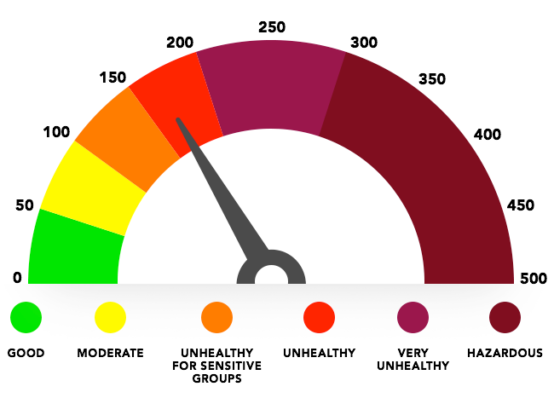

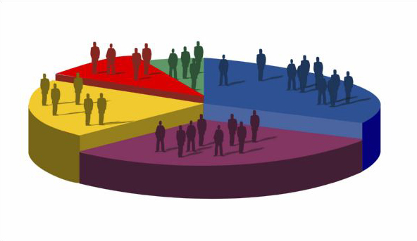
Air Quality, Health & Census
Adam
Brian
Yamini
Vinu

Slide 2
Project Scope
Correlation between
-Air quality
-Health
-Geographic
-Economic

Slide 3
Data Sources
U.S. Census Data
County Health Data
Air Quality Data

Slide 4
Key take aways [Adam]

Slide 5
Key take aways [Brian]

Slide 6
Key take aways [Yam]

Slide 7
Key take aways [Vinu]

Slide 8
Summary of all outputs
Incomplete data from one source (Air Quality) made it difficult to find relationships between more complete data sets (census), but the data that we found showed that generally the more populous areas had worse air quality

Slide 9

Q & A
http://www.dnrec.delaware.gov/volunteer/Pages/AQvolunteers.aspx

