Slide 1
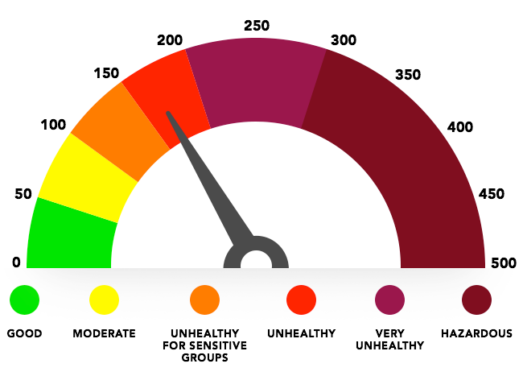

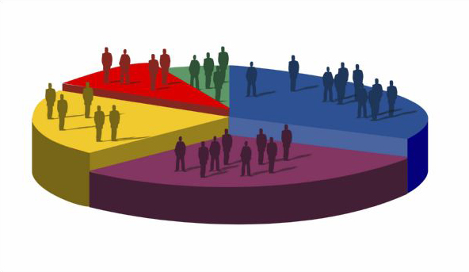
Air Quality, Health & Census
Adam
Brian
Yamini
Vinu

Slide 2
Project Scope
Correlation between
-Air quality
-Health
-Geographic
-Economic

Slide 3
Data Sources
U.S. Census Data
County Health Data
Air Quality Data

Slide 4
Key takeaways [Adam]
I started this project wanting to look at the relationship between air quality, health, and economic information.
As I started aggregating data sets for the three factors, I quickly saw that the analysis would only be as good as the least complete data set. I saw this by checking the length of the merged data frames.
This prompted me to make a visual representation of the most complete data set we had (census). Once I had the population information on a map, it was fairly easy to change variables, so I looked at the air quality data and saw a large portion of the map fall off, but was still able to see the inverse correlation between county population and air quality.
I chose to include a map with all of the air quality monitor stations to show the driver of the blank pieces of data and used shading to indicate where large amounts of data were recorded.

Slide 5
Key take aways [Brian]

Slide 6
Air Quality Index
An air quality index (AQI) is a number used by government agencies to communicate to the public how polluted the air currently is or how polluted it is forecast to become. As the AQI increases, an increasingly large percentage of the population is likely to experience increasingly severe adverse health effects.[1]
EPA(United States Environmental Protection Agency) [2] calculates the AQI for five major air pollutants regulated by the Clean Air Act: ground-level ozone, particle pollution (also known as particulate matter(PM2.5,and PM10)), carbon monoxide, sulfur dioxide, and nitrogen dioxide.

Slide 7
Data representing in tabular form
Measure Id | Measure Name | State Name | Report Year | Value | Income
83 | Ozone Concentration | California | 2015 | 11.47 | $67k
83 | Ozone Concentration | Nevada | 2015 | 3.5 | $55k
83 | Ozone Concentration | New Jersey | 2015 | 1.7 | $76k
83 | Ozone Concentration | Rhode Island | 2015 | 3.7 | $59k
83 | Ozone Concentration | South Dakota | 2015 | 2.5 | $51k

Slide 8
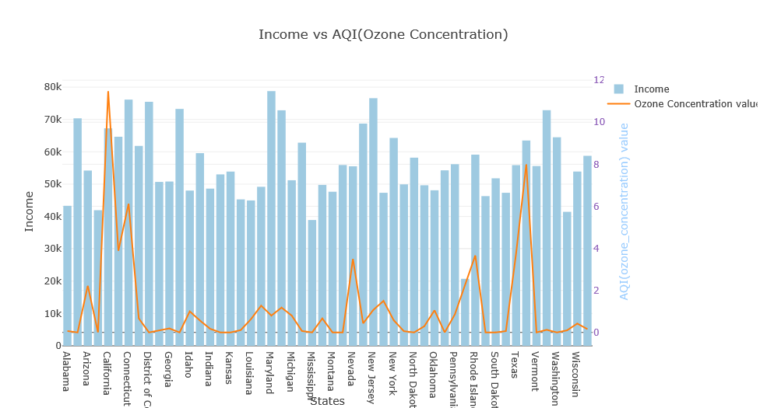
Co-relation Between Income and AQI in the year 2015
$67k,11.47
$55k,3.5
$59k,3.7
$76k,1.07

Slide 9
Summary of all outputs
Incomplete data from one source (Air Quality) made it difficult to find relationships between more complete data sets (census).

Slide 10

Q & A
http://www.dnrec.delaware.gov/volunteer/Pages/AQvolunteers.aspx

