Slide 1
Air Quality, Health by state
Adam
Brian
Yamini
Vinu

Slide 2
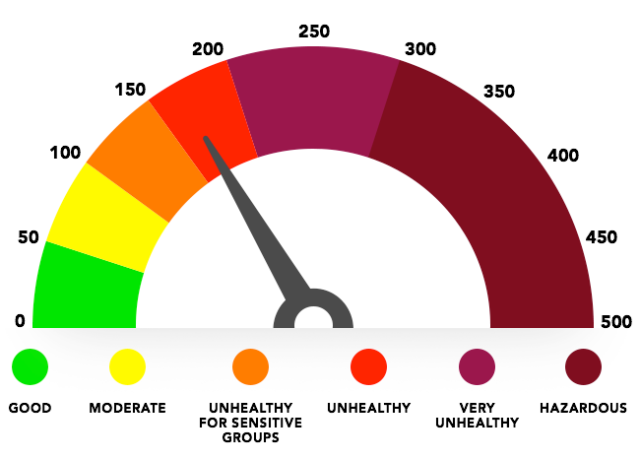
Air Quality Index
https://airmega.com/air-quality-index/

Slide 3

http://www.dnrec.delaware.gov/volunteer/Pages/AQvolunteers.aspx

