Slide 1
Improve Gallaudet Workday
AHC 621
Access Innovators Emeka and Amy
Redesigning class registration and override requests for Gallaudet students.

Slide 2
Milestone 1: Background and Problem Statement
Background
Gallaudet is a Deaf-centered university.
Workday is required for class registration, schedules, and academic information.
Students rely on it during time-sensitive registration periods.
Problem
Some Workday tasks feel confusing and take too many steps.
This can create stress and delay registration.
Primary Users
Gallaudet Students
Advisors and faculty
University support staff
Goal: Understand where the workflow breaks down and redesign the process to be clearer, faster, and more supportive.
Stakeholder priorities: Easier navigation, clearer instructions, visible progress, and better access to support.

Slide 3
Milestone 1 to 2: Research Plan and Direction for Solutions
Research activities:
Task observation and feedback collection from Gallaudet students
Main task focus:
Course search, registration, class schedule review, and override requests.
General design direction:
Reduce extra clicks, combine related steps, and make next actions easier to understand.
What we wanted to improve
Navigation that feels more direct
Clear status messages and confirmation
Reduce steps to register classes

Slide 4
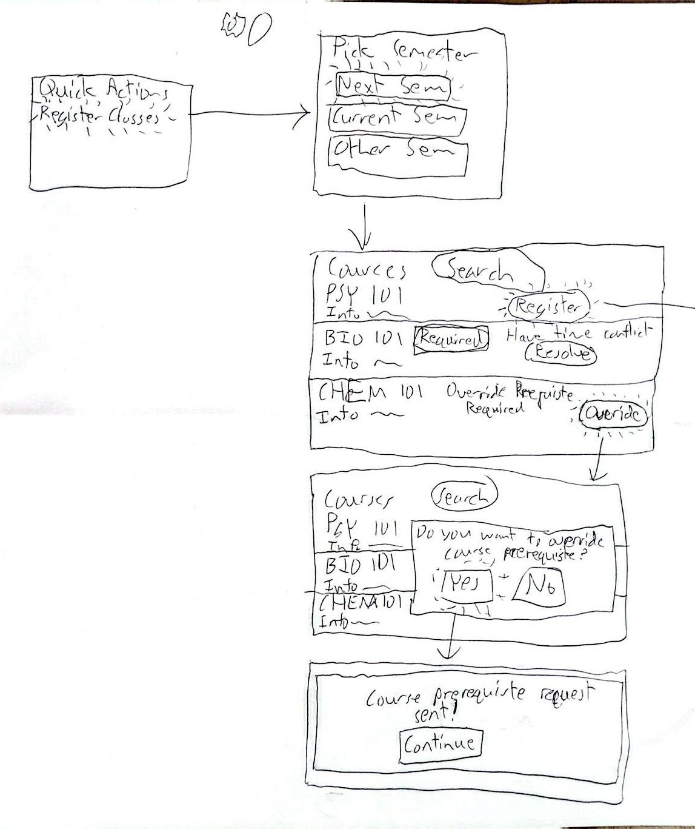
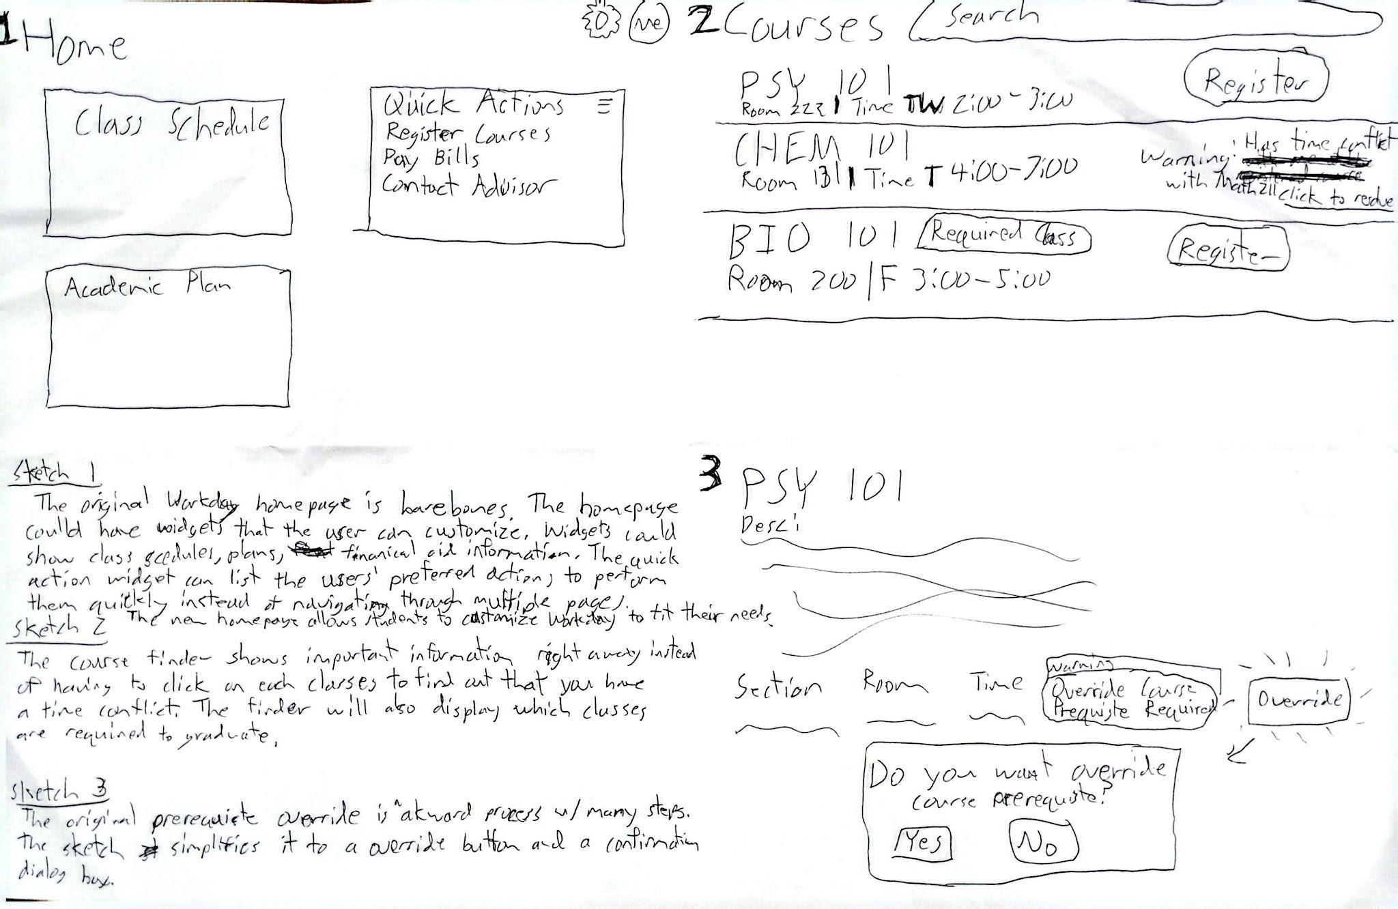
Milestone 2: Sketches and Early Concepts
The sketches explored a simpler path from searching for a course to requesting an override.
We added visible steps, accessibility shortcuts, and clearer confirmation messages.
Early sketches showing a simpler Workday class registration and override process.
4

Slide 5
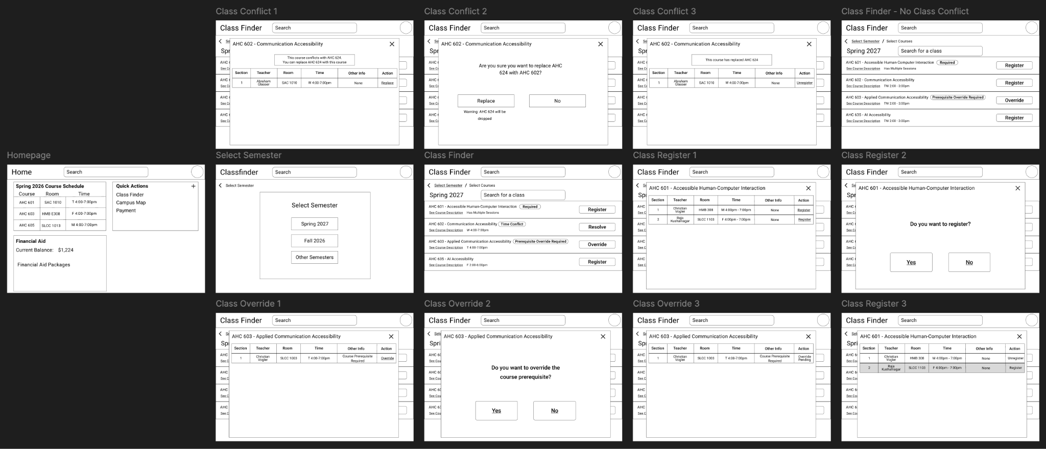
Milestones 3: Low-Fidelity Prototype
Low-fidelity prototype showing class search, registration, and override request flow.

Slide 6
Milestones 4: Low-Fidelity Prototype Evaluation
Procedures
Tested with 8 participants with a test case
You are an AHCP student who is trying to register for 3 classes, AHC 601, AHC 602, and AHC 603, for Spring 2027.
We recorded how much time the participants took to complete their task
Participants completed a post-evaluation survey
Then we had a short open-ended discussion

Slide 7
Milestones 4: Low-Fidelity Prototype Evaluation
Survey Questions
The interface is easy/hard to use.
The interface is understandable.
The registration process is understandable.
How fast/slow is the process?
From 1 to 10, how satisfied are you with the current design?
Do you have any suggestions for improvement?
Do you have any additional feedback?

Slide 8
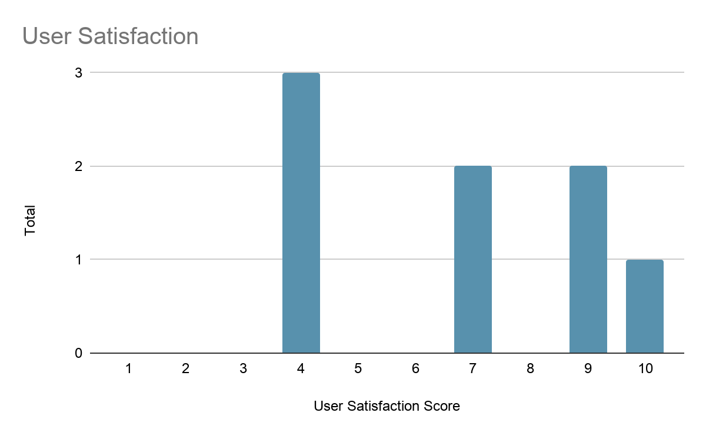
Milestones 4: Low-Fidelity Prototype Evaluation
Average Time: 2 min
 | Average Score
Interface Usability | 4
Interface Understandability | 4.25
Registration Process Understandability | 3.75
Registration Process Speed | 3.5
User Satisfaction | 6.75
A table of averages for each survey question
A user satisfaction bar chart plotting how many users gave a specific user satisfaction score

Slide 9
Milestones 4: Low-Fidelity Prototype Evaluation
Actions for High-Fidelity Prototype
Add more colors to make buttons and other elements standout
Better feedback system
E.g., make it easier for students to check their schedules
Show link to conflicting class, so the user can easily check the class before making decisions
“I like that I can clearly see important information [on the homepage] in one place”
“it is very clear and simple, but I would like to see more color visible that easy for people know where to click next or guide to next step.”

Slide 10
Live Prototype Walkthrough
Link to Prototype

Slide 11
Future Work
Further refine the class registration process
Add more features
Academic plan page
Financial aid page
Interview more users to better understand their needs
Test with more users
Include users with various disabilities

Slide 12
Conclusion
This project focused on a real challenge: helping Gallaudet students complete important Workday tasks with less stress and confusion.
Across the milestones, we moved from problem definition to sketches, prototype testing, and a higher-fidelity redesign.
The final concept shows that clearer navigation, visible progress, and fewer steps to register classes.

Slide 13

Thank you
Questions?

