Slide 1
Objects, messages, arguments
Structure: Object.message(arguments)
E.g. 3.1415.round(0.1);
Object 3.1415
message round()
argument 0.1

Slide 2
Two ways to write expressions in SC
Receiver notation: 3.1415.round(0.1);
Functional notation: round(3.1415, 0.1);

Slide 3
Possible enclosures
Collections: [ list of items ]
Functions: { often multiple lines of code }
Strings: "words inside quotes"
Symbols: ’singlequotes’

Slide 4
Conditionals: if/else and case
if/else syntax:
if(condition, {true action}, {false action})
e.g.
if(100 > 50, {"true".postln }, { "false".postln });

Slide 5
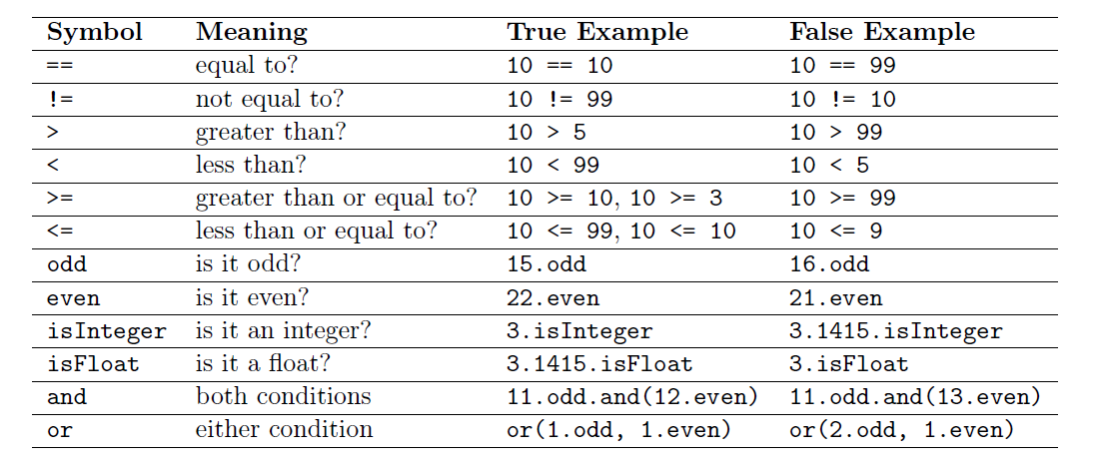

Slide 6
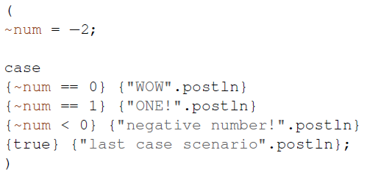
Case syntax:
case e.g.
{test1} {action1}
{test2} {action2}
{test3} {action3}
. . .
{testN} {actionN};

Slide 7
Functions
Define function:
f = {arg a, b; ["a+b=", a+b, "a*b=", a*b].postln};
Now you can give two numbers as arguments to f
e.g. f.value(3,7)

Slide 8
Arrays
Creating arrays:
e.g. a = [10, 11, 12, 13, 14, 15, 16, 17];
Array.series(size: 6, start: 10, step: 3);
series(10, 13, 25);
Array.fill(10, rrand(1, 10));

Slide 9
Some basic operations:
a.reverse // reverses the elements in array
a.choose // picks one element at random
a.size // returns size of array
a.at(0) // retrieves item at specified position
a.add(44) // creates new array with new element at the end
a.put(2, “opps”) // put "oops" at index 2
["wow", 99] ++ a; // concatenates the two arrays into a new one

Slide 10
Mini-HW Problem 3
Try to find all “Prime numbers” in 500~999.
Your result should contain each Prime number
and total number of Prime on post window.

