Slide 1
Audio fingerprinting
EE366200 – DSP Lab Final Project
103061139
陳玉璇
103061213
黃瑋玲

Slide 2
goals
Distance functions between two numeric vectors u and v. We consider functions provided in scipy.spatial.distance

Slide 3






Flow path
1
3
5
Download training data
Sampling
Spetrogram
Find peaks
Fingerprint hashing
Recognize song
2
4
Pretrained Word2Vec Model: Downloaded from Formosa Grand Challenge, https://goo.gl/CrzuQN

Slide 4
fingerprinting
Distance functions between two numeric vectors u and v. We consider functions provided in scipy.spatial.distance

Slide 5
Distance functions between two numeric vectors u and v. We consider functions provided in scipy.spatial.distance

Slide 6
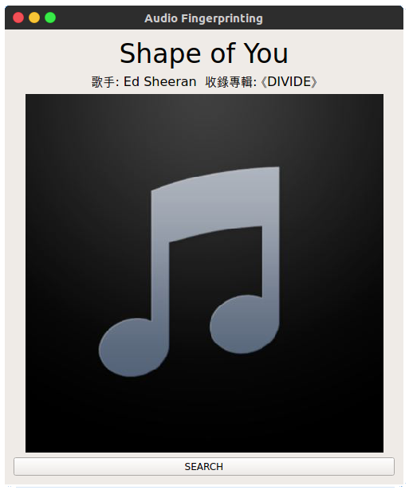
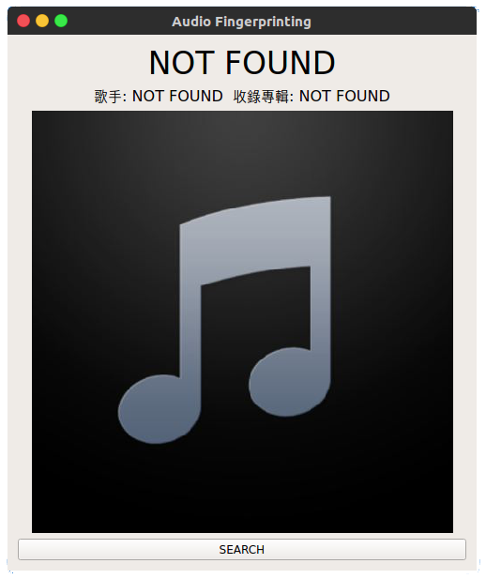
results
Distance functions between two numeric vectors u and v. We consider functions provided in scipy.spatial.distance
Searching songs
Songs Not found

