Slide 1
Audio fingerprinting
EE366200 – DSP Lab Final Project
103061139
陳玉璇
103061213
黃瑋玲

Slide 2
Flow path
Distance functions between two numeric vectors u and v. We consider functions provided in scipy.spatial.distance

Slide 3
fingerprinting
Distance functions between two numeric vectors u and v. We consider functions provided in scipy.spatial.distance

Slide 4
Distance functions between two numeric vectors u and v. We consider functions provided in scipy.spatial.distance

Slide 5
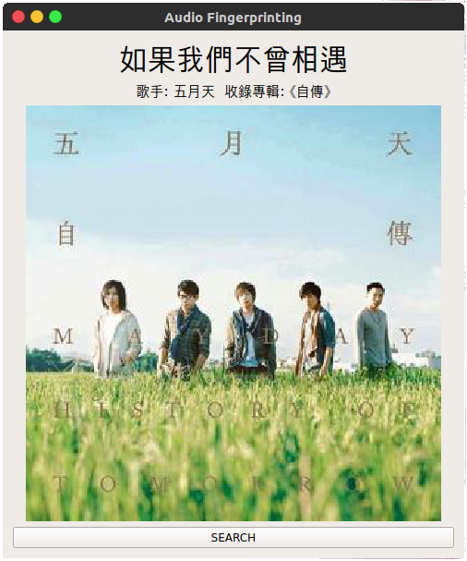
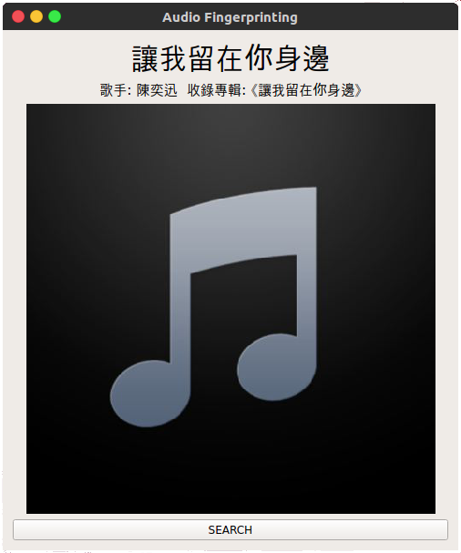
results
Distance functions between two numeric vectors u and v. We consider functions provided in scipy.spatial.distance
With Album photos
no Album photos

