Slide 1
Audio fingerprinting
EE366200 – DSP Lab Final Project
103061139
陳玉璇
103061213
黃瑋玲

Slide 2
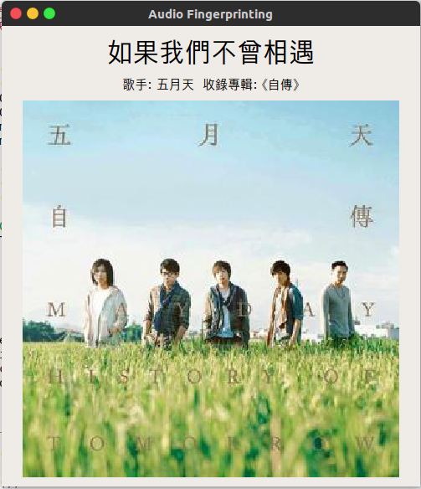
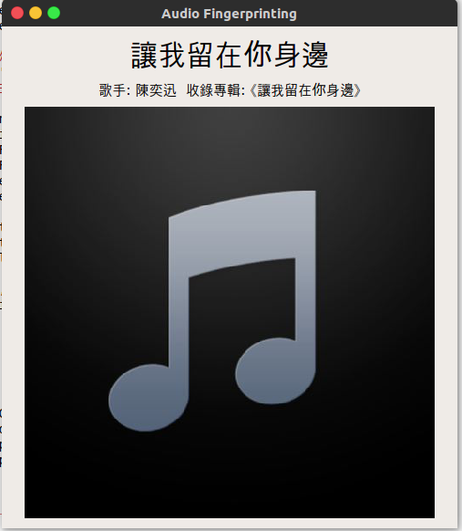
results
x
x
With Album photos
no Album photos

