Slide 1
Exercise for Lecture 01

Slide 2
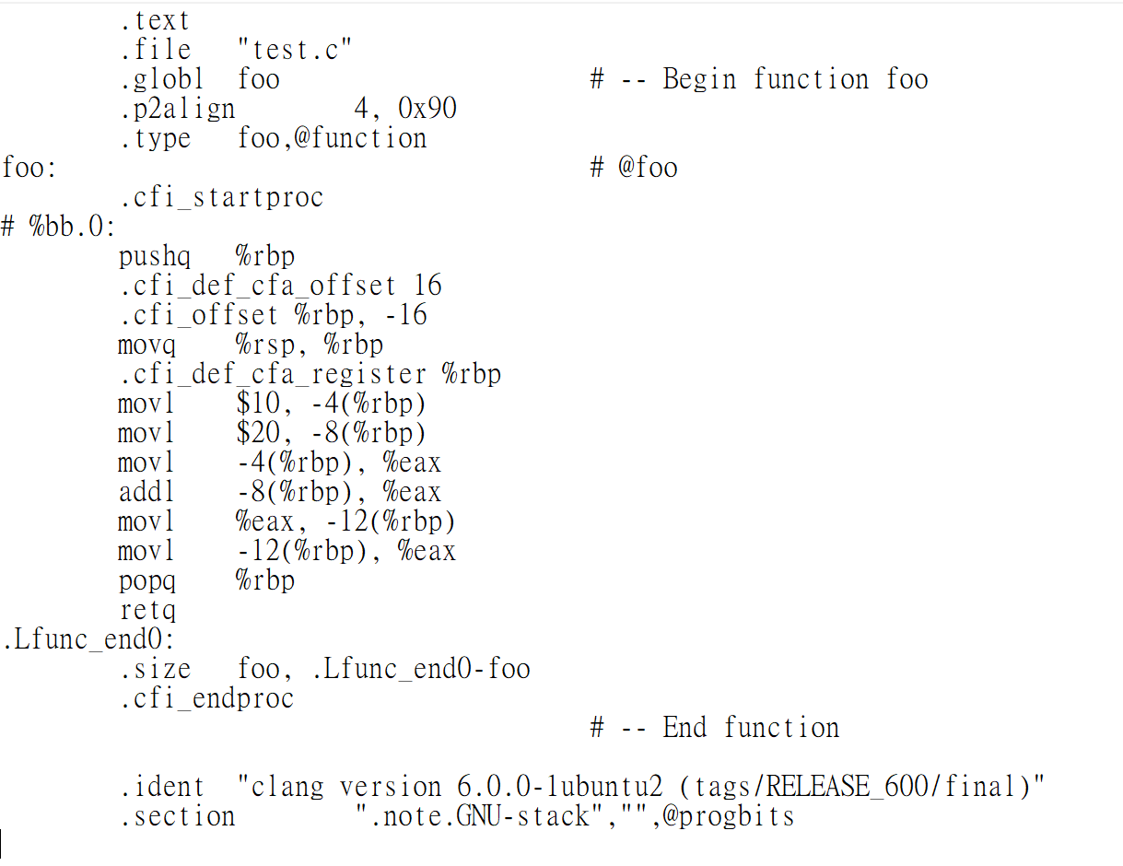
Exercise 1 – Part A
clang –S test.c
int foo ()
{
int a, b, c;
a = 10;
b = 20;
c = a+b;
return c;
}
-12(%rbp)
30
c=30
-8(%rbp)
%eax=10
20
b=20
-4(%rbp)
%eax=10+20
10
a=10
%rbp
%eax=30

Slide 3
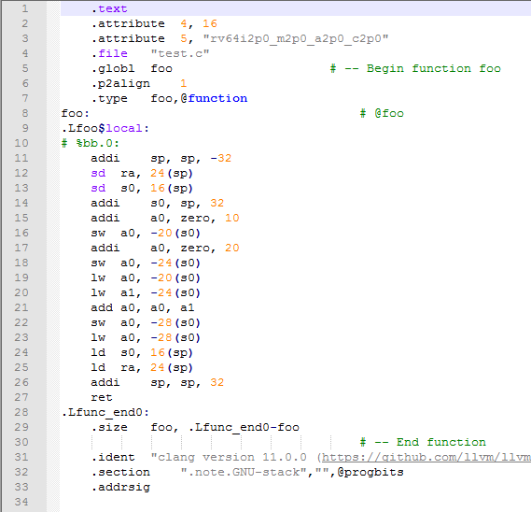
Exercise 1 – Part A
clang –S test.c
int foo ()
{
int a, b, c;
a = 10;
b = 20;
c = a+b;
return c;
}

Slide 4
Calling Convention
addi sp, sp, -32
sp(stack pointer)用來放置 stack指標的值，儲存之後函式結束時要回到的地方
sd ra,24(sp)
ra使用來放置 return address，當函數(function)要結束返回時，便會返回到此暫存器中所儲存的位址
sd s0,16(sp)
s0/fp可被當做是 Saved register或 Frame pointer
函數被呼叫前後必須維持此暫存器s0的內容一致

Slide 5
addi s0, sp, 32
addi a0, zero, 10
sw a0, -20(s0)
addi a0, zero, 20
sw a0, -24(s0)
lw a0, -20(s0)
lw a1, -24(s0)
add a0, a0, a1
sw a0, -28(s0)
lw a0, -28(s0)
s0 = sp+32
a0 = zero+10
save word a0 to -20(s0)
a0 = zero+20
save word a0 to -24(s0)
load word a0 from -20(s0)
load word a1 from -24(s0)
a0 = a0 + a1
save word a0 to -28(s0)
load word a0 from -28(s0)
sp
c=30
-24(s0)
b=20
a=10
-16(s0)
s0(frame pointer)
-8(s0)
ra(return address)
s0

Slide 6
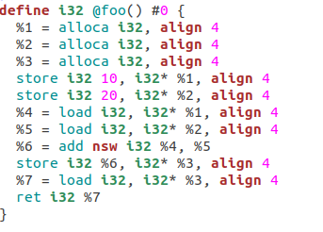
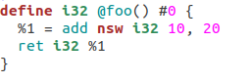
Exercise 1 – Part B
clang -Xclang -disable-O0-optnone –c –emit-llvm test.c
llvm-dis test.bc
opt –mem2reg test.bc –o test01.bc
llvm-dis test01.bc
1.不從load/store存取，改用register
透過 load/store 存取
2.Constant Propagation

Slide 7
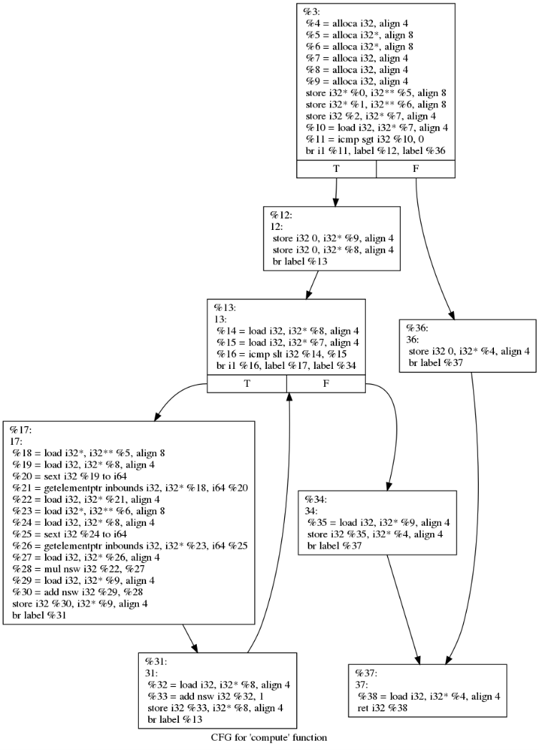
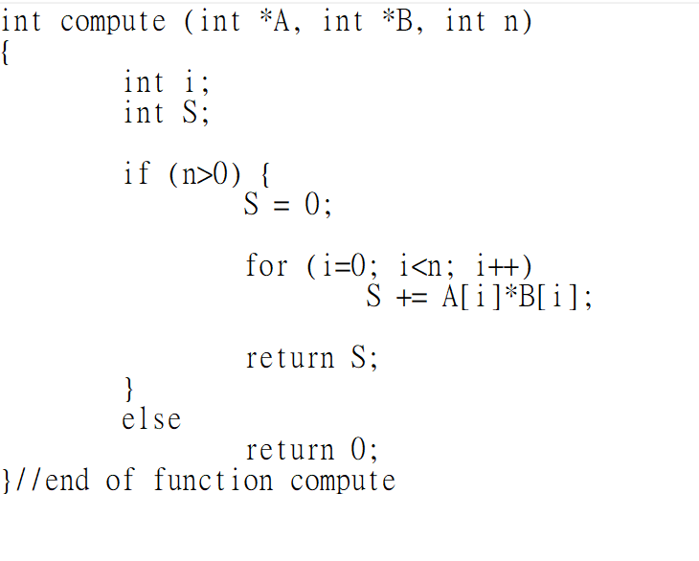
Exercise 2
int i
int S
if (n>0)
S = 0
i = 0
i<n
return 0
S += A[i]*B[i]
return S
i++

