Slide 1
Exercise for Lecture 02

Slide 2
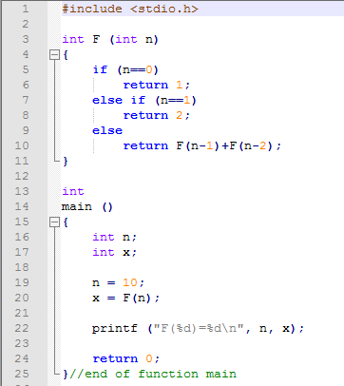
Question 1
Find out the assembly code generated from
(1) function F
(2) function main
(3) Function printf

Slide 3
