Slide 1
Introduction to Database System
Prof. Shin-Hung Chang

Slide 2

資訊爆炸

Slide 3
資訊爆炸的時代， 「被找到」才有機會生存

Slide 4
What is Database?
一群相關資料的集合體
此集合體內的資料，以最少重複方式來儲存
以最佳的形態供多數人使用
使用者取存資料時，只要透過資料庫管理系統(DBMS)協助即可。

Slide 5
Evolution

Slide 6
DataBase Management System DBMS,資料庫管理系統
一套管理資料庫的軟體工具
由一組程式模組負責組織、管理、儲存和讀取資料庫的資料
使用者對於資料庫的任何操作，都一定需要透過資料庫管理系統來處理

Slide 7
DBMS
Database
Administrator
(DBA)
董事長
Data Control
Language
(DCL)
Database
Manager
OS
開發工程師
Database
Developer
Data Definition
Language
(DDL)
AP
Database
*File
*Structure
*Dictionary
使用者
Database
User
Data Manipulation
Language
(DML)
Query
AP

Slide 8
DBMS -SQL
(1)Data Control Language, DCL
資料控制語言，資料庫安全管理的權限設定指令。
(2)Data Definition Language, DDL
資料定義語言，建立資料表(Table)、視界(View)、和索引(Index)和設定關連表的完整性限制條件等SQL指令。
(3)Data Manipulation Language, DML
資料操作語言，用來進行資料表查詢(Select)、新增(Insert)、刪除(Delete)、更新(Update)等 SQL指令。

Slide 9


Slide 10


Slide 11
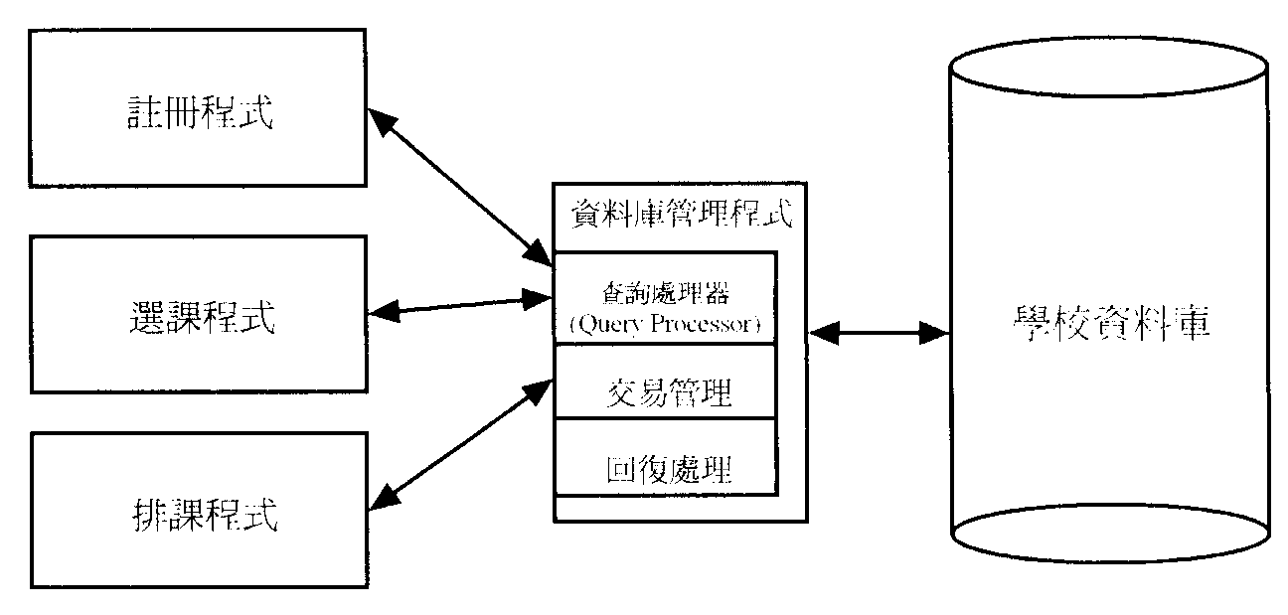
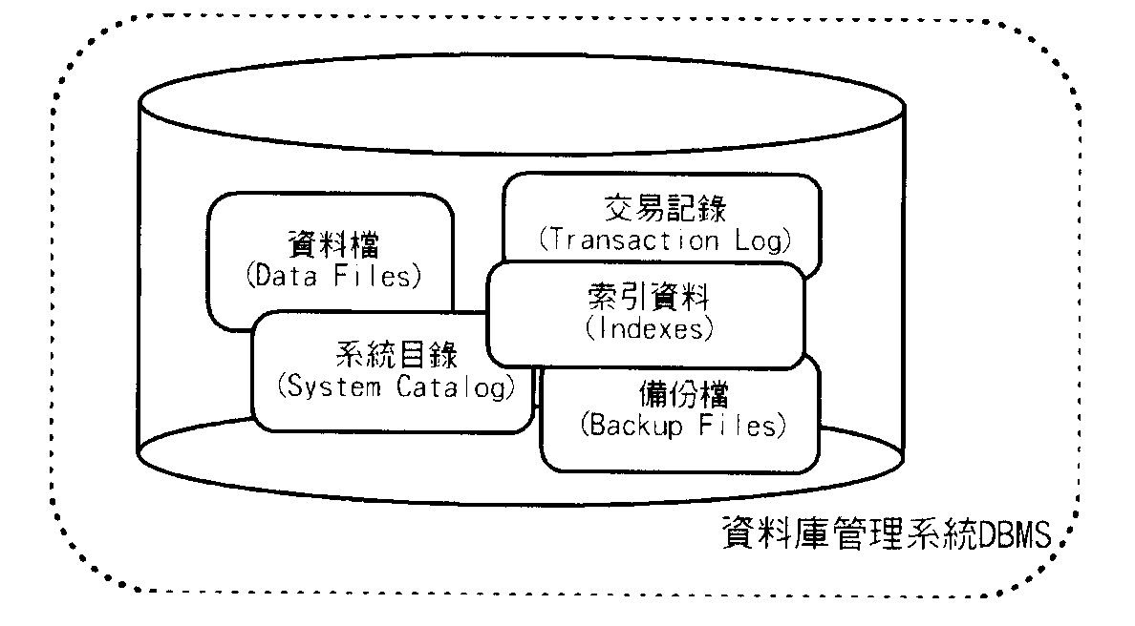
註冊程式
地圖管理
星海資料庫
對戰管理

Slide 12
Current Database
Today’s database implementations are almost based on relational data model.
Relation model gives us a single way to represent data
A two-dimensional table called relation.

Slide 13
A Relation is a Table
A Domain
(columns, attributes)
name manufactory
海尼根 海尼根公司
台啤 臺灣煙酒公司
阿比 葡萄王公司
A Tuple
(rows,
instance)

Slide 14
橫肉(國語) 豬腳(台語)
A Domain
(columns, attributes)
A Tuple
(rows,
instance)
橫 Row
直 column

Slide 15
Schema
A Relation schema =
Relation name (attributes: types of attributes)
Example:
Beers(name, manufactory) or
Beers(name: string, manufactory: string)
Relational Database = collection of relations.
Database schema = set of all relation schemas in the database.
1
2
3

Slide 16
Why Relation Model?
Simple model.
Often matches how we think about data (table).
Abstract model that underlies SQL, the most important database language today.
Relational model is a set-based model.

Slide 17
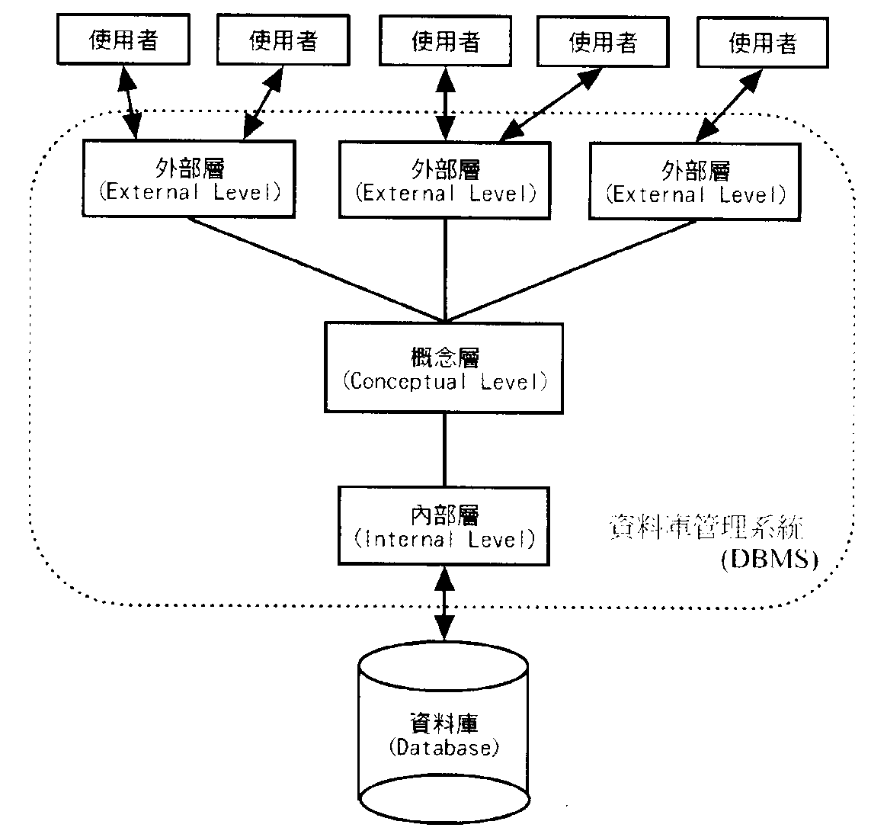
Database Three Layers
美國國家標準協會在1980年代就建立三階層資料庫的概念來建構資料庫，稱為ANSI/SPARC三階層架構

Slide 18
Three Layers (1/3)
(1)外部層(External level)
是最接近使用者的層次，描述個別使用者所見資料庫的部份集合或資訊內涵。
(2)概念層(Conceptual level)
描述整體資料庫的邏輯結構、是概念上完整的資料庫。
(3)內部層(Internal level)
是最接近資料實體的層次，描述資料庫在輔助儲存體存放方式、是實際儲存資料的結構。

Slide 19
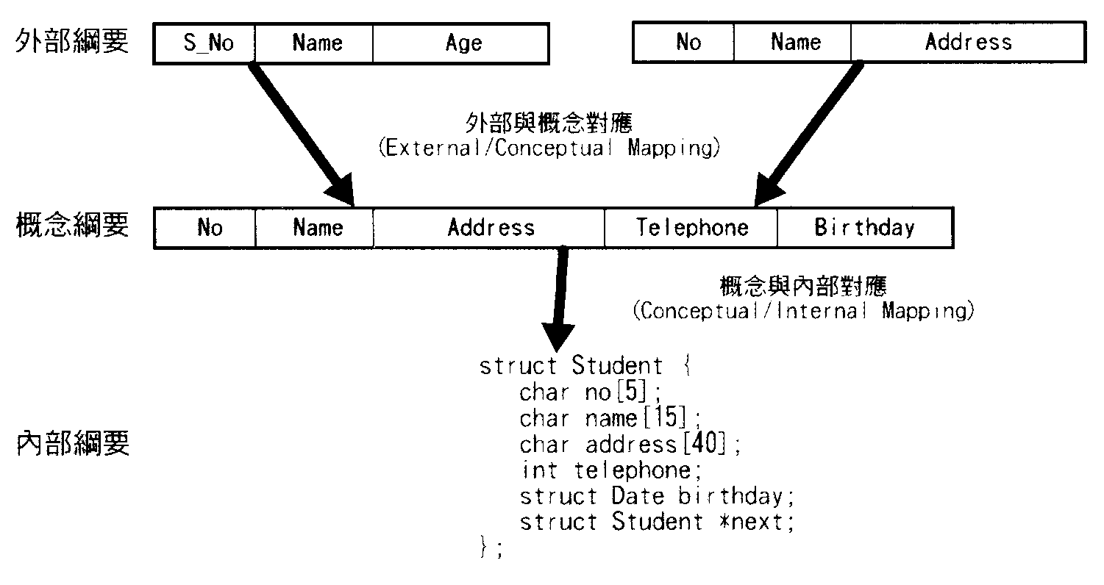
Three Layers (2/3)

Slide 20
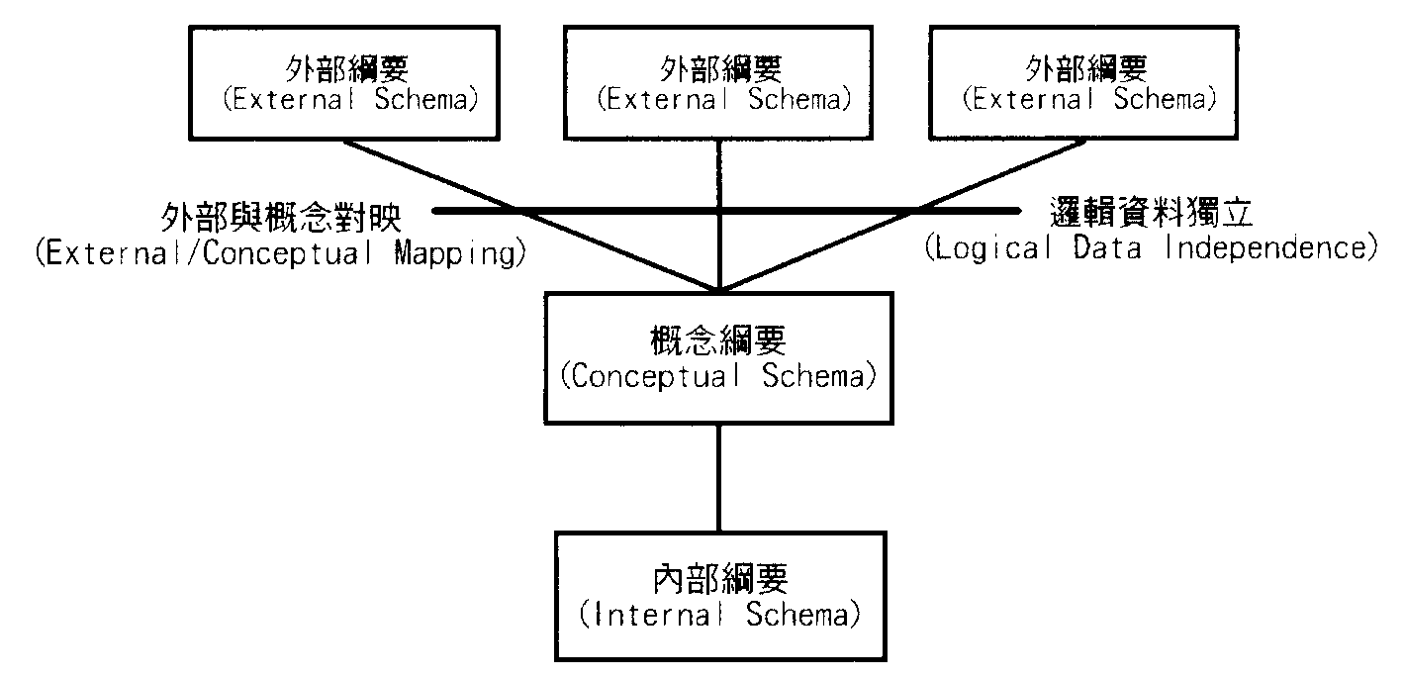
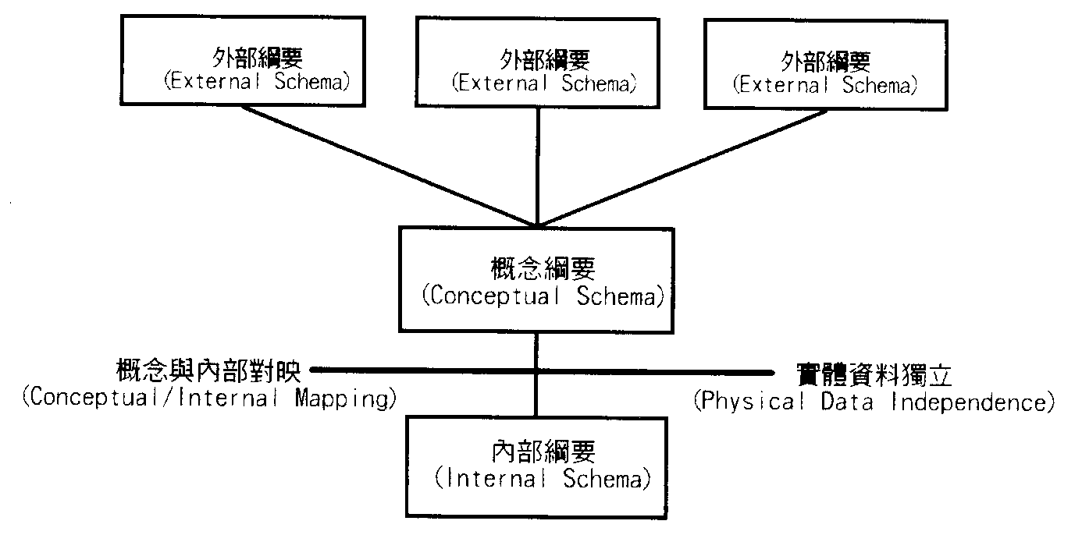
Three Layers (3/3)

Slide 21
Algebraic and Logical Query Languages Chapter 5
Prof. Shin-Hung Chang

Slide 22
What is an “Algebra”
Mathematical system consisting of:
Operands --- variables or values from which new values can be constructed.
Operators --- symbols denoting procedures that construct new values from given values.

Slide 23
What is Relational Algebra?
Operands are
relations or
variables that represent relations.
Operators are
designed to do the most common things that we need to do with relations in a database.
The result is an algebra that can be used as a query language for relations.

Slide 24
Roadmap
There is a core relational algebra that has traditionally been thought of as the relational algebra.
But there are several other operators we shall add to the core in order to model better the language SQL --- the principal language used in relational database systems.

Slide 25

Summary
∪
∩
－
:Union
:Intersect
:Difference
:Select
:Project
:Product
:Nature Join
:Rename
:Duplication Eliminate
: Sort
: Group+Aggregate
Set Operation
σ
π
×
Theta
join
Outer Theta
join
o
Relational
Operation
o
C
L
C
C
o
Outer
join
C
R
o
o
L
o
R
ρ
δ
τ
γ
Extension
Operation
:primitive operations

Slide 26
Core Relational Algebra
Set operations
Union, intersection, and difference
Require both operands have the same relation schema.
Remove parts of a relation
Select
Picking certain rows (tuples).
Project
Picking certain columns.

Slide 27
Core Relational Algebra (Cont.)
Combine tuples of two relations
Cartesian Product
Pairs the tuples of two relations in all possible ways
Join
Selectively pairs the tuples from two relations
Rename relations or attributes
Does not affect the tuples of a relation
But change the relation schema
Name of attributes or name of relation itself

Slide 28
Set Operations
R∪S
Set of elements that are in R or S both.
An element appears only once in the union
R∩S
Set of elements that are in R and S both
R-S
Set of elements that are in R but not in S
R-S ≠S-R

Slide 29
Selection
Selection operator, applied to a relation R, produces a new relation with a subset of R’s tuples.
Denoted by R1:=σ_{C}(R2)
R1 := SELECT_{C} (R2)
C is a condition (as in “if” statements) that refers to attributes of R2.
R1 is all those tuples of R2 that satisfy C.

Slide 30
Example
Relation Sells:
bar alcohol price
ROOM18 TB台啤 2.50
ROOM18 KM高梁 2.75
Lunge bar TB台啤 2.50
Lunge bar KM高梁 3.00
ROOM18Menu := σ_{bar=“ROOM18”}(Sells)
bar alcohol price
ROOM18 TB台啤 2.50
ROOM18 KM高梁 2.75

Slide 31
Projection
Used to produce from a relation R a new relation that has only some of R’s columns.
Denoted by: R1:=π_{(A1,A2,…,An)}(R2)
R1 := PROJECT_{L} (R2)
L is a list of attributes from the schema of R2.
R1 is constructed by looking at each tuple of R2, extracting the attributes on list L, in the order specified, and creating from those components a tuple for R1.
Eliminate duplicate tuples, if any.

Slide 32
Example
Relation Sells:
bar alcohol price
ROOM18 TB台啤 2.50
ROOM18 KM高梁 2.75
LungeBar TB台啤 2.50
LungeBar KM高梁 3.00
Prices := π_{alcohol,price}(Sells)
alcohol price
TB台啤 2.50
KM高梁 2.75
KM高梁 3.00

Slide 33
Cartesian Product
Called “Cross-Product” or just “Product”
R3 := R1 × R2
Pair each tuple t1 of R1 with each tuple t2 of R2.
Concatenation t1t2 is a tuple of R3.
Schema of R3 is the attributes of R1 and R2, in order.
But beware attribute A of the same name in R1 and R2: use R1.A and R2.A.

Slide 34
Example: R3 := R1 × R2
R1( A B )
1 2
3 4
R2( B C )
5 6
7 8
9 10
R3( A R1.B R2.B C )
1 2 5 6
1 2 7 8
1 2 9 10
3 4 5 6
3 4 7 8
3 4 9 10

Slide 35
Natural Join
A₁, A₂,…A_{n} are all the attributes that are in both R1 and R2. Then a tuple r from R1 and s from R2 are successfully psired iff r and s all agree on A₁, A₂,…A_{n.}
Denoted by R3=R1 R2
A frequent type of join connects two relations by:
Equating attributes of the same name, and
Projecting out one copy of each pair of equated attributes.
Called natural join.

Slide 36
Example
Sells( bar alcohol price ) Bars( bar addr )
ROOM18 TB台啤 2.50 ROOM18 信義路
ROOM18 KM高梁 2.75 LungeBar 中山路
LungeBar TB台啤 2.50
LungeBar HN海尼根 3.00
BarInfo := Sells Bars
BarInfo( bar alcohol price addr )
ROOM18 TB台啤 2.50 信義路
ROOM18 KM高梁 2.75 信義路
LungeBar TB台啤 2.50 中山路
LungeBar HN海尼根 3.00 中山路

Slide 37
Theta-Join
The Natural Join pairs tuples using one specific condition.
Denoted by: R3:=R1 R2
R3 := R1 JOIN_{C} R2
Take the product R1 × R2.
Then apply SELECT_{C} to the result.
As for SELECT, C can be any boolean-valued condition.
Historic versions of this operator allowed only theta , where theta was =, <, > etc.; hence the name “theta-join.”
C

Slide 38
Example
Sells( bar alcohol price ) Bars( name addr )
ROOM18 TB台啤 2.50 ROOM18 信義路
ROOM18 KM高梁 2.75 LungeBar 中山路
LungeBar TB台啤 2.50
LungeBar HN海尼根 3.00
BarInfo := Sells _{Sells.bar = Bars.name} Bars
BarInfo( bar alcohol price name addr )
ROOM18 TB台啤 2.50 ROOM18 信義路
ROOM18 KM高梁 2.75 ROOM18 信義路
LungeBar TB台啤 2.50 LungeBar 中山路
LungeBar HN海尼根 3.00 LungeBar 中山路

Slide 39
Renaming
The RENAME operator gives a new schema to a relation.
Denoted by R1:=ρ_{(A1, … ,An)}(R2)
R1 := RENAME_{R1(A1,…,An)}(R2) makes R1 be a relation with attributes A1,…,An and the same tuples as R2.

Slide 40
Example
Bars( name addr )
ROOM18 信義路
KungeBar 中山路
R:= ρ_{R(bar, addr)}(Bars)
R( bar addr )
ROOM18 信義路
KungeBar 中山路

Slide 41
Building Complex Expressions
Algebra allow us to express sequences of operations in a natural way.
Example: in arithmetic: (x + 4) ×(y - 3).
Relational algebra allows the same.
Three notations, just as in arithmetic:
Sequences of assignment statements.
Expressions with several operators.
Expression trees.

Slide 42
Sequences of Assignments
Create temporary relation names.
Renaming can be implied by giving relations a list of attributes.
Example: R3 := R1 R2 can be written:
R4 := R1 × R2
R3 := σ_{C} (R4)
C

Slide 43
Expressions in a Single Assignment
Example: theta-join
R3 := R1 R2
can be written: R3 := σ_{C} (R1 × R2)
Precedence of relational operators:
Unary operators --- select, project, rename
Product and Join
Intersection
Union and Difference
But you can always insert parentheses to force the order you desire.
C

Slide 44
Expression Trees
Leaves are operands
Either variables standing for relations or particular, constant relations.
Interior nodes are operators
Applied to their child or children.

Slide 45
Example
Using the relations
Bars(name, addr) and
Sells(bar, alcohol, price)
Find the names of all the bars that are either on 信義路 or sell TB台啤 for less than $3.

Slide 46
As a Tree:
R:=
σ _{addr = “信義路”}(Bars)
ρ_{(name)} (π_{bar} (σ _{price<3 AND beer=“TB台啤”} (Sells)))
∪
UNION
ρ_{(name)}
π_{name}
π_{bar}
σ _{addr = “信義路”}
σ _{price<3 AND beer=“TB台啤”}
Bars
Sells

Slide 47
Example
Using Sells(bar, alcohol, price), find the bars that sell two different alcohols at the same price.
Strategy:
By renaming, define a copy of Sells, called S(bar, alcohol1, price).
The natural join of Sells and S consists of quadruples (bar, alcohol, alcohol1, price), such that the bar sells both alcohols at this price

Slide 48
The Tree
π_{bar}
σ_{alcohol != alcohol1}
ρ_{S(bar, alcohol1, price)}
Sells
Sells

Slide 49
Schemas for Interior Nodes
An expression tree defines a schema for the relation associated with each interior node.
Similarly, a sequence of assignments defines a schema for each relation on the left of the := sign.

Slide 50
π_{title, year}
∩
σ _{length≧100}
σ _{studioName= ‘fox’}
Movie
Movie
π_{title, year}
(σ _{length≧100} (Movie)
σ _{studioName= ‘fox’} (Movie))
∩
R(t,y,l,i,s,p):=σ _{studioName= ‘fox’} (Movie))
S(t,y,l,i,s,p):= σ _{length≧100} (Movie)
T(t,y,l,i,s,p):= R∩S
Answer(title,year):= π_{title, year}(T)

Slide 51
Schema-Defining (Rules 1)
Union, intersection, and difference: the schemas of the two operands must be the same, so use that schema for the result.
Selection: schema of the result is the same as the schema of the operand.
Projection: list of attributes tells us the schema.

Slide 52
Schema-Defining (Rules 2)
Product: the schema is the attributes of both relations.
Use R.A, etc., to distinguish two attributes named A.
Theta-join: same as product.
Natural join: use attributes of both relations.
Shared attribute names are merged.
Renaming: the operator tells the schema.

Slide 53
Suppose relations R and S have n tuples and m tuples, respectively.
Please give the minimum and maximum numbers of tuples that the results of the following expressions can have.
R ∪ S
Max:n+m Min:maximun(n,m)
R S
Max:nxm Min:0
σ_{C} (R)×S, for some condition C
Max:nxm Min:0
π_{L} (R)－S, for some list of attributes L
Max:n Min:0

Slide 54
Relational Algebra on Bags
A Bag is like a set, but an element may appear more than once.
Multiset is another name for “bag.”
Example:
{1,2,1,3} is a bag.
{1,2,3} is also a bag that happens to be a set.
Bags also resemble lists, but order in a bag is unimportant.
Example:
{1,2,1} = {1,1,2} as bags
[1,2,1] != [1,1,2] as lists

Slide 55
Why Bags?
SQL, the most important query language for relational databases is actually a bag language.
SQL will eliminate duplicates, but usually only if you ask it to do so explicitly.
Some operations, like projection, are much more efficient on bags than sets.

Slide 56
Operations on Bags
Selection applies to each tuple, so its effect on bags is like its effect on sets.
Projection also applies to each tuple, but as a bag operator, we do not eliminate duplicates.
Products and joins are done on each pair of tuples, so duplicates in bags have no effect on how we operate.

Slide 57
Example: Bag Selection
R( A B ) S( B C )
1 2 3 4
5 6 7 8
1 2
σ_{A+B<5} (R) = A B
1 2
1 2

Slide 58
Example: Bag Projection
R( A B ) S( B C )
1 2 3 4
5 6 7 8
1 2
π_{A} (R) = A
1
5
1

Slide 59
Example: Bag Product
R( A B ) S( B C )
1 2 3 4
5 6 7 8
1 2
R × S = A R.B S.B C
1 2 3 4
1 2 7 8
5 6 3 4
5 6 7 8
1 2 3 4
1 2 7 8

Slide 60
Example: Bag Theta-Join
R( A, B ) S( B, C )
1 2 3 4
5 6 7 8
1 2
R _{R.B<S.B} S = A R.B S.B C
1 2 3 4
1 2 7 8
5 6 7 8
1 2 3 4
1 2 7 8

Slide 61
Bag Union
Union, intersection, and difference need new definitions for bags.
An element appears in the union of two bags the sum of the number of times it appears in each bag.
Example:
{1,2,1} UNION {1,1,2,3,1}
= {1,1,1,1,1,2,2,3}

Slide 62
Bag Intersection
An element appears in the intersection of two bags the minimum of the number of times it appears in either.
Example:
{1,2,1} ∩ {1,2,3}
= {1,2}
{1,2,1,1} ∩ {1,2,3,1}
={1,2,1}

Slide 63
Bag Difference
An element appears in the difference A – B of bags as many times as it appears in A, minus the number of times it appears in B.
But never less than 0 times.
Example:
{1,2,1} – {1,2,3}
= {1}

Slide 64
Beware: Bag Laws != Set Laws
Not all algebraic laws that hold for sets also hold for bags.
For one example, the commutative law for union (R ∪ S = S ∪ R ) does hold for bags.
Since addition is commutative, adding the number of times x appears in R and S doesn’t depend on the order of R and S.

Slide 65
An Example of Inequivalence
Set union is idempotent, meaning that
S ∪ S = S.
However, for bags, if x appears n times in S, then it appears 2n times in S ∪ S.
Thus S ∪ S != S in general.

Slide 66
The Extended Algebra
DELTA δ= eliminate duplicates from bags.
TAU τ= sort tuples.
Extended projection : arithmetic, duplication of columns.
GAMMA γ= grouping and aggregation.
OUTERJOIN: avoids “dangling tuples”
dangling tuple : tuples that do not join with anything.

Slide 67
Duplicate Elimination
Denoted by : R1:=δ(R2)
R1 := DELTA(R2).
R1 consists of one copy of each tuple that appears in R2 one or more times.

Slide 68
Example: Duplicate Elimination
R = A B
1 2
3 4
1 2
δ(R) = A B
1 2
3 4

Slide 69
Sorting
Denoted by: R1:=τ_{L} (R2)
R1 := TAU_{L} (R2).
L is a list of some of the attributes of R2.
R1 is the list of tuples of R2 sorted first on the value of the first attribute on L, then on the second attribute of L, and so on.
Break ties arbitrarily.
TAU is the only operator whose result is neither a set nor a bag.

Slide 70
Example: Sorting
R = A B
1 2
3 4
5 2
τ_{B} (R) = [(5,2), (1,2), (3,4)]
=[(1,2), (5,2), (3,4)]

Slide 71
Extended Projection
Using the same π_{L} operator, we allow the list L to contain arbitrary expressions involving attributes, for example:
Arithmetic on attributes, e.g., A+B.
Duplicate occurrences of the same attribute
A→C (→:rename)
A+B →C

Slide 72
Example: Extended Projection
R = A B
1 2
3 4
π_{A+B →C,A→A1,A→A2} (R) = C A1 A2
3 1 1
7 3 3

Slide 73
Aggregation Operators
Aggregation operators are not operators of relational algebra.
Rather, they apply to entire columns of a table and produce a single result.
The most important examples:
SUM, AVG, COUNT, MIN, and MAX

Slide 74
Example: Aggregation
R = A B
1 3
3 4
3 2
SUM(A) = 7
COUNT(A) = 3
MAX(B) = 4
AVG(B) = 3

Slide 75
Grouping Operator
Denoted by γ_{L} (R2)
R1 := GAMMA_{L} (R2). L is a list of elements that are either:
Individual attributes (for grouping)
AGG(A)
AGG is one of the aggregation operators
A is an attribute

Slide 76
Applying γ_{L}(R)
Group R
According to all the grouping attributes on list L.
That is, form one group for each distinct list of values for those attributes in R.
Within each group, compute AGG(A ) for each aggregation on list L.
The result of γ contains one tuple from each group.

Slide 77
Example: Grouping/Aggregation
R = A B C
1 2 3
4 5 6
1 2 5
γ_{A,B,AVG(C)} (R) = ??
Then, average C within
groups:
A B AVG(C)
1 2 4
4 5 6
First, group R :
A B C
1 2 3
1 2 5
4 5 6

Slide 78
Outer Join
Suppose we join R JOIN_{outer} S
Denoted by R S.
A tuple of R that has no tuple of S with which it joins is said to be dangling.
Similarly for a tuple of S.
Outerjoin preserves dangling tuples by padding them with a special NULL symbol in the result.
Denoted by ⊥.
o

Slide 79
Example: Outer Join
R = A B S = B C
1 2 2 3
4 5 6 7
(1,2) joins with (2,3), but the other two tuples
are dangling.
o
R S = A B C
1 2 3
4 5 ⊥
⊥ 6 7

Slide 80
Variants of Outer Join
o
Left outer join: R S
is like outer join, but only dangling tuples of left arguments R are padded with ⊥.
Right outer join: R S
is like outer join, but only dangling tuples of right arguments R are padded with ⊥.
L
o
R

Slide 81
Example: Left Outer Join
R = A B S = B C
1 2 2 3
4 5 6 7
(1,2) joins with (2,3), but the other two tuples
are dangling.
o
R S = A B C
1 2 3
4 5 ⊥
L

Slide 82
Example: Right Outer Join
R = A B S = B C
1 2 2 3
4 5 6 7
(1,2) joins with (2,3), but the other two tuples
are dangling.
o
R S = A B C
1 2 3
⊥ 6 7
R

Slide 83
Theta-Outer Join
o
Denoted by R S
Left Theta outer join: R S is like outer join, but only dangling tuples of left arguments R are padded with ⊥.
Right Theta outer join: R S is like outer join, but only dangling tuples of right arguments R are padded with ⊥.
C
o
C
L
o
C
R

Slide 84
Example: Theta-Outer Join
R = A B S = B C
1 2 2 3
4 5 6 7
v
v
o
R S = A R.B S.B C
1 2 2 3
4 5 ⊥ ⊥
⊥ ⊥ 6 7
R.B=S.B

Slide 85
Left Theta-Outer Join
R = A B S = B C
1 2 2 3
4 5 6 7
v
v
o
R S = A R.B S.B C
1 2 2 3
4 5 ⊥ ⊥
L
R.B=S.B

Slide 86
Right Theta-Outer Join
R = A B S = B C
1 2 2 3
4 5 6 7
v
v
o
R S = A R.B S.B C
1 2 2 3
⊥ ⊥ 6 7
R
R.B=S.B

Slide 87
Depend and Independent Operations
R∩S = R – ( R – S )
R S = σ_{C} (R × S)
R S = π_{L}(σ_{C} (R × S) )
C→R.A₁=S. A₁ AND R.A₂=S. A₂ AND … R.A_{n}=S. A_{n}
A₁… A_{n} are all attributes appearing in the schemas of both R and S.
L = list of attributes in the schema R + attributes in the schema S that are not in schema of R
C

Slide 88
Depend and Independent Operations
δ is a special case of γ
If R(A₁, A₂,…A_{n}) is a relation,
then δ(R) = γ_{A1, A2,…An} (R)
γ_{A1, A2,…An} (R) = π_{A1, A2,…An} (R)

Slide 89
Summary
∪
∩
－
:Union
:Intersect
:Difference
:Select
:Project
:Product
:Nature Join
:Rename
:Duplication Eliminate
: Sort
: Group+Aggregate
Set Operation
σ
π
×
Theta
join
Outer Theta
join
o
Relational
Operation
o
C
L
C
C
o
Outer
join
C
R
o
o
L
o
R
ρ
δ
τ
γ
Extension
Operation
:primitive operations

Slide 90
Example
R = A B S = B C
0 1 0 1
2 3 2 4
0 1 2 5
2 4 3 4
3 4 0 2
3 4
π_{A+B, A}²_{, B}² (R)=
A+B A² B²
1 0 1
5 4 9
1 0 1
6 4 16
7 9 16

Slide 91
Example
R = A B S = B C
0 1 0 1
2 3 2 4
0 1 2 5
2 4 3 4
3 4 0 2
3 4
π_{B+C, C-1} (S)=
B+C C-1
1 0
6 3
7 4
7 3
2 1
7 3

Slide 92
Example
R = A B S = B C
0 1 0 1
2 3 2 4
0 1 2 5
2 4 3 4
3 4 0 2
3 4
τ_{B, A} (R)=
A B
0 1
0 1
2 3
2 4
3 4

Slide 93
Example
R = A B S = B C
0 1 0 1
2 3 2 4
0 1 2 5
2 4 3 4
3 4 0 2
3 4
δ(R)=
A B
0 1
2 3
2 4
3 4

Slide 94
Example
R = A B S = B C
0 1 0 1
2 3 2 4
0 1 2 5
2 4 3 4
3 4 0 2
3 4
γ_{A, SUM(B)} (R)=
A SUM(B)
0 2
2 7
3 4

Slide 95
Example
R = A B S = B C
0 1 0 1
2 3 2 4
0 1 2 5
2 4 3 4
3 4 0 2
3 4
γ_{B, AVG(C)} (S)=
B AVG(C)
0 1.5
2 4.5
3 4

Slide 96
Example
R = A B S = B C
0 1 0 1
2 3 2 4
0 1 2 5
γ_{A, MAX(C)} (R×S)=
A max(C)
0 5
2 5
A R.B S.B C
0 1 0 1
0 1 2 4
0 1 2 5
2 3 0 1
2 3 2 4
2 3 2 5
0 1 0 1
0 1 2 4
0 1 2 5

Slide 97
Example
R = A B S = B C
0 1 0 1
2 3 2 4
0 1 2 5
2 4 3 4
3 4 0 2
3 4
v
v
v
o
A B C
0 1 ⊥
2 3 4
2 3 4
0 1 ⊥
2 4 ⊥
3 4 ⊥
R S=
L

Slide 98
Example
R = A B S = B C
0 1 0 1
2 3 2 4
0 1 2 5
2 4 3 4
3 4 0 2
3 4
v
v
v
o
A B C
⊥ 0 1
⊥ 2 4
⊥ 2 5
2 3 4
⊥ 0 2
2 3 4
R S=
R

Slide 99
Example
R = A B S = B C
0 1 0 1
2 3 2 4
0 1 2 5
2 4 3 4
3 4 0 2
3 4
v
o
v
R S=
A B C
0 1 ⊥
2 3 4
2 3 4
0 1 ⊥
2 4 ⊥
3 4 ⊥
⊥ 0 1
⊥ 2 4
⊥ 2 5
⊥ 0 2
v

Slide 100
Example
o
R = A B S = B C
0 1 0 1
2 3 2 4
0 1 2 5
2 4 3 4
3 4 0 2
3 4
R S=
R.B<S.B
v
A R.B S.B C
0 1 2 4
0 1 2 5
0 1 3 4
0 1 3 4
0 1 2 4
0 1 2 5
0 1 3 4
0 1 3 4
2 3 ⊥ ⊥
2 4 ⊥ ⊥
3 4 ⊥ ⊥
⊥ ⊥ 0 1
⊥ ⊥ 0 2
v
v
v
v
v

Slide 101
Introduction to SQL (1)
Prof. Shin-Hung Chang

Slide 102
Why SQL?
SQL is a very-high-level language
To avoid specifying a lot of data-manipulation details
What makes SQL viable is that its queries are “optimized” quite well, yielding efficient query executions

Slide 103
DBMS
Database
Administrator
(DBA)
董事長
Database
Manager
Data Control
Language
(DCL)
OS
開發工程師
Database
Developer
Data Definition
Language
(DDL)
AP
Database
*File
*Structure
*Dictionary
使用者
Database
User
Data Manipulation
Language
(DML)
Query
AP

Slide 104
SQL “Select”
Default
Select [ All / Distinct ] domains
From 表
Where 條件
Group By 如何分組
Having 分組後條件
Order By 排序
Project
Select
Group
輸出
Extension
Sorting

Slide 105
Select-From-Where Statements
The principal form of a query is:
SELECT desired attributes
FROM one or more tables
WHERE condition about tuples of the tables

Slide 106
Our Running Example
All our SQL queries will be based on the following database schema.
Underline indicates key attributes.
Alcohol (name, manf)
Bars (name, addr, license)
Drinkers (name, addr, phone)
Likes (drinker, Alcohol )
Sells (bar, Alcohol , price)
Frequents (drinker, bar)

Slide 107
Example
Using Alcohol (name, manf), what beers are made by台灣菸酒公司?
SELECT name
FROM Alcohol
WHERE manf = ‘台灣菸酒公司’;

Slide 108
Result of Query
name
‘台啤’
‘玉山二鍋頭 ’
‘玉泉紹興酒’
The answer is a relation with a single attribute,
name, and tuples with the name of each Alcohol
by 台灣菸酒公司, such as 台啤.

Slide 109
Meaning of Single-Relation Query
Begin with the relation in the FROM clause
Apply the selection indicated by the WHERE clause
Apply the extended projection indicated by the SELECT clause

Slide 110
Operational Semantics
To implement this algorithm think of a tuple variable ranging over each tuple of the relation mentioned in FROM
Check if the “current” tuple satisfies the WHERE clause
If so, compute the attributes or expressions of the SELECT clause using the components of this tuple

Slide 111
‘*’ In SELECT clauses
When there is one relation in the FROM clause, ‘*’ in the SELECT clause stands for “all attributes of this relation”
Example using Alcohol (name, manf):
SELECT *
FROM Alcohol
WHERE manf = ‘台灣菸酒公司’;

Slide 112
Result of Query:
name manf
‘台啤’ ‘台灣菸酒公司’
‘玉山二鍋頭’ ‘台灣菸酒公司’
‘玉泉紹興酒’ ‘台灣菸酒公司’
Now, the result has each of the attributes
of Alcohol.

Slide 113
Renaming Attributes
If you want the result to have different attribute names, use “AS <new name>” to rename an attribute
Example based on Alcohol (name, manf):
SELECT name AS wine, manf
FROM Alcohol
WHERE manf = ‘台灣菸酒公司’

Slide 114
Result of Query:
wine manf
‘台啤’ ‘台灣菸酒公司’
‘玉山二鍋頭’ ‘台灣菸酒公司’
‘玉泉紹興酒’ ‘台灣菸酒公司’

Slide 115
Expressions in SELECT Clauses
Any expression that makes sense can appear as an element of a SELECT clause
Example: from Sells (bar, alcohol, price):
SELECT bar, alcohol,
price * 30 AS priceInNT$
FROM Sells;

Slide 116
Result of Query
bar alcohol price
ROOM18 台啤 5
Lunge 台啤 6
ROOM18 金門高樑 50
bar alcohol priceInNT$
ROOM18 台啤 150
Lunge 台啤 180
ROOM18 金門高樑 1500

Slide 117
Another Example: Constant Expressions
From Likes (drinker, alcohol):
SELECT drinker,
‘愛喝台啤’ AS whoLikesTB
FROM Likes
WHERE alcohol = ‘台啤’;

Slide 118
Result of Query
drinker whoLikesTB
‘張天才’ ‘愛喝台啤’
‘王建民’ ‘愛喝台啤’
… …

Slide 119
Complex Conditions in WHERE Clause
From Sells (bar, alcohol, price), find the price ROOM18 charges for 台啤:
SELECT price
FROM Sells
WHERE bar = ‘ROOm18’ AND
alcohol = ‘台啤’;

Slide 120
Result of Query
prize
5

Slide 121
Important Points
Two single quotes inside a string represent the single-quote (apostrophe)
‘This’’s a book’. (This’s a book)
Conditions in the WHERE clause can use AND, OR, NOT, and parentheses in the usual way boolean conditions are built
SQL is case-insensitive. In general, upper and lower case characters are the same, except inside quoted strings

Slide 122
Patterns
WHERE clauses can have conditions in which a string is compared with a pattern, to see if it matches
General form:
<Attribute> LIKE <pattern>
<Attribute> NOT LIKE <pattern>
Pattern is a quoted string with
‘%’ = ‘any string’
‘_’ = ‘any character’

Slide 123
Example
From Drinkers(name, addr, phone) find the drinkers with exchange 555:
SELECT name
FROM Drinkers
WHERE phone LIKE‘ %555- _ _ _ ’;

Slide 124
NULL Values
Tuples in SQL relations can have NULL as a value for one or more components
Meaning depends on context. Several cases:

Slide 125
NULL Values (con’t)
Value Unknown :
I know there is some value that belongs here but I don’t know what it is
Value Inapplicable :
There is no value that makes sense here
Value withheld:
We are not authorized to know the value that belongs here
(EX:宇宙的寬度)
(EX:∞)
(EX:黑色幽默.mp3)
125
Notes:
125

Slide 126
Comparing NULL’s to Values
The logic of conditions in SQL is really 3-valued logic:
TRUE, FALSE, and UNKNOWN
When any value is compared with NULL, the truth value is UNKNOWN
But a query only produces a tuple in the answer if its truth value for the WHERE clause is TRUE (not FALSE or UNKNOWN)

Slide 127
Three-Valued Logic
To understand how AND, OR, and NOT work in 3-valued logic
TRUE = 1, FALSE = 0, and UNKNOWN = ½
AND = MIN, OR = MAX, NOT(x) = 1-x
Example:
TRUE AND (FALSE OR NOT(UNKNOWN))
= MIN(1, MAX(0, (1 - ½ )))
= MIN(1, MAX(0, ½ ) = MIN(1, ½ ) = ½

Slide 128
Example
From the following Sells relation:
bar alcohol price
ROOM18 台啤 NULL
SELECT bar
FROM Sells
WHERE price < 2.00 OR price >= 2.00;
UNKNOWN UNKNOWN
UNKNOWN

Slide 129
Reason: 2-Valued Laws != 3-Valued Laws
Some common laws, like the commutativity of AND, hold in 3-valued logic
But others do not; example: the “law of excluded middle,” p OR NOT p = TRUE
When p = UNKNOWN, the left side is MAX( ½, (1 – ½ )) = ½ != 1.

Slide 130
Ordering the Output
We may ask that the tuples produced by a query be presented in sorted order
Add to the ‘select-from-where’ statement
Relation: Sells (bar, alcohol, price)
Example:
SELECT *
FROM Sells
WHERE bar = ROOm18 AND
alcohol = 台啤;
ORDER BY price, alcohol, bar;

Slide 131
Output
From the following Sells relation:
price alcohol bar
10 台啤 ROOM18

Slide 132
Multi-Relation Queries
Interesting queries often combine data from more than one relation
We can address several relations in one query by listing them all in the FROM clause
Distinguish attributes of the same name by “<relation>.<attribute>”

Slide 133
Example
Using relations
Likes(drinker, alcohol)
Frequents(drinker, bar)
find the alcohols liked by at least one person who frequents ROOM18
SELECT alcohol
FROM Likes, Frequents
WHERE bar = ‘ROOM18’ AND
Frequents.drinker = Likes.drinker;

Slide 134
Output
From the following Likes and Frequents relation:
alcohol
台啤

Slide 135
Formal Semantics
Almost the same as for single-relation queries:
Start with the product of all the relations in the FROM clause
Apply the selection condition from the WHERE clause
Project onto the list of attributes and expressions in the SELECT clause

Slide 136
Operational Semantics
Imagine one tuple-variable for each relation in the FROM clause
These tuple-variables visit each combination of tuples, one from each relation
If the tuple-variables are pointing to tuples that satisfy the WHERE clause, send these tuples to the SELECT clause

Slide 137
Example
Frequents
Likes
drinker bar drinker alcohol
tv1 tv2
張天才 台啤
張天才 ROOM18
to output
check
for ROOM18
check these
are equal

Slide 138
Explicit Tuple-Variables
Sometimes, a query needs to use two copies of the same relation
Distinguish copies by following the relation name by the name of a tuple-variable, in the FROM clause
It’s always an option to rename relations this way, even when not essential

Slide 139
Example
From Alcohol (name, manf), find all pairs of alcohols by the same manufacturer
Do not produce pairs like (TB台啤,TB台啤)
Produce pairs in alphabetic order, e.g. (TB台啤,YS 玉山二鍋頭), not (YS 玉山二鍋頭, TB台啤)
SELECT a1.name, a2.name
FROM Alcohol a1, Alcohol a2
WHERE a1.manf = a2.manf AND
a1.name < a2.name;

Slide 140
Output
From the following Alcohol relation:
name name
TB台啤 YS 玉山二鍋頭

Slide 141
Subqueries
A parenthesized SELECT-FROM-WHERE statement
(subquery) can be used as a value in a number of places
including FROM and WHERE clauses
Example: in place of a relation in the FROM clause, we can place another query, and then query its result
Better use a tuple-variable to name tuples of the result.

Slide 142
Subqueries that Return One Tuple
If a subquery is guaranteed to produce one tuple, then the subquery can be used as a value
Usually, the tuple has one component
Also typically, a single tuple is guaranteed by keyness of attributes
A run-time error occurs if there is no tuple or more than one tuple

Slide 143
Example
From Sells (bar, alcohol, price), find the bars that serve 台啤 for the same price ROOM18 charges for 台啤
Two queries would surely work:
Find the price ROOM18 charges for台啤
Find the bars that serve 台啤 at that price

Slide 144
Subquery Solution
(SELECT price
FROM Sells
WHERE bar = ‘ROOM18’
AND beer = ‘台啤’);
The price at
which ROOM18
sells 台啤

Slide 145
Query + Subquery Solution
The price at
which ROOM18
sells 台啤
145
SELECT bar
FROM Sells
WHERE alcohol = ‘台啤’ AND
price = (SELECT price
FROM Sells
WHERE bar = ‘ROOM18’
AND beer = ‘台啤’);
Notes:
145

Slide 146
The IN Operator
<tuple> IN <relation> is true if and only if the tuple is a member of the relation
<tuple> NOT IN <relation> means the opposite
IN-expressions can appear in WHERE clauses
The <relation> is often a subquery

Slide 147
Example
From Alcohol(name, manf) and Likes(drinker, alcohol), find the name and manufacturer of each alcohol that 張天才 likes

Slide 148
Subquery
From Alcohol(name, manf) and Likes(drinker, alcohol), find the name and manufacturer of each alcohol that 張天才 likes
(SELECT alcohol
FROM Likes
WHERE drinker = ‘張天才’);
The set of
Alcohols
張天才 likes
148
Notes:
148

Slide 149
Query+Subquery
From Alcohol (name, manf) and Likes (drinker, alcohol), find the name and manufacturer of each alcohol that 張天才 likes
SELECT *
FROM Alcohol
WHERE name IN (SELECT alcohol
FROM Likes
WHERE drinker = ‘張天才’);
The set of
Alcohols
張天才 likes
149
Notes:
149

Slide 150
The Exists Operator
EXISTS( <relation> ) is true if and only if the <relation> is “not empty”
Being a boolean-valued operator, EXISTS can appear in WHERE clauses

Slide 151
Example
From Alcohol (name, manf), find the Alcohol that is the unique Alcohol by a manufacturer
151
Notes:
151

Slide 152
Subquery
Notice scope rule: manf refers
to closest nested FROM with
a relation having that attribute.
(SELECT *
FROM Alcohol
WHERE manf = a1.manf AND
name <> a1.name);
Set of Alcohol
with the same
manf as a1, but not the
same Alcohol
SQL “not equals”
operator

Slide 153
Query + Subquery
Notice scope rule: manf refers
to closest nested FROM with
a relation having that attribute.
Set of Alcohol
with the same
manf as a1, but not the
same Alcohol
SQL “not equals”
operator
153
SELECT name
FROM Alcohol a1
WHERE NOT EXISTS
(SELECT *
FROM Alcohol
WHERE manf = a1.manf AND
name <> a1.name);
Notes:
153

Slide 154
Example
From the following Alcohol relation:
name manf
TB台啤 台灣菸酒公司
YS 玉山二鍋頭 台灣菸酒公司
name manf
TB台啤 台灣菸酒公司
FALSE
Not EXISTS
TRUE
Not EXISTS

Slide 155
The Operator ANY
x = ANY( <relation> ) is a boolean condition meaning that x equals at least one tuple in the relation
Similarly, = can be replaced by any of the comparison operators
Example: x >= ANY( <relation> ) means x is not smaller than all tuples in the relation
Note tuples must have one component only

Slide 156
The Operator ALL
Similarly, x <> ALL( <relation> ) is true if and only if for every tuple t in the relation, x is not equal to t
That is, x is not a member of the relation
The <> can be replaced by any comparison operator
Example: x >= ALL( <relation> ) means there is no tuple larger than x in the relation

Slide 157
Example
From Sells (bar, alcohol, price), find the Alcohol(s) sold for the highest price.

Slide 158
Subquery
price from the outer
Sells must not be
less than any price
158
(SELECT price
FROM Sells);
Notes:
158

Slide 159
Query+Subquery
price from the outer
Sells must not be
less than any price
159
From Sells(bar, alcohol, price), find the Alcohol(s) sold for the highest price.
SELECT alcohol
FROM Sells
WHERE price >= ALL(
SELECT price
FROM Sells);
Notes:
159

Slide 160
SQL “Select”
Default
Select [ All / Distinct ] domains
From 表
Where 條件
Group By 如何分組
Having 分組後條件
Order By 排序
Project
Select
Group
輸出
Extension
Sorting

