Slide 1
More SQL
Prof. Shin-Hung Chang

Slide 2
DBMS
Database
Administrator
(DBA)
董事長
Database
Manager
Data Control
Language
(DCL)
OS
開發工程師
Database
Developer
Data Definition
Language
(DDL)
AP
Database
*File
*Structure
*Dictionary
使用者
Database
User
Data Manipulation
Language
(DML)
Query
AP

Slide 3
Defining a Database Schema
A database schema comprises declarations for the relations (“tables”) of the database.
Many other kinds of elements may also appear in the database schema, including views, indexes, and triggers, which we’ll introduce later.

Slide 4
Declaring a Relation
Simplest form is:
CREATE TABLE <name>
(<list of elements>);
And you may remove a relation from the database schema by:
DROP TABLE <name>;

Slide 5
Elements of Table Declarations
The principal element is a pair consisting of an attribute and a type.
The most common types are:
INT or INTEGER (synonyms).
REAL or FLOAT (synonyms).
CHAR(n ) = fixed-length string of n characters.
VARCHAR(n ) = variable-length string of up to n characters.
Notes:
Char (n) => 記憶體會給n個位子 沒用完也會保留 但是維護起來會比較快
Varchar(n) => 用多少給多少 維護起來比較慢

Slide 6
Example: Create Table
CREATE TABLE Sells
( bar CHAR(20),
beer VARCHAR(20),
price REAL
);

Slide 7
Dates and Times
DATE and TIME are types in SQL.
The form of a date value is:
DATE ‘yyyy-mm-dd’
Example:
DATE ‘2007-12-25’ for Dec. 25, 2007.

Slide 8
Times as Values
The form of a time value is:
TIME ‘hh:mm:ss’
with an optional decimal point and fractions of a second following.
Example:
TIME ’15:30:02.5’
= two and a half seconds after 3:30PM.

Slide 9
Declaring Keys
An attribute or list of attributes may be declared PRIMARY KEY or UNIQUE.
These each say the attribute(s) so declared functionally determine all the attributes of the relation schema.
There are a few distinctions to be mentioned later.
Notes:
Primary key 主見 => 每個tuple的值都要不一樣 比如說 輔仁大學的學生學號 不允許NULL
UNIQUE =>每個tuple的值都要不一樣 可以有NULL

Slide 10
Declaring Single-Attribute Keys
Place PRIMARY KEY or UNIQUE after the type in the declaration of the attribute.
Example:
CREATE TABLE alcohols
(
name CHAR(20) UNIQUE,
manf CHAR(20)
);
Notes:
這張表 不會有同名的人 可是會有null的
Null 不能當主見

Slide 11
Declaring Multiattribute Keys
A key declaration can also be another element in the list of elements of a CREATE TABLE statement.
This form is essential if the key consists of more than one attribute.
May be used even for one-attribute keys.

Slide 12
Example: Multiattribute Key
The bar and beer together are the key for Sells:
CREATE TABLE Sells
(
bar CHAR(20),
alcohol VARCHAR(20),
price REAL,
PRIMARY KEY (bar, alcohol)
);
Notes:
主件可以市多個欄位

Slide 13
PRIMARY KEY Versus UNIQUE
The SQL standard allows DBMS implementers to make their own distinctions between PRIMARY KEY and UNIQUE.
Example: some DBMS might automatically create an index (data structure to speed search) in response to PRIMARY KEY, but not UNIQUE.
Notes:
主見 會自動設index

Slide 14
Required Distinctions
However, standard SQL requires these distinctions:
There can be only one PRIMARY KEY for a relation, but several UNIQUE attributes.
No attribute of a PRIMARY KEY can ever be NULL in any tuple.
But attributes declared UNIQUE may have NULL, and there may be several tuples with NULL.
Notes:
只能有一個primary key 可以有多個 unique

Slide 15
Other Declarations for Attributes
Two other declarations we can make for an attribute are:
NOT NULL means that the value for this attribute may never be NULL.
DEFAULT <value> says that if there is no specific value known for this attribute’s component in some tuple, use the stated <value>.

Slide 16
Example: Default Values
CREATE TABLE Drinkers (
name CHAR(30) PRIMARY KEY,
addr CHAR(50) DEFAULT ‘鳳凰號’,
phone CHAR(16)
);
Notes:
DEFAULT類是初始的功能

Slide 17
Effect of Defaults -- 1
Suppose we insert the fact that 1號鐵雄 is a drinker, but we know neither her address nor her phone.
An INSERT with a partial list of attributes makes the insertion possible:
INSERT INTO Drinkers(name)
VALUES(‘1號鐵雄’);

Slide 18
Effect of Defaults -- 2
But what tuple appears in Drinkers?
name addr phone
‘1號鐵雄’ ‘鳳凰號’ NULL
If we had declared phone NOT NULL, this insertion would have been rejected.

Slide 19
Adding Attributes
We may change a relation schema by adding a new attribute (“column”) by:
ALTER TABLE <name> ADD
<attribute declaration>;
Example:
ALTER TABLE Drinker ADD
enemy CHAR(16) DEFAULT ‘惡魔黨’;
Notes:
新增一個 欄位

Slide 20
Deleting Attributes
Remove an attribute from a relation schema by:
ALTER TABLE <name>
DROP <attribute>;
Example: we don’t really need the license attribute for bars:
ALTER TABLE Bars DROP license;
Notes:
刪除某個欄位

Slide 21
Views
A view is a “virtual table”, a relation that is defined in terms of the contents of other tables and views.
Declare by:
CREATE VIEW <name> AS <query>;
In contrast, a relation whose value is really stored in the database is called a base table.
Notes:
將查出來的表而且會很常使用到 暫時存在view裡面
有點像是c++ 的temp

Slide 22
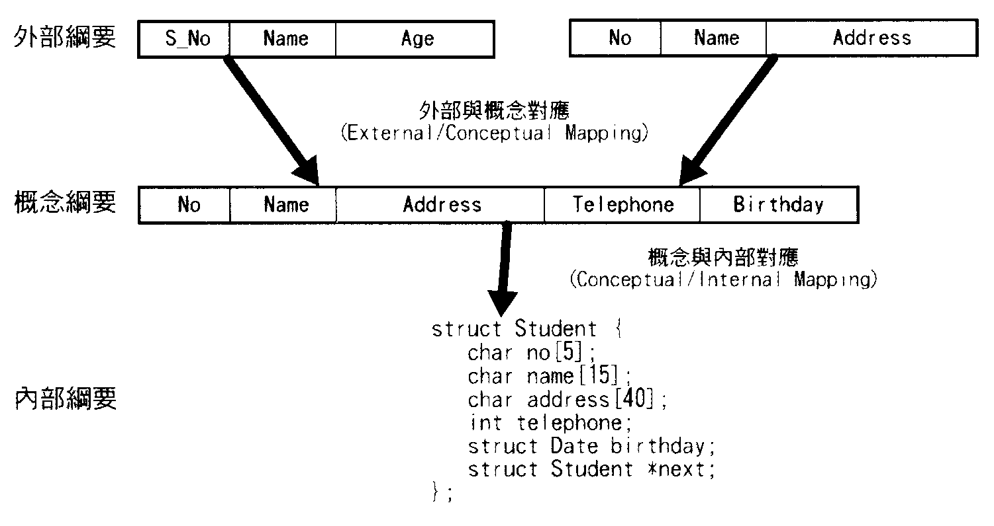

Slide 23
Example: View Definition
CanDrink (drinker, alcohol) is a view “containing” the drinker-alcohol pairs such that the drinker frequents at least one bar that serves the alcohol:
CREATE VIEW CanDrink AS
SELECT drinker, alcohol
FROM Frequents, Sells
WHERE Frequents.bar = Sells.bar;
Notes:
View 不能做更改
如果要更改 要去更改原本的表

Slide 24
Example: Accessing a View
You may query a view as if it were a base table.
There is a limited ability to modify views if the modification makes sense as a modification of the underlying base table.
Example:
SELECT alcohol FROM CanDrink
WHERE drinker = ‘ㄧ號鐵雄’;
Notes:
修改原本的表單
View 裡面的值不會更改
要重下指令 view 才會更改
並不會自動更新view

Slide 25
What Happens When a View Is Used?
The DBMS starts by interpreting the query as if the view were a base table.
Typical DBMS turns the query into something like relational algebra.
The queries defining any views used by the query are also replaced by their algebraic equivalents, and “spliced into” the expression tree for the query.

Slide 26
Example: View Expansion
π_{alcohol}
σ_{drinker=‘3號珍珍’}
CanDrink
π_{drinker, alcohol}
Frequents Sells

Slide 27
DMBS Optimization
It is interesting to observe that the typical DBMS will then “optimize” the query by transforming the algebraic expression to one that can be executed faster.
Key optimizations:
Push selections down the tree.
Eliminate unnecessary projections.

Slide 28
Example: Optimization
π_{alcohol}
σ_{drinker=‘3號珍珍’} Sells
Frequents
Notice how
most tuples
are eliminated
from Frequents
before the
expensive join.

