Slide 1
The Relational Data Model
Prof. Shin-Hung Chang

Slide 2

Current Database
Today’s database implementations are almost based on relational data model.
Relation model gives us a single way to represent data
  A two-dimensional table called relation.

Slide 3
A Relation is a Table
A Domain
(columns, attributes)
name manufactory
海尼根 海尼根公司
台啤 臺灣煙酒公司
阿比 葡萄王公司
A Tuple
(rows,
instance)

Slide 4
橫肉(國語) 豬腳(台語)
A Domain
(columns, attributes)
A Tuple
(rows,
instance)
橫 Row
直 column

Slide 5
Schema
A Relation schema =
  Relation name (attributes: types of attributes)
  Example:
    Beers(name, manufactory) or
    Beers(name: string, manufactory: string)
Relational Database = collection of relations.
Database schema = set of all relation schemas in the database.
1
2
3

Slide 6
Why Relation Model?
Simple model.
Often matches how we think about data (table).
Abstract model that underlies SQL, the most important database language today.
  Relational model is a set-based model.

Slide 7
From E/R Diagrams to Relations
Entity sets become relations with the same set of attributes.
Relationships become relations whose attributes are only:
  The keys of the connected entity sets.
  Attributes of the relationship itself.

Slide 8
Entity Set -> Relation
name
manufactory
name
address
Drinkers
Beers
Beers (name, manufactory)
Drinkers (name, address)

Slide 9
Relationship -> Relation
manufactory
name
address
name
Drinkers
Likes
Beers
husband
1
2
Favorite
Buddies
Likes(Dname,Bname)
wife
Favorite(Dname,Bname)
Married
Buddies(Dname1,Dname2)
Married(hName, wName)

Slide 10
manufactory
name
address
name
Bar
sell
Beers
Price
Sell (Barname,Beername,Price)

Slide 11
Discovering Keys for Relations
When a relation schema was developed by converting an E/R design to relations, we can often predict the key of the relation

Slide 12
Keys from Entity Set
If the relation comes from an entity set then the key for the relation is the key attributes of this entity set.
S-id
name
add
sex
age
S-id
name
address
sex
Students
age

Slide 13
Key from Relationships
If the relation is from relationship of E/R model, then we have three situations.
M:M
  Keys of both E₁ and E₂ are Key of relation
M:1
  Keys of E₁ are Key of relation
1:1
  Keys of E₁ or E₂ are Keys of relation
E₁
R
E₂
Notes:
多對多的key 兩邊都要拿
多對一 拿多的key
一對一 拿誰都可以

Slide 14
Relationship -> Relation
manufactory
name
address
name
Drinkers
Likes
Beers
husband
Favorite
Likes(Dname,Bname)
wife
Favorite(Dname,Bname)
Married
Married(hName, wName)

Slide 15


Discovering Keys for Relations
E₁
E₂
E₁
E₂
E₁
E₂
M
M
M
1
1
1

Slide 16
Combining Relations
It is OK to combine the relation for an entity-set E with the relation R for a many-one relationship from E to another entity set.

Slide 17
manufactory
name
address
name
Drinkers
Beers
Favorite
Example: Drinkers(Dname, address), E and
Favorite(Dname, Bname), R (M:1)
=>DrinkerFav(Dname, address, favBeer).
Notes:
多對一出來的表可以合併到”多“的那張表上當一個attribute

Slide 18
Drinker
Favorite
Dname addr
王建民 123 Maple
張天才 中正路510號
科南 毛利事務所
Dname Bname
王建民 海尼根
張天才 海尼根
DrinkerFav
Dname addr FavoriteBeer
王建民 123 Maple 海尼根
張天才 中正路510號 海尼根
科南 毛利事務所 NULL

Slide 19
Favorite
Beer
Dname Bname
王建民 海尼根
張天才 海尼根
Bname Manuf
海尼根 海尼根公司
台啤 海尼根公司
DrinkerFav
?
Bname Manuf Dname
海尼根 海尼根公司 王建民
海尼根 海尼根公司 張天才
台啤 海尼根公司 NULL
Redundancy

Slide 20
name
manufactory
address
name
Drinkers
Like
Beers
Example: Drinkers(Dname, address), E and
Like(Dname, Bname), R (M:M)
=>Drinker1(name, address, LikeBeer).

Slide 21
Risk with
Many-Many Relationships
Combining Drinkers with Likes would be a mistake. It leads to redundancy, as:
name addr beer
Sally 123 Maple Bud
Sally 123 Maple Miller
Redundancy

Slide 22
Handling Weak Entity Sets
Relation for a weak entity set must include attributes for its complete key (including key belonging to its supporting entity sets).
A supporting (double-diamond) relationship is redundant and yields no relation.

Slide 23
Example
背號
Tname
Bname
棒球選手
play
team
team(Tname)
棒球選手(背號, Tname, Bname)
play(背號, Tname, Tname)
At becomes part of
Logins
Must be the same
Notes:
如果是weak entity set 是可以不用relatione ship

Slide 24
Entity Sets With Subclasses
Three Approaches (1/3)
(1)Object-oriented : each entity belongs to exactly one class; create a relation for each class, with all its attributes.
Notes:
有三種方法
1.物件導向

Slide 25
Example
title
year
Movies
isa
weapon
Murder
Mysteries

Slide 26
Object-Oriented
title year
柯男:通向天國的倒計時
Movies
title year weapon
德洲電鋸殺人魔 2005
七夜怪談 2003
Murder
Mysteries
2001
電鋸
錄影帶
Notes:
通稱 oo
缺點 : 當要找所有都有的屬性 會比較慢 譬如 年分
優點 : 找特定屬性的速度會比較快 譬如 懸疑謀殺

Slide 27
Entity Sets With Subclasses
Three Approaches(2/3)
(2)Use nulls : create one relation; entities have null in attributes that don’t belong to them.

Slide 28
Using Nulls
title year weapon
柯男:通向天國的倒計時 2001 NULL
德洲電鋸殺人魔 2005 電鋸
七夜怪談 2003 錄影帶
Movies
Notes:
優缺點跟oo剛好相反

Slide 29
Entity Sets With Subclasses
Three Approaches(3/3)
(3)E/R style : create one relation for each subclass, with only the key attribute(s) and attributes attached to that E.S.; entity represented in all relations to whose subclass/E.S. it belongs.

Slide 30
E/R Style
title year
柯男:通向天國的倒計時 2001
德洲電鋸殺人魔 2005
七夜怪談 2003
Movies
title weapon
德洲電鋸殺人魔
七夜怪談
Murder
Mysteries
電鋸
錄影帶
Notes:
使用 最多的方法
方法 把title 加到懸疑謀殺裡面
缺點 title 要記兩次

Slide 31
Comparisons
(1) OO approach good for queries
  like “find the 電鋸殺人 in 2005”
  Just look in “ MurderMysteries Relation ”.
(2) Using nulls saves space
  Unless there are lots of attributes that are usually null.
(3) E/R approach good for queries
  like “find all movies made in 2003”
  Just look in “ Movies Relations”.

Slide 32
Turn E/R Diagram into
Relation Schema
(1)Transfer Regular Entity
(2)Transfer Weak Entity
(3)Transfer Relationship
(4)Transfer Multi-value Attributes

Slide 33
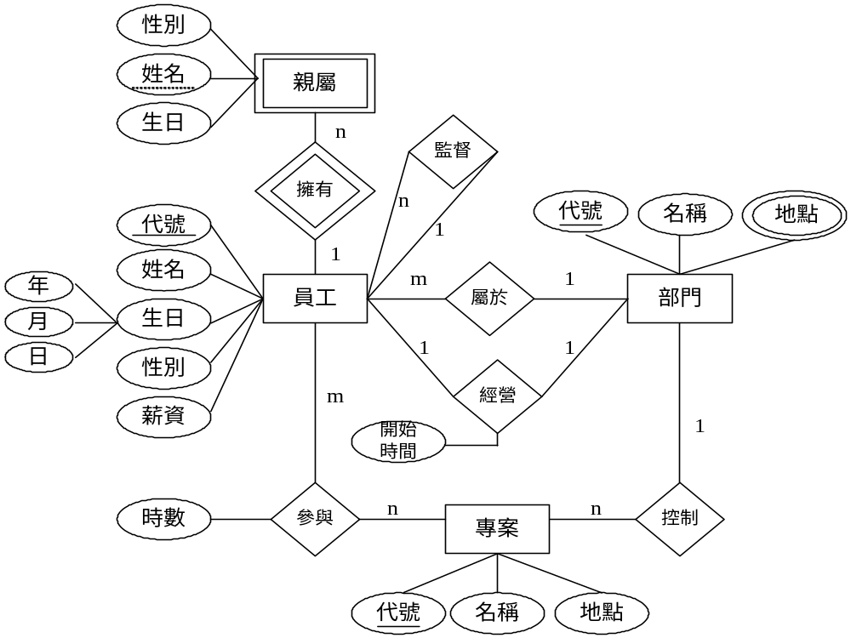

Slide 34
Regular Entity
  員工(員工代號,姓名,生日,性別,薪資,屬於部門代號,經營部門代號,經營開始時間,監督員工代號)
  專案(專案代號,名稱,地點,控制部門代號)
  部門(部門代號,名稱)
Weak Entity
  親屬(員工代號,姓名,性別,生日)
Relationship
  參與(員工代號,專案代號,時數)
  屬於(員工代號,部門代號)
  經營(員工代號,部門代號,開始時間)
  監督(員工代號,員工代號)
  控制(部門代號,專案代號)

Slide 35
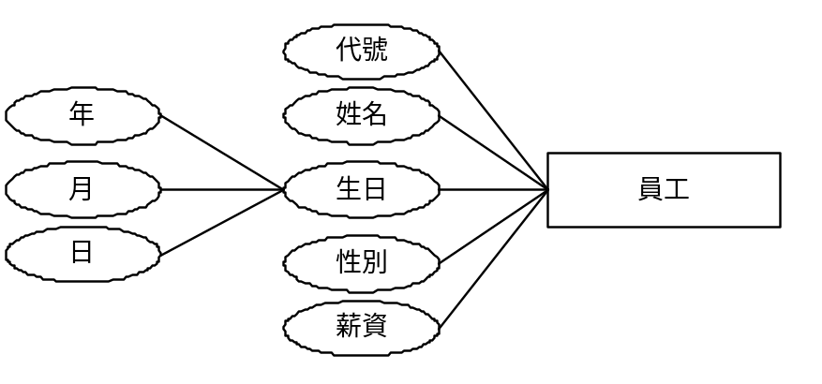
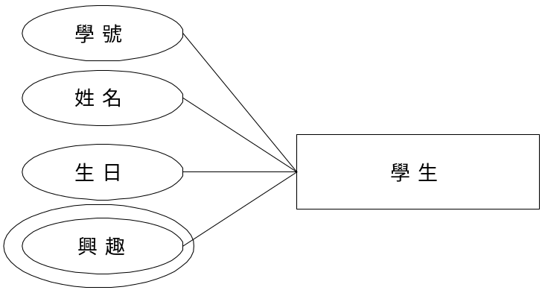
Multi-value Attributes
  地點(部門代號, 地點)
複合屬性(Composite Attribute)
多重值屬性(Multi-valued Attribute)

Slide 36
Other E/R Model Presentation
Shin-Hung Chang

Slide 37
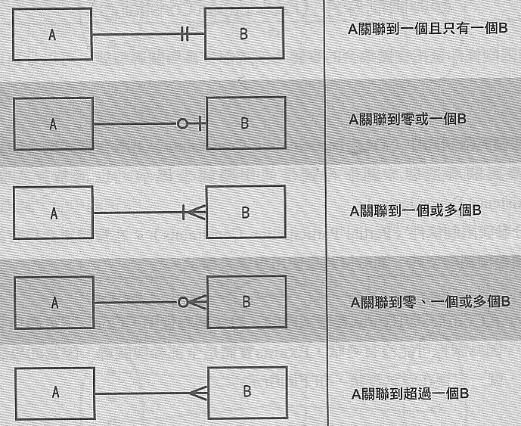
Crow Foot

Slide 38

(min, max)

