Slide 1
Multiple-Input Neuron
Example:
Students take a class on a Pass/Fail basis
Students | p1 (Midterm) | p2 (Final) | a (Pass/Fail)
A | 80 | 60 | +1 (Pass)
B | 50 | 50 | -1 (Fail)
C | 90 | 80 | +1 (Pass)
D | 30 | 60 | -1 (Fail)
E | 40 | 90 | +1 (Pass)
F | 90 | 50 | +1 (Pass)

Slide 2
Example of Multiple-Input Neuron (1/3)
For input p = (p1, p2) //grades of a students
Pass if w₁ p₁ + w₂ p₂ > threshold
((w₁ p₁ + w₂ p₂)− threshold) > 0
Fail if w₁ p₁ + w₂ p₂ < threshold
((w₁ p₁ + w₂ p₂)− threshold) < 0
This can be written as
a = sign ((w₁ p₁ + w₂ p₂) − threshold)

Slide 3
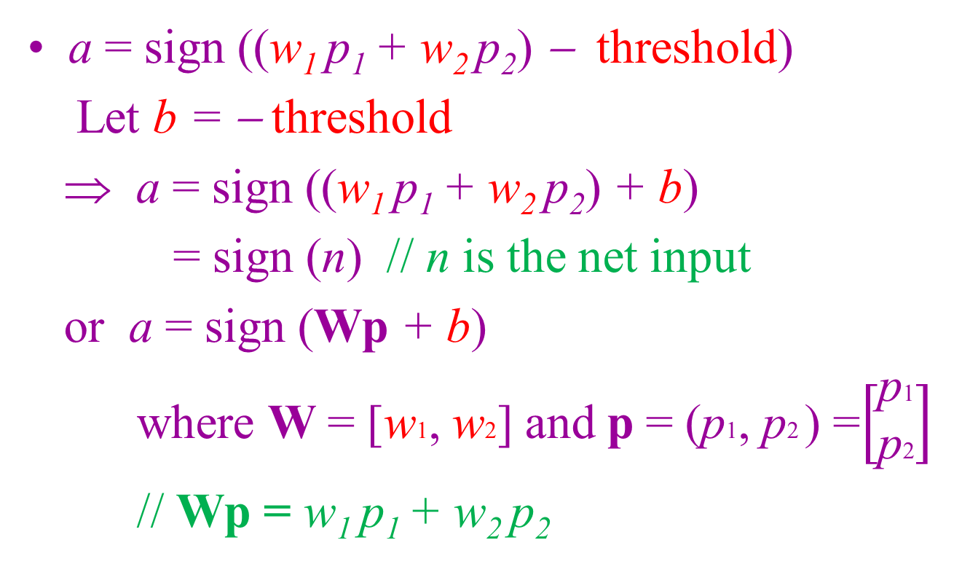
Example of Multiple-Input Neuron (2/3)
a = sign ((w₁ p₁ + w₂ p₂) − threshold)
Let b = − threshold
⇒ a = sign ((w₁ p₁ + w₂ p₂) + b)
= sign (n) // n is the net input
or a = sign (Wp + b)
where W = [w1, w2] and p = (p1, p2 ) =$\left[\begin{matrix}\text{p}\text{1} \\ \text{p}\text{2}\end{matrix}\right]$
// Wp = w₁ p₁ + w₂ p₂

Slide 4
Example of Multiple-Input Neuron (3/3)
a = sign (n) = sign (Wp + b)
⇒ a = f (n) = f (Wp + b)
where f is a symmetrical hard limit transfer function
Remark:
If f is a symmetrical hard limit transfer function, then
a = f (n) = -1, if n < 0
a = f (n) = +1, if n ≥ 0

Slide 5
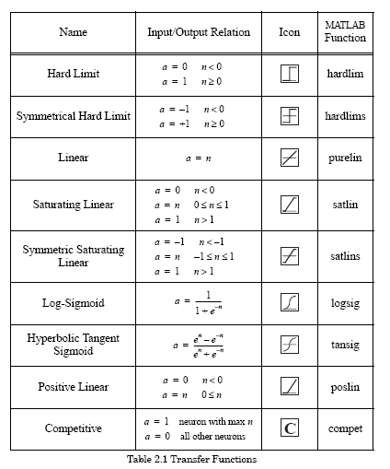
Other Transfer Functions

Slide 6
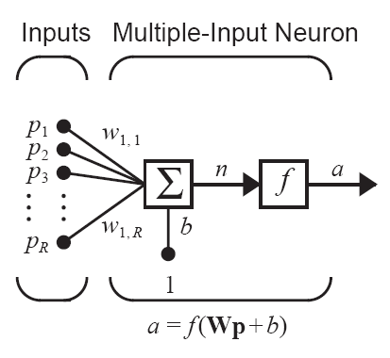
Multiple-Input Neuron (1/2)
Typically, a neuron has more than one input.
A neuron with R inputs is shown below.
The individual inputs p₁, p₂,…, p_{R} are each weighted by corresponding elements w₁₁, w₁₂,…,w_{1R} of the weight matrix W.
Net input: n = w₁₁ p₁ + w₁₂ p₂+…+ w_{1R}p_{R} + b = Wp + b
Neuron output: a = f(Wp + b)

Slide 7
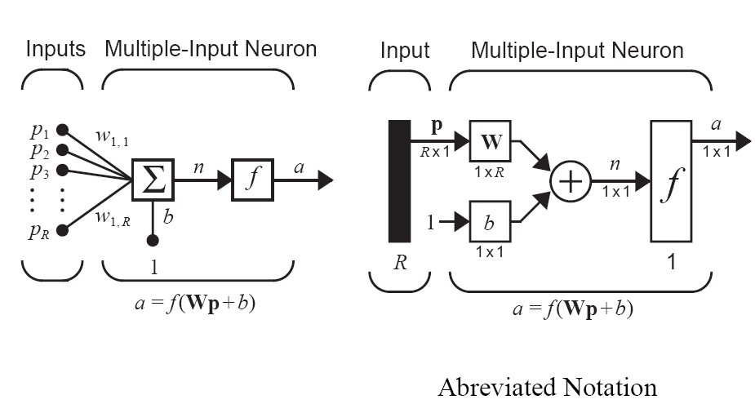
Multiple-Input Neuron (2/2)

Slide 8
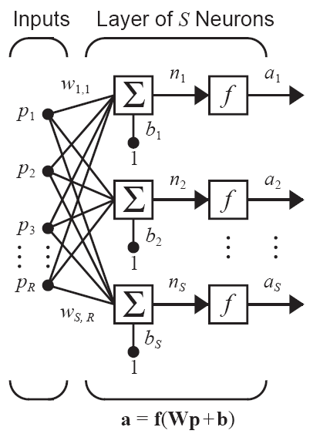
A Layer of Neurons (1/3)
A single-layer network of neurons is shown on the right.
Note that each of the R inputs is connected to each of the neurons and that the weight matrix W now has S rows.

Slide 9
A Layer of Neurons (2/3)
R: number of input
S: number of neuron in a layer (R ≠ S, usually)
Input vector p is a vector of length R
Bias vector b and output vector a are vectors of length S
Weight matrix W is an S×R matrix

Slide 10
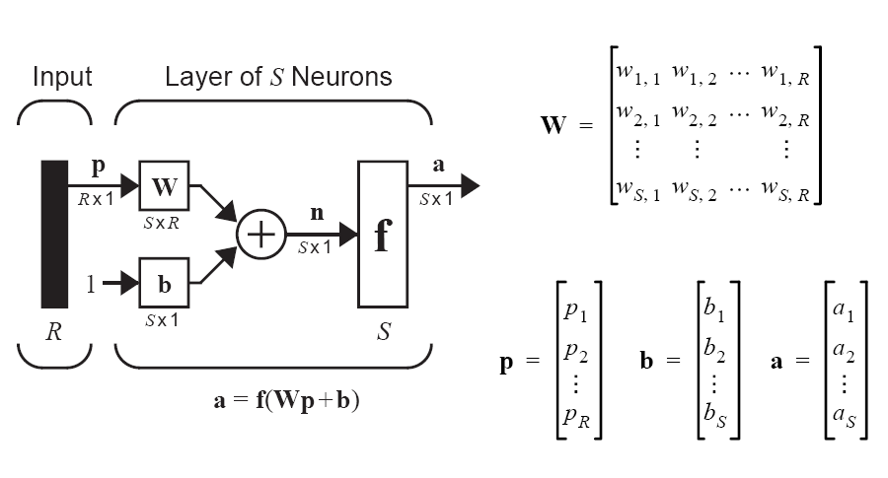
A Layer of Neurons (3/3)
Abbreviated Notation

