Slide 1
An Illustrative Example
Grace J. Hwang
Readings: Chapter 3; Hagan

Slide 2
Outline
Objectives
Theory and Examples
Problem Statement
Perceptron
Two-Input Case
Pattern Recognition Example
Hamming Network
Feedforward Layer
Recurrent Layer
Hopfield Network

Slide 3
Objectives
Use three different neural network architectures to solve a simple pattern recognition problem.
Feedforward network
E.g. perceptron
Competitive network
E.g. Hamming network
Recurrent associative memory network
E.g. Hopfield network

Slide 4
Problem Statement (1/2)
Apple/Orange Sorter
shape texture weight
Neural Network
Sensors
Sorter
Apples
Oranges

Slide 5
Problem Statement (2/2)
Sort the fruit according to type.
Three properties :
Shape
1: if the fruit is approximately round
-1: if it is more elliptical
Texture
1: if the surface of the fruit is smooth
-1: if it is rough
Weight
1: if the fruit is more than one pound
-1: if it is less than one pound

Slide 6
Prototype Vectors
Measurement Vector
Three-input
Shape: {1 : round ; -1 : elliptical}
Texture: {1 : smooth ; -1 : rough}
Weight: {1 : > 1 lb. ; -1 : < 1 lb.}
Prototypes

Slide 7
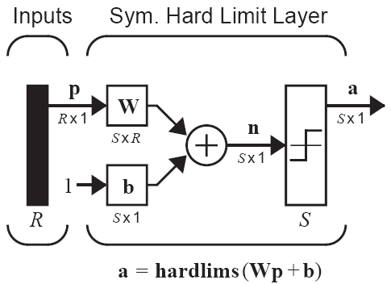
Perceptron (1/2)
Single-neuron perceptrons can classify input vectors into two categories.
Symmetrical Hard Limit
a = -1, if n < 0
a = +1, if n ≥ 0
MATLAB function: hardlims

Slide 8
Perceptron (2/2)
A three-input/single-neuron perceptron (R = 3) is able to solve the orange and apple recognition problem.
However, we first investigate the capabilities of a two-input/single-neuron perceptron (R = 2), which can be easily analyzed graphically.

Slide 9
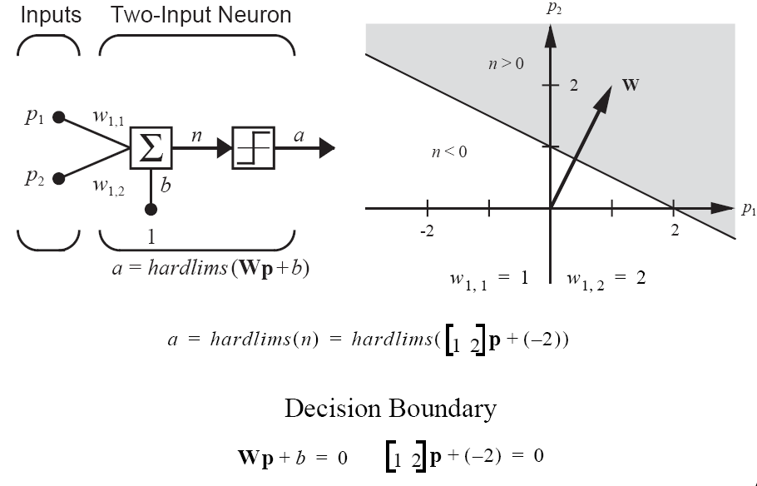
Two-Input Case

Slide 10
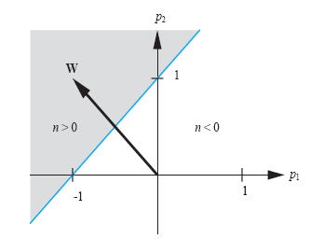
Perceptron Decision Boundary
The decision boundary should separate the prototype vectors.
The weight vector should be orthogonal to the decision boundary, and should point in the direction of the vector which should produce an output of 1.=>找到一條方程式，讓橘子跟蘋果分別在線的左右兩邊
The bias determines the position of the boundary.=>判斷線是否通過原點
Because the boundary must be linear, the single-layer perceptron can only be used to recognize patterns that are linearly separable (can be separated by a linear boundary).

Slide 11

Pattern Recognition Example (1/5)
Now consider the apple and orange pattern recognition problem.
The perceptron equation for apple/orange example will be
最好b還是要加，有可能判斷的方程式，並不會通過原點
We want to choose the bias and the elements of the weight matrix so that the perceptron will be able to distinguish between apples and oranges.

Slide 12
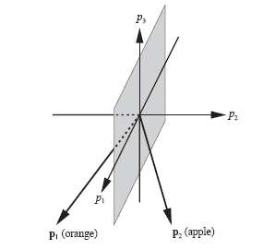
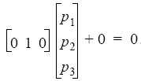
Pattern Recognition Example (2/5)
The two prototype vectors
can be drawn as the figure on the right.
兩個向量 => 一條直線
三個向量，=>一個平面
A decision boundary should separate the prototype vectors.
One possible solution is p₂ = 0, or .

Slide 13
Pattern Recognition Example (3/5)
The weight vector should be orthogonal to the decision boundary, and should point in the direction of the vector which should produce an output of 1.
The bias determines the position of the boundary.
Therefore the weight matrix and bias will be

Slide 14
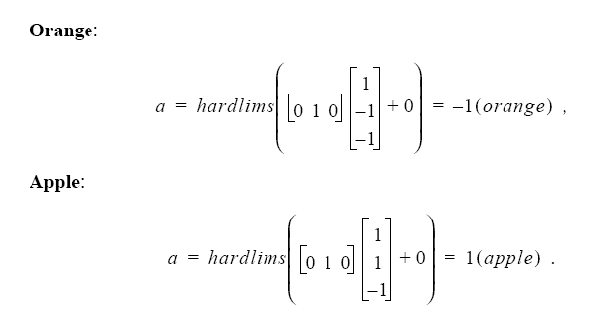
Pattern Recognition Example (4/5)
Testing the Network

Slide 15


Pattern Recognition Example (5/5)
What happens if we put a not-so-perfect orange into the classifier? Let’s say that an orange with an elliptical shape is passed through the sensors.
The input vector would then be
The response of the network would be

Slide 16
Hamming Network (1/2)
The Hamming Network was designed explicitly to solve binary pattern recognition problems.
Each element in the input vector has only two possible values, e.g., 1 or -1.
The Hamming Network uses
feedforward layer
recurrent (feedback) layer
The objective of the Hamming network is to decide which prototype vector is closest to the input vector.
This decision is indicated by the output of the recurrent layer.
There is one neuron in the recurrent layer for each prototype pattern.

Slide 17
Hamming Network (2/2)

Slide 18
Hamming Network - Feedforward Layer (1/4)
The feedforward layer performs a correlation, or inner product, between each of the prototype patterns and the input pattern.
The connection matrix W¹ are set to the prototype patterns.
The feedforward layer uses a linear transfer function, and each element of the bias vector is equal to R, where is the number of elements in the input vector.
By adding to the inner product we guarantee that the outputs of the feedforward layer can never be negative.

Slide 19
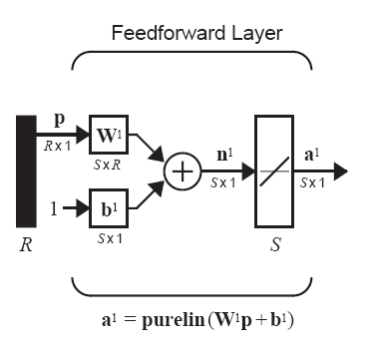


Hamming Network - Feedforward Layer (2/4)
The connection matrix W¹ are set to the prototype patterns.
Each element of the bias vector b¹ is set to be R, such that the outputs a¹ can never be negative.
Linear Transfer Function
a = n = (wp + b)
MATLAB function:
purelin

Slide 20
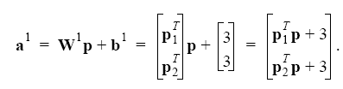
Hamming Network - Feedforward Layer (3/4)
With these choices for the weight matrix and bias vector, the output of the feedforward layer is
Note that the outputs of the feedforward layer are equal to the inner products of each prototype pattern with the input, plus R.

Slide 21
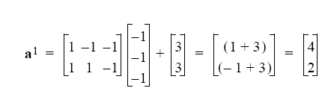
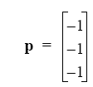
Hamming Network - Feedforward Layer (4/4)
If , then
The Hamming distance between two vectors is equal to the number of elements that are different.
It is defined only for binary vectors.
The neuron with the largest output will correspond to the prototype pattern that is closest in Hamming distance to the input pattern.
Note that output = 2 × (R – Hamming distance)
In our example, we have a¹₁ = 2 × (3 – 1) = 4, a¹₂ = 2 × (3 – 2) = 2

Slide 22
Hamming Network - Recurrent Layer (1/3)
The recurrent layer of the Hamming network is what is known as a “competitive” layer.
The neurons in this layer are initialized with the outputs of the feedforward layer, which indicate the correlation between the prototype patterns and the input vector.
Then the neurons compete with each other to determine a winner.

Slide 23
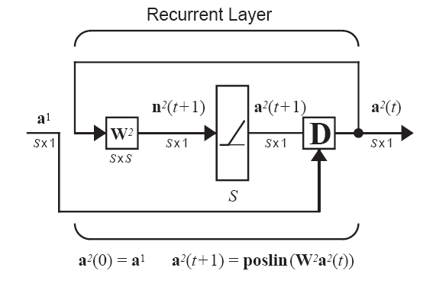


Hamming Network - Recurrent Layer (2/3)
n²(t+1) = W²a²(t)
a²(t+1) = poslin(n²(t+1)) = poslin(W²a²(t))
Positive Linear Function
a = 0, if n < 0
a = n, if n ≥ 0
MATLAB function:
poslin
(Don’t forget that the superscripts here indicate the layer number, not a power of 2.)

Slide 24
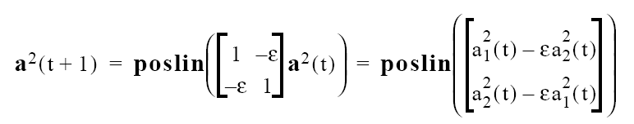
Hamming Network - Recurrent Layer (3/3)
Each element is reduced by the same fraction of the other.
The larger element will be reduced by less, and the smaller element will be reduced by more, therefore the difference between large and small will be increased.
The effect of the recurrent layer is to zero out all neuron outputs, except the one with the largest initial value (which corresponds to the prototype pattern that is closest in Hamming distance to the input).

Slide 25
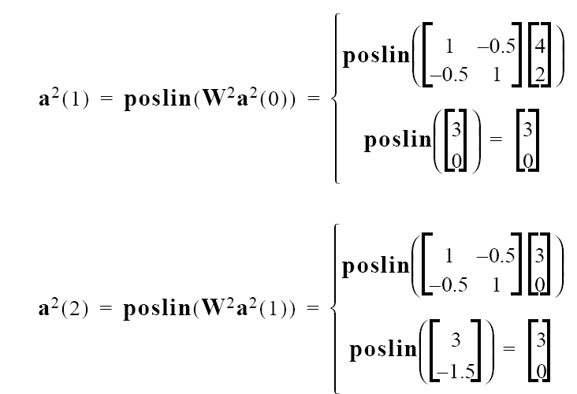
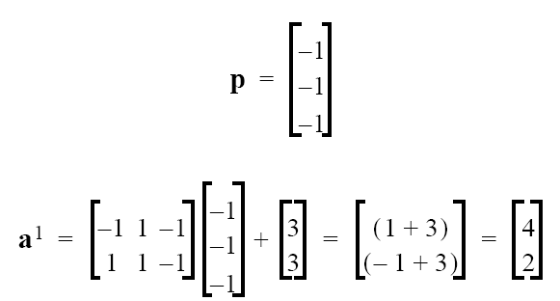
Hamming Network - Example of Operation (1/2)
First layer
Second layer
with ε= 0.5

Slide 26
Hamming Network - Example of Operation (2/2)
Since the outputs of successive iterations produce the same result, the network has converged.
Prototype pattern number one, the orange, is chosen as the correct match, since neuron number one has the only nonzero output.
The winning neuron is corresponding to the prototype which is closest to the input vector.
The Hamming distance from the orange prototype to the input pattern is 1, and the Hamming distance from the apple prototype to the input pattern is 2.

Slide 27
Hopfield Network (1/4)
The Hopfield network is a recurrent network.
The neurons in this network are initialized with the input vector, then the network iterates until the output converges.
Symmetric Saturating
Linear Function
a = -1, if n < -1
a = n, if –1 ≤ n ≤ 1
a = 1, if n > 1
MATLAB function:
satlins

Slide 28
Hopfield Network (2/4)
In the Hamming network the nonzero neuron indicates which prototype pattern is chosen.
The Hopfield network actually produces the selected prototype pattern at its output.
The design of the weight matrix and the bias vector for the Hopfield network is a more complex procedure than it is for the Hamming network.

Slide 29
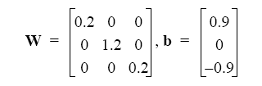
Hopfield Network (3/4)
To illustrate the operation of the network, we have determined a weight matrix and a bias vector that can solve our orange and apple pattern recognition problem.

Slide 30
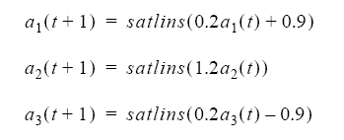
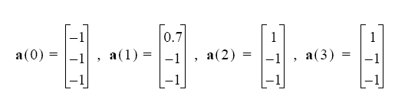
Hopfield Network (4/4)
The operations of the Hopfield network are:
Take our oblong orange to test the Hopfield network:
(orange)

Slide 31
Summary
The perceptron has a single output, which takes on values of 1 (apple) or –1 (orange).
In the Hamming network, the single nonzero neuron indicated which prototype has the closest match (neuron 1 indicates orange and neuron 2 indicates apple).
In the Hopfield network, the prototype pattern itself appears at the output of the network.

