Slide 1
406262333吳佩臻

Slide 2
如何產生一張黃色的透明紙，並疊在視訊上?
yellow = np.full(frame.shape, (0, 255,255), dtype=np.uint8)
產生黃色紙
yellowedFrame= cv2.addWeighted(frame, 0.7, yellow, 0.3, 0)
黃色紙跟視訊的顯示比重
bg = cv2.bitwise_and(yellowedFrame, yellowedFrame, mask= mask02)
=>透明黃色紙跟視訊相疊

Slide 3
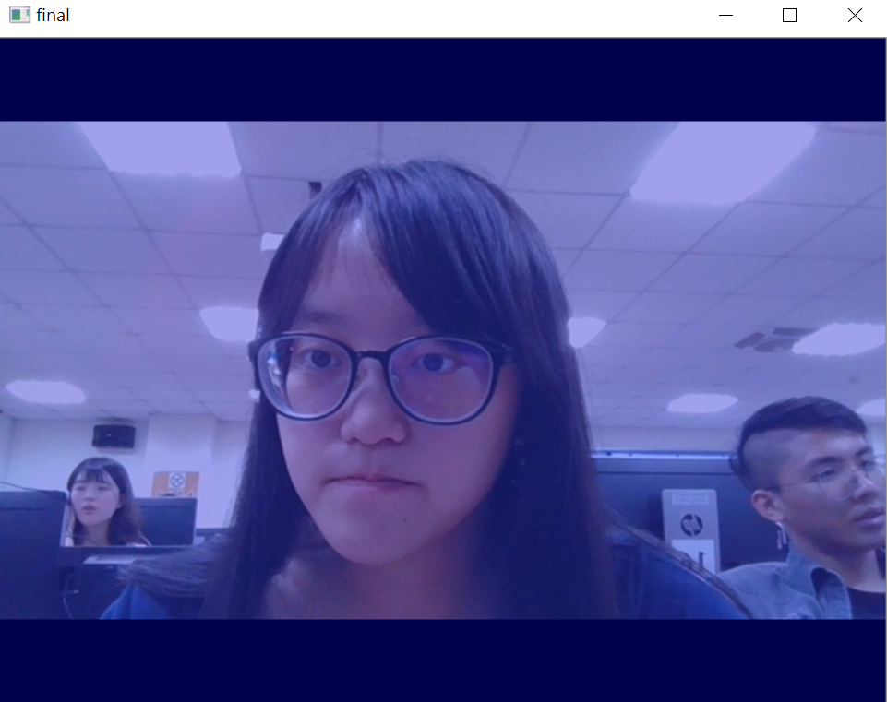

Slide 4
Mask01 如何求得?
mask01 = np.zeros((rows, columns), np.uint8)
mask = cv2.inRange(hsv, lower_blue, upper_blue)
新得到的改變
mask01 = cv2.bitwise_or(mask01, mask)
把新得到的 跟 就得做結合

Slide 5
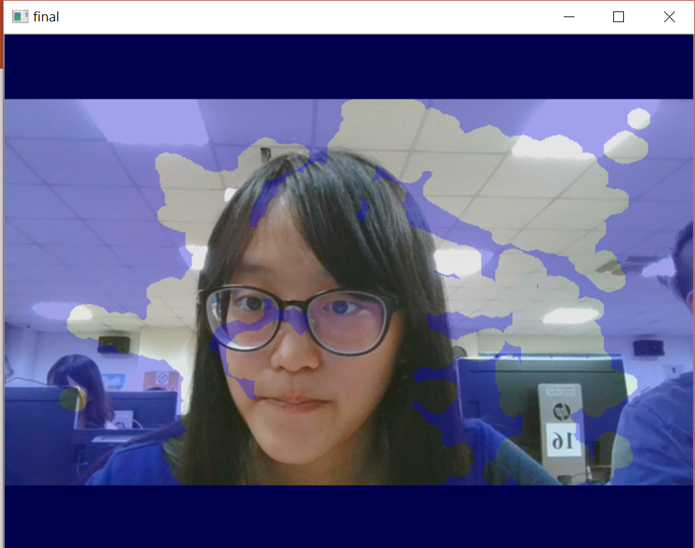
如何把玻璃擦乾淨
fg = cv2.bitwise_and(frame,frame, mask= mask01)
bg = cv2.bitwise_and(yellowedFrame, yellowedFrame, mask= mask02)
final = cv2.add(fg, bg)

Slide 6
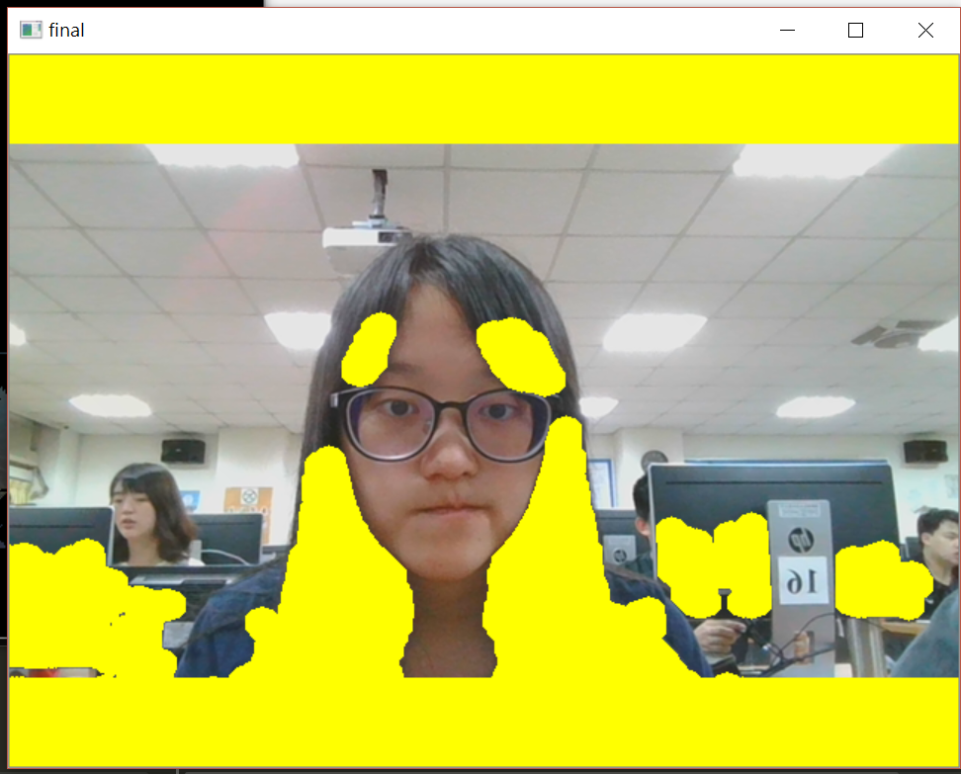
染頭髮

Slide 7
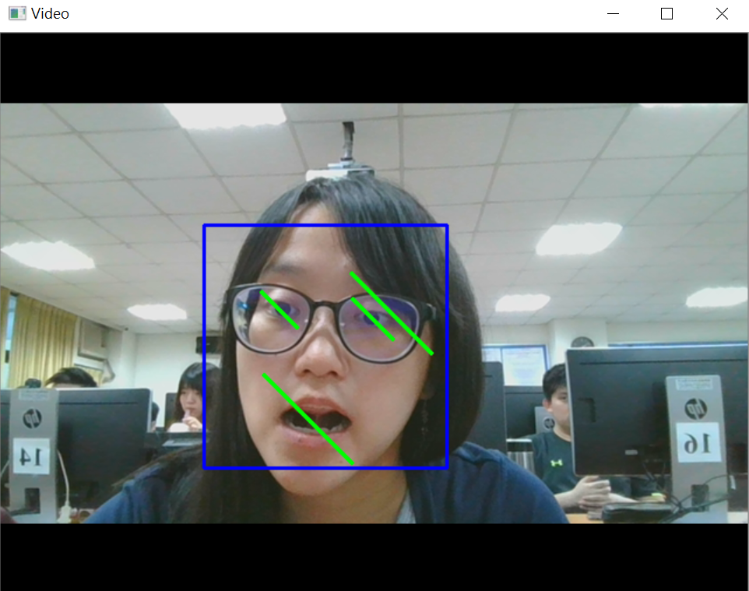
臉部辨識

Slide 8
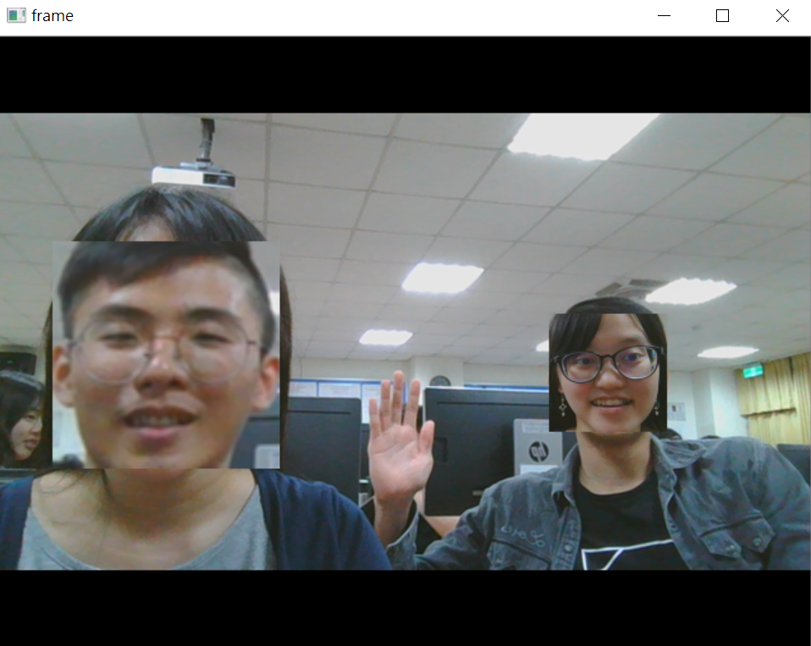
臉交換

